Slide 1
5 : Archiving & Preservation
Mark Sullivan
Digital Library of the Caribbean

Slide 2
Archiving and Preservation of Digital Projects

Slide 3
Digitization: One Puzzle Piece
Digitization is one piece of a digital preservation plan, but only one piece
Without the rest of the puzzle, digitization is ultimately useless for preserving and archiving our historical and cultural resources
Include Digital Preservation and full lifecycle of the image and data in all digitization plans.

Slide 4
Preservation and Long-Term Access Through Networked Services Project Survey
Surveyed over 200 organizations, mostly European archives and libraries
Digital content volume to increase 25-fold over next decade
70% of respondents expect to hold over 100TB of content
Only 47% of organizations had an allocated budget for digital preservation
(http://www.planets-project.eu/publications)
Large-Scale Digitization

Slide 5
Digital Preservation Is…
Digital preservation is:
Active
Constant process
Exponentially multi-tiered
About ensuring continuing accessibility
Relatively new and somewhat in its infancy

Slide 6
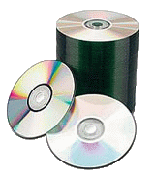
Digital Preservation is NOT…
Compact Disks
2002 – 6,000 CD’s ( 2.6 TB )
2008 – 23,000 CD/DVD ( 48 TB )
Unmanageable
Slowly deteriorating
Two (or 3 or 4) copies

Slide 7
Table of Contents
What to preserve? How do I know it is preserved?
Object-level Preservation
File-level Preservation
Organizational: Trustworthy Digital Repositories
Recommendations
Questions

Slide 8
What to Preserve?
How do I know it is preserved?

Slide 9
What to preserve? How do I know it is preserved?
Text-level preservation?
Aujourd'hui premier janvier dix huit cent quatre, le Général en chef de l'Armée indigène, accompagné des généraux, chefs de l'armée, convoqués à l'effet de prendre les mesures qui doivent tendre au bonheur du pays:
Après avoir fait connaître aux généraux assemblés ses véritables intentions d'assurer à jamais aux indigènes d'Haïti un gouvernement stable, objet de sa plus vive sollicitude : ce qu'il a fait à un discours qui tend à faire connaître aux puissances étrangères la résolution de rendre le pays indépendant, et de jouir d'une liberté consacrée par le sang du peuple de cette île ; et, après avoir recueilli les avis, a demandé que chacun des généraux assemblés prononçât le serment de renoncer à jamais à la France, de mourir plutôt que de vivre sous sa domination, et de combattre jusqu'au dernier soupir pour l'indépendance.
Notes:
Encoding concerns remain

Slide 10
What to preserve? How do I know it is preserved?
Text-level preservation?
Today, January 1, 1804, the General in Chief of the Indigenous Army, accompanied by generals and army chiefs convoked in order to take measures tending to the happiness of the country:
After having made known to the assembled generals his true intention of forever ensuring to the natives of Haiti a stable government — the object of his greatest solicitude, which he did in a speech that made known to foreign powers the resolution to render the country independent, and to enjoy the liberty consecrated by the blood of the people of this island; and, after having gathered their opinions, asked each of the assembled generals to pronounce a vow to forever renounce France; to die rather than to live under its domination; and to fight for independence with their last breath.

Slide 11
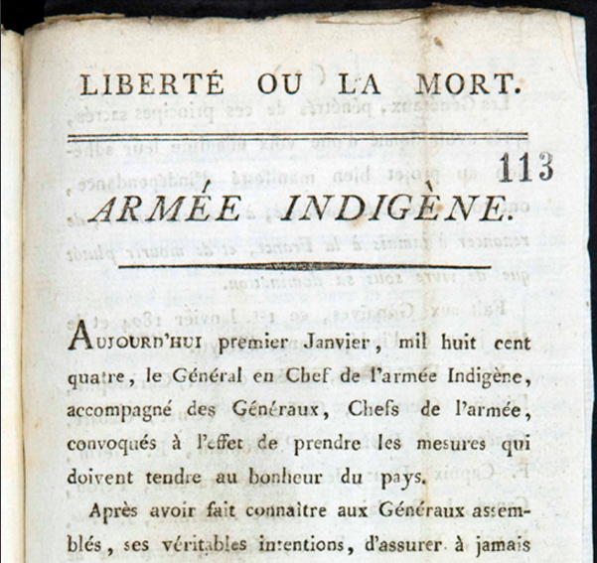
What to preserve? How do I know it is preserved?

Slide 12
What to preserve? How do I know it is preserved?
“It is the actual information content of a document, data-set, or sound or video recording that should be preserved, not the Microsoft Word file, or the Excel spreadsheet, or the QuickTime movie.”
- Angela Dappert and Markus Enders (British Library) “Digital Preservation Metadata Standards.” Information Standards Quarterly. Spring 2010.
Also the context and layout though.

Slide 13
Object-Level Preservation

Slide 14
Object-Level Preservation
More than just the images and text (but also!)
Descriptive Information
Describes the intellectual entity ( title, author )
Same information used for discovery and display of object
Structural Information
Table of contents, page order
File Information
File size
Checksums and digital signatures for fixity and authenticity checks
Administrative Information
Provenance and access conditions for the object

Slide 15
Object-Level Metadata
METS
Metadata Encoding and Transmission Standard
Descriptive Metadata Container
MODS ( Metadata Object Description Standard )
Dublin Core
VRACore ( Visual Resource Association )
MarcXML
Structural Metadata
Technical File Metadata
Administrative Metadata

Slide 16
PREMIS
PREservation Metadata : Implementation Strategies
Metadata needed to support preservation
Contains what “most working repositories are likely to need to know” ( Dappert and Enders )
HUGE data dictionary – must pick and choose
Describes historical preservation actions/agents
Provides information needed for any future preservation actions
Can be encoded in METS file

Slide 17
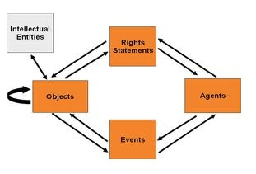
PREMIS

Slide 18
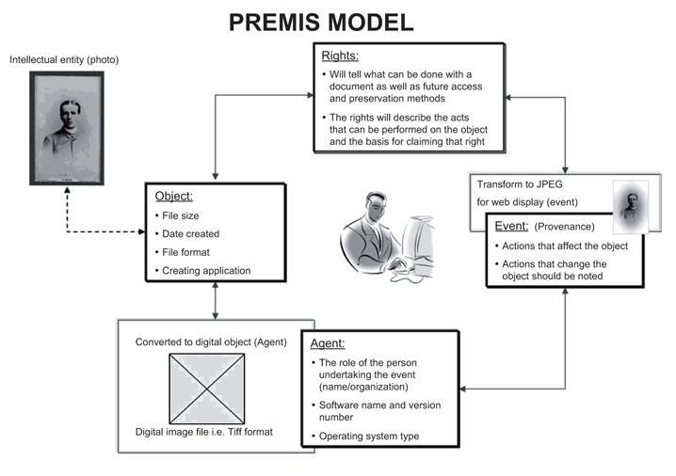
PREMIS

Slide 19
File-Level Preservation

Slide 20
Necessary Preservation File Information
Example PREMIS Image Record
Checksums and Size
Preservation Level ( full, bitwise, etc.. )
Behaviors
Format ( MIME, Format Registry, Validation Info )
Creating Applications
Capture Information (MIX)
Environments ( software, operating system, processor, hardware )
All migrations events

Slide 21
File Format Migration / Emulation
Any sound preservation strategy must deal with the ephemeral nature of file formats
Migration v. Emulation
Must either constantly migrate forward or at least have a migration strategy
Migration strategy is also ephemeral and represents best current options

Slide 22
Recommended File Formats
Four basic criteria
Specification must be freely available
Must be no patents or licenses on the format
Other digital repositories using or endorsed format
Variety of tools for writing and rendering format

Slide 23
Recommended File Formats
Migration strategy is also ephemeral and represents best current options
Archivematica ( UNESCO preservation system )
Presented with a .WMV ( Windows Media Video ) proprietary file
Current strategy: Convert to MPEG-2
Future strategy: Convert to Motion JPEG2000

Slide 24
Organizational: Trustworthy Digital Repositories

Slide 25
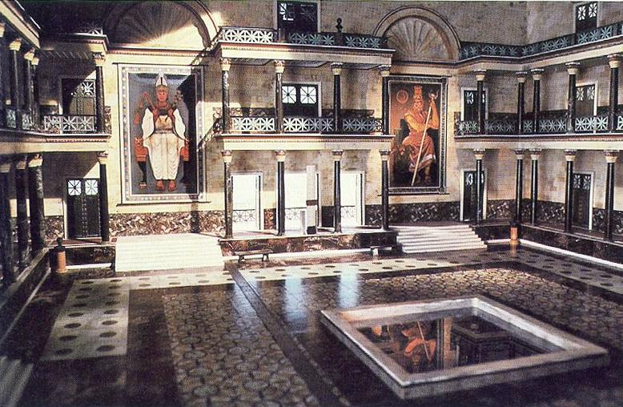
Alexandria Library

Slide 26
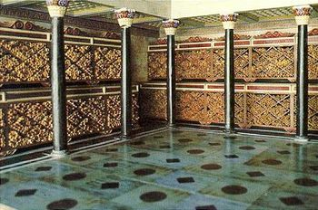
Alexandria Library

Slide 27
Digital Preservation Community Process Models
Open Archival Information System (OAIS)
Preserving Digital Information published by Task Force on Archiving Digital Information in 1996.
Draft OAIS reference model published in 1999
Primary benchmark and chief process model for the preservation of digital assets
InterPARES
International Researchon Permanent Authentic Records in Electronic Systems.
Focuses on records maintenance
Digital Curation Centre: Curation Lifecycle Model
Defines three levels of preservation and best practices for each

Slide 28
OAIS Reference Model
Provides framework for understanding of archival concepts needed for long term digital information preservation and access
Provides concepts needed by non-archival organizations to be effective participants in the preservation process
Provides framework for describing and comparing different strategies and techniques
Provides basis for comparing data models of digital information preserved and how they change over time
Guides the identification and production of OAIS-related standards

Slide 29
An OAIS must:
Negotiate for and accept appropriate information from producers
Obtain enough rights to ensure long term preservation
Determine the designated community
Ensure preserved objects are independently understandable to designated community
Follow documented policies and procedures which ensure the information is preserved against all reasonable contingencies
Ensure object can be disseminated as authenticated copies of the original or the original
Make preservation information available to designated community

Slide 30
Toward Certified Digital Repositories
Where are we?
Granular standards (PREMIS)
Process Models (OAIS, InterPARES)
In 2000, RLG and OCLC published Trusted Digital Repositories: Attributes and Responsibilities
This inches us closer, by defining a Trusted Digital Repository and expands the discussion to include the policies, standards, as well as technology infrastructure as a trusted system.

Slide 31
Developing Metrics for Certification
Nestor Catalogue of Criteria for Trusted Digital Repositories
Network of Expertise in Long-term Storage of Digital Resources
Provides:
Information and criteria for self-assessment for digital repositories
Training Tools
Iterative process – Documentation, Transparency, Adequacy, and Measurability

Slide 32
Developing Metrics for Certification
DRAMBORA
Digital Repository Audit Model Based on Risk Assessment
Digital Curation Center (DCC) and Digital Preservation Europe (DPE)
Focuses on risk identification, risk prioritization, and risk mitigation of risks through six step process of self-assessment.
Developed from a TRAC-based self-assessment originally

Slide 33
Developing Metrics for Certification
TRAC
Trusted Repositories Audit & Certification Criteria & Checklist
Research Libraries Group (RLG) and U.S. National Archives and Record Administration (NARA)
2005 - Grant from Andrew W. Mellon Foundation to develop procedures and activities to audit and certify digital archives.
2007 - Final publication includes 84 criteria
Organizational infrastructure
Digital object management
Technologies (IT and security)
Two repositories ( Portico and HathiTrust ) initially audited
Portico certified as a trustworthy digital repository for CRL community

Slide 34
Toward Standards
Conformity Assessment Requirements for Bodies Providing Audi and Certification of Management Systems ( ISO/IEC 17021 ) is current international standard applied
Audit and Certification of Trustworthy Digital Respositories ( CCSDS 652.0-R1, ISO/DIS 16363 ) still under development as an ISO standard
Requirements for Bodies Providing Audit and Certification of Candidate Trustworthy Digital Respositories also under development as an ISO standard

Slide 35
Archiving Recommendation

Slide 36
Recommendations
Be aware of the ongoing cost of preservation and plan according
Be a part of something larger
Subject-based trusted repositories
LLMC ( Law Library Microform Consortium )
Regional and International trusted repositories
HathiTrust
Florida Dark Archive / State Universities

Slide 37
Review of Topics
What to preserve? How do I know it is preserved?
Object-level Preservation
File-level Preservation
Organizational: Trustworthy Digital Repositories
Recommendations

Slide 38
Questions?

