Slide 1
Selected Views on Indentured Labor in the Caribbean 1804 - 1956
From: the University of Florida Latin American Collection (Gainesville, FL)
www.uflib.ufl.edu/lac
Richard F. Phillips & Michelle McClure El Neil
ricphil@uflib.ufl.edu
michelleelneil@uflib.ufl.edu

Slide 2
Selected Materials on the Indentured in the Caribbean from the UF Latin American Collection
Online from LAC Webpage:
www.uflib.ufl.edu/lac
The Caribbean history reader (edited by Nicola Foote):
call# LAC F2175.C326 2012
Indentured labor and the integration of Trinidad into the world economy (dissertation by Karen S. Dhanda; Syracuse 2000):
call# LAC HD4875.T7 D42 2000; Full text on PROQUEST
Royal Gazette of British Guiana [microfilm]:
(most years 1804 -1883) call# LAC 079.881 R88
The Creole [microfilm]: call# LAC 079.881 C916
(most years 1856 – 1882, 1905)
Port of Spain Gazette [microfilm]: call# LAC 079.7298 P839
(most years 1828 – 1956)

Slide 3
Map of Caribbean Basin

Slide 4
Notice
“Subscriber will feel thankful to any person who will lodge the Negro Boy WILLIAM, her property, in the County Jail, or deliver him to his owner.”
Royal Gazette (Jan. 3, 1830)

Slide 5
Lots & buildings, slaves, household furniture
“The following well-known prime Carpenter Negroes: Phillander, Joe, Richard, Harry. Also, the woman Kitty a good huckstress and servant of all work. Furniture…”
Royal Gazette (Jan. 5, 1830)

Slide 6
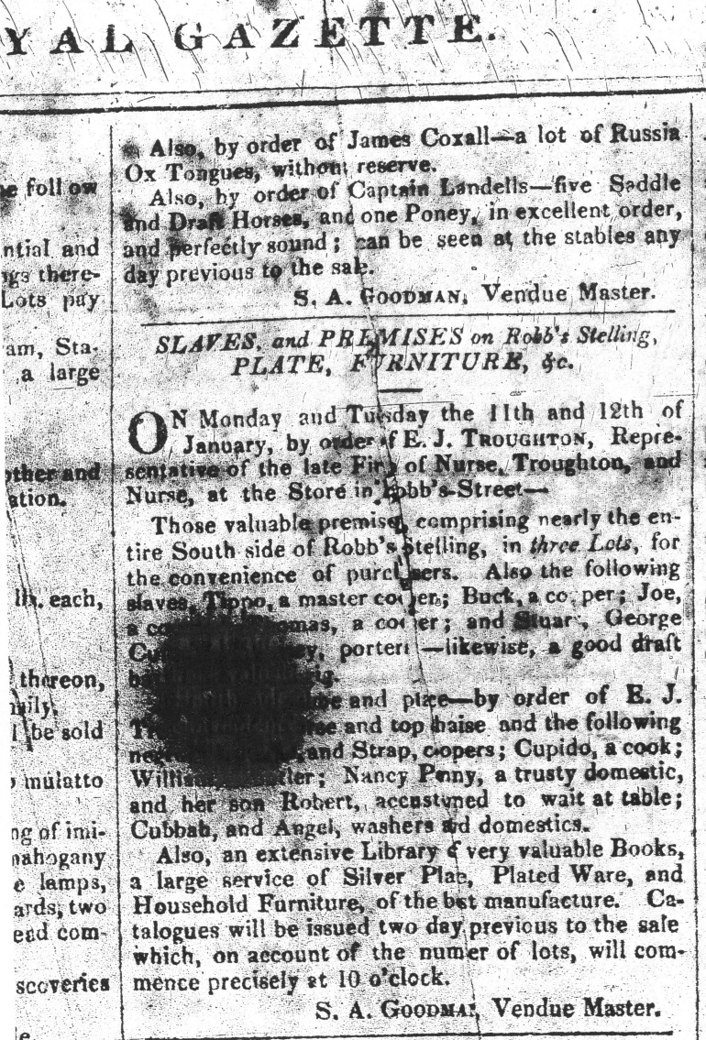
Slaves and Premises on Robb’s Stelling for sale
Also the following slaves available: “Tippo” a master cooper (?);
“George” a good draft… ;
Cubbah and Angel washers and domestics.
Royal Gazette (Jan. 7, 1830)

Slide 7
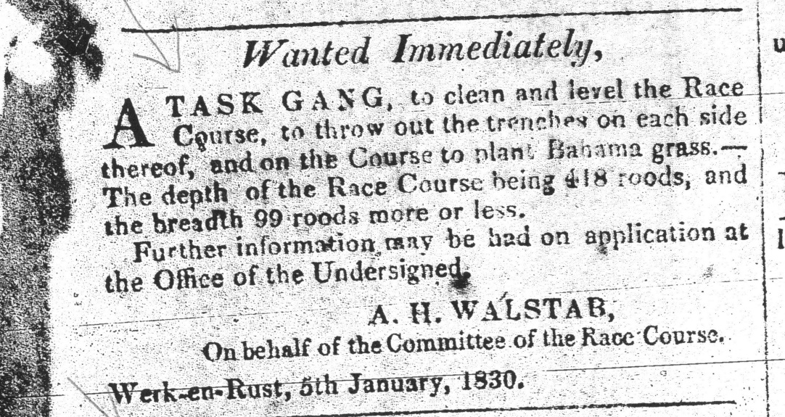
Wanted Immediately – A task gang
A task gang needed:
to clean and level the race course
throw out trenches on each side
plant Bahama grass
Royal Gazette (Jan. 5, 1830)

Slide 8
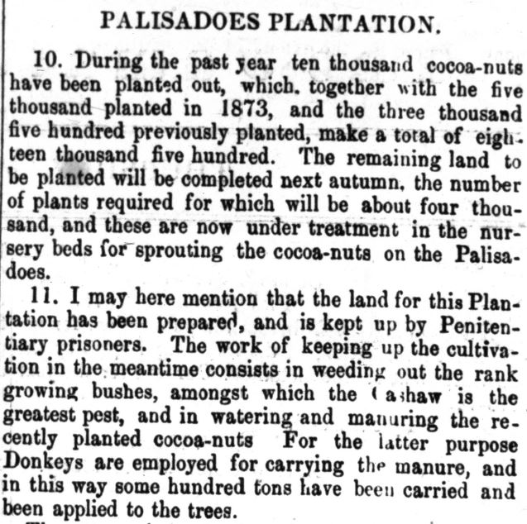
Palisadoes Plantation 1875
10,000 cocoa-nuts planted last year
Plantation is worked by penitentiary prisoners
Donkeys have carried hundreds of tons of manure applied to trees
Jamaican Gazette supplement (Mar. 25, 1875)

Slide 9
Immigration Office
Surinaamsche Courant (Jan. 20, 1876)

Slide 10
Guiana. The Rush to their Famed Gold Fields
A once dead and antiquated town is rejuvenated and crowded due to gold rush – people coming from all over the globe.
Port of Spain Gazette (Aug. 19, 1876)

Slide 11
Mr. Quintin Hogg voyage in private steam yacht
“He is bringing his whole family household with him – wife, children, and servants…”
Royal Gazette (Jan. 7, 1877)

Slide 12
Ordinance No. 13 of Year 1876 – Authorize the detention of vagrants
Authorize the detention of infirm vagrants in an Alms House.
Royal Gazette (Jan. 9, 1877)

Slide 13
Immigration Office
Royal Gazette (Jan. 13, 1877)

Slide 14
Girl Lost
“Disappeared from the house of her Mistress…clear skin black girl of eight years of age...”
Royal Gazette (Jan. 2, 1877)

Slide 15
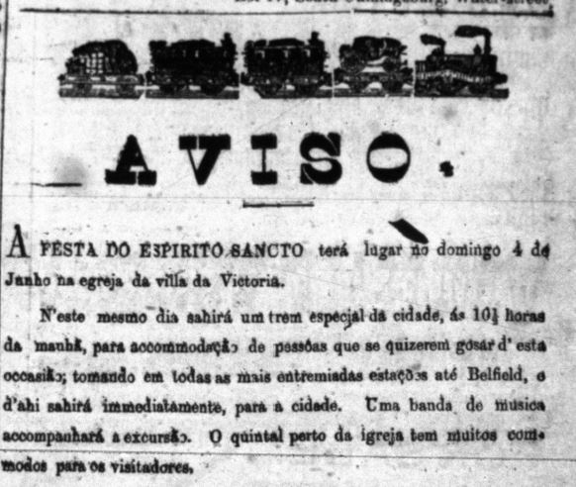
A Festa Do Espirito Sancto
…….
The Creole (Mar. 12, 1882)

Slide 16
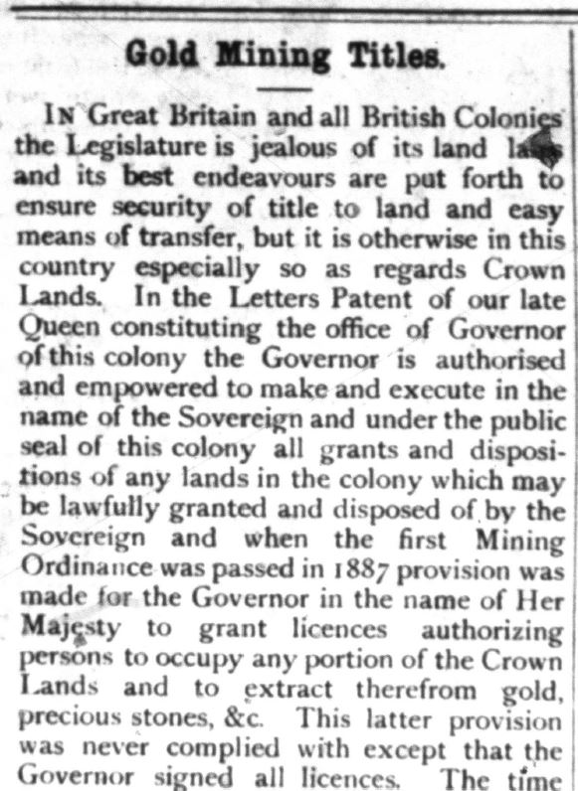
Gold Mining Titles
Governor, in the name of Her Majesty, has power to grant licenses authorizing persons to occupy and extract gold and precious stones from Crown Lands…
The Creole (Mar. 31, 1882)

Slide 17
“An old coolie man told me…”
Lands allotted to them are useless and even fatal with no drinking water.
The Creole (May 12, 1882)

Slide 18
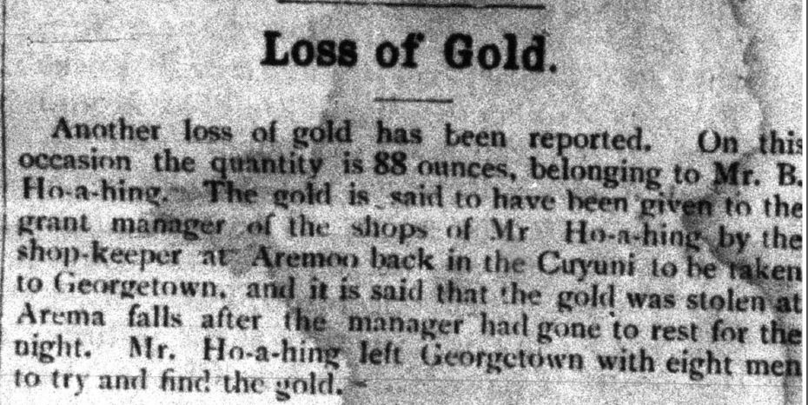
Loss of Gold
“Mr. Ho-a-hing left Georgetown with eight men to try and find the gold.”
The Creole (Mar. 31, 1882)

Slide 19
MAN OVERBOARD
A coolie named Tom
The Creole (March 31, 1882)

Slide 20
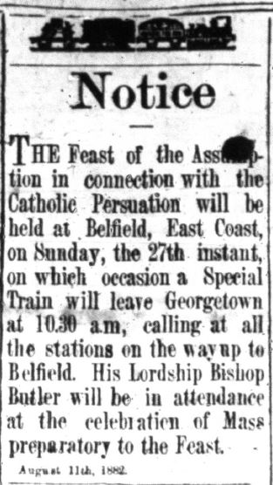
Feast of the Assumption (Catholic Persuasion)
The Feast of the Assumptions will be held on Sunday the 27th, with a special train to transport.
The Creole (Aug. 11, 1882)

Slide 21
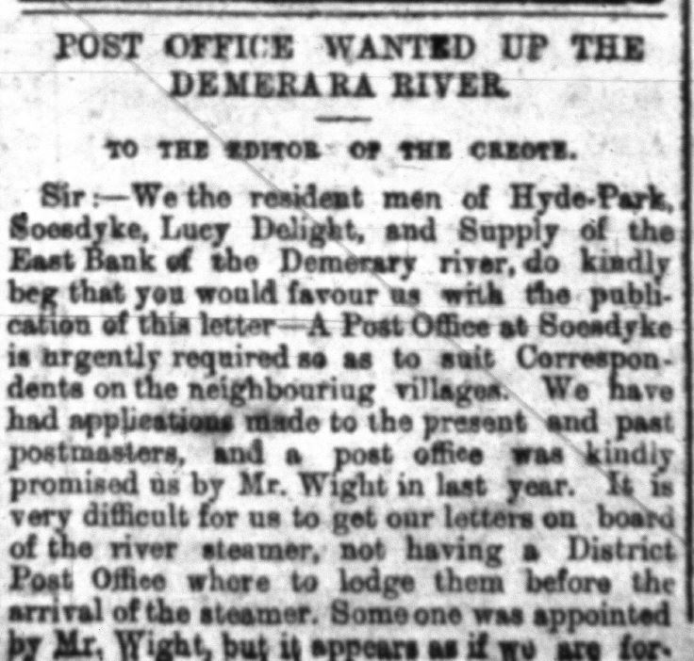
Post Office Wanted up the Demerara
“A Post Office at Soodyke is urgently required.” It is difficult to get letters on board of the river steamer.
The Creole (Mar. 31, 1882)

Slide 22
She is Determined to Live in Gaol
Coolie woman charged again 7 days in gaol for vagrancy.
“Zaban” is an indentured immigrant to Woodford Lodge estate.
Port of Spain Gazette (Oct. 1, 1896)

Slide 23
The Ganja Evil – introduced by East Indian coolies
Topic of interest in Jamaica: the coolie use of ganja.
Talks of the need for Government to take measures to prevent the smoking habit taking a firm hold on people.
Port of Spain Gazette (Oct. 13, 1896)

Slide 24
Jamaica Cigars – form a line
Cigars ran out – disappointing a constant stream of customers.
Port of Spain Gazette (July 18, 1896)

Slide 25
Another leper run in
Coolie man found begging in the street emitting an offensive smell – sufficient to warrant his isolation.
Port of Spain Gazette (Sept. 16, 1896)

Slide 26
The Police Courts
“A sickly looking Indian found sleeping on a footpath and not giving a good account of himself” – sent to jail for 14 days hard labor.
Port of Spain Gazette (July 2, 1903)

Slide 27
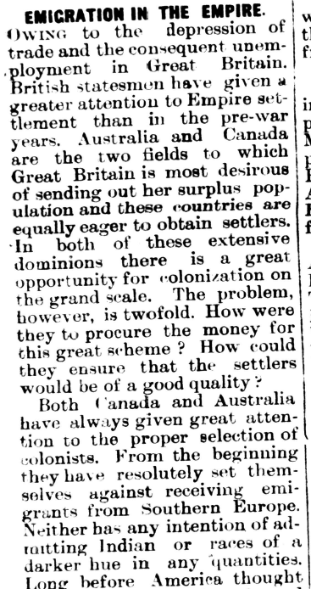
Emigration in the Empire
Great Britain desires to send its surplus population to settle in Australia and Canada. Must ensure that settlers are of ‘good quality’ – no emigrants from Southern Europe nor India or any races of a darker hue.
The Barbados Advocate (Jan. 23, 1926)

Slide 28
END OF PRESENTATION

