Slide 1
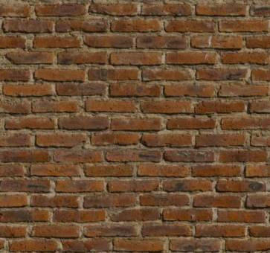
Creating Healing Environments Through Virtual Augmented Reality: How Technology Can Help Nature Deficit Disorder in Kids

Slide 2
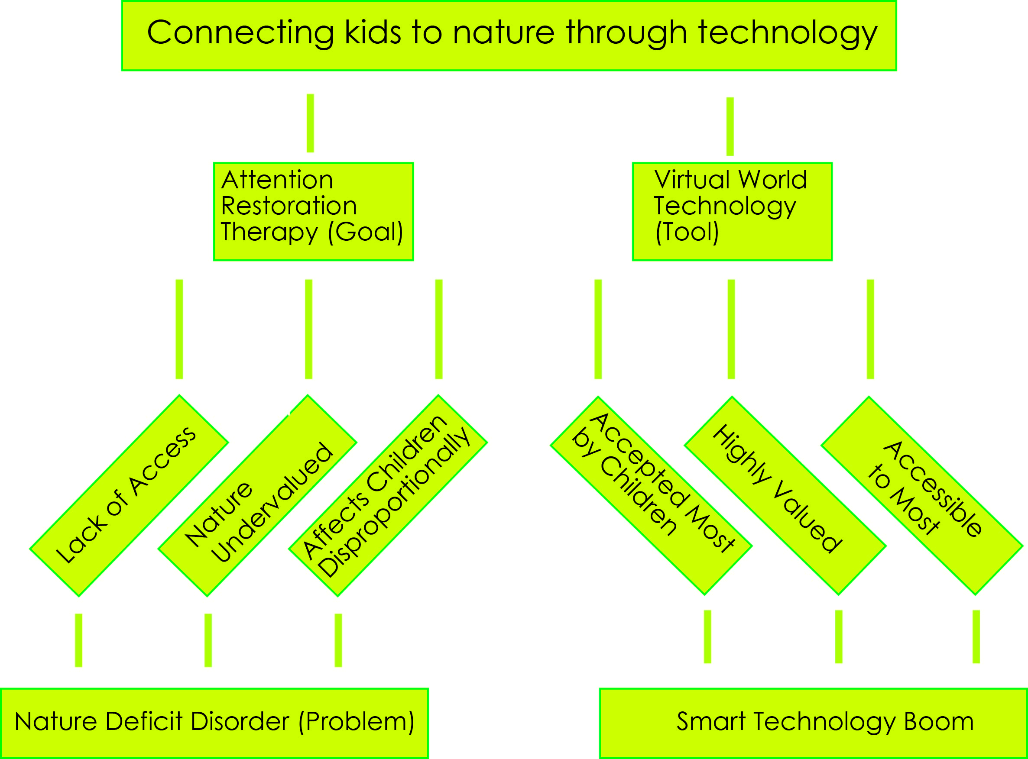

Slide 3
The Decline of Nature
Nature
City
Nature
Nature Deficit Disorder
Effects Nature Deficit Disorder:
Basic Cognitive Functioning
Creativity and Higher Mental Tasks
Spiritual
Notes:
Basic Cognitive Functioning
After a few minutes of being immersed on a crowded city street, “the brain is less able to hold things in memory, and suffers from reduced self-control.”
^{Involuntary attention}
^{Directed attention}
Creativity
^{Wieden Kennedy nest}
Spiritual
Louv religious leader meeting – to be spiritual is to be in awe
^{Richard Hoffman-} transcendental experience beauty

Slide 4
The Generation that Nature Abandoned
“…I was encouraged to find that many people now of college age – those who belong to the first generation largely to grow up in a de-natured environment – have tasted just enough nature to intuitively understand what they have missed. This yearning is a source of power……They do not intend to be the last children in the woods.” –Richard Louv

Slide 5
Attention Restoration Therapy
Compatibility
Escapism
Fascination
Coherence

Slide 6
Case Studies

Slide 7
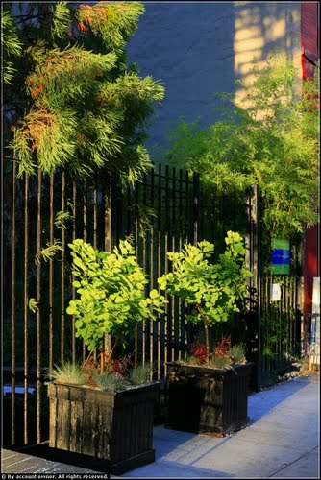
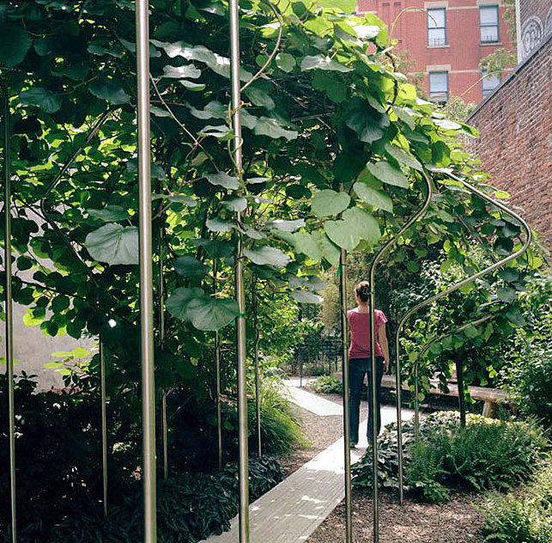
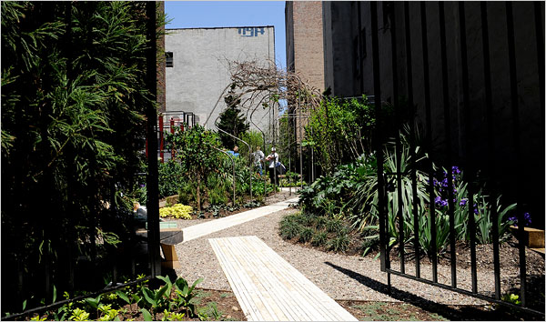
Toyota Children’s Learning Garden
Michael Van Valkenburg
New York, New York

Slide 8
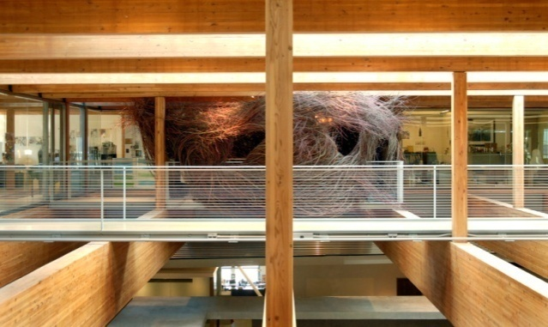
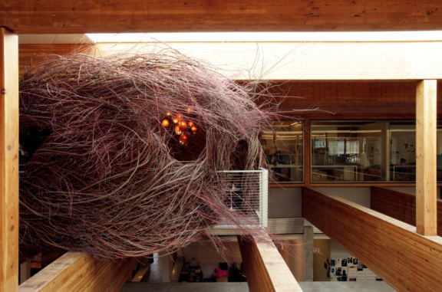
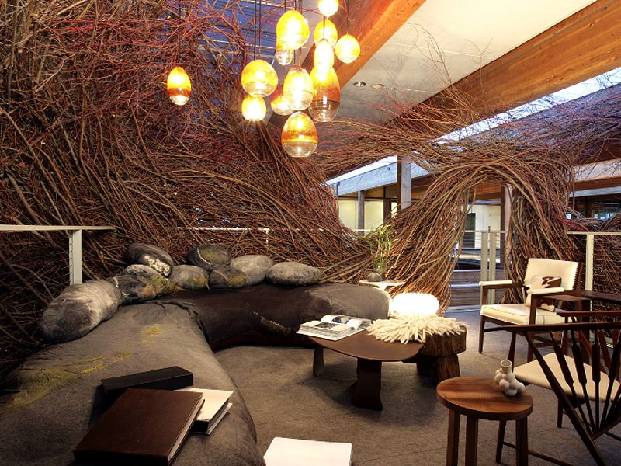
The Nest
Patrick Dougherty
Portland, Oregon

Slide 9
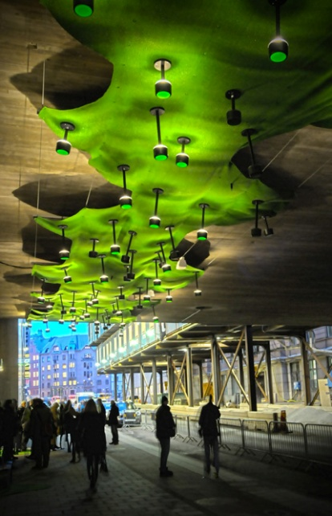
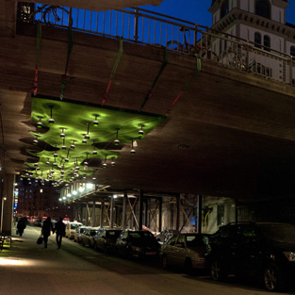
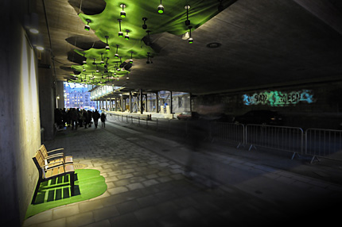
Urban Green
Ljusarkitektur
Stockholm, Sweden

Slide 10
Case Study Summary
Use of Levels
Use of Texture
Cocoon – Like Environment

Slide 11
How to Bring Back Nature …….Through Technology?
Mass Accessible
The Increasing Acceptance of Video Games
The Digital Value
Notes:
Mass Accessible
Video game industry sales
Crown fountain millenium park chicago
Acceptance
Video game industry boom
Technology used in smartphones
Enable decisions, dynamic path
Digital Value

Slide 12
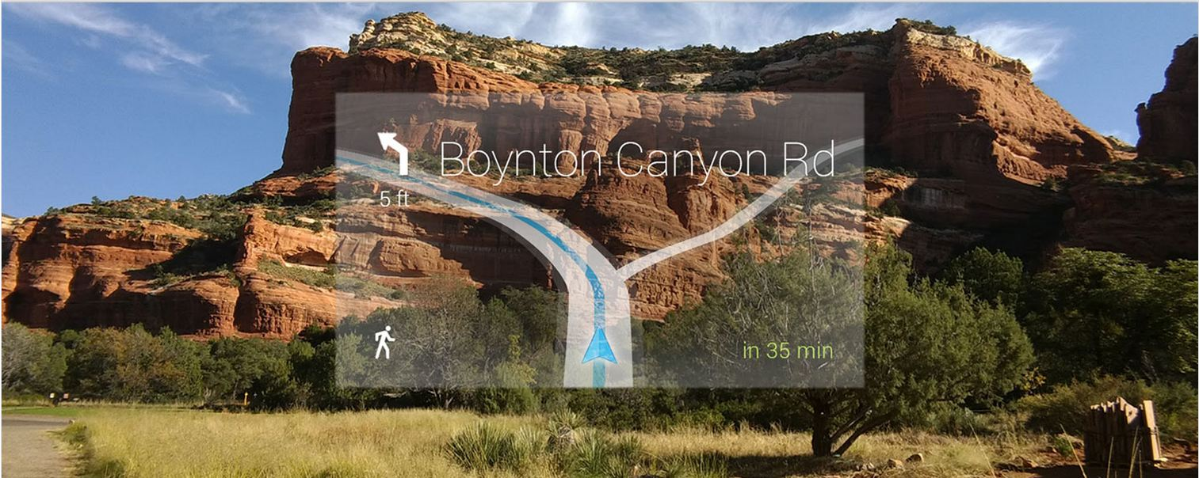
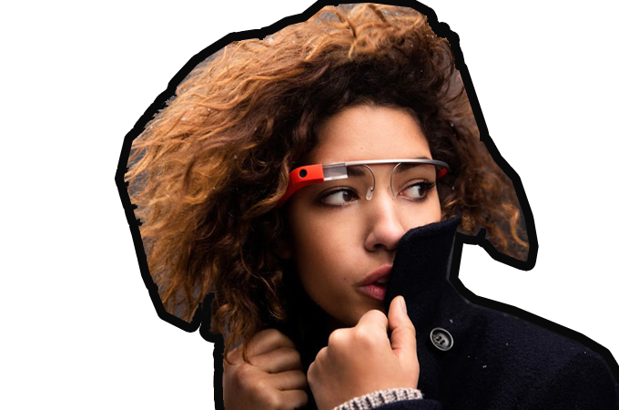
Google Glass

Slide 13
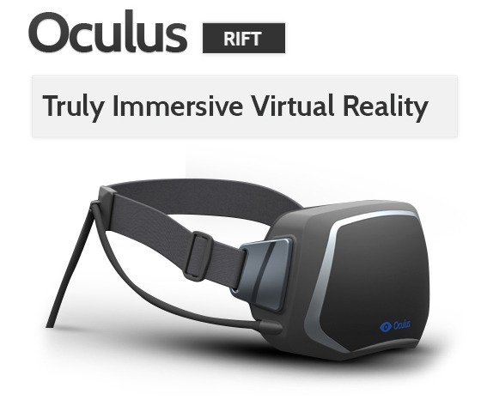
Notes:
Fusion of google and virtual
Future possibility of virtual real world
Guide technology, raise awareness
What my project does

Slide 14
Site Selection

Slide 15
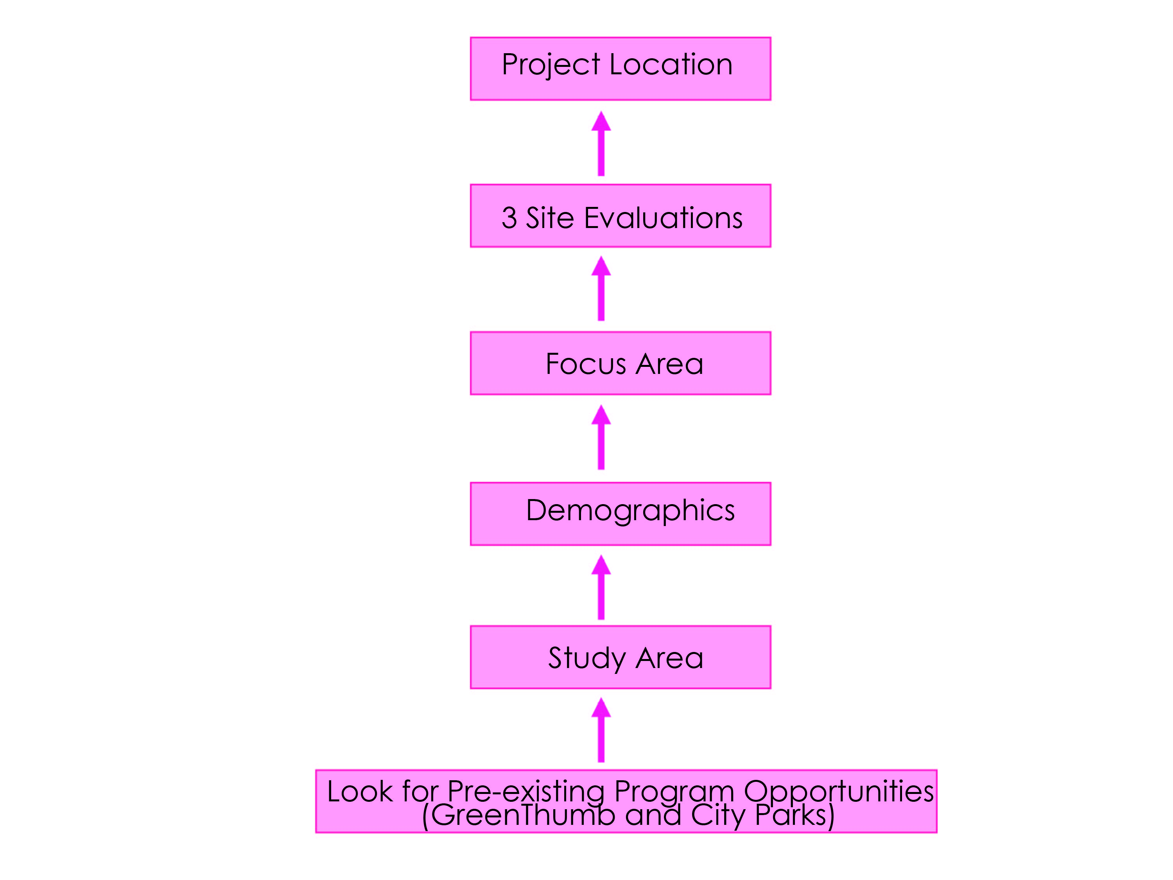
Site selection

Slide 16
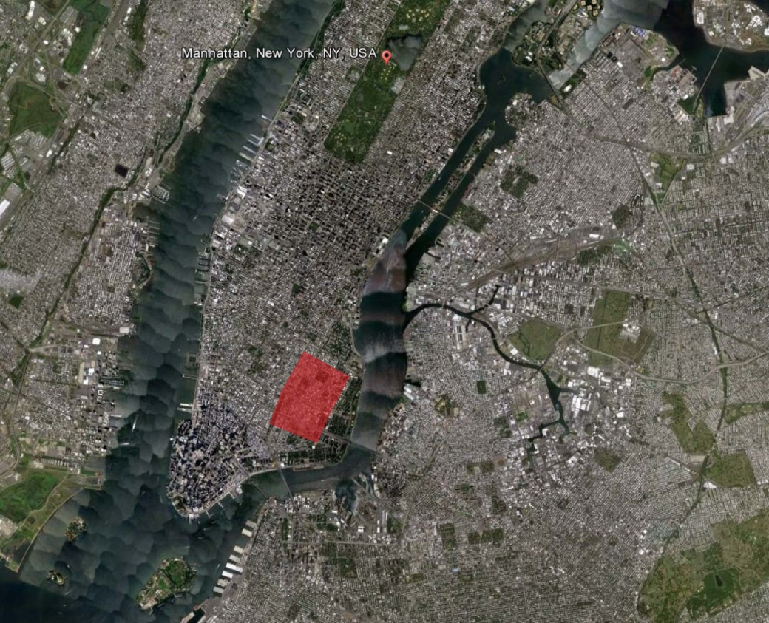
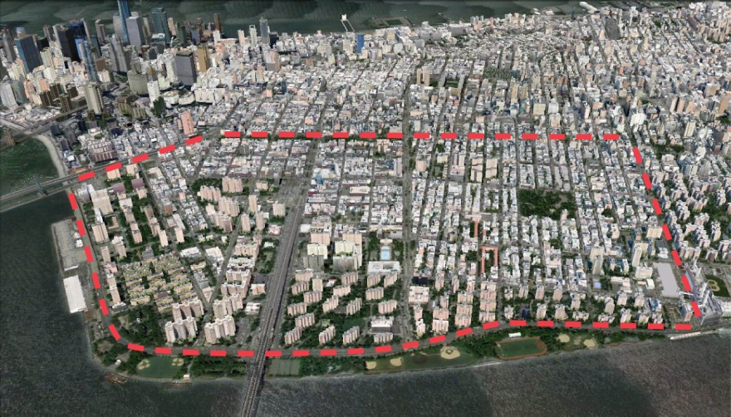
Site Area

Slide 17
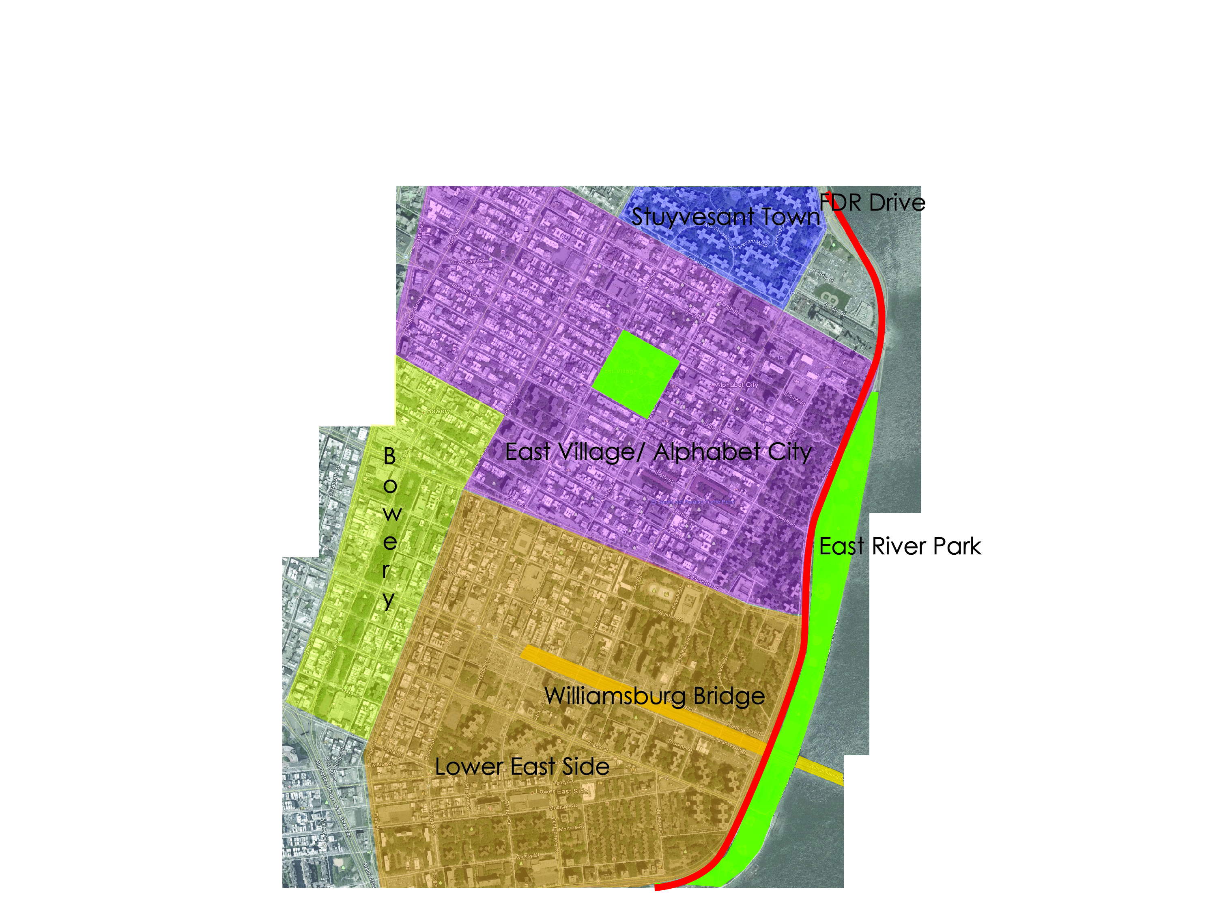
Context

Slide 18
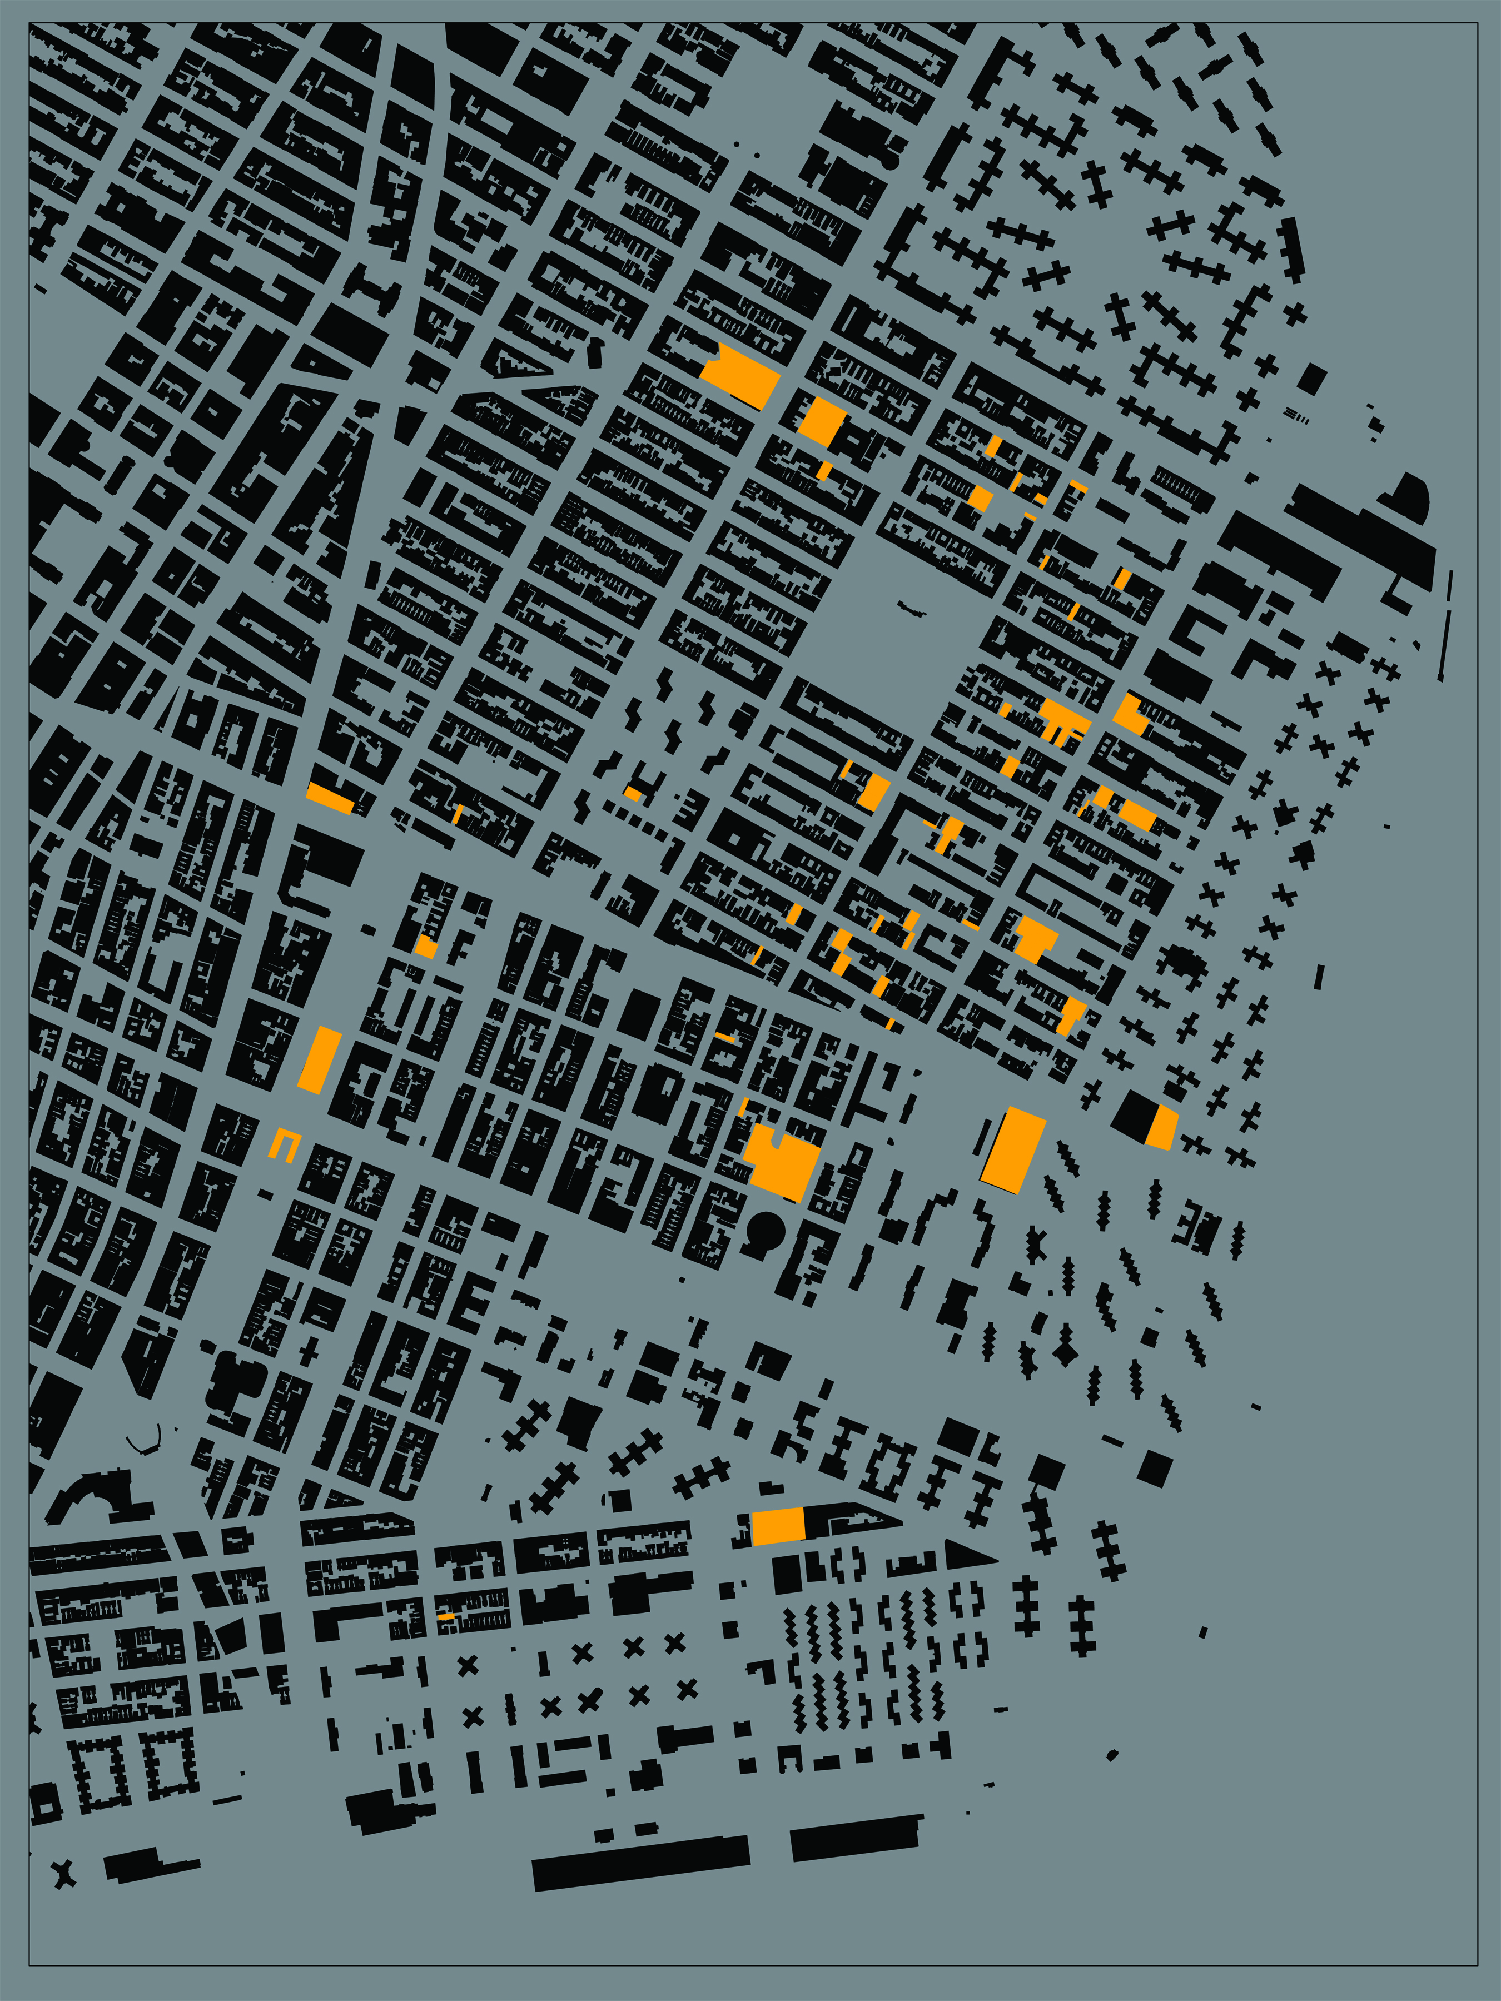
GreenThumb

Slide 19
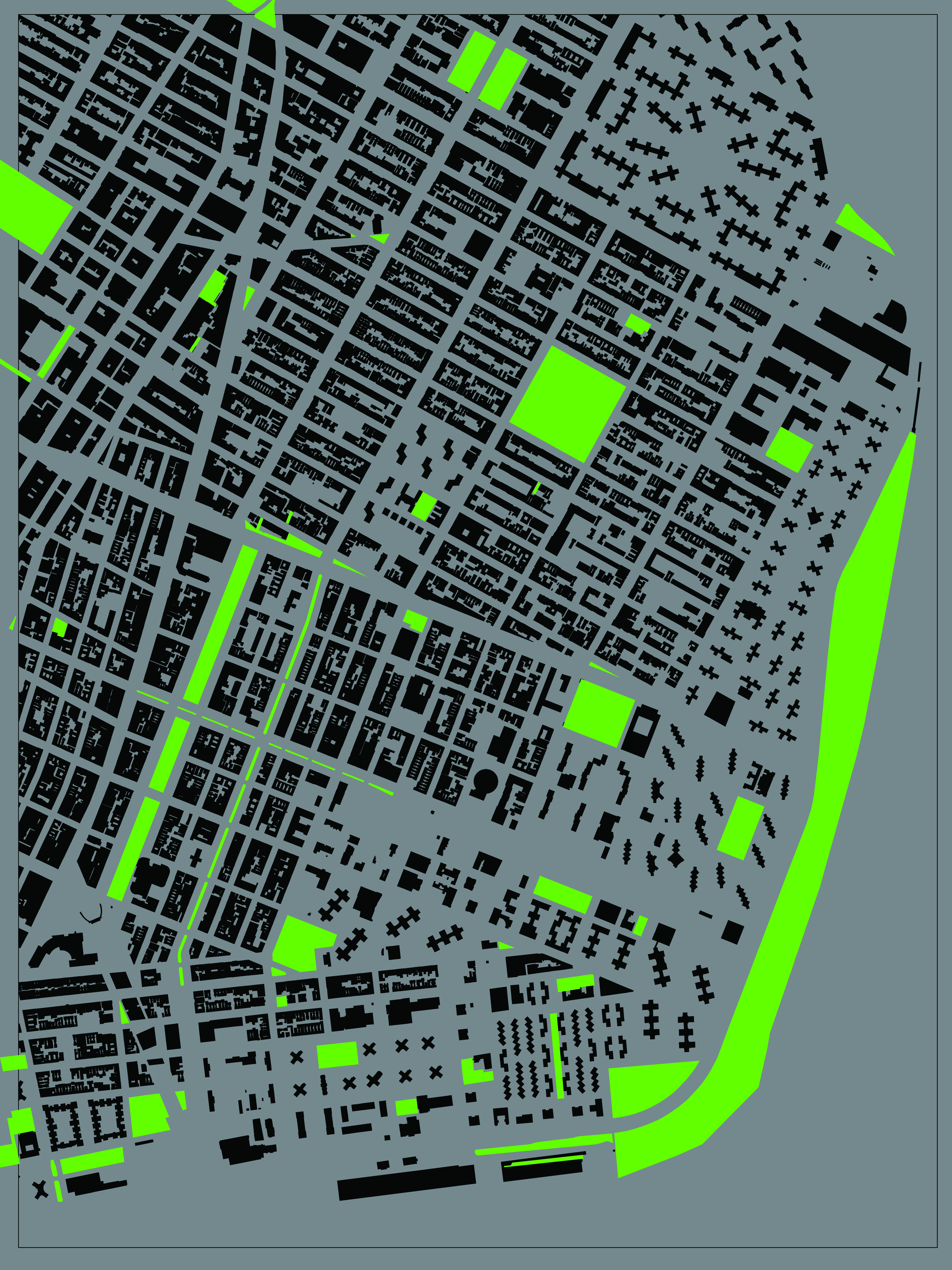
City Parks

Slide 20
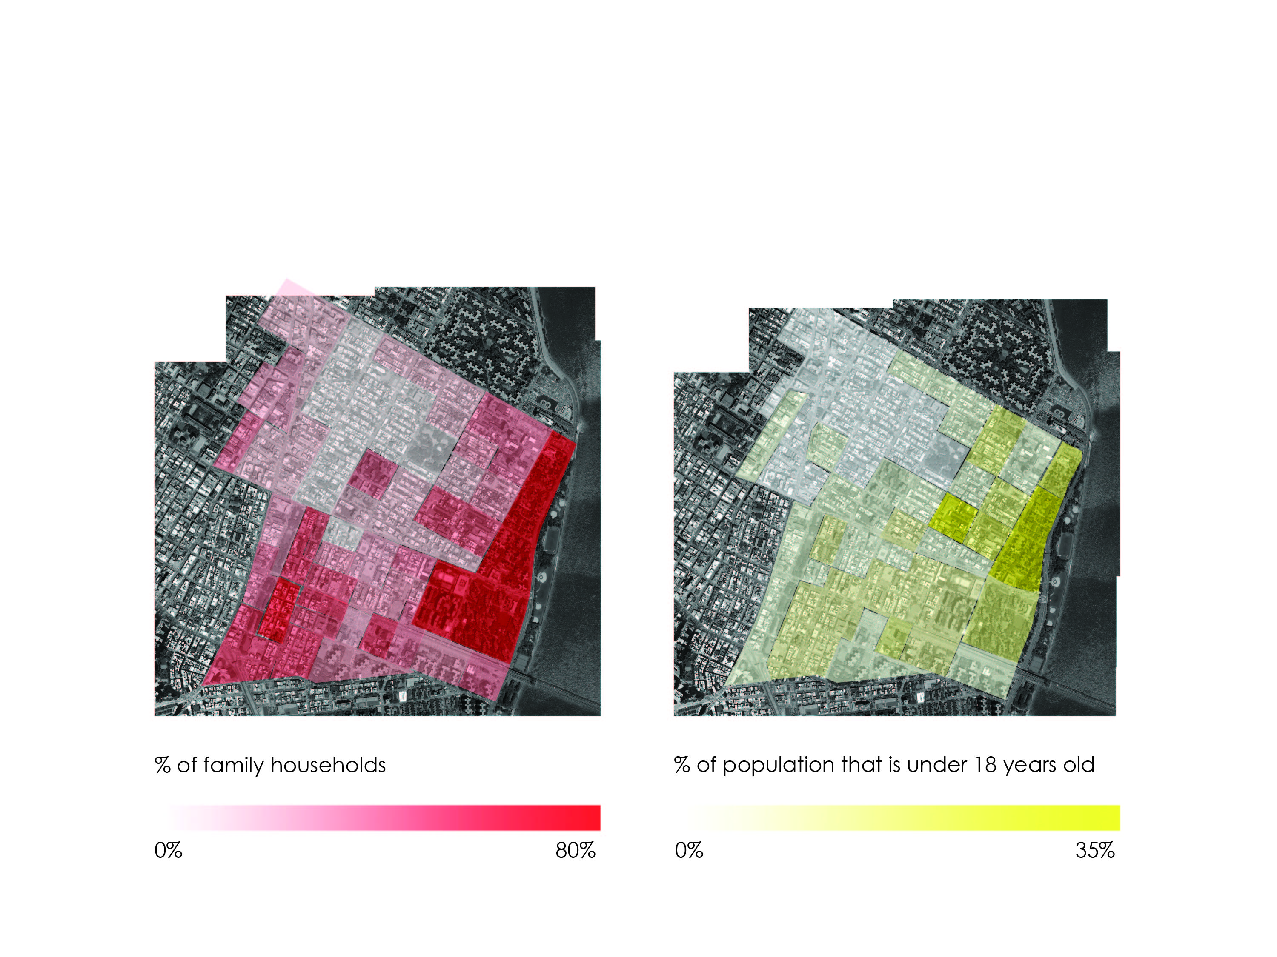
Demographics

Slide 21
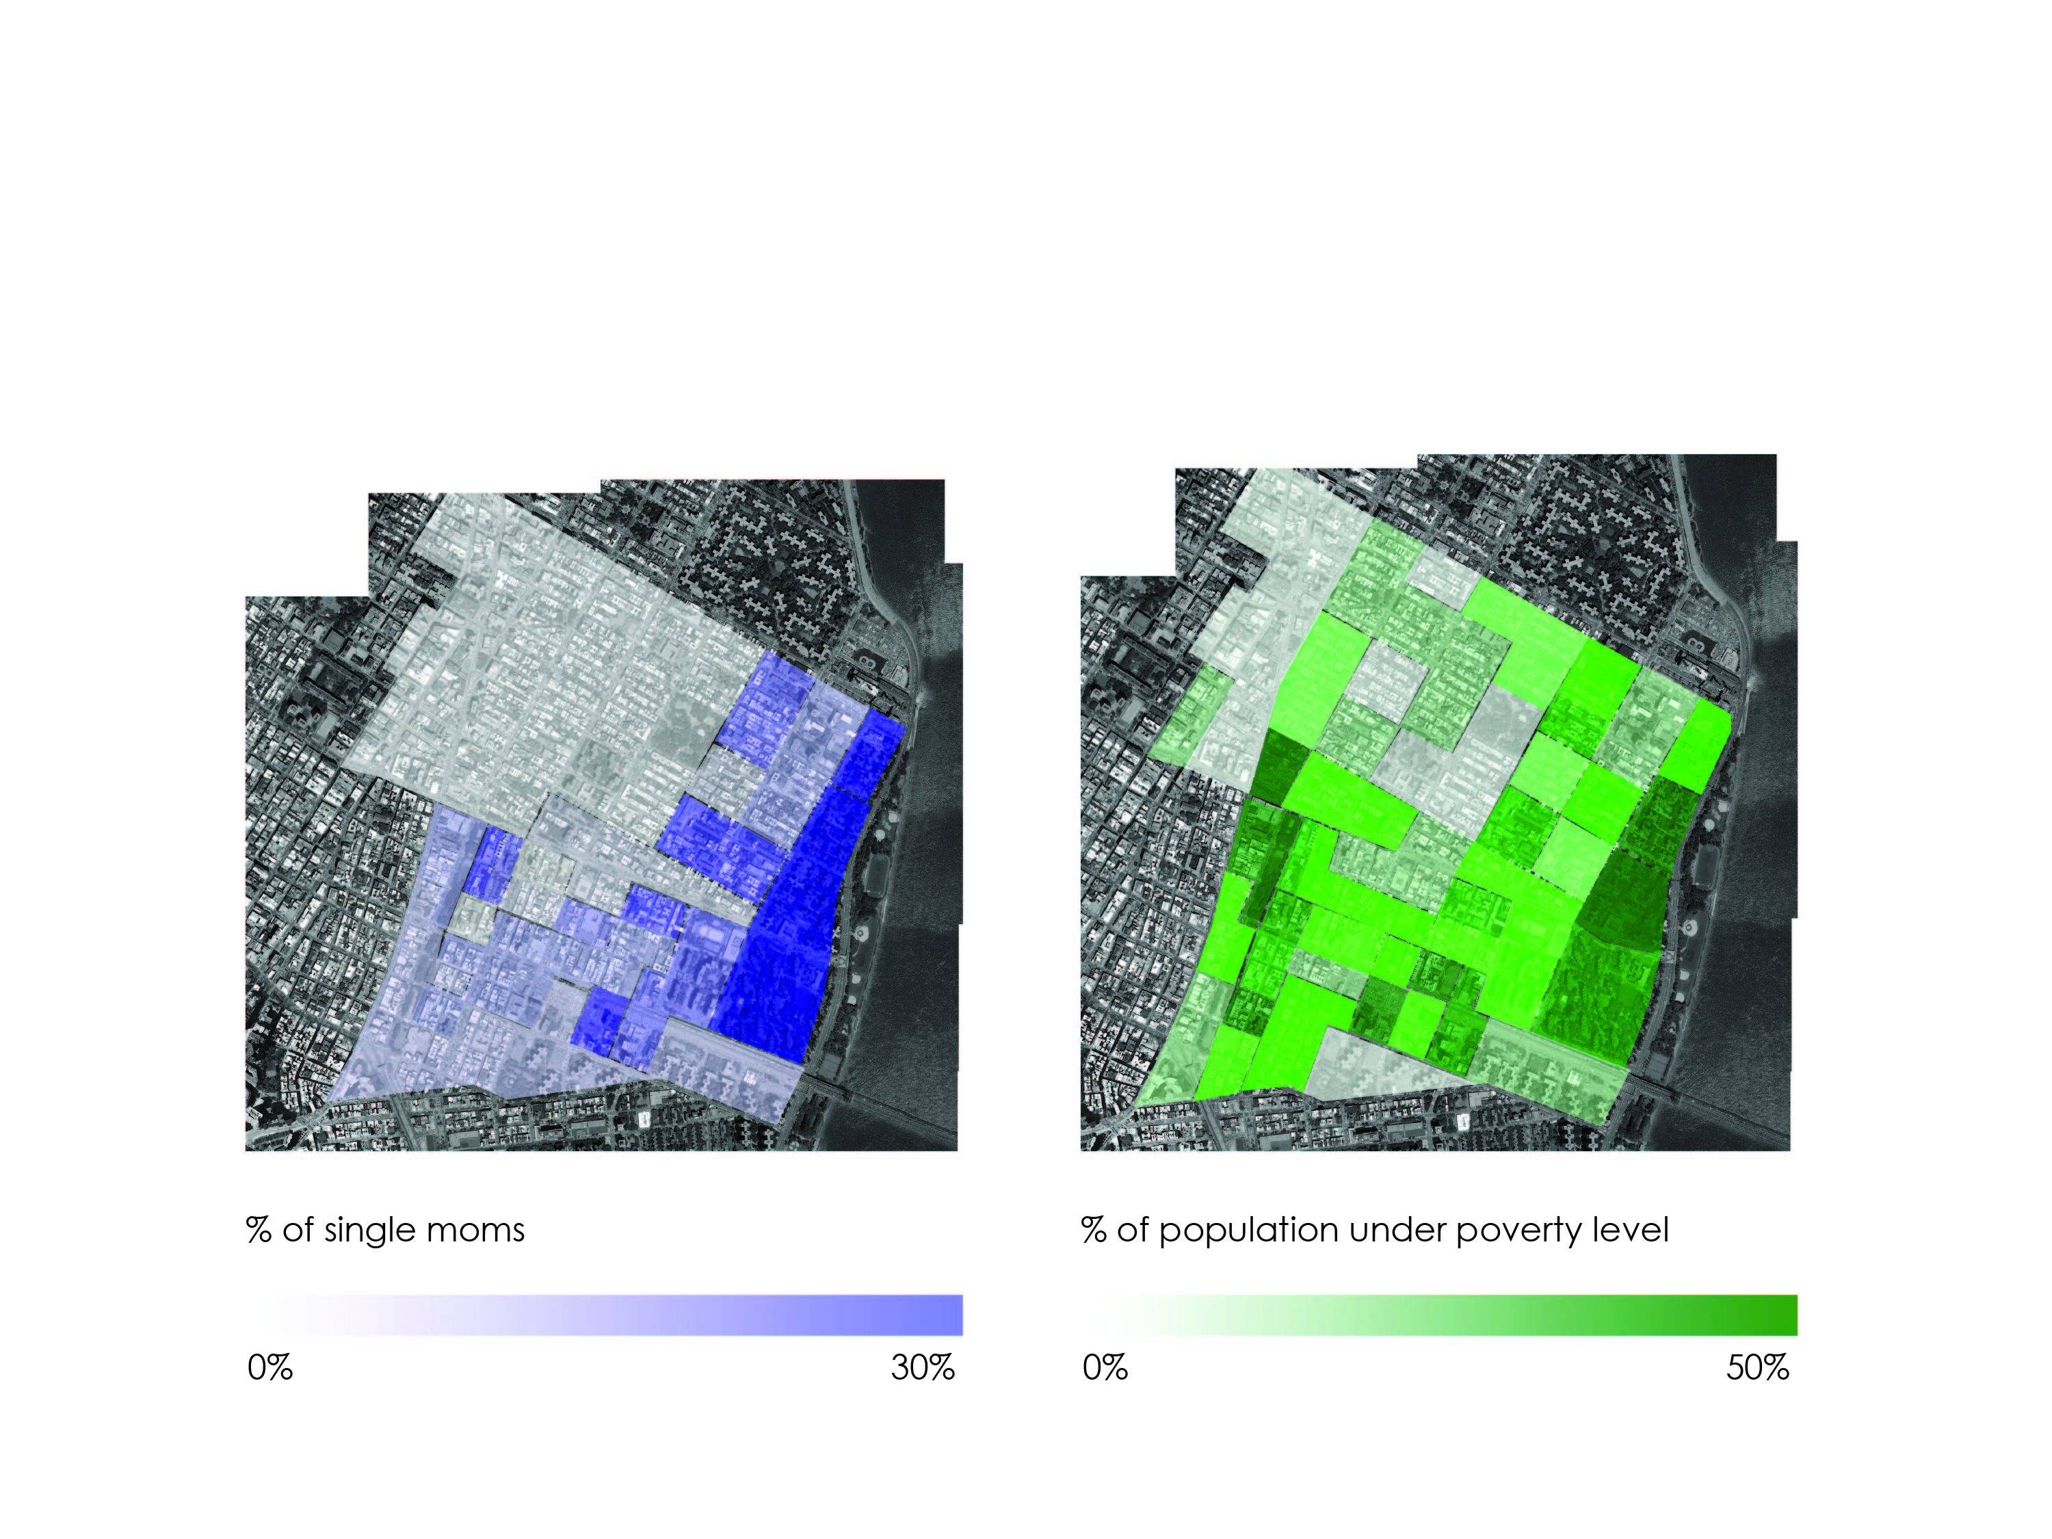
Demographics

Slide 22
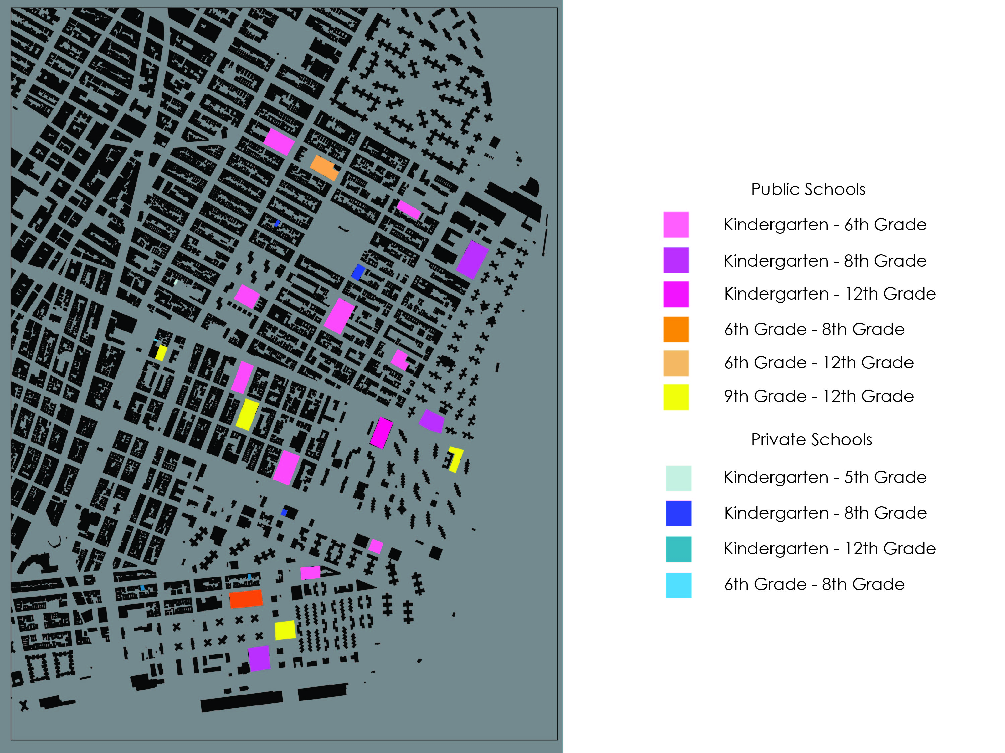
Schools

Slide 23
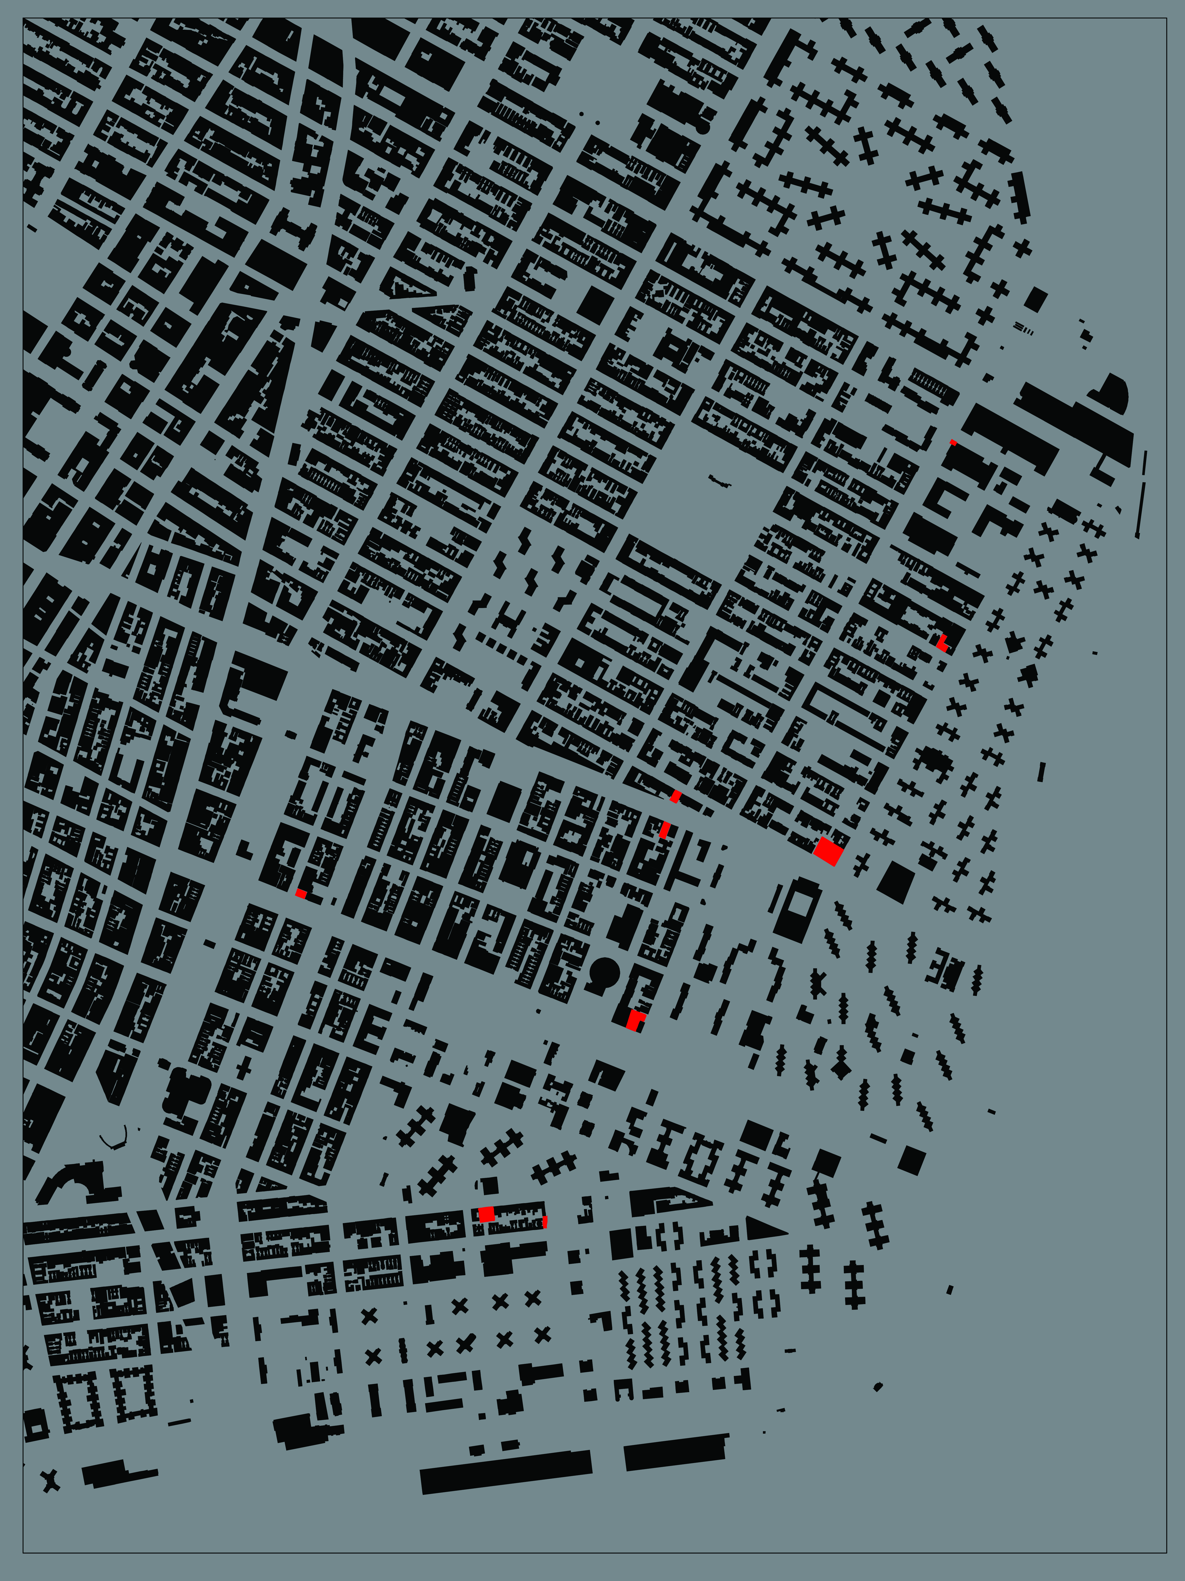
Vacant Lots

Slide 24
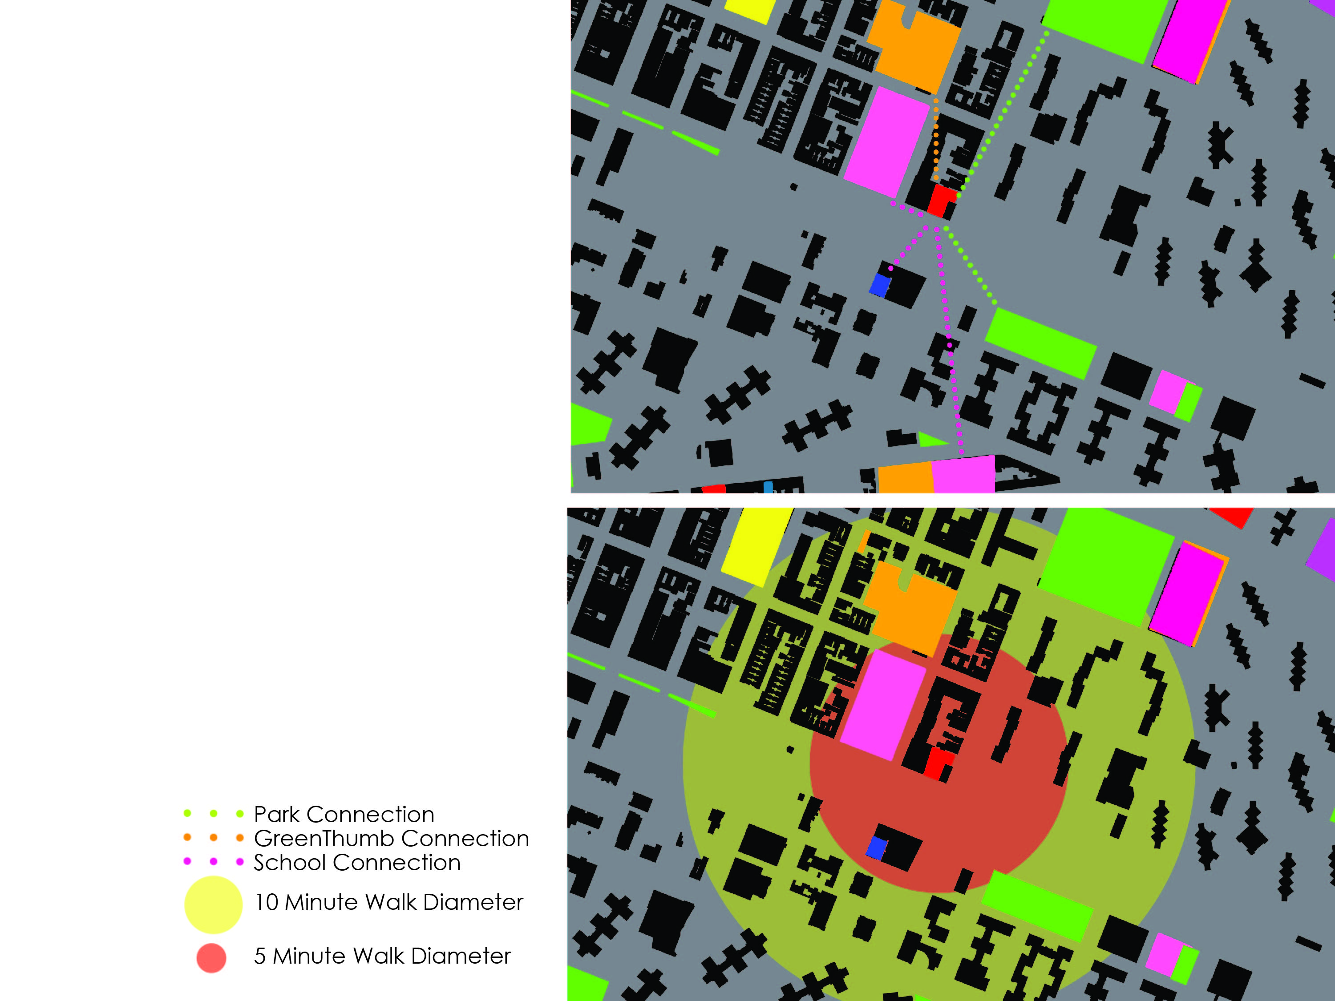
Site 1

Slide 25
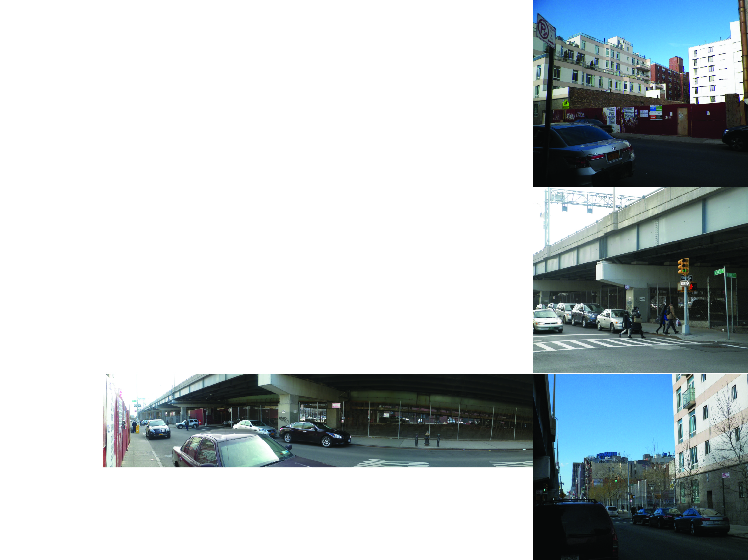

Slide 26
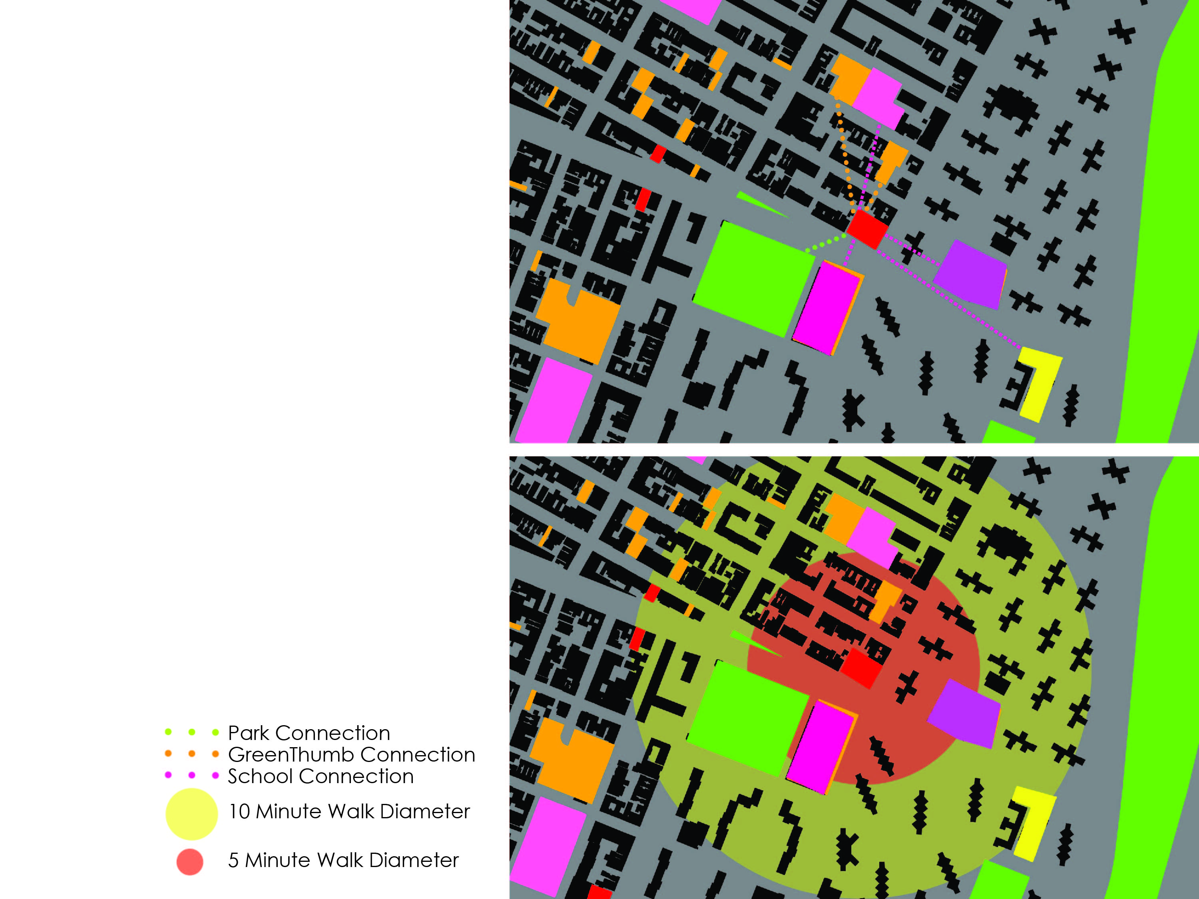
Site 2

Slide 27
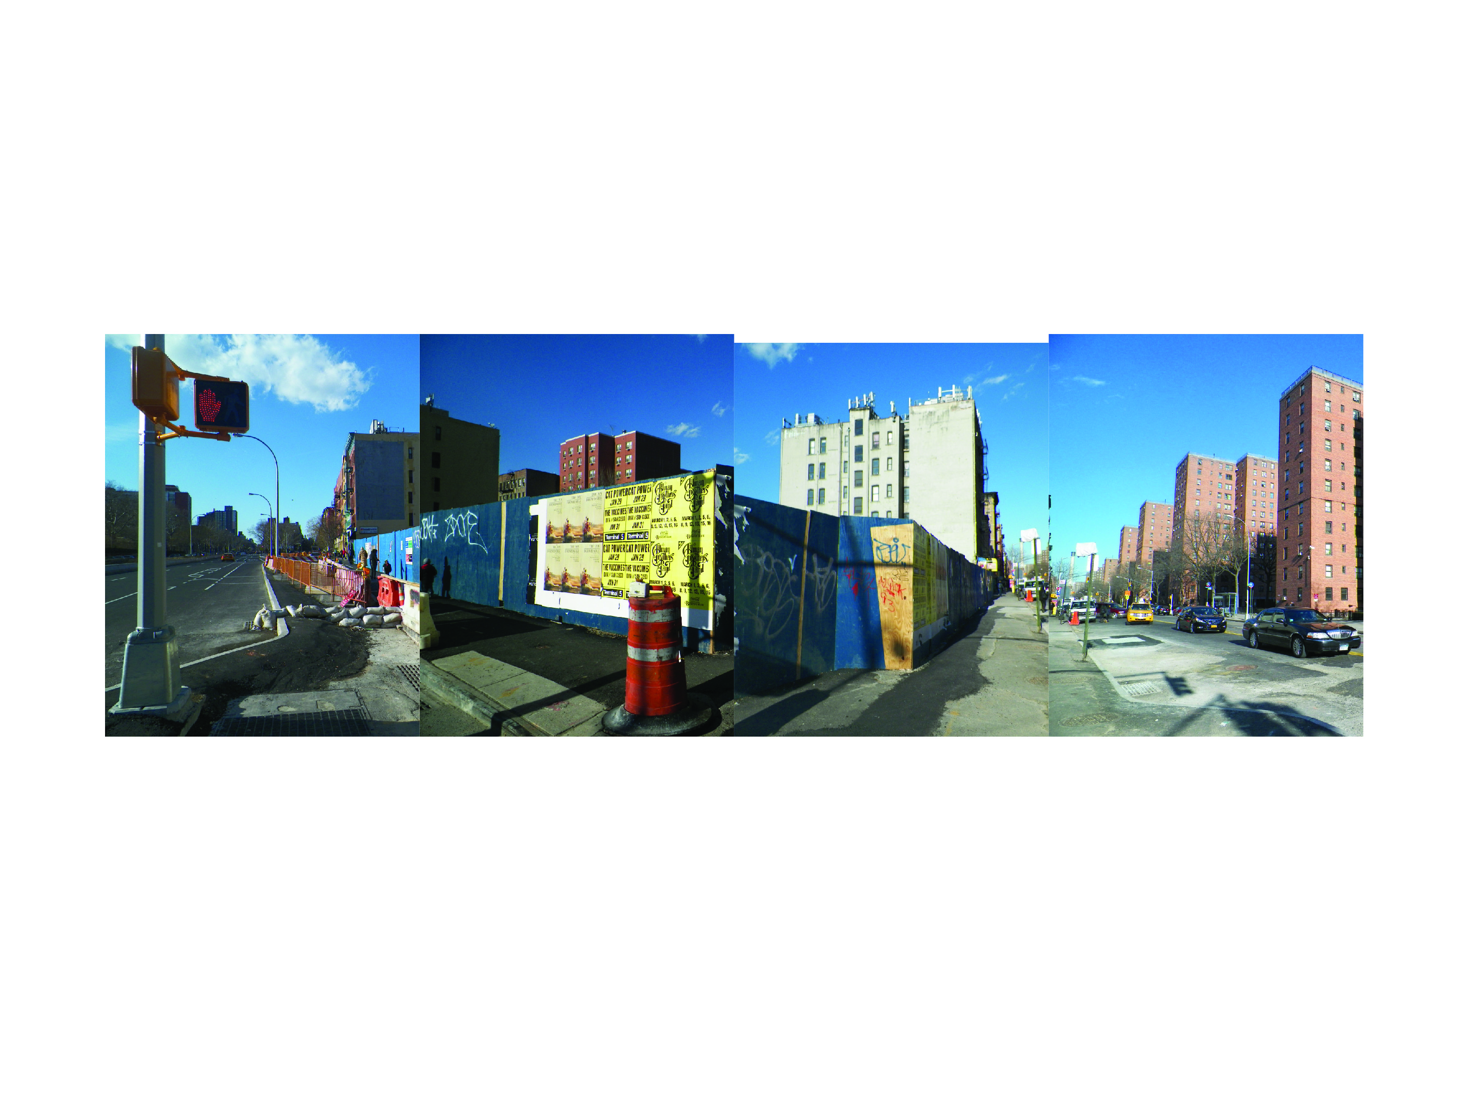

Slide 28
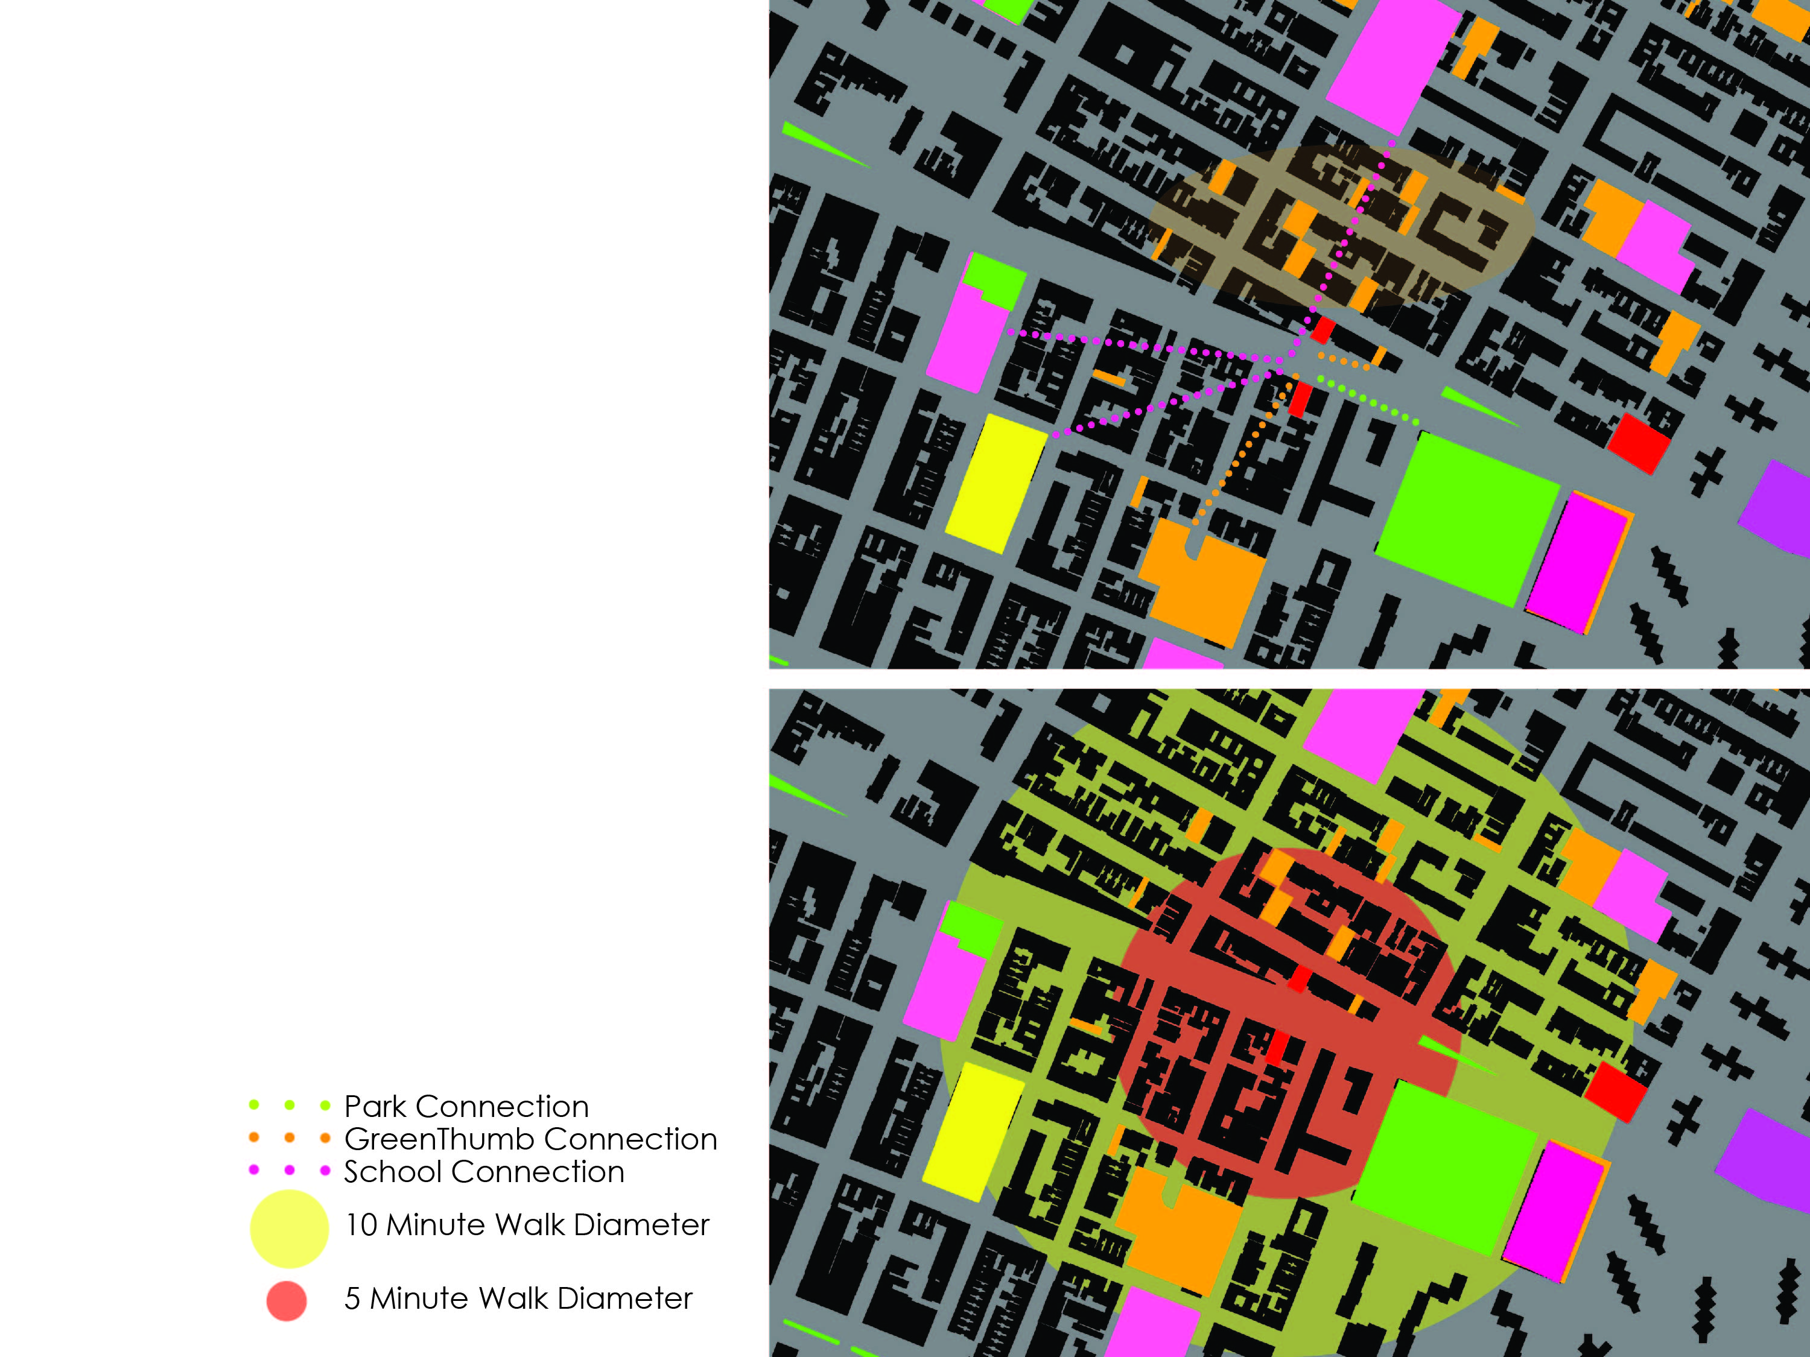
Site 3

Slide 29
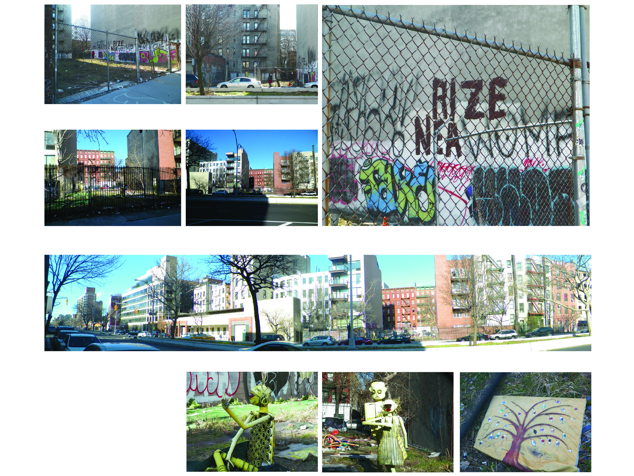

Slide 30
Design Process

Slide 31
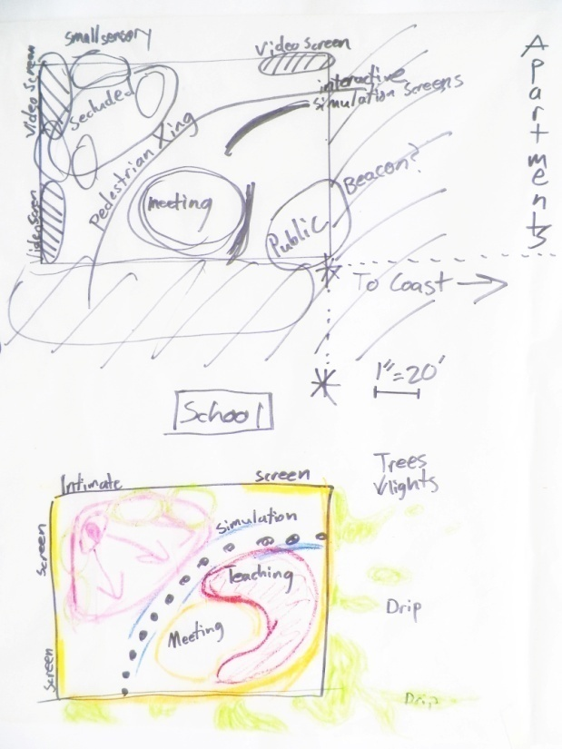
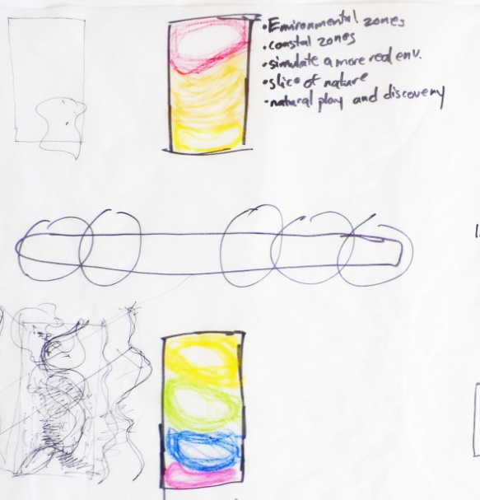
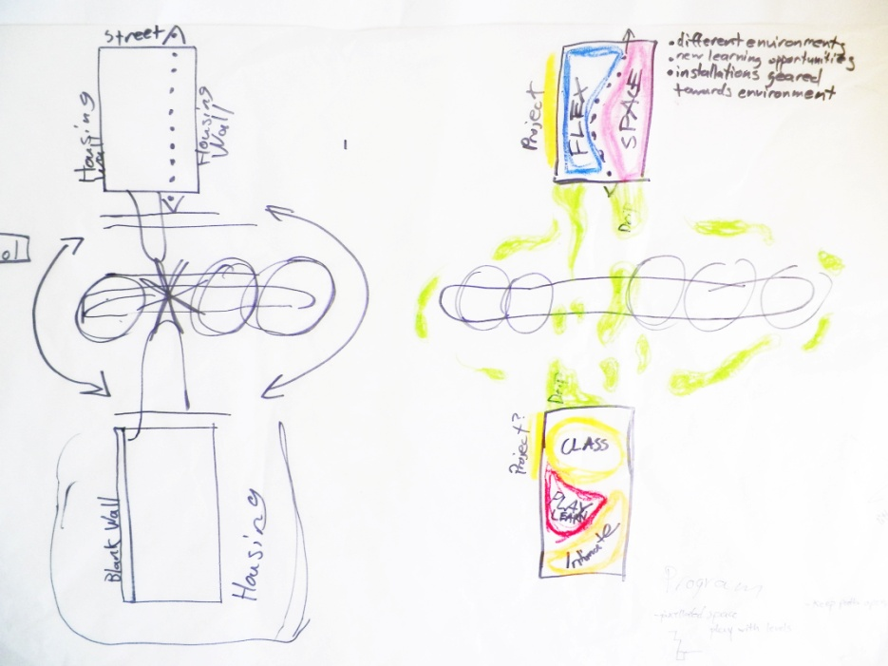
Initial Concepts

Slide 32
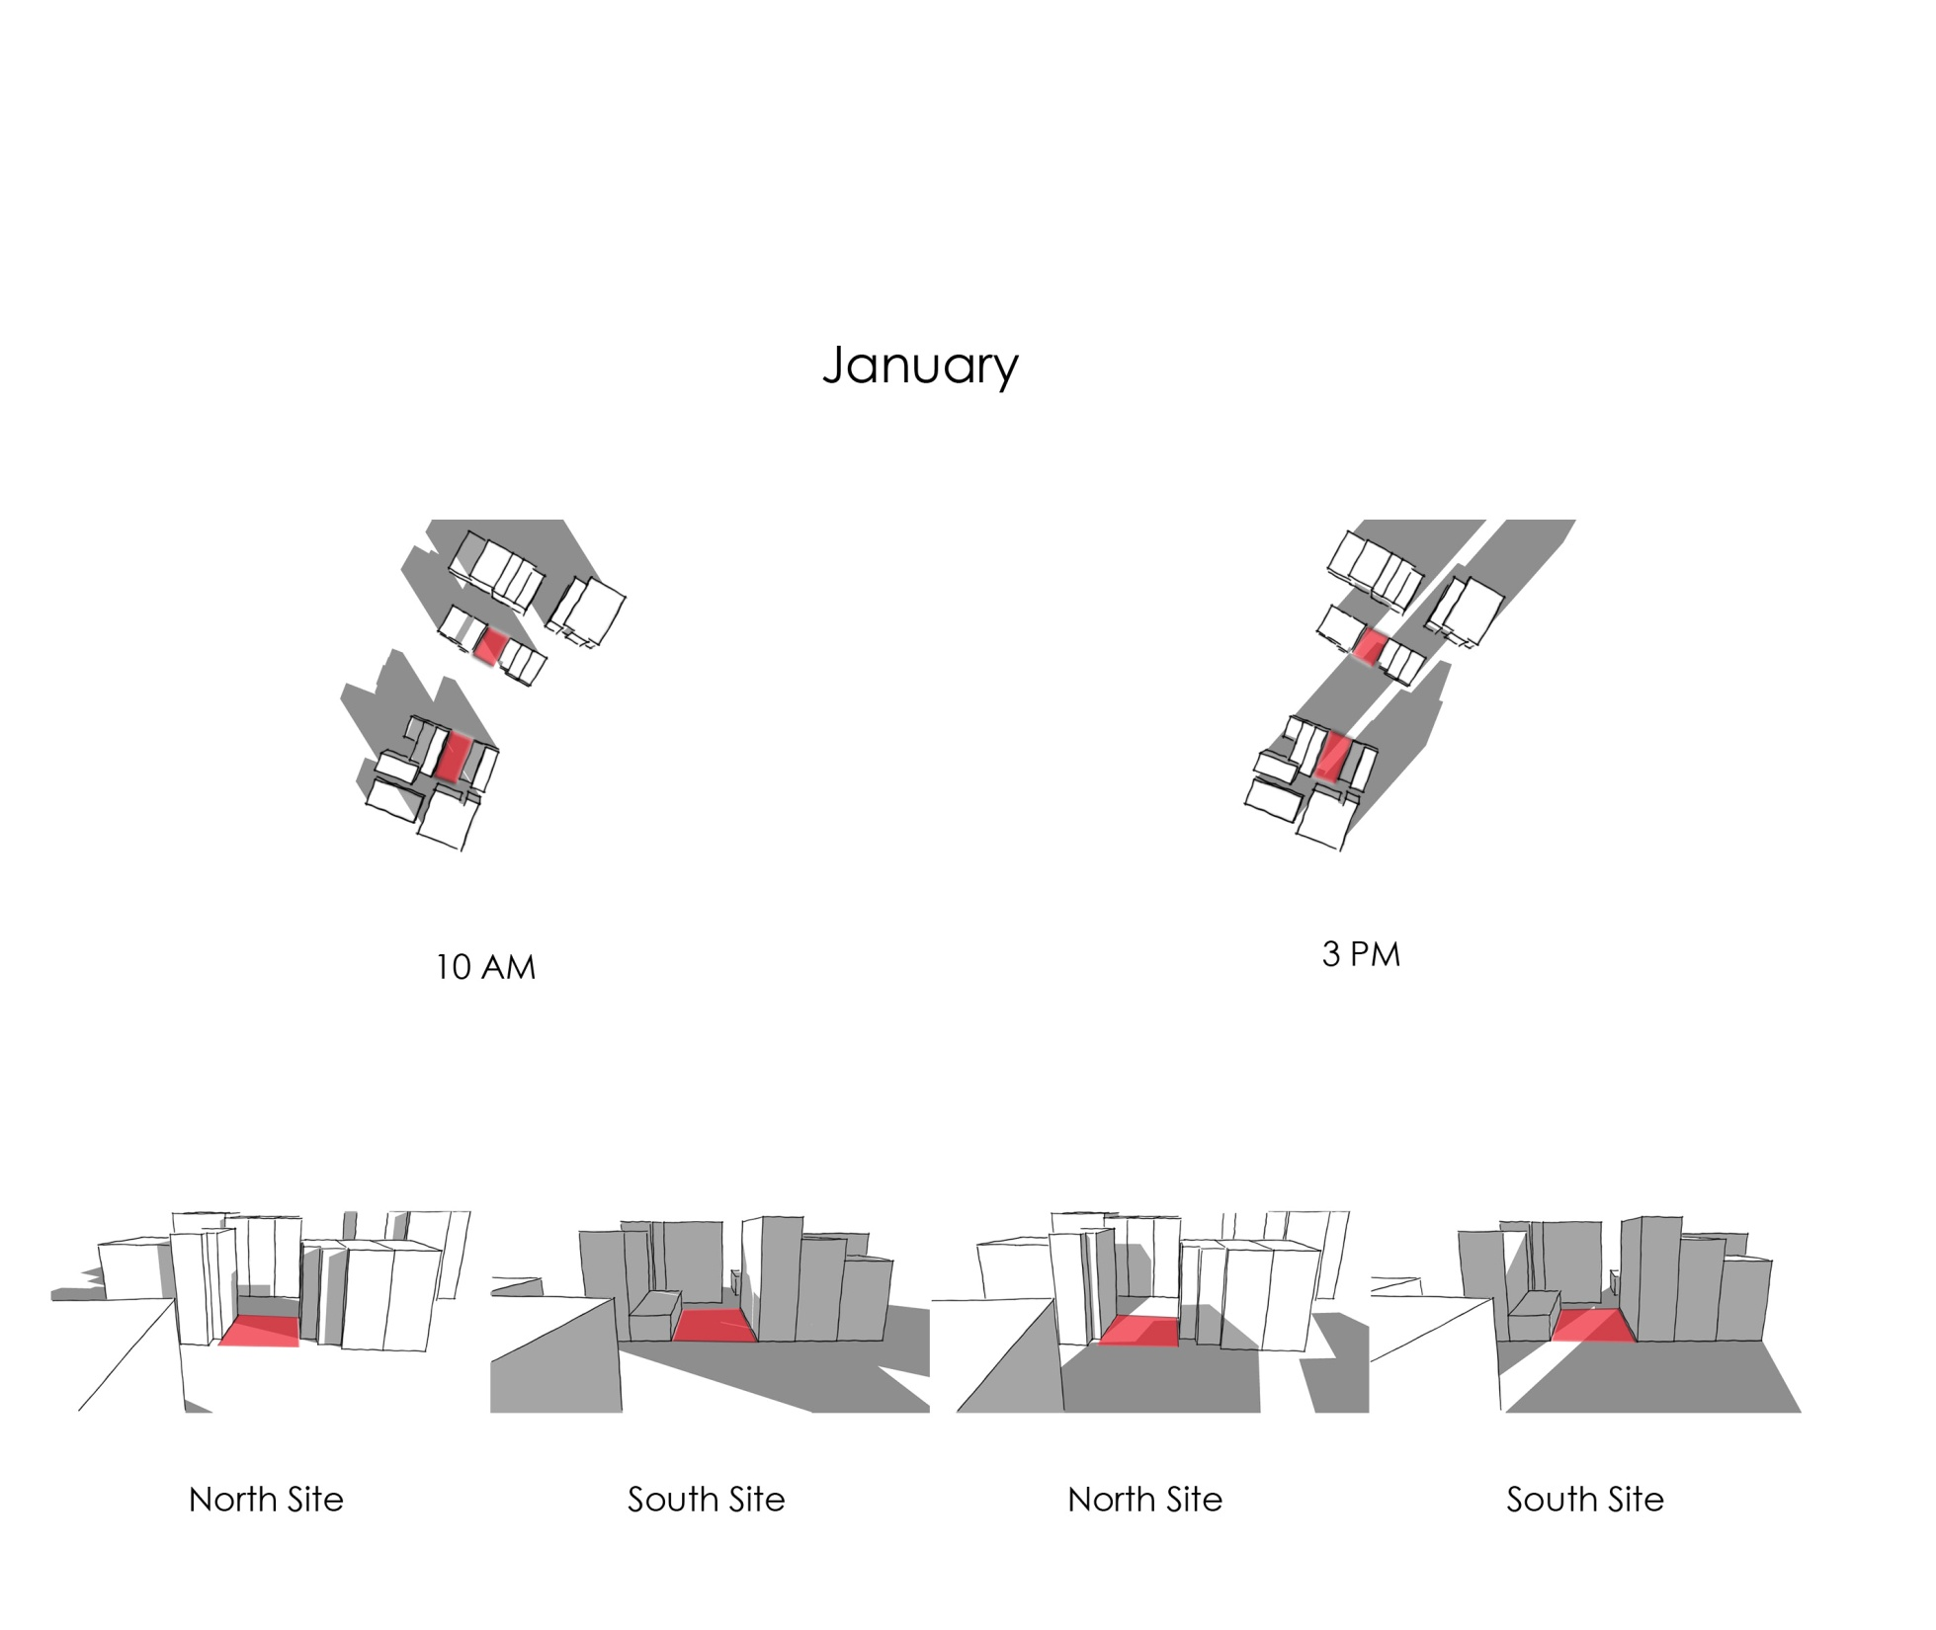
Sun-Shade Diagram

Slide 33
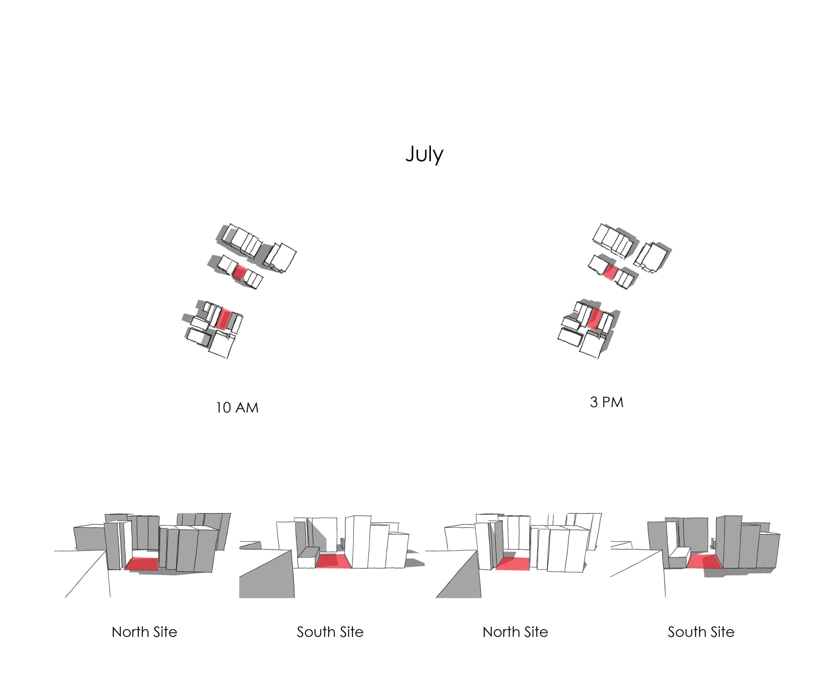
Sun-Shade Diagram

Slide 34
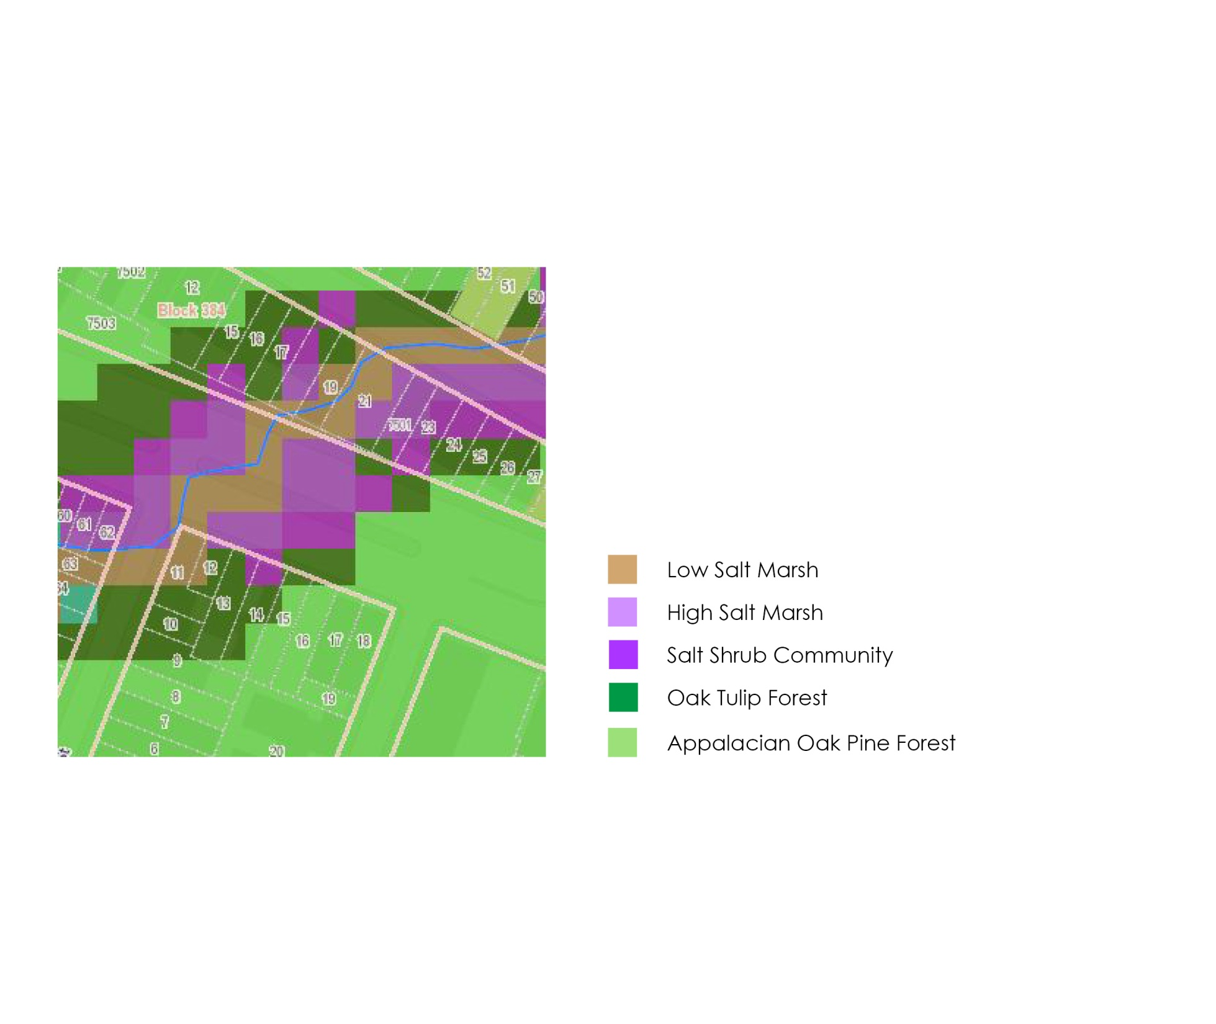
OASIS 1609 Eco-Communities

Slide 35
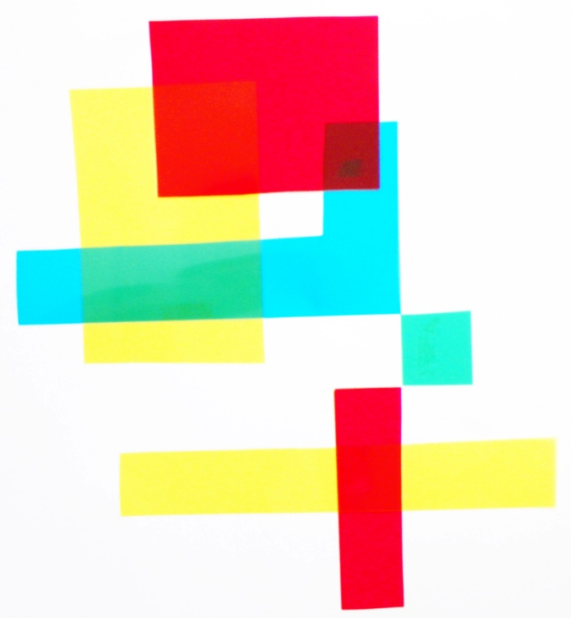
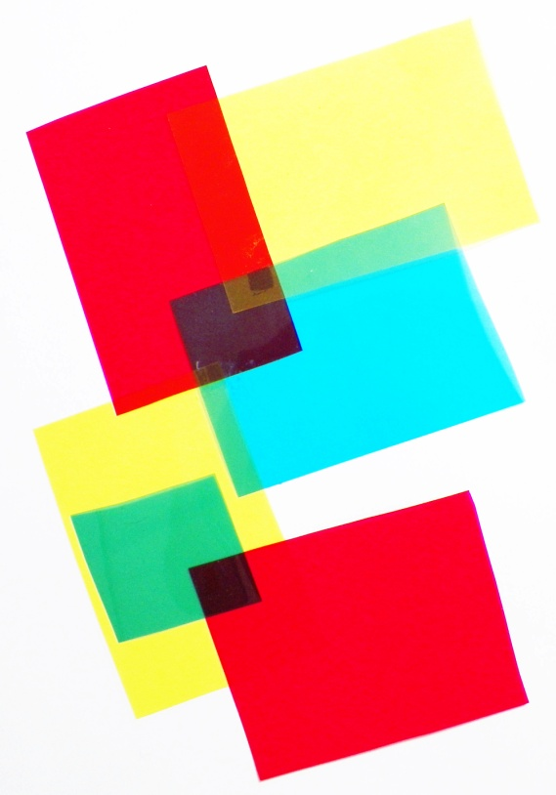
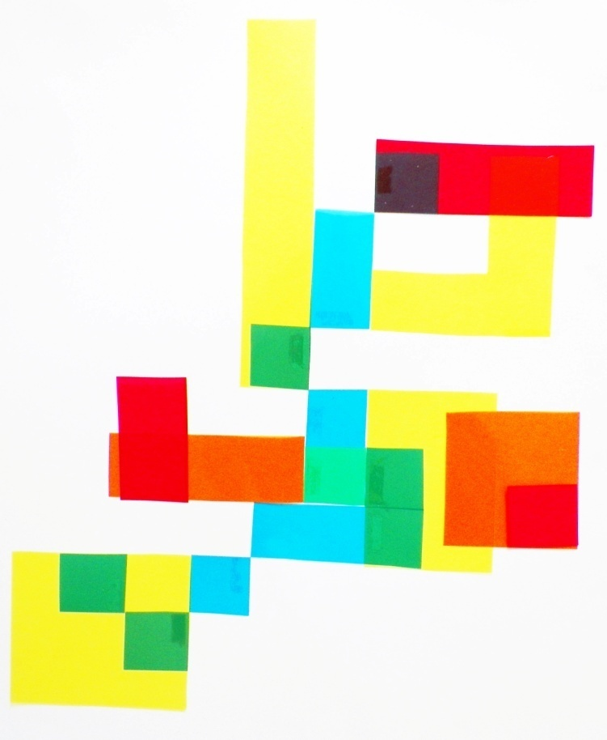
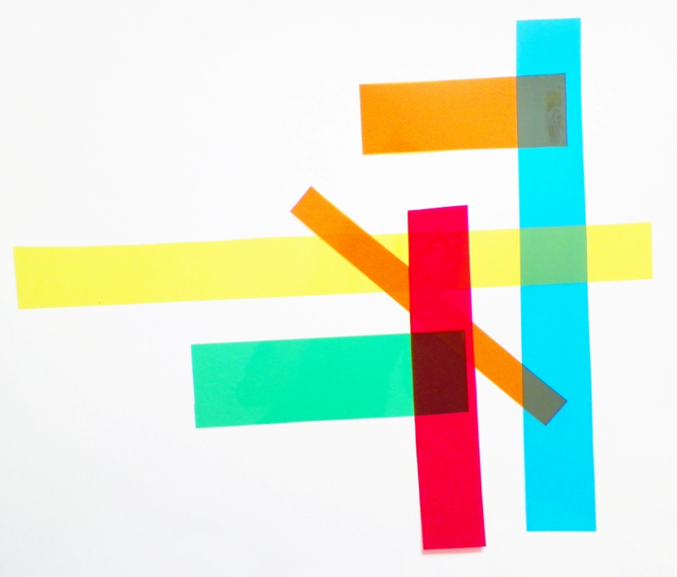
Pixel Play

Slide 36
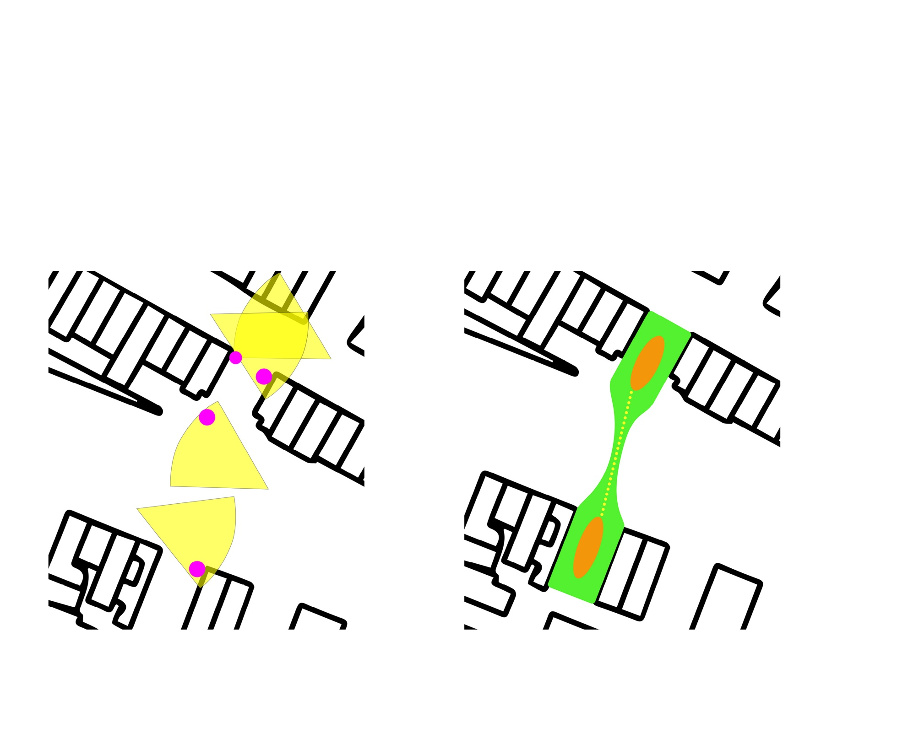
Spatial Opportunities
Sightlines
Active/ Passive

Slide 37
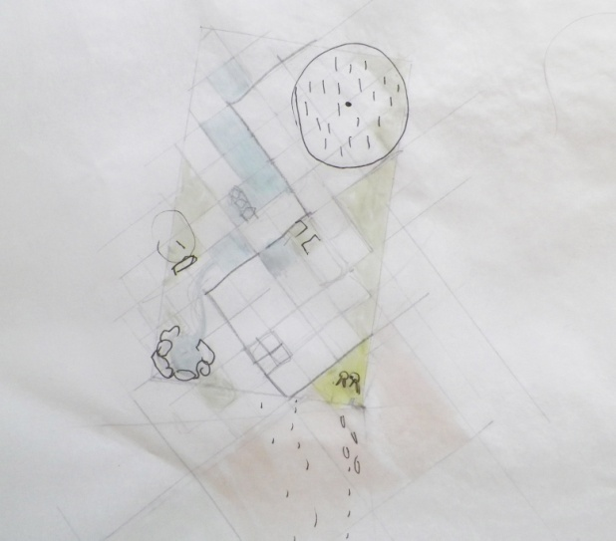
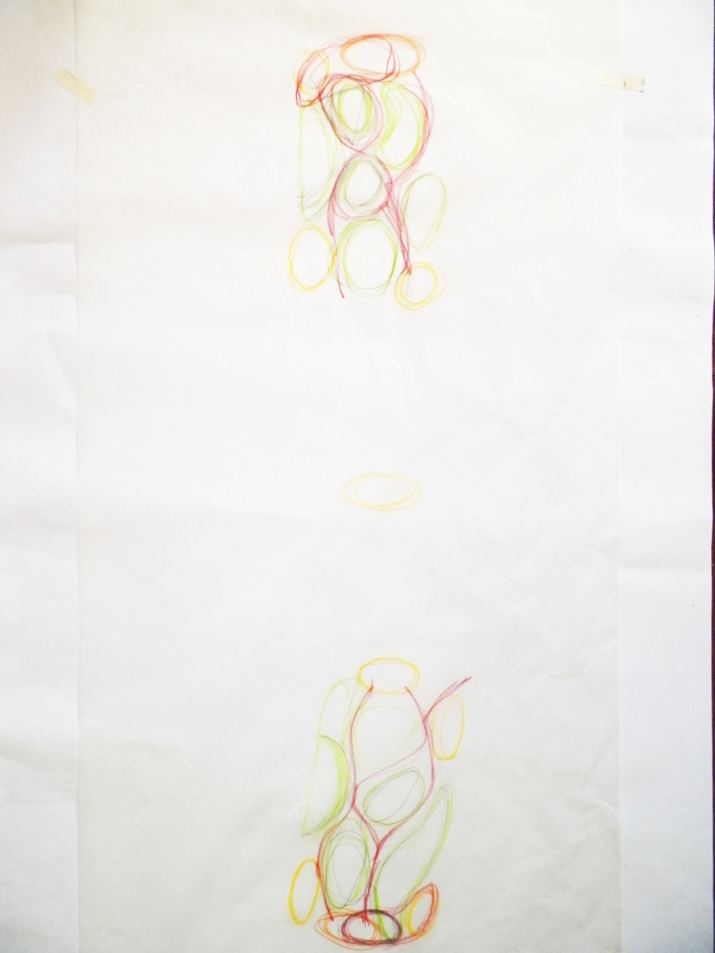
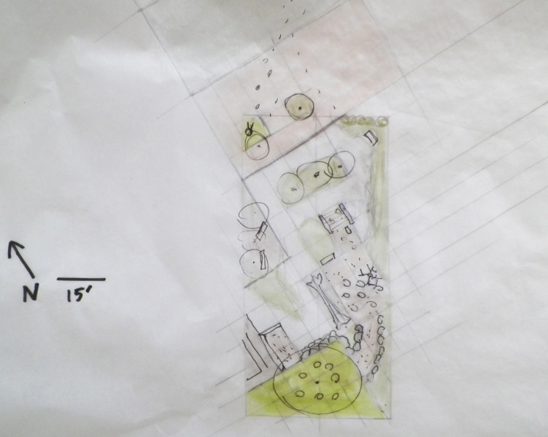
Furthering the Concept

Slide 39
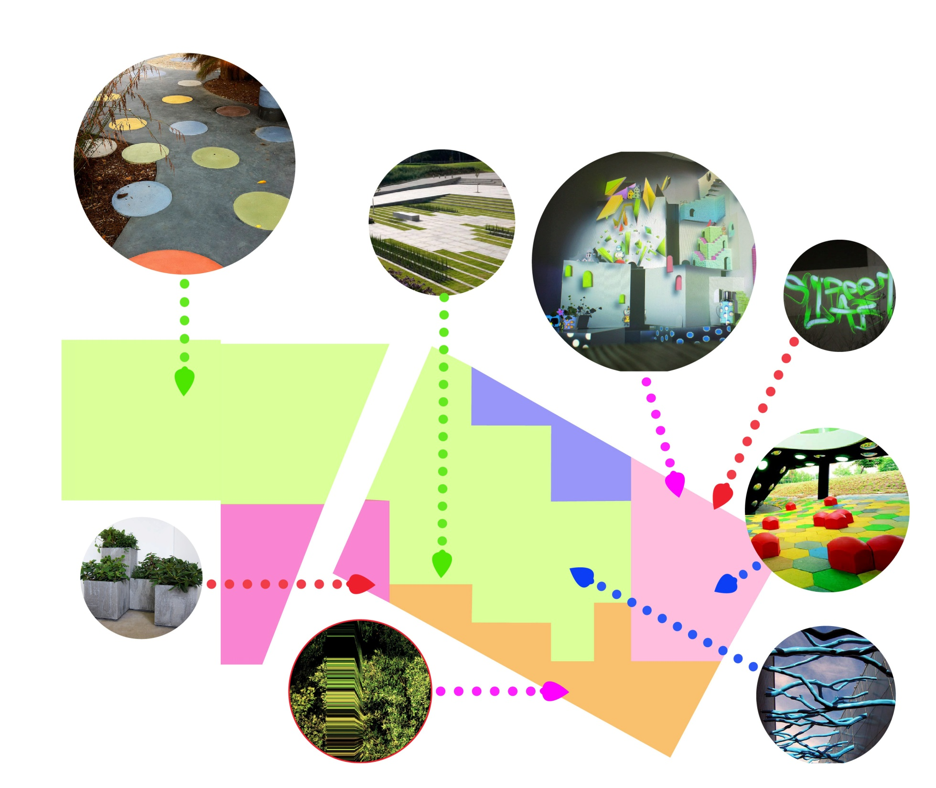

Slide 40
The Narrative

Slide 43
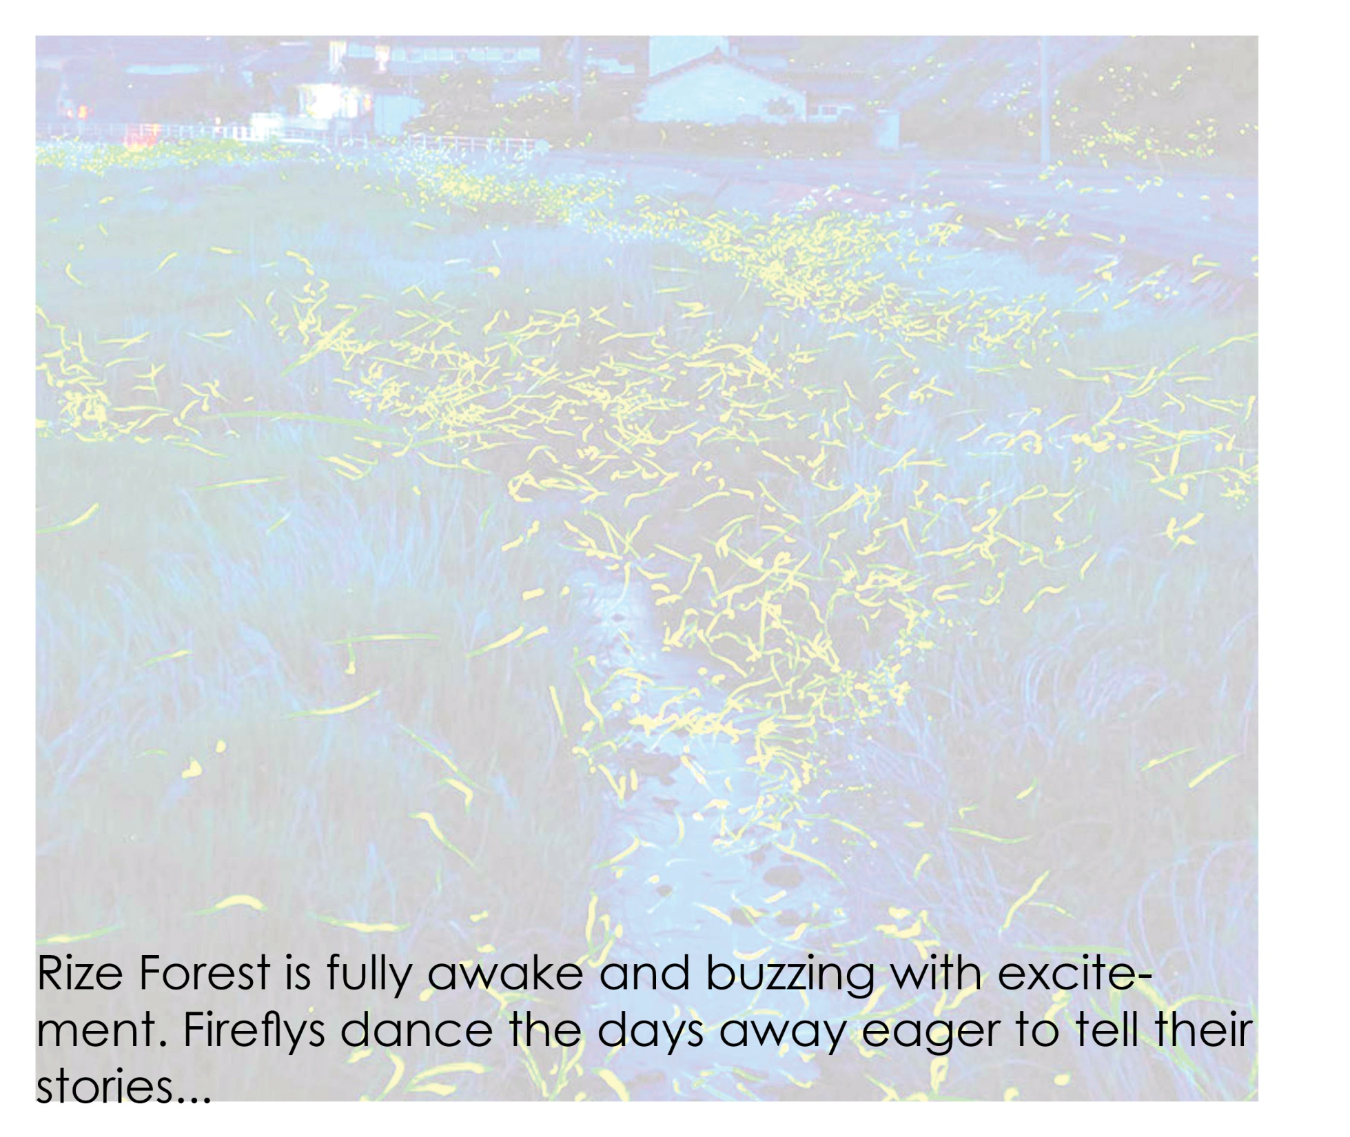

Slide 49
RIZE Forest

