Slide 1
Connecting Patrons to Digital Resources through GIS at the University of Florida
Mark Sullivan
Head of Digital Development and Web Services
Technical Support Services
University of Florida Libraries

Slide 2
GIS Projects
From the Air: the photographic record of Florida's lands
Ephemeral Cities
Unearthing Saint Augustine’s Colonial History

Slide 3
GIS Projects
From the Air: the photographic record of Florida's lands
Ephemeral Cities
Unearthing Saint Augustine’s Colonial History

Slide 4
Aerials Project : Background
160,000+ well used and aging SCS and DOT aerial photographs.
Freely used state-wide by faculty, staff, students, public, and private consultants

Slide 5
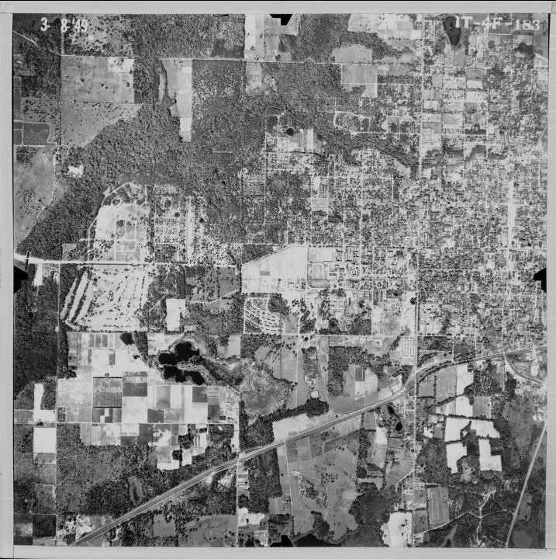
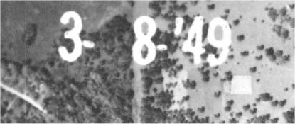
Aerials Project : Air Photo Tile

Slide 6
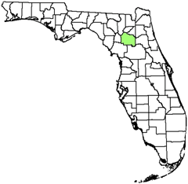
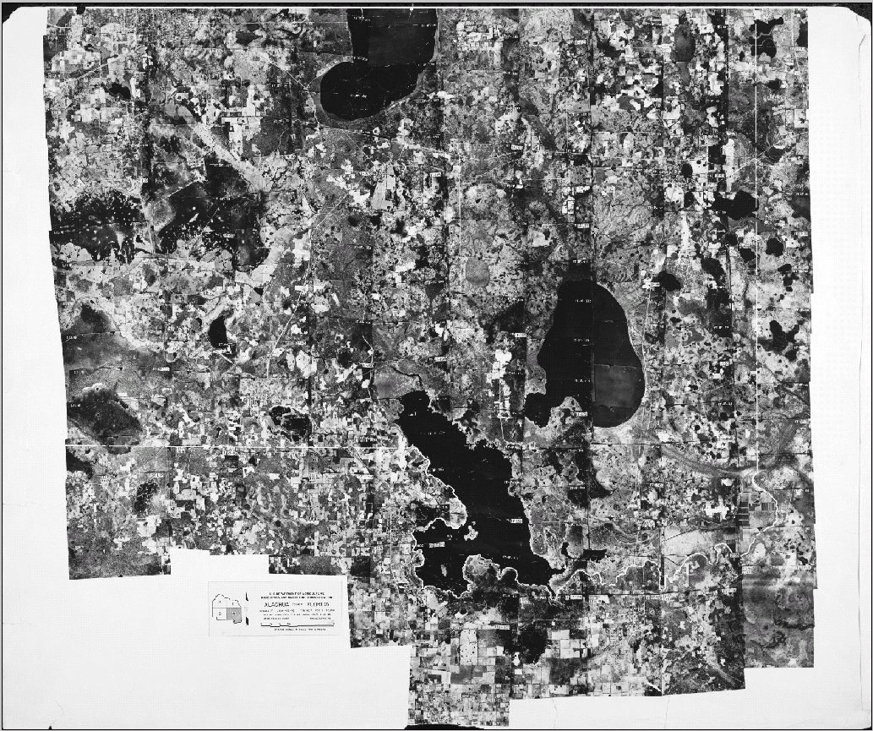
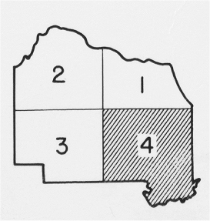
Aerials Project : Photo Tile Index Mosaic

Slide 7
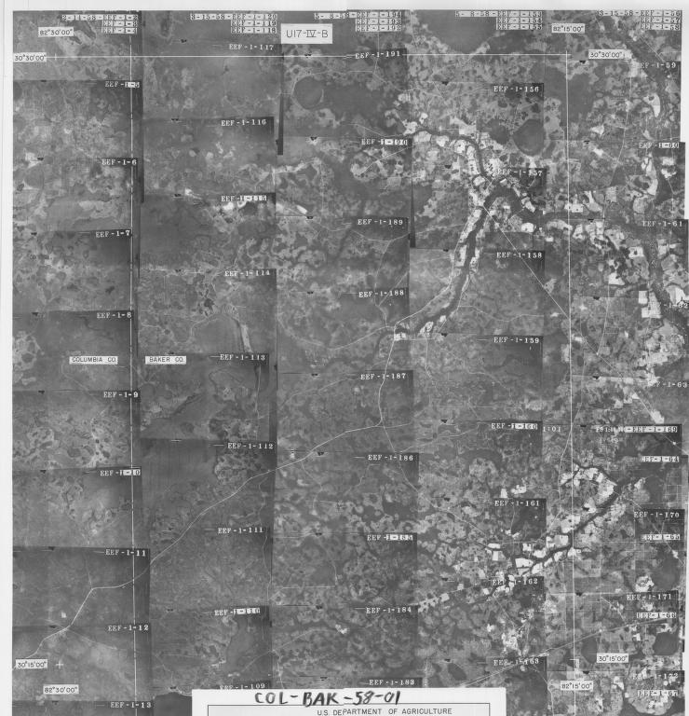

Slide 8
Aerials Project : Goals
Preservation and Access
Create an archival copy of UF’s Historical Aerial Photography Collection
Create a web-based, spatially referenced index to the collection.
Provide remote access to aerial photography

Slide 9
Aerials Project : Objectives
Scan 2,400+ mosaic index sheets
Scan 120,000+ aerial photography tiles
Geographically reference index sheets
Create spatial index database linked to individual air photo tiles
Deliver spatial index and tiles on the web

Slide 10
Aerials Project : Funding
Three Library Services and Technology Act (LSTA) grants
2002-2003, Phase I – 1935 to 1952
2003-2004, Phase II – 1953 to 1970
2009-2010, Phase III – 1971 to 1990

Slide 11
Aerials Project : Collaborative Project
UF’s Digital Library Center (lead)
Map & Imagery Library
Government Documents
Information Technology
Geomatics Program (Civil Engineering)
Florida Center for Library Automation (initially)

Slide 12
Workflow

Slide 13
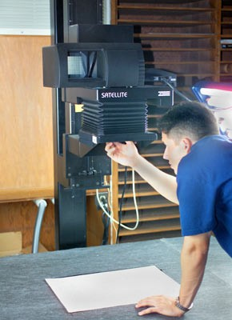
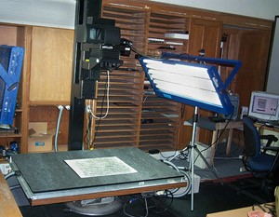
Aerials Project : Mosaic Indexes Image Capture

Slide 14
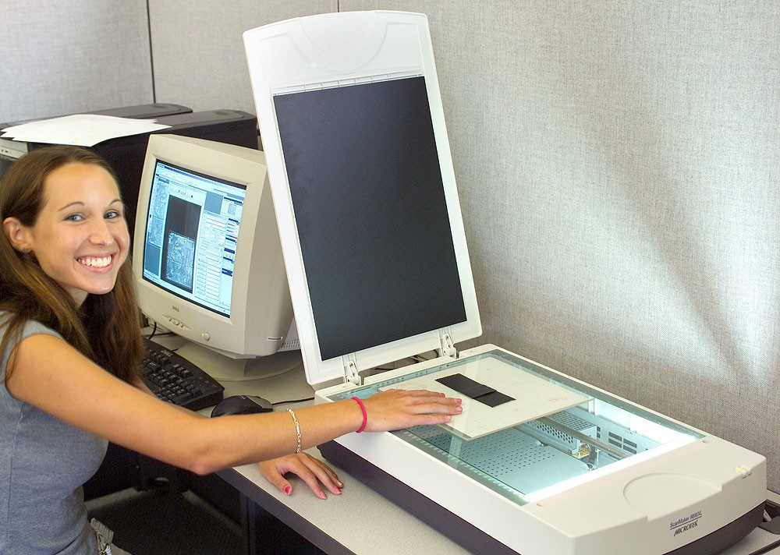
Aerials Project : Aerial Tile Image Capture

Slide 15
Aerials Project : Imaging Issues
Erasing obstructing marks from grease pencil
Flattening curved tiles
Managing large-scale workflow (custom software)
“Chain of custody”
Scanner quality

Slide 16
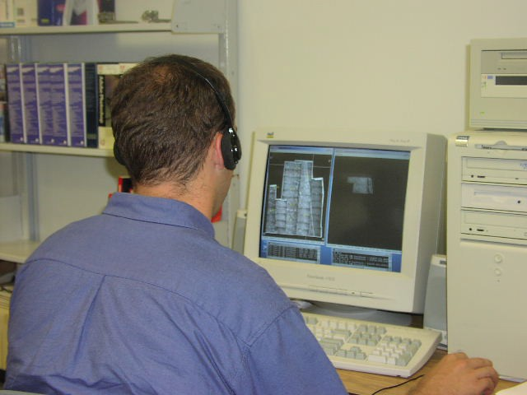
Aerials Project : GIS Creation
People
Software
Hardware
Data

Slide 17
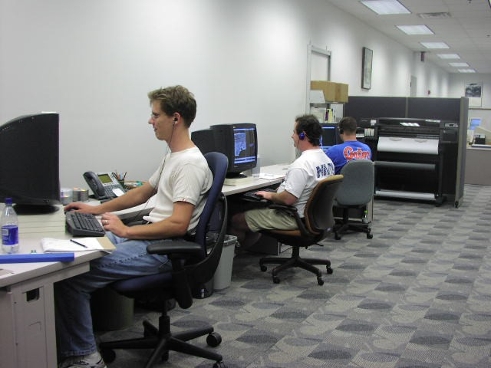
Aerials Project : GIS Creation - People
6 Geomatics students
Summer cooperative program
Minimal Experience

Slide 18
Aerials Project : GIS Creation - Software
Leica’s Erdas Imagine – image post-processing
Adobe Photoshop – image post-processing
ESRI’s ArcGIS
Workstation – Georeferencing/Rectification
ArcMap – Georeferencing QA/QC
ArcIMS – Internet Map Server
Geomatics Coordinate Transformation Program

Slide 19
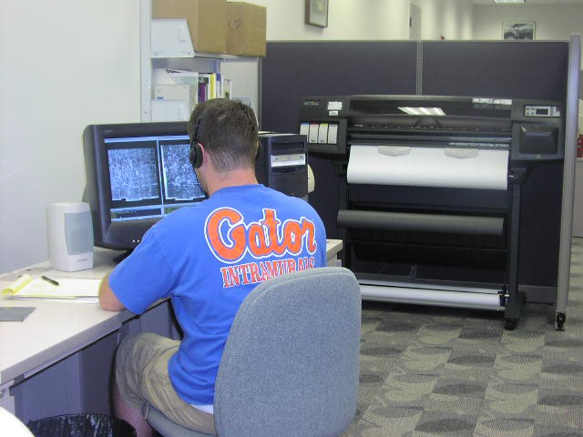
Aerials Project : GIS Creation - Hardware
2 high-end workstations for GIS work
3 additional library computers
Existing server
infrastructure

Slide 20
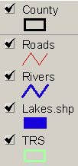
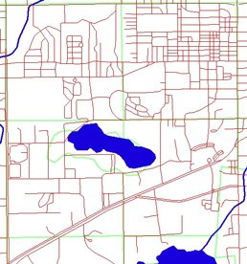
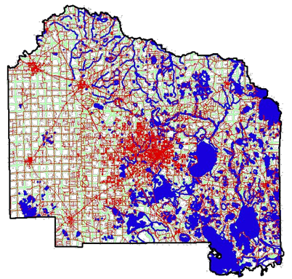
Aerials Project : Ancillary Data Layers Used
67 Counties
3 Meter DOQs
Roads
Rivers
Lakes
TRS
County Boundary

Slide 21
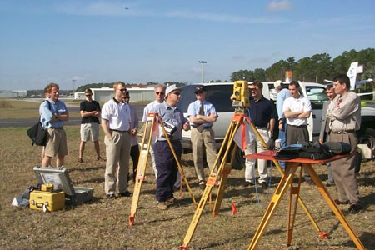
Aerials Project : Ancillary Data Layers Used
www.labins.org
www.dep.state.fl.us/gis
www.fgdl.org

Slide 22
Aerials : Image Processing and GIS Data
Create separate tie (pixel coordinates) and ground control (real world coordinates) layers using Arc Workstation
Transform layers from pixel coordinates to real world coordinates using Geomatics software program
Warp image using Arc Workstation
QA/QC warped image using ArcMap
Create photo tile point layer and value
Add to database

Slide 23
Aerials Project : Index Mosaic Issues

Slide 24
Aerials Project : Tie layer

Slide 25
Aerials Project : Ground Control Layer
Aerial Mosaic Index
Digital Orthophoto Quarter Quads (1meter)

Slide 26
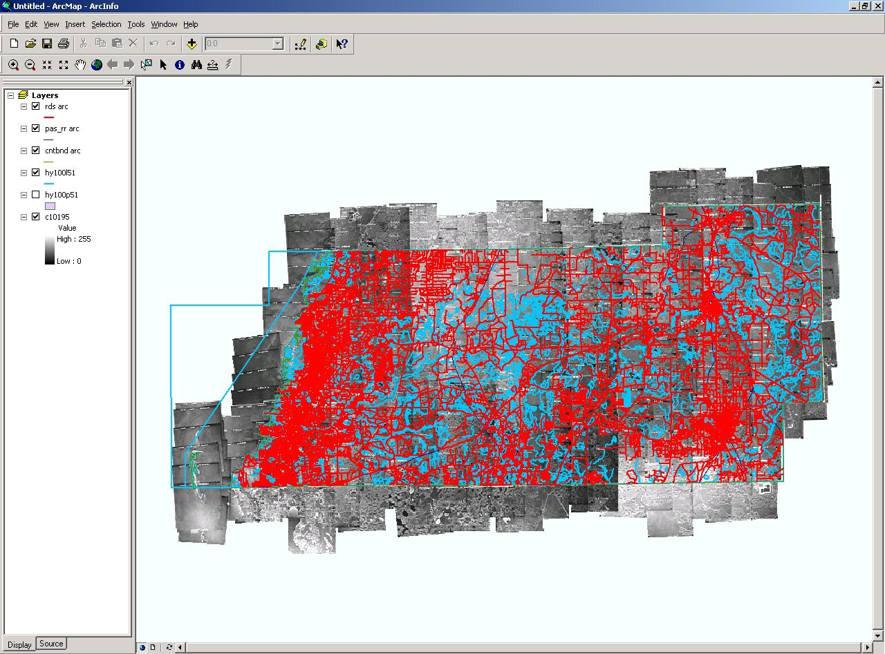
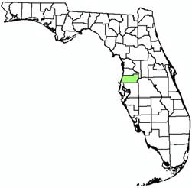
Aerials Project : Real World Warped Image

Slide 27
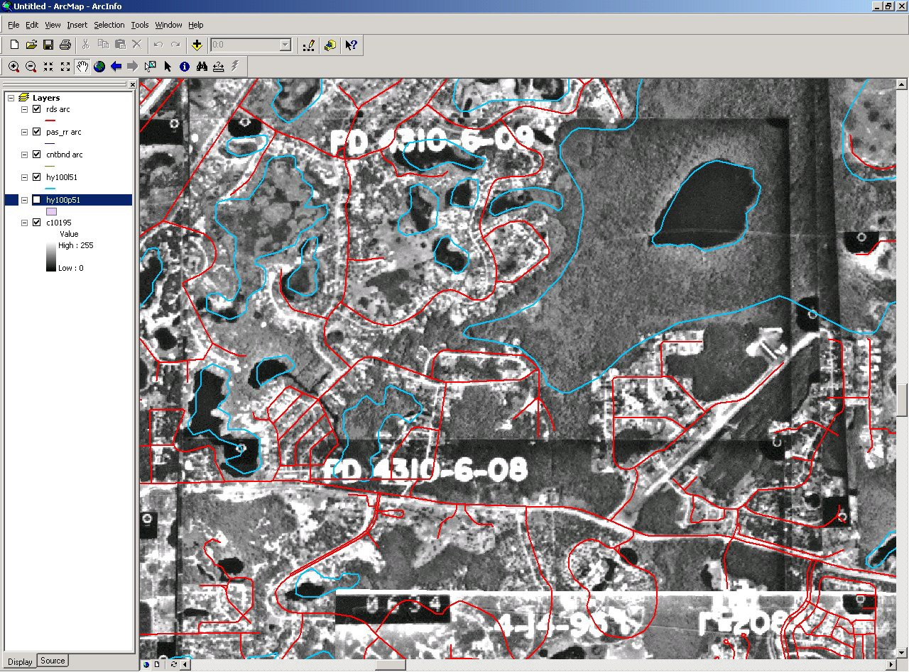
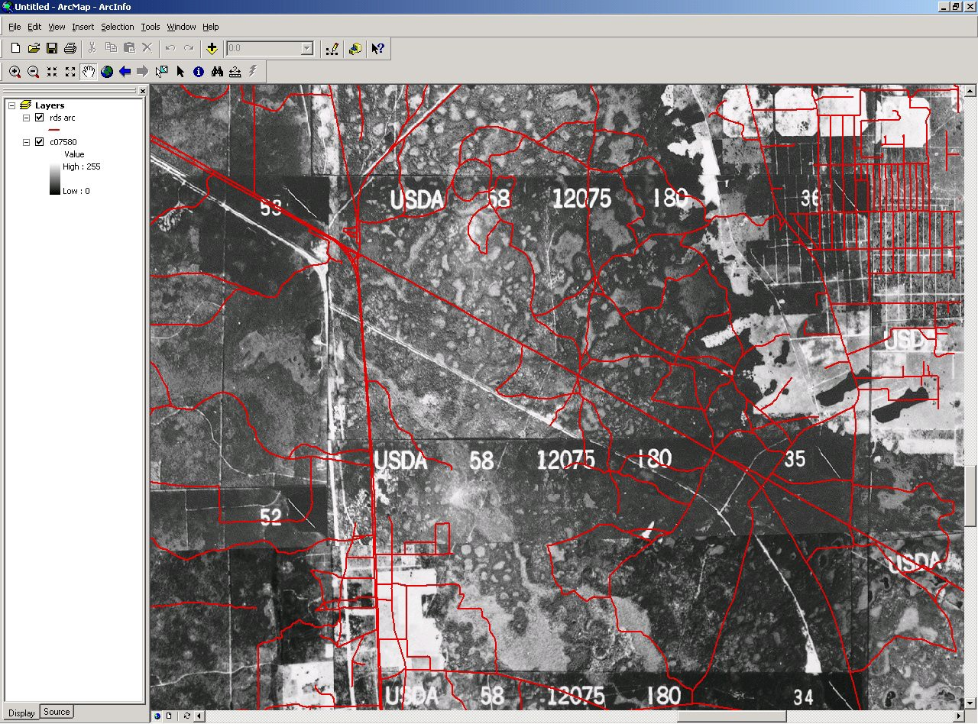
Aerials Project : ArcMap Visual QA/QC
ACCEPTED
REJECTED

Slide 28
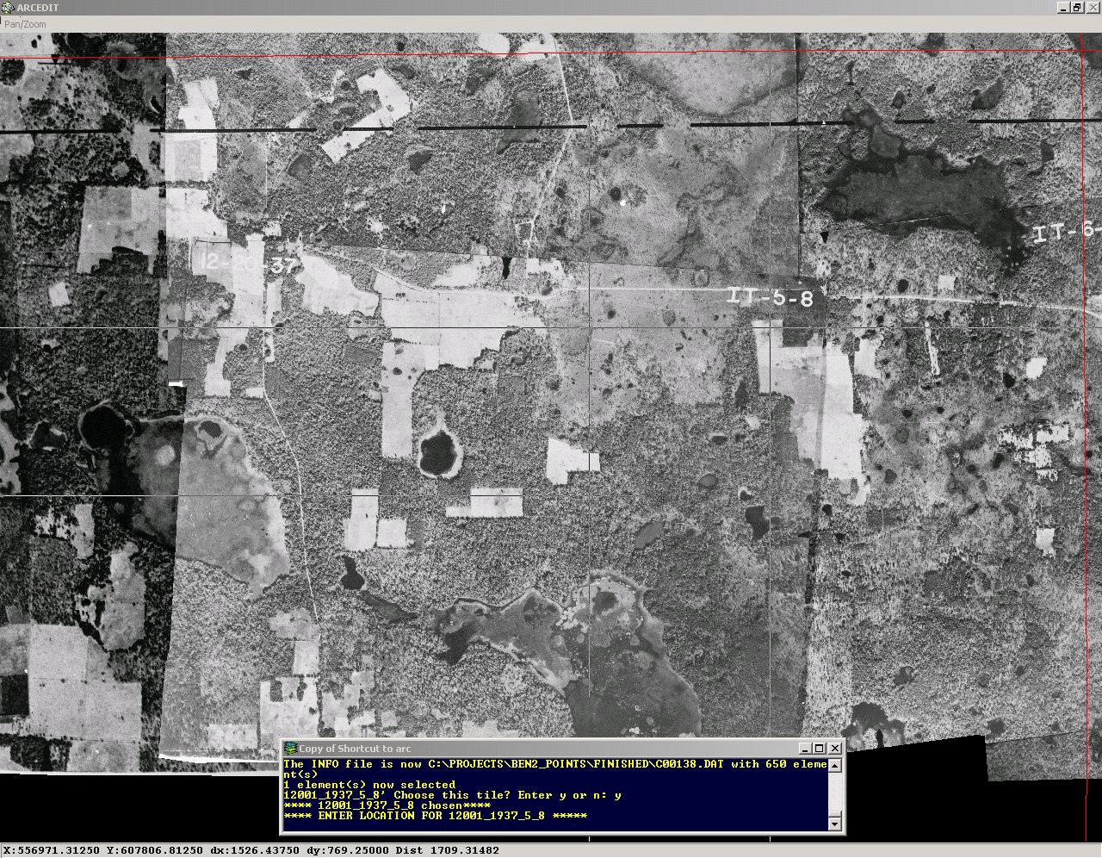
Aerials Project : Photo Tile Point Layer
TILE NAME
POINT LOCATION

Slide 29
Aerials Project : Additional Search Fields
Assigned additional fields using ESRI’s ArcMap
Township and Range
City and County
USGS Quad Name, DOQQ (NW, SW, NE, SE)
Zip Code

Slide 30
Aerials Project : Central Question / Error
Are desktop scans sufficient for historical observations using GIS?
Observed error of 5 to 15 meters
Over 4 million hits

Slide 31
Aerials Project : Map Servers
GIS Interface
Based on ESRI’s ArcIMS
SobekCM Digital Repository
Google-based Interface

Slide 32
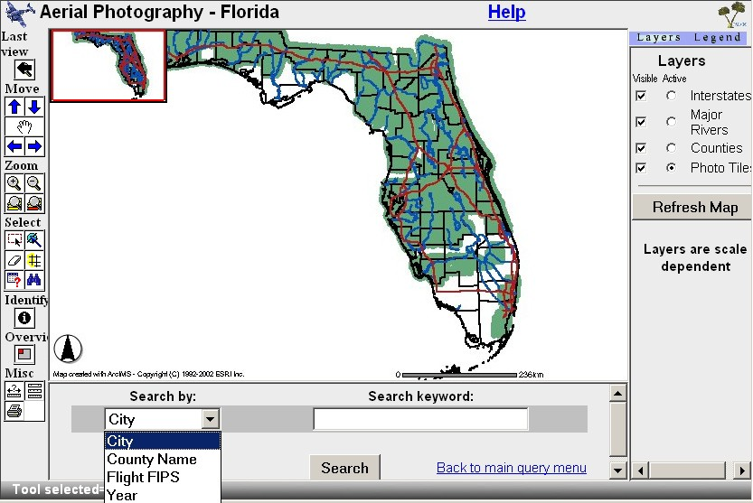
Aerials Project : GIS Interface

Slide 33
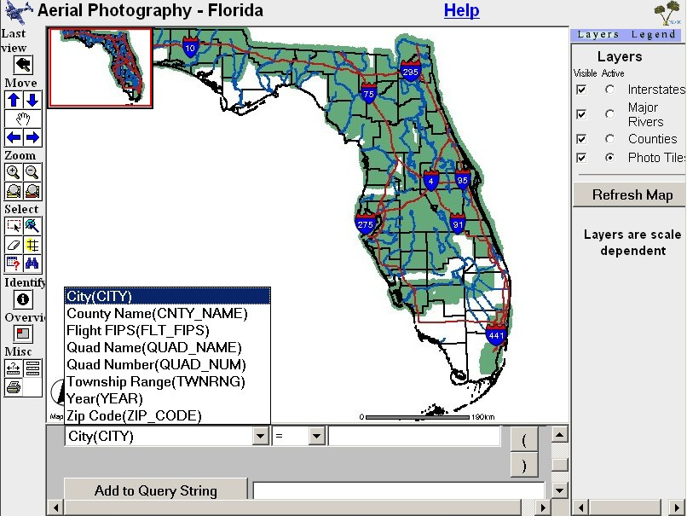
Aerials Project : GIS Interface

Slide 34
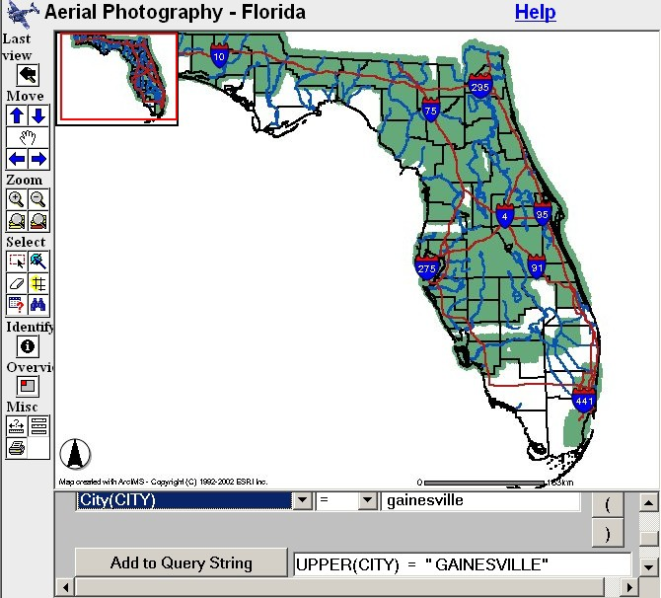
Aerials Project : GIS Interface

Slide 35
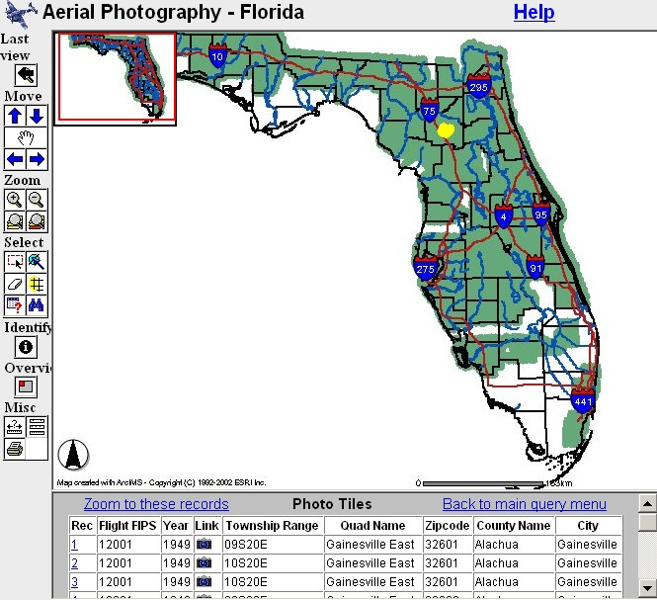
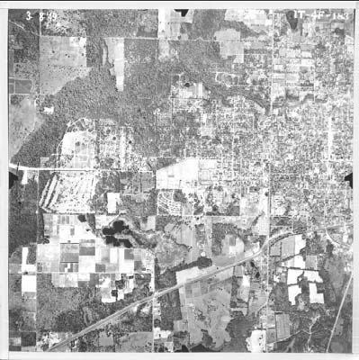
Aerials Project : GIS Interface

Slide 36
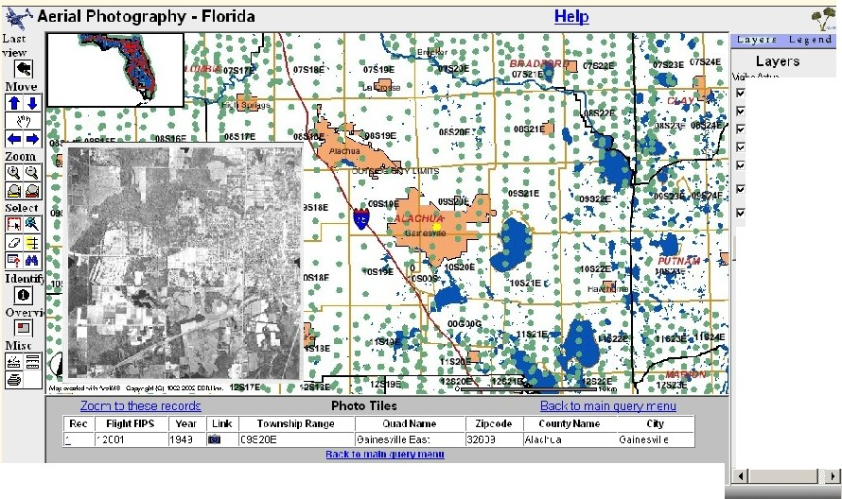
Aerials Project : GIS Interface

Slide 37
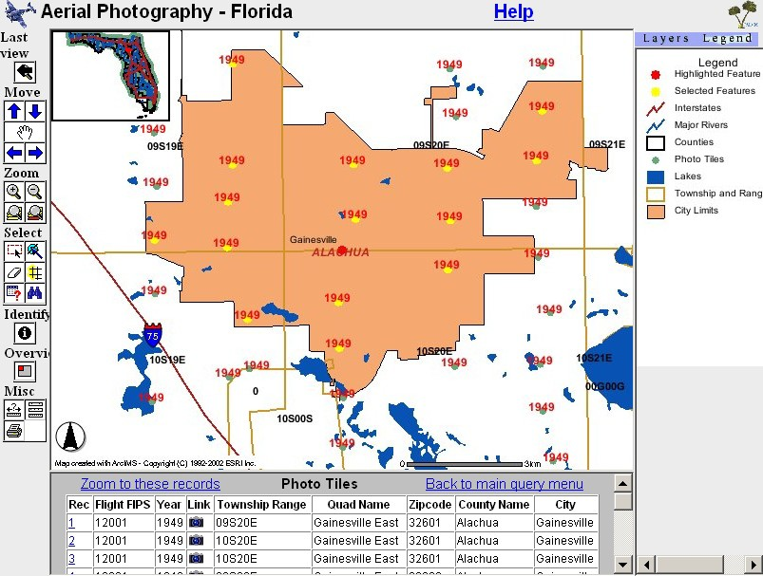
Aerials Project : GIS Interface

Slide 38
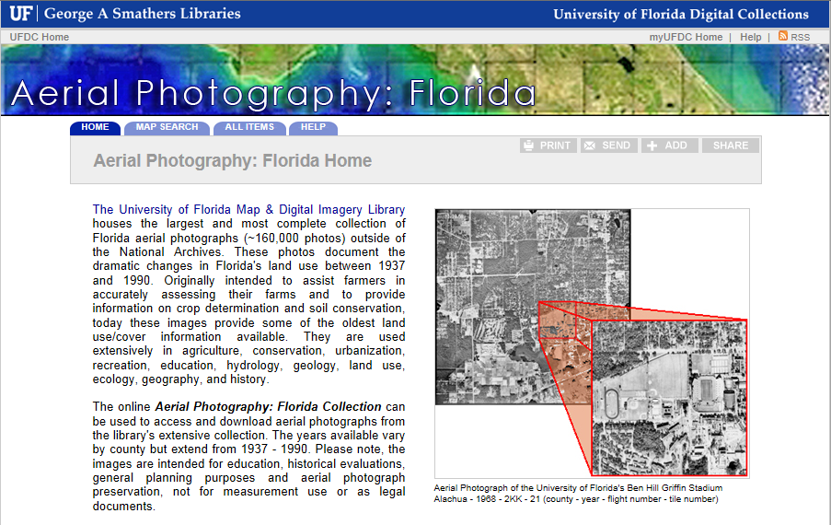
Aerials Project : Digital Collection
http://ufdc.ufl.edu/aerials

Slide 39
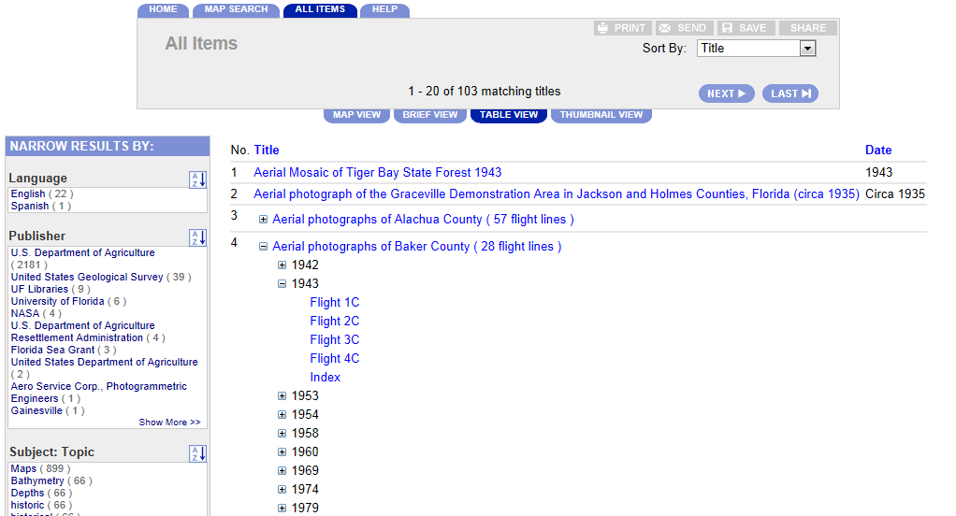
Aerials Project : Digital Collection
http://ufdc.ufl.edu/aerials

Slide 40
Aerials Project : Google-based Interface
Access to download aerial tiles as high-resolution JPEG2000
Ability to represent the tiles as rectangles, rather than points
Calculated rectangles from the point, using point and scale (altitude) information
Simple, familiar search interface

Slide 41
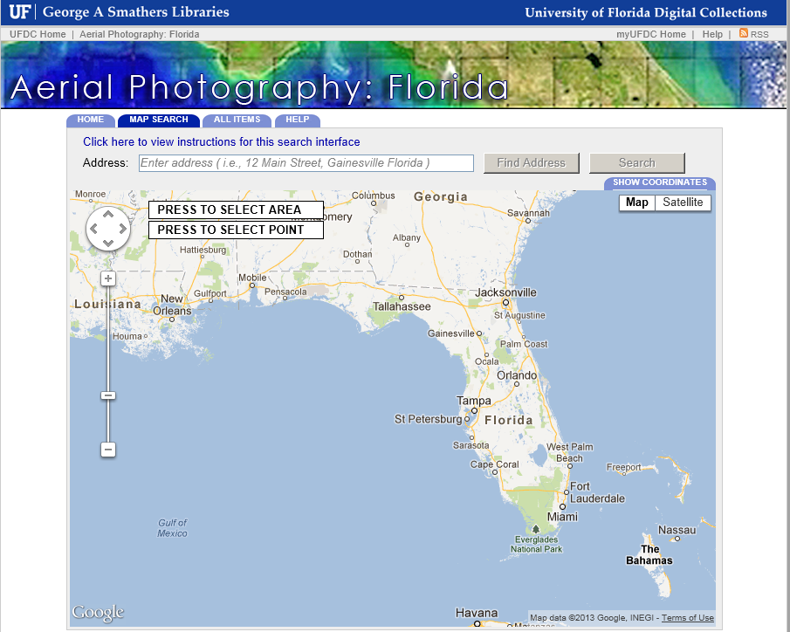
Aerials Project : Google-based Interface

Slide 42
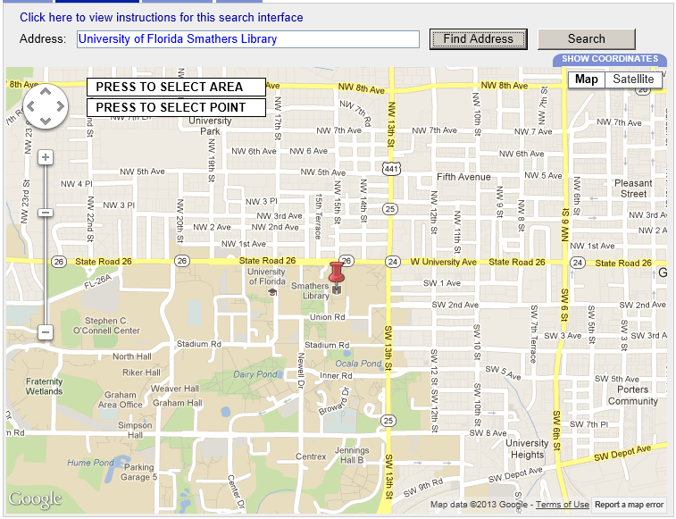
Aerials Project : Google-based Interface
Reverse Geo-Coding : Address → Point

Slide 43
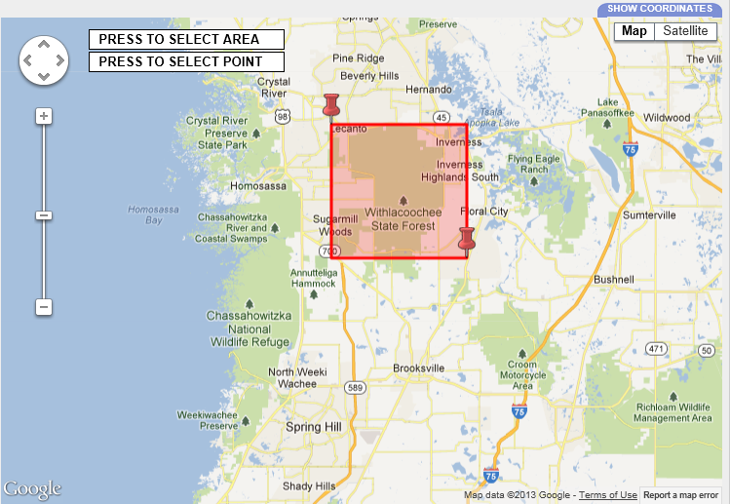
Aerials Project : Google-based Interface
Searching an Area

Slide 44
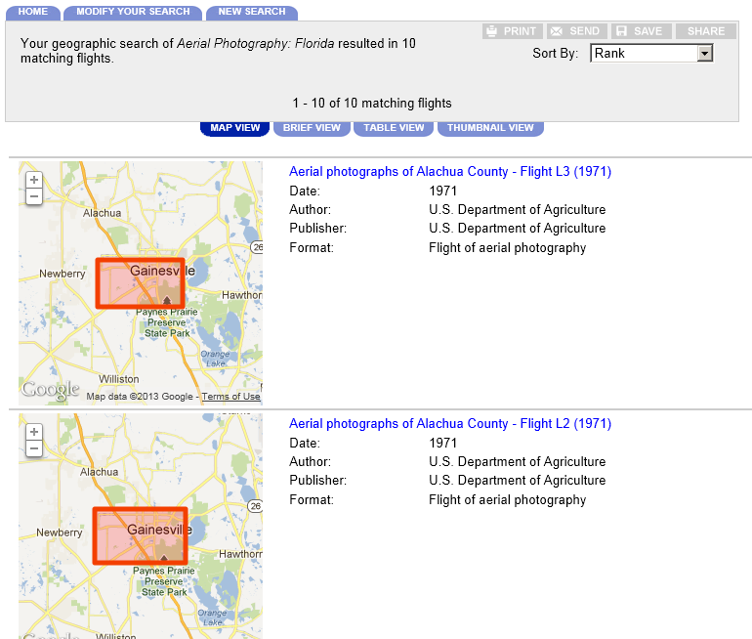
Aerials Project : Google-based Interface

Slide 45
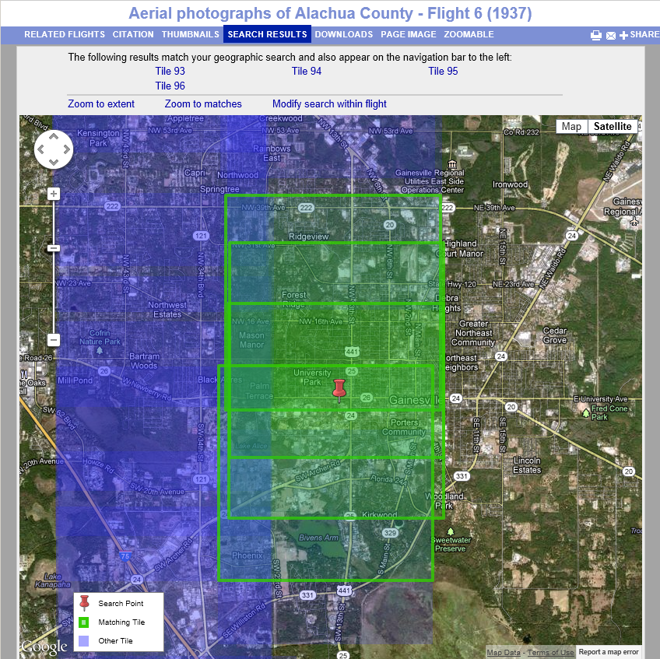
Aerials Project : Google-based Interface

Slide 46
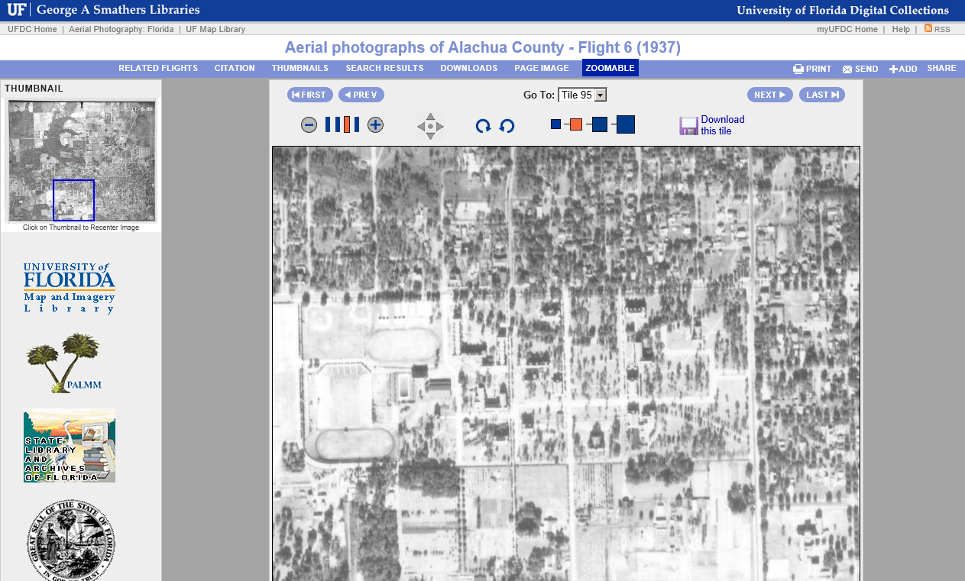
Aerials Project : Google-based Interface

Slide 47
GIS Projects
From the Air: the photographic record of Florida's lands
Ephemeral Cities
Unearthing Saint Augustine’s Colonial History

Slide 48
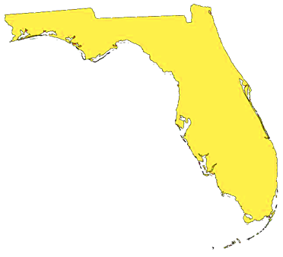
Ephemeral Cities : Focus
Ephemera
Gainesville
Key West
Tampa
1880-1910

Slide 49
Ephemeral Cities : Goals
Preservation and Access
Place histories in geographic context and link to digital resources
Build a query method to support browsing the data

Slide 50
Ephemeral Cities : Funding
Institute of Museum and Library Services Grant
2004-2005

Slide 51
Ephemeral Cities : Collaborative Project
University of Florida
Florida International University
University of South Florida
Alachua County Library District
Alachua County Ancient Records Department
Matheson Historical Center & Museum (Gainesville)
Monroe County Public Library
City of Key West, Florida
Key West Arts & Historical Society
South Florida Water Management District
Henry B. Plant Museum (Tampa)
Tampa Bay History Center

Slide 52
Ephemeral Cities : Objective
Objective: Place histories in geographic context and link to digital resources.
“There is properly no history, only biography”
– Ralph Waldo Emerson

Slide 53
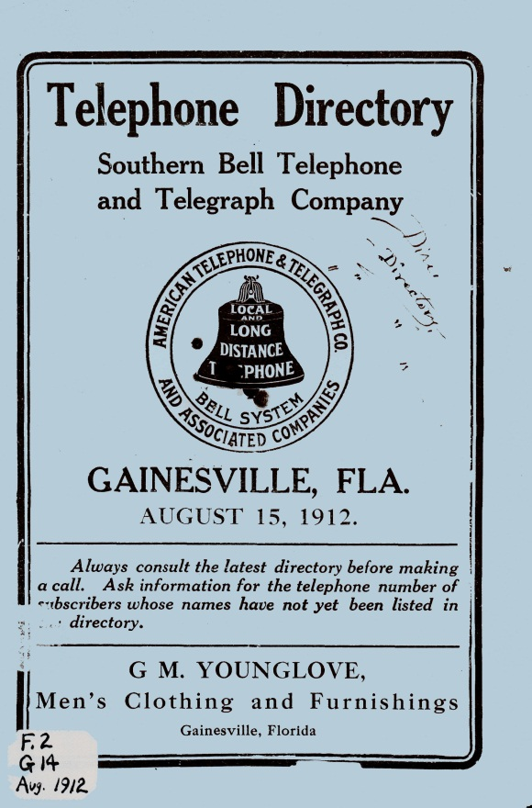
Ephemeral Cities : Name Data Sources
Data:
People
Families
Companies
Governments, etc..
Sources:
City Directories
Telephone Books
Other name-rich resources

Slide 54
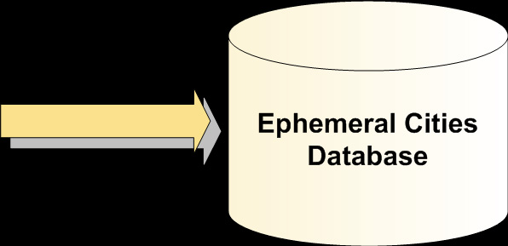
Ephemeral Cities : From Page to Data

Slide 55
Ephemeral Cities : From Page to Data
Four steps to convert from image to data:
Page image processed by Optical Character Recognition [OCR] Engine to obtain text
Custom parsing software converts text into spreadsheets
Spreadsheets manually reviewed for errors and corrected
Corrected spreadsheets loaded into relational database

Slide 56
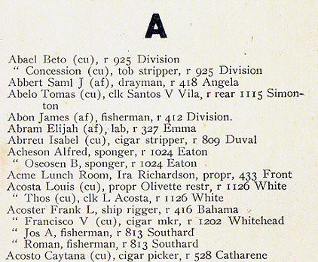
Ephemeral Cities : From Page to Data
Step 1: Page image processed by Optical Character Recognition [OCR] Engine to obtain text

Slide 57
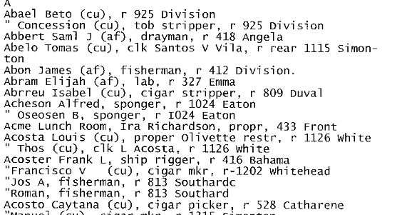
Ephemeral Cities : From Page to Data
Step 1: Page image processed by Optical Character Recognition [OCR] Engine to obtain text

Slide 58
Ephemeral Cities : From Page to Data
Step 2: Custom parsing software converts text into spreadsheets

Slide 59
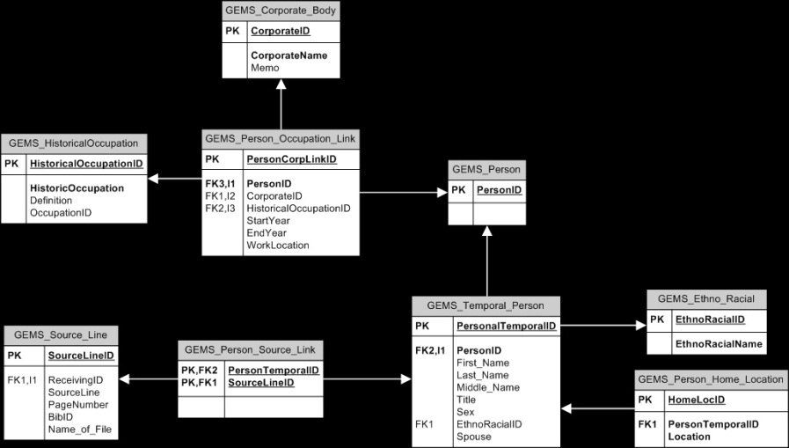
Ephemeral Cities : From Page to Data
Step 3: Spreadsheets manually reviewed for errors and corrected
Step 4: Corrected spreadsheets loaded into relational database

Slide 60
Ephemeral Cities : Objective
Objective: Place histories in geographic context and link to digital resources.

Slide 61
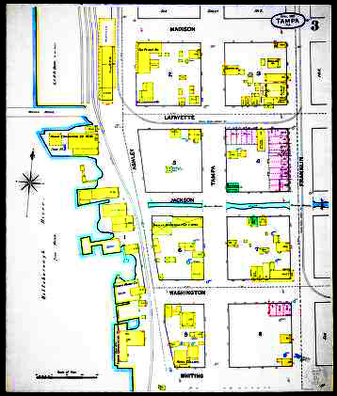
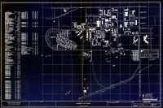
Ephemeral Cities : Geographic Data Sources
Data:
Spatial Coordinates
Cities
Buildings
Streets, etc..
Sources:
Maps
Plans
Sanborn Maps of Florida

Slide 62
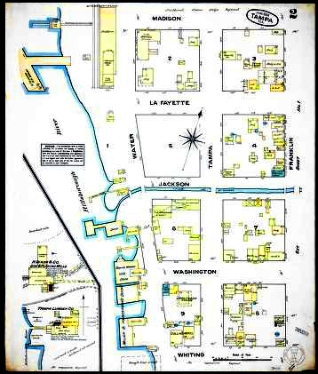
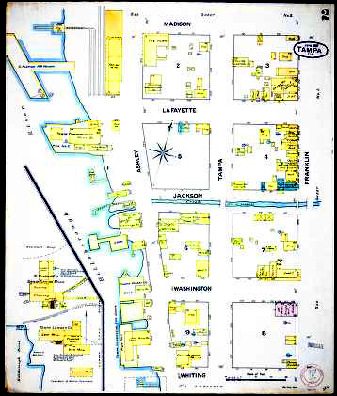
Ephemeral Cities : Geographic Data Sources
Tampa, Florida
1884
1887
1889

Slide 63
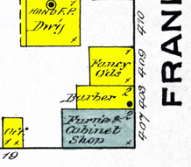
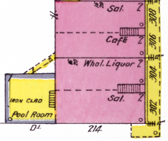
Ephemeral Cities : Geographic Data Sources
↑
Fancy Oils
Barber
Cabinet Shop
Mostly Wooden Structures
↑
Saloon
Café
Wholesale Liquor
Saloon
Mostly Brick
Structures
Yellow = Wooden Structure Blue/Green = Stone Structure Red/Pink = Brick Structure

Slide 64
Ephemeral Cities : Map to Data

Slide 65
Ephemeral Cities : Map to Data
Four steps to convert from map image to data:
Map image is geo-rectified, placing it in the larger geographic context of the world.
Individual features indexed from the map image
Features matched between maps from different years
Geographic data loaded into the growing database

Slide 66
Ephemeral Cities : Map to Data
Step 1: Map image is geo-rectified, placing it in a larger geographic context.
Establishes the relationship between page coordinates (i.e. x,y) of a planar map of image with known real-world coordinates (i.e. latitude, longitude)
Control points, points with known real-world coordinates, are used during this process.
Once complete, every point on the map corresponds to a real-world coordinate point.

Slide 67
Ephemeral Cities : Map to Data
Step 2: Individual features indexed from the map image
A new GIS point layer is added to the map.
Each building is identified by placing a point feature on the map.
Additionally, the following information is recorded:
- Use Description (i.e. ‘Saloon’, ‘Dwelling’, ‘Hotel’)
- Street Number
- Street
- Location Description
- Block number and sheet number (if applicable)

Slide 68
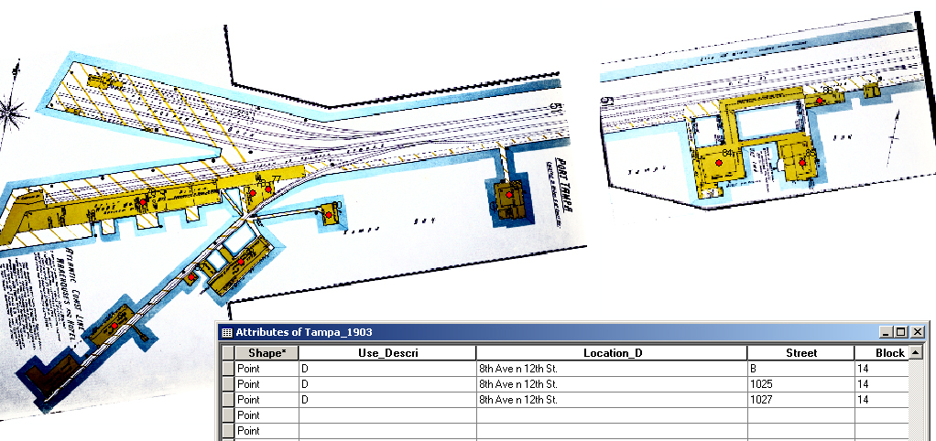
Ephemeral Cities : Map to Data

Slide 69
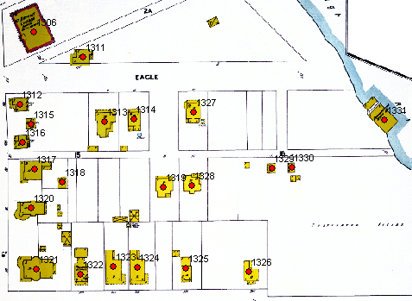
Ephemeral Cities : Map to Data

Slide 70
Ephemeral Cities : Map to Data
Step 3: Features matched between maps of different years
All the maps for a city are loaded into the ArcIMS GIS software.
Fading between maps of different years allows assistants to visually identify buildings and features which are common between the different years.
This building and feature information is saved so the data reflects that a feature which spans the map years appears only as one feature or building.
For example, the Alachua Hotel in may be in the same building he Gainesville Hotel occupied in 1912.

Slide 71
Ephemeral Cities : Map to Data
Step 4: Geographic data loaded into the growing database

Slide 72
Ephemeral Cities : Objective
Objective: Place histories in geographic context and link to digital resources.

Slide 73
Ephemeral Cities : Digital Resources
Sources:
Government Records
Books
Monographs
Pamphlets
Photographs
Postcards
Newspapers
Artifacts

Slide 74
Ephemeral Cities : Database Architecture

Slide 75
Ephemeral Cities : Objective
Objective: Build a query method to support browsing the data.
Requirements:
Must be web based
Needs to be simple to use
Must support sophisticated research needs
Geographic Interface

Slide 76
Ephemeral Cities : Query Tool Architecture

Slide 77
Ephemeral Cities : Difficulties
Data overload!
Not enough tools
No digital repository
architecture
Are we ready now?
Photo credit: Mary Schneider ( ICT-KM)

Slide 78
GIS Projects
From the Air: the photographic record of Florida's lands
Ephemeral Cities
Unearthing Saint Augustine’s Colonial History

Slide 80
USACH : Focus
St. Augustine
1500 – 1750
Pre-historic

Slide 81
USACH : Goals
Preservation and Access
Digitization of new materials regarding colonial St. Augustine
Geo-Spatial / Temporal search mechanism
Make geo-placement of maps and photographs more accessible

Slide 82
USACH : Funding
National Endowment of Humanities
August 2012 – April 2014

Slide 83
USACH : Collaborative Project
University of Florida Libraries
St. Augustine Government House
St. Augustine Historical Society
City of St. Augustine Archeology Department
Museum Studies, UF

Slide 84
USACH : Stay Tuned!
Main interface and most digitization complete by January 2014.

Slide 85
GIS Projects
From the Air: the photographic record of Florida's lands
Ephemeral Cities
Unearthing Saint Augustine’s Colonial History

Slide 86
Contact & Links
Mark Sullivan
George A. Smathers Libraries
University of Florida
MarSull@uflib.ufl.edu
http://ufdc.ufl.edu/aerials
http://ufdc.ufl.edu/usach

Slide 87
Credits
Joe Aufmuth, Stephanie Haas, et al. From the Air creating a GIS and Web Interface to Historical Aerial Photography, University of Florida Digital Collections, 2002.
Erich Kesse, Mark Sullivan. Ephemeral Cities Presentation, University of Florida Digital Collections, 2005.

