Slide 1
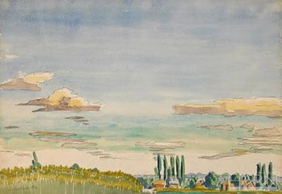
Samuel P. Harn Museum of Art
Langley Foyer Exhibition Proposal
Framing the Frame
Kathleen Boyle
Laura Ferrante
Hannah Soh
April 20, 2011
Charles Ephraim Burchfield, Long Summer Evening, 1916
Notes:
Initial thank yous, exhibition seminar, names

Slide 2
What is
Framing the Frame?
An opportunity for visitors to visually engage with various frames and framing techniques as well as provide the foundation and tools to critically think about the broader context of frames in an art museum

Slide 3
Big Idea:
Museum practice structures our understanding of objects through framing techniques.

Slide 4
Exhibition Proposal
Notes:
Framing the Frame is an exhibition that aims to draw attention to frames and framing devices in the art museum in order to make people think about the way display influences their understanding of art. This will be illustrated through both innovative and traditional display methods. We plan to represent the Harn’s collection by using works from all curatorial departments.

Slide 5
Proposal Package
Abstract
Introductory wall panel
Object checklist and images
Object labels
Layout and design
Education and outreach
Aiming and Framing
Frame Quest
Frame the Art Museum
Educational Guide
Press release
Digital copy

Slide 6
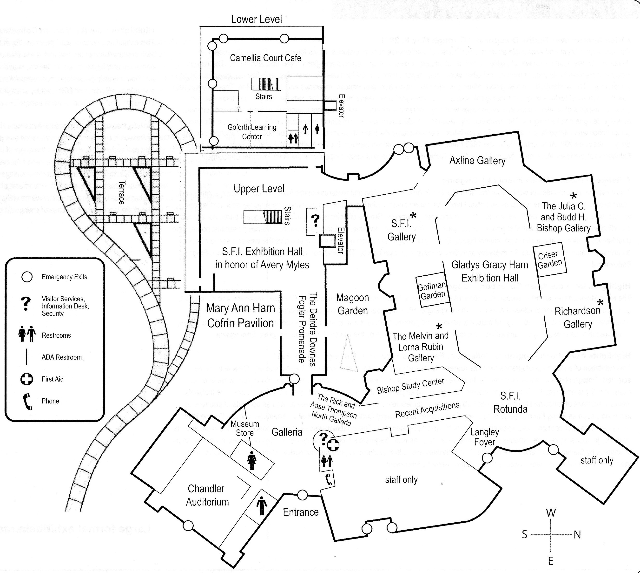

Slide 7
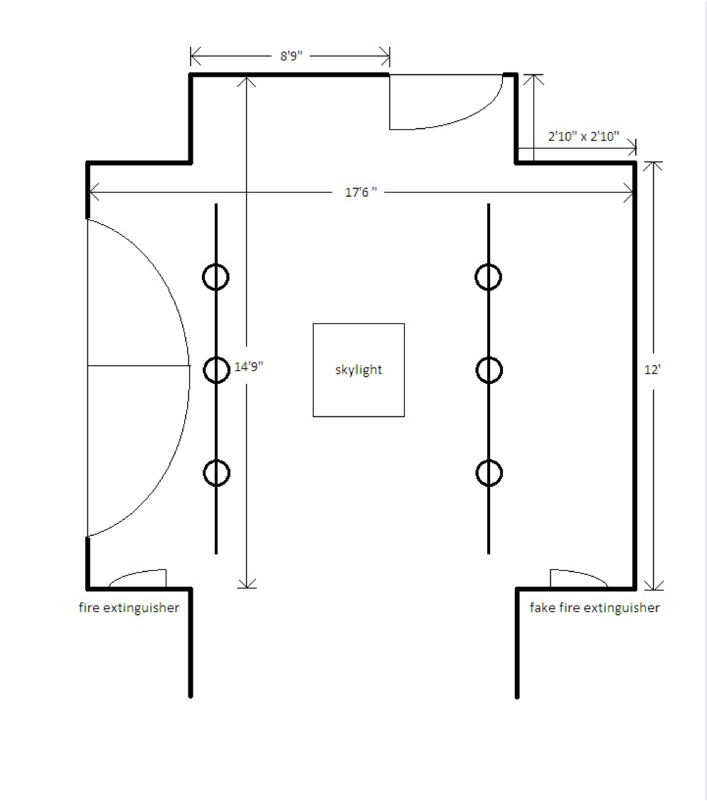

Slide 8
Framing the Frame
The task of any discussion of frames and framing in the arts is first and foremost to counter the tendency of the frame to invisibility with respect to the artwork. We see the artwork, but we do not see the frame.
-Paul Duro, The Rhetoric of the Frame
Why do frames matter? The picture frame is a tool that has existed for centuries. Established as a fine art tradition, frames are commonly accepted as devices that make works of art appear more attractive. Yet, frames serve more than a decorative function.
Framing the Frame invites viewers to engage critically with various framing methods within an art museum. From different styles of picture frames to design techniques used for displays, this exhibition outlines the functions of frames as a means of influencing one’s understanding of art. Why do we use frames? How do frames shape the ways we see art? What are examples of non-traditional frames?
The frame serves an important purpose; it becomes a window, through which viewers see art. Framing the Frame will highlight the ways in which frames perform this duty, both within the exhibition and throughout other galleries in the Harn. By drawing attention to the image within, the border of the frame mediates as a boundary between the outside world and art. Museum visitors ignore frames, focusing instead on the works of art they contain. It is time to see the frame.

Slide 9
5
4
3
6
7
2
8
1

Slide 10
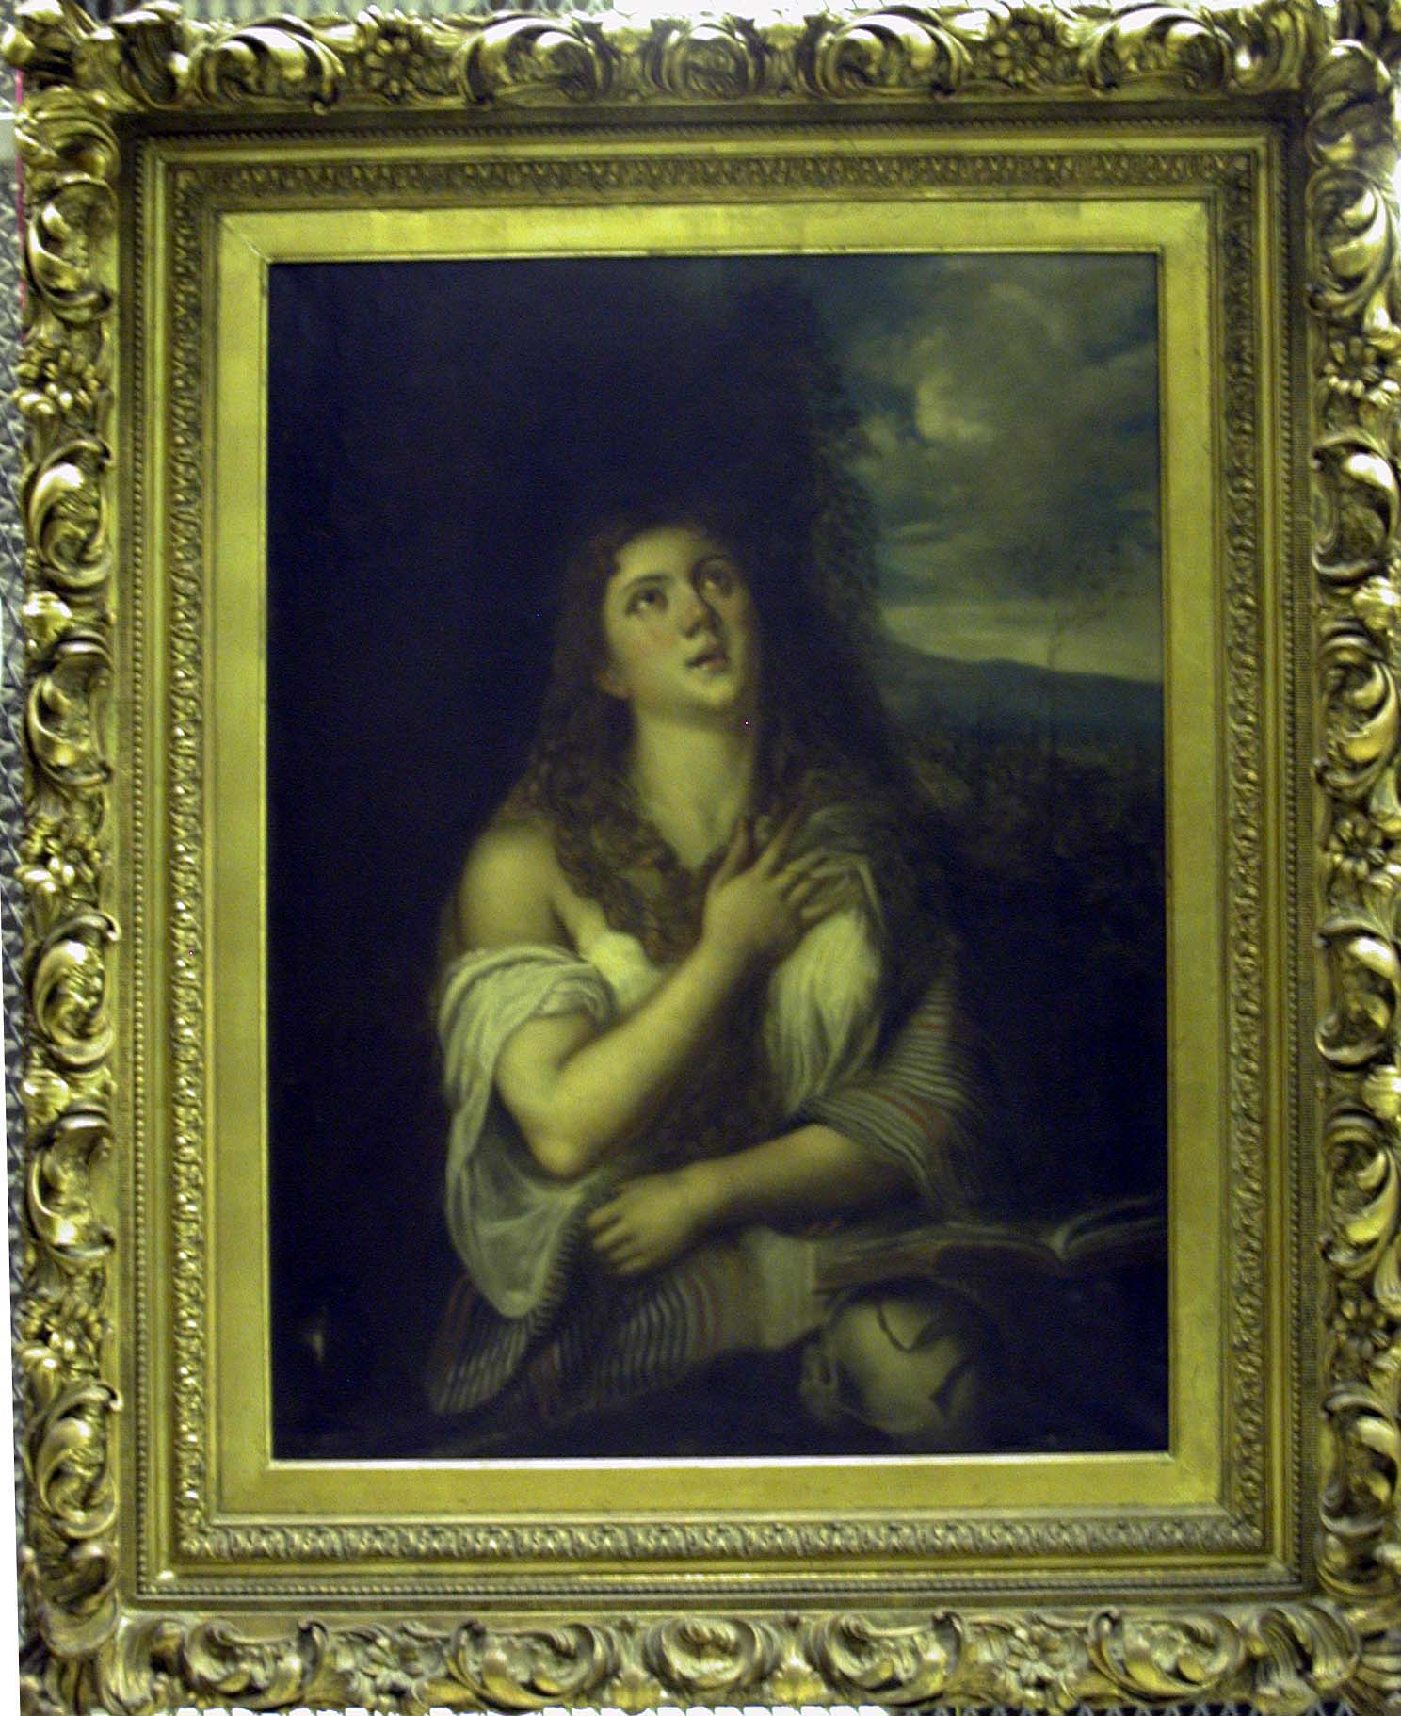
1

Slide 11
Unknown
Copy after Titian’s The Penitent Magdalene
19th Century
Oil on canvas
40 x 30 in. (101.6 x 76.2 cm)
framed: 55 1/2 x 45 1/2 in. (141 x 115.6 cm)
PA-83-4
Gift of Jeannean Green
The use of frames in Europe began with small panel paintings in the 12th and 13th century. Initially, the frames and the paintings were made from the same piece of wood. Over time, the more efficient method of the engaged frame emerged. This process attaches wooden custom fit molding to flat wooden panels for the artwork.
Prior to the Renaissance, many frames in Europe were customized architectural elements. During the 14th century, a rise in arts patronage necessitated frames with more portability. The portable, removable frame became an essential component in the display of painting on canvas. Most present-day frames are still based upon this model—a three-dimensional border that accents the artwork it borders.
Framing method: gilded frame, hang at eye level

Slide 12
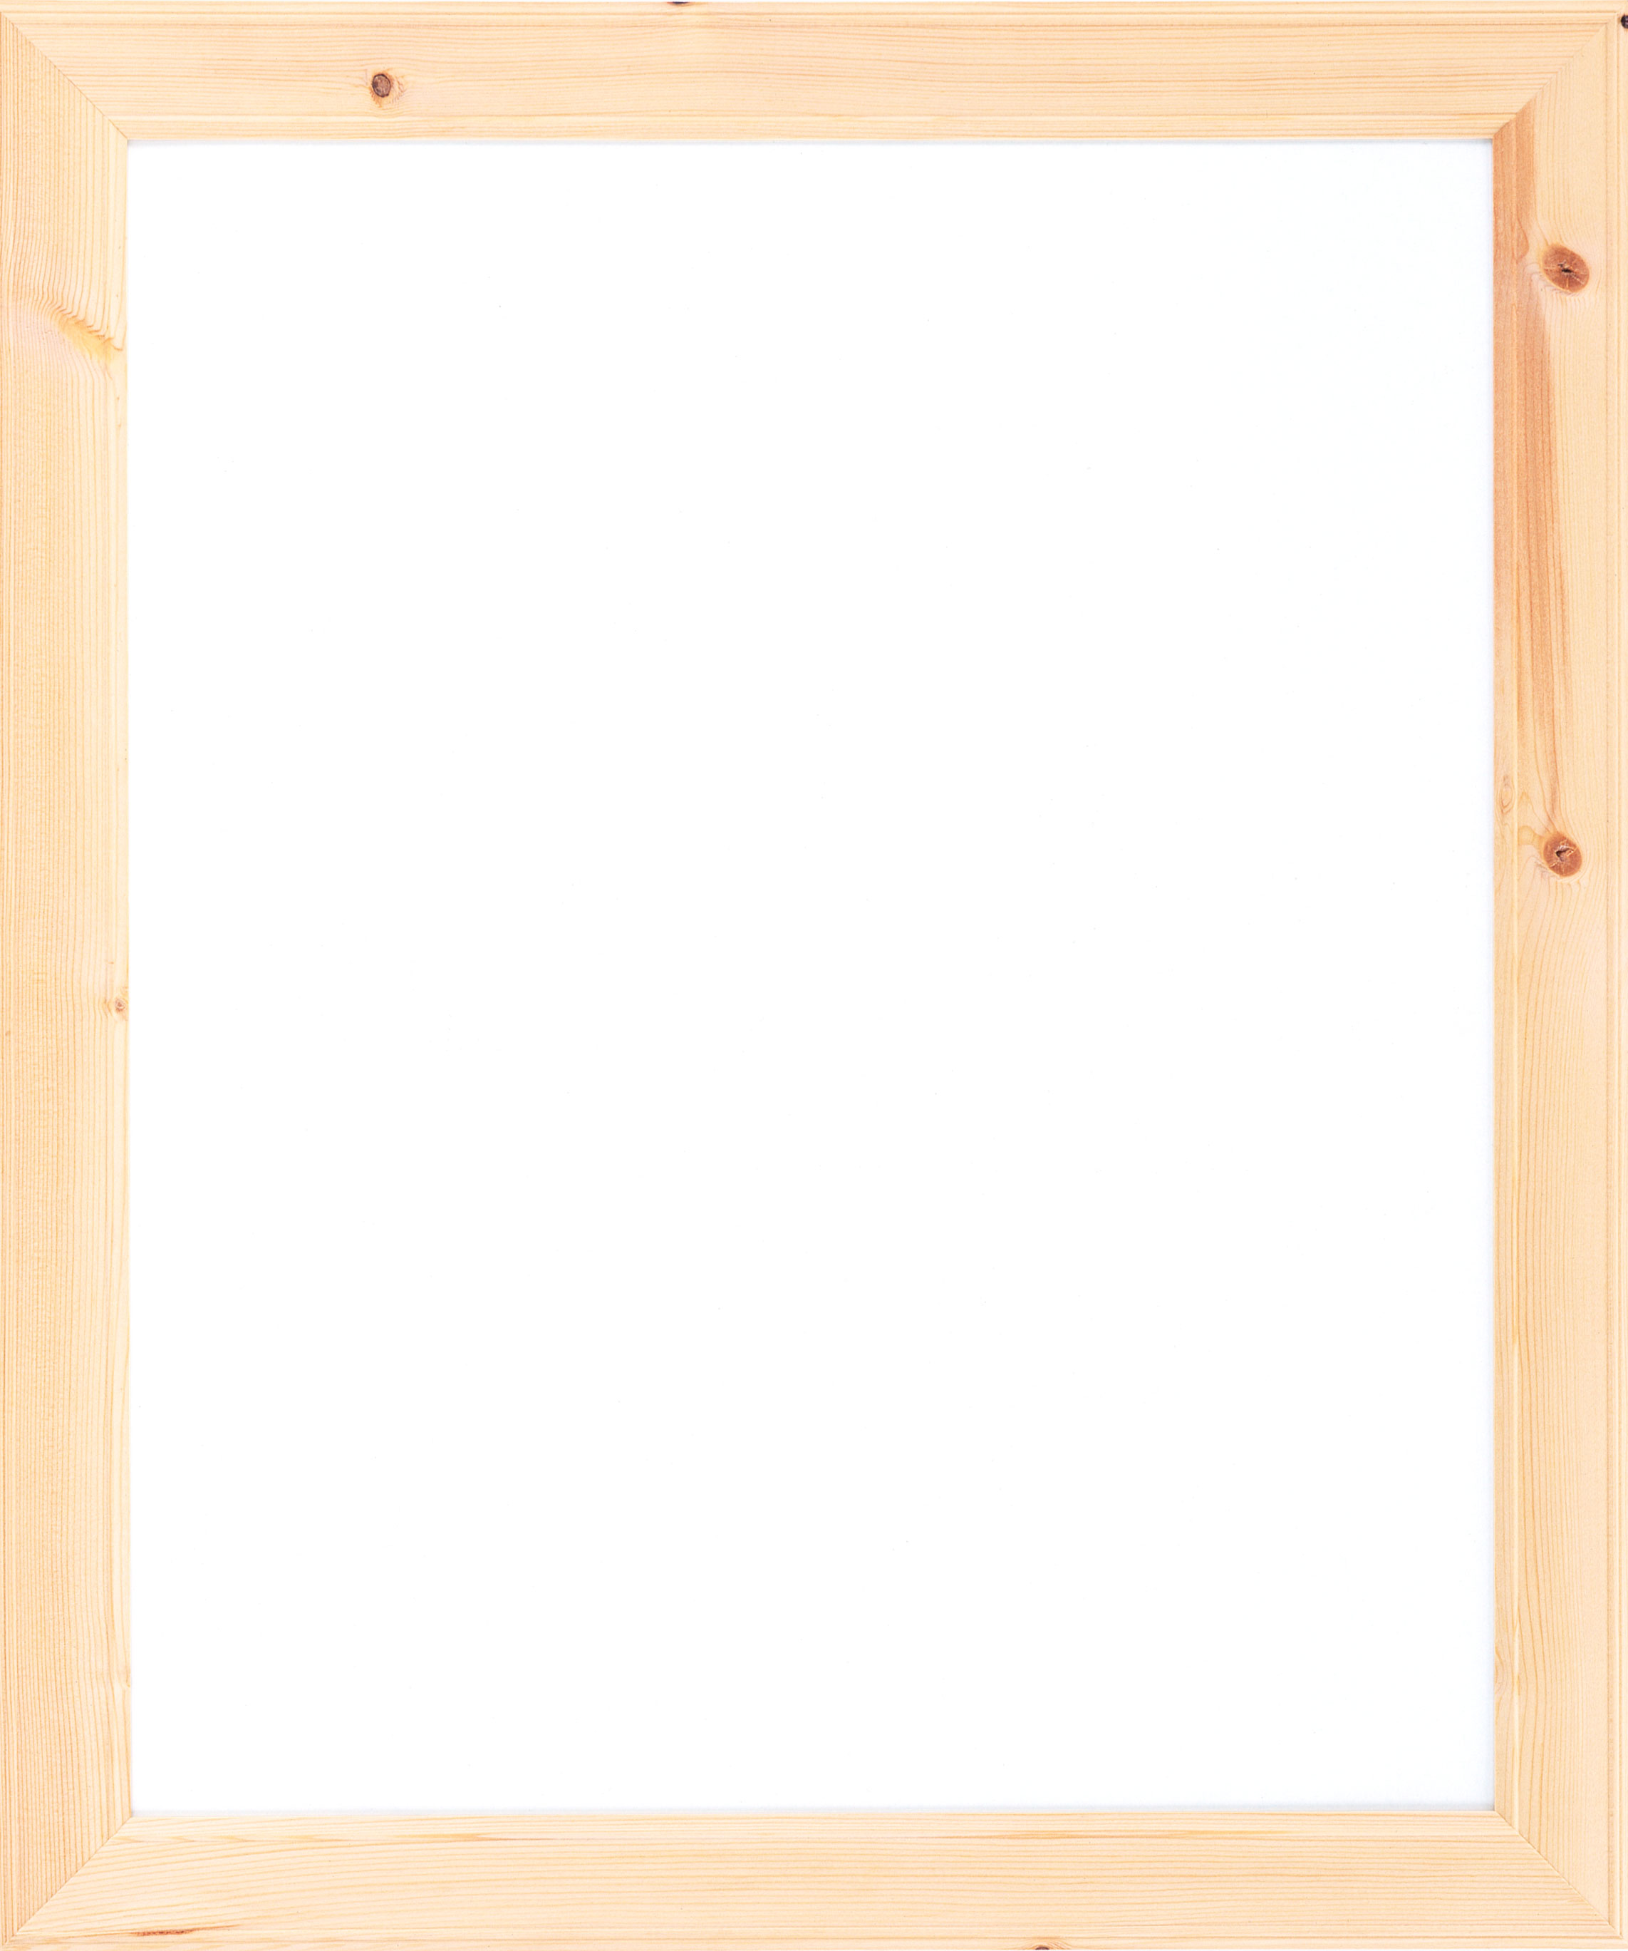
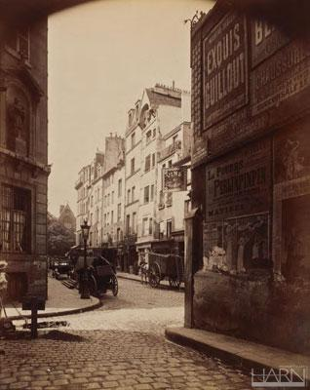
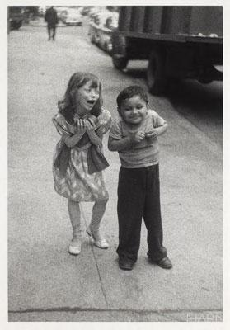
2

Slide 13
Eugene Atget
France, 1857 – 1927
Rue Boutebrie, Paris
ca. 1900
Albumen silver print
8 1/2 x 6 7/8 in. (21.6 x 17.5 cm)
2004.40
Gift of Melvin and Lorna Rubin
Diane Arbus
American, 1923 – 1971
Child Teasing Another
1960
Gelatin silver print by Neil Selkirk, 1990s
Mat: 20 x 16 in. (50.8 x 40.6 cm)
Image: 8 7/8 x 6 in. (22.5 x 15.2 cm)
2005.42
Museum purchase with funds provided by the Melvin and Lorna Rubin Endowment
The advent of photography in the late 19th century introduced a new medium for fine art. Museums frame photographs in simple frames regardless of the time period in which the photograph was taken. This presents a contrast to the various frames used for paintings of similar date. How does the style of frame influence the way you see the photograph? If the photographs were placed in carved, gilded frames would it change the way you think about the image?
Framing method: matted, same frame, hang vertically

Slide 14
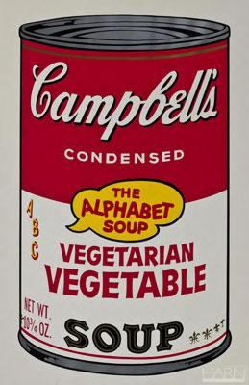
3

Slide 15
Andy Warhol
American, 1928 – 1987
Soup Can, Vegetarian Vegetable
1964
Silkscreen
Print mark: 32 x 18 3/4 in.
Frame: 41 5/8 x 29 1/4 in. (105.7 x 74.3 cm)
1989.12.1
Gift of Richard Anuszkiewicz
Contemporary art challenges the need for frames. Some works benefit from a frame’s appearance while others bypass the use of frames entirely. Pop art collapses the space between everyday life and art. It often uses commercial imagery as social commentary. Andy Warhol is known for his “factory” that produced hundreds of silkscreened controversial works. Warhol’s Soup Can, Vegetarian Vegetable is both matted and framed. Does the frame intensify or weaken the commercialism of the image? Does it make the image a work of art?
Framing method: matted, framed, hang elevated above eye level

Slide 16
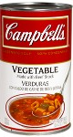
4

Slide 17
Campbell’s Vegetable Vegetarian soup can
2011
Aluminum, paper, soup
Does displaying an object in an art museum automatically make it a work of art? Warhol changed the relationship between popular culture and art. Here the exhibition questions the connections between an infamous painting and the original object it depicts. By framing this common object behind glass in a museum, how are your perceptions of the can confronted? Does this juxtaposition influence you to think differently about the Warhol painting?
Framing method: pedestal, vitrine, against wall

Slide 18
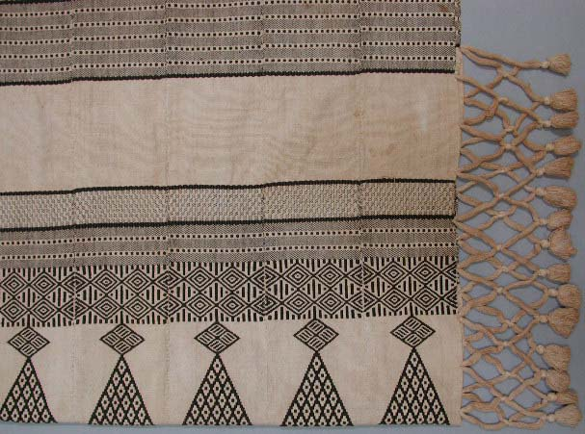
5

Slide 19
Hammock Mende people, Southern Sierra Leone
c. 1950 Cotton 26 in. x 7 ft. 3 in. (66 x 221 cm) 2002.31.8
Gift of Lewis Berner and family
What happens when decorated materials like canvas, wood, or paper are unframed? It simply becomes an object with a decorated surface. A picture frame hides the edges of such materials and disguises the fact that the image is applied to an object. Why then are the edges of this textile exposed? What kinds of objects are unframed?
These frames draw attention to specific parts of the textile. Frames create visual borders. The borders cut off the lines, colors, patterns, and textures of the painting, as well as help focus attention on the enclosed spaces.
Framing method: object mounted on wall, empty picture frames hanging from ceiling at various heights
Alternative framing method: object mounted on wall, Plexiglas in front of textile, frame decals on Plexiglas

Slide 20
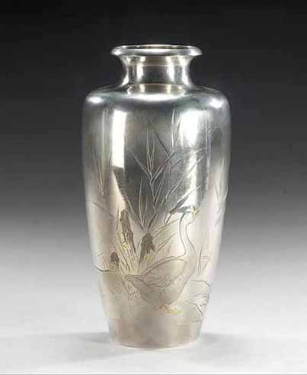
6

Slide 21
Yoshiyuki
Japanese, active late 19th - early 20th century
Vase with Design of Goose by a Stream Meiji, Meiji period, 1868-1912 Silver, gold, and copper 8 3/8 in. (21.2 cm) 2003.44.1
Museum purchase, gift of Dr. and Mrs. David A. Cofrin with additional funds provided by the David A. Cofrin Art Acquisition Endowment
Museums generally show objects at eye level. This case’s altered proportions subvert viewer expectations by creating a new visual experience. Is it worse? Is it better?
Framing method: low pedestal, tall vitrine

Slide 22
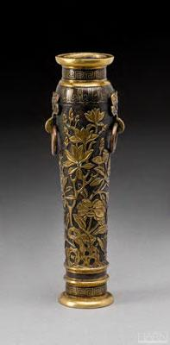
7

Slide 23
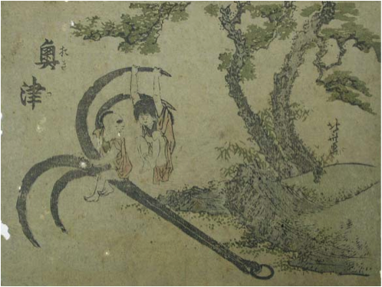
Hu Wenming
Chinese, active late 16th - early 17th century
Incense Tool Vase
Ming Dynasty (1368-1644)
7 1/4 x 2 1/2 x 1 3/4 in. (18.4 x 6.4 x 4.4 cm)
Bronze with gilding and inlaid silver wire
2005.21.1
Museum purchase, gift of private donors
Katsushika Hokusai
Japanese, 1760 - 1849
Okitsu, from an untitled series of views of the Tôkaido Road station
c. 1800
4 7/8 x 6 1/2 in. (12.4 x 16.5 cm)
Color woodcut
PR-00-23
Gift of Rudolph Weaver
Display cases work the same way as picture frames by creating a discrete space for images. Placing these two objects together creates a single image that imposes a relationship on them. Would such a relationship exist if they were in separate display cases?
Framing method: pedestal, vitrine

Slide 24
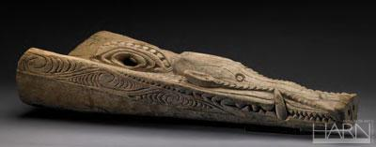
8

Slide 25
Canoe Prow
Iatmul people, Papua New Guinea, Korogo village
20th century Wood 39 1/2 x 15 1/4 x 8 in. (100.3 x 38.7 x 20.3 cm) S85-SPNG-G204
Gift of Dr. Samuel Spring
The edges of a pedestal restrict the area surrounding an object and create a frame for it. This display creates a visual tension by allowing the object to leave its designated space and intrude upon the viewers’ space. How does this display violate the idea that frames form boundaries?
Framing method: pedestal, against wall, object slightly suspended above pedestal

Slide 26
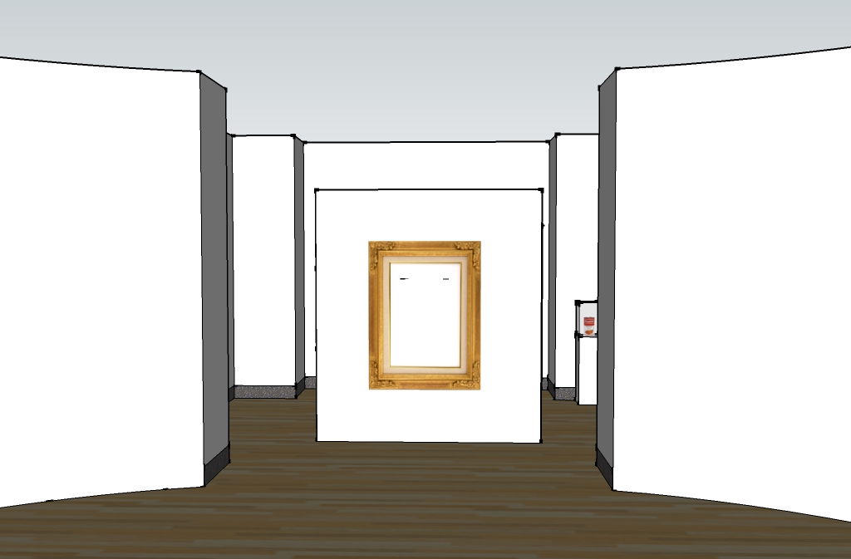
Introductory Wall
Panel
Introductory
Wall
Panel

Slide 27
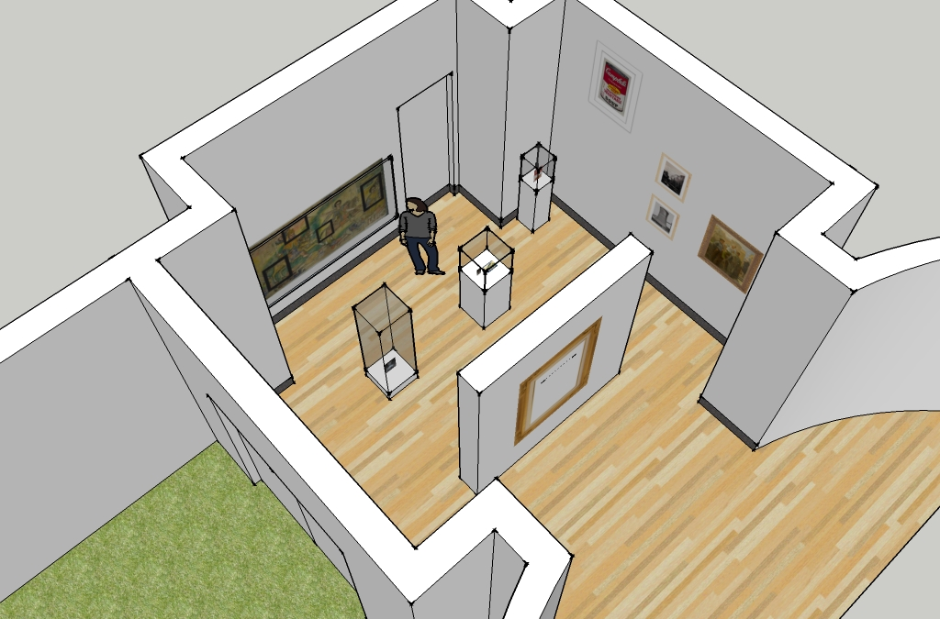

Slide 28
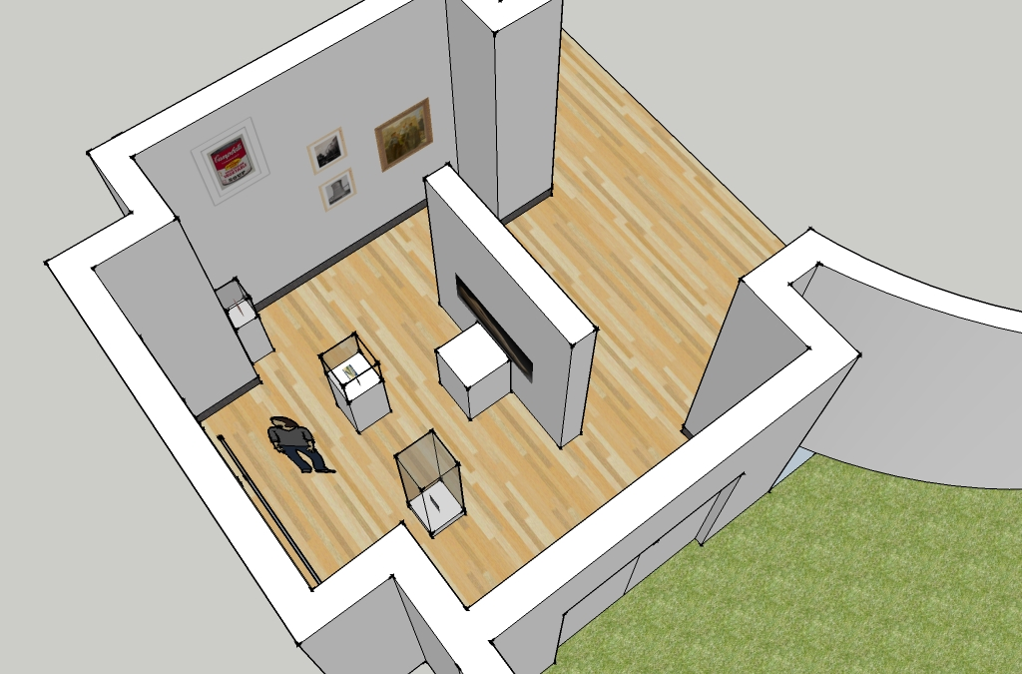

Slide 29
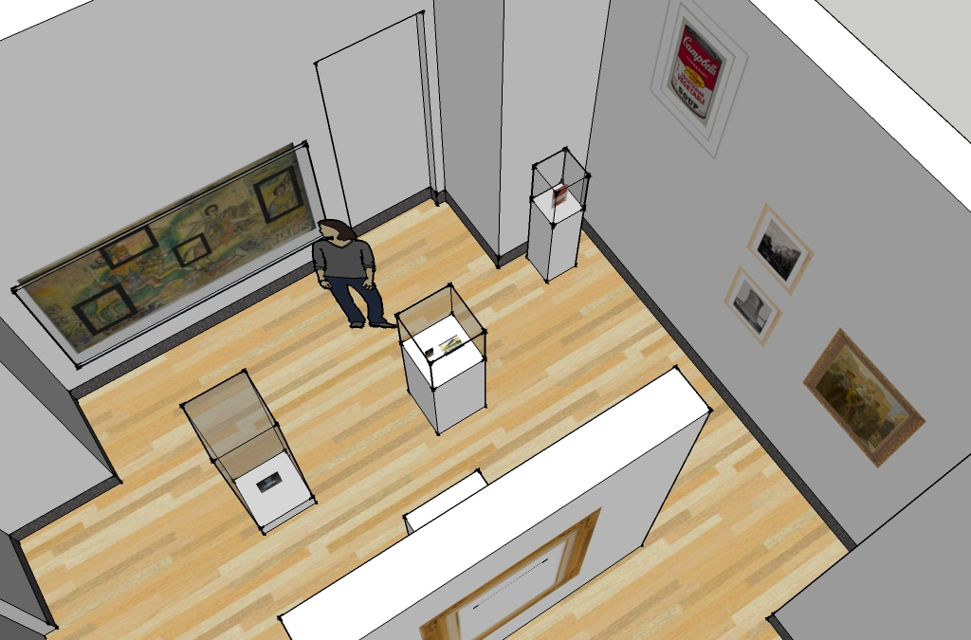

Slide 30
Education and Outreach

Slide 31
Aiming and Framing

Slide 32
Aiming and Framing

Slide 33
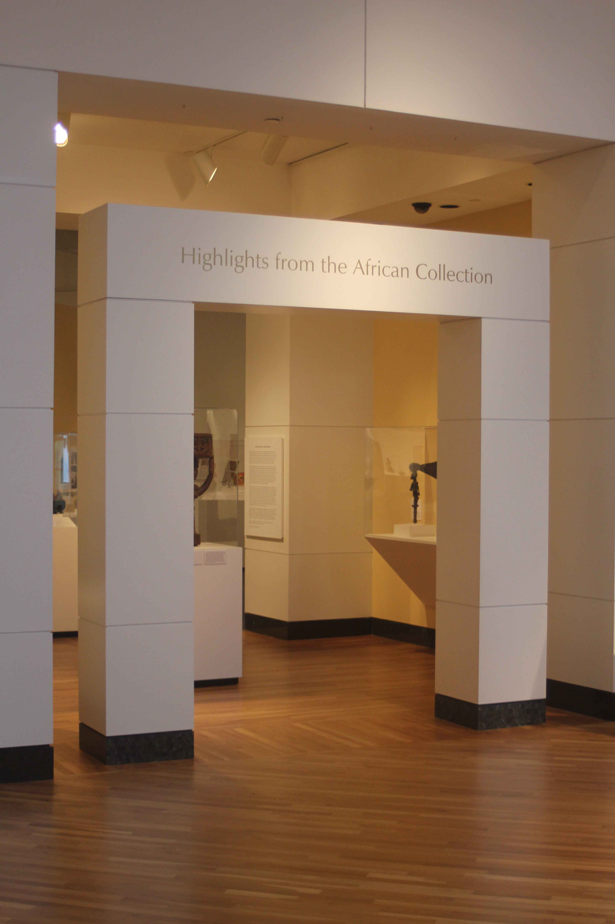
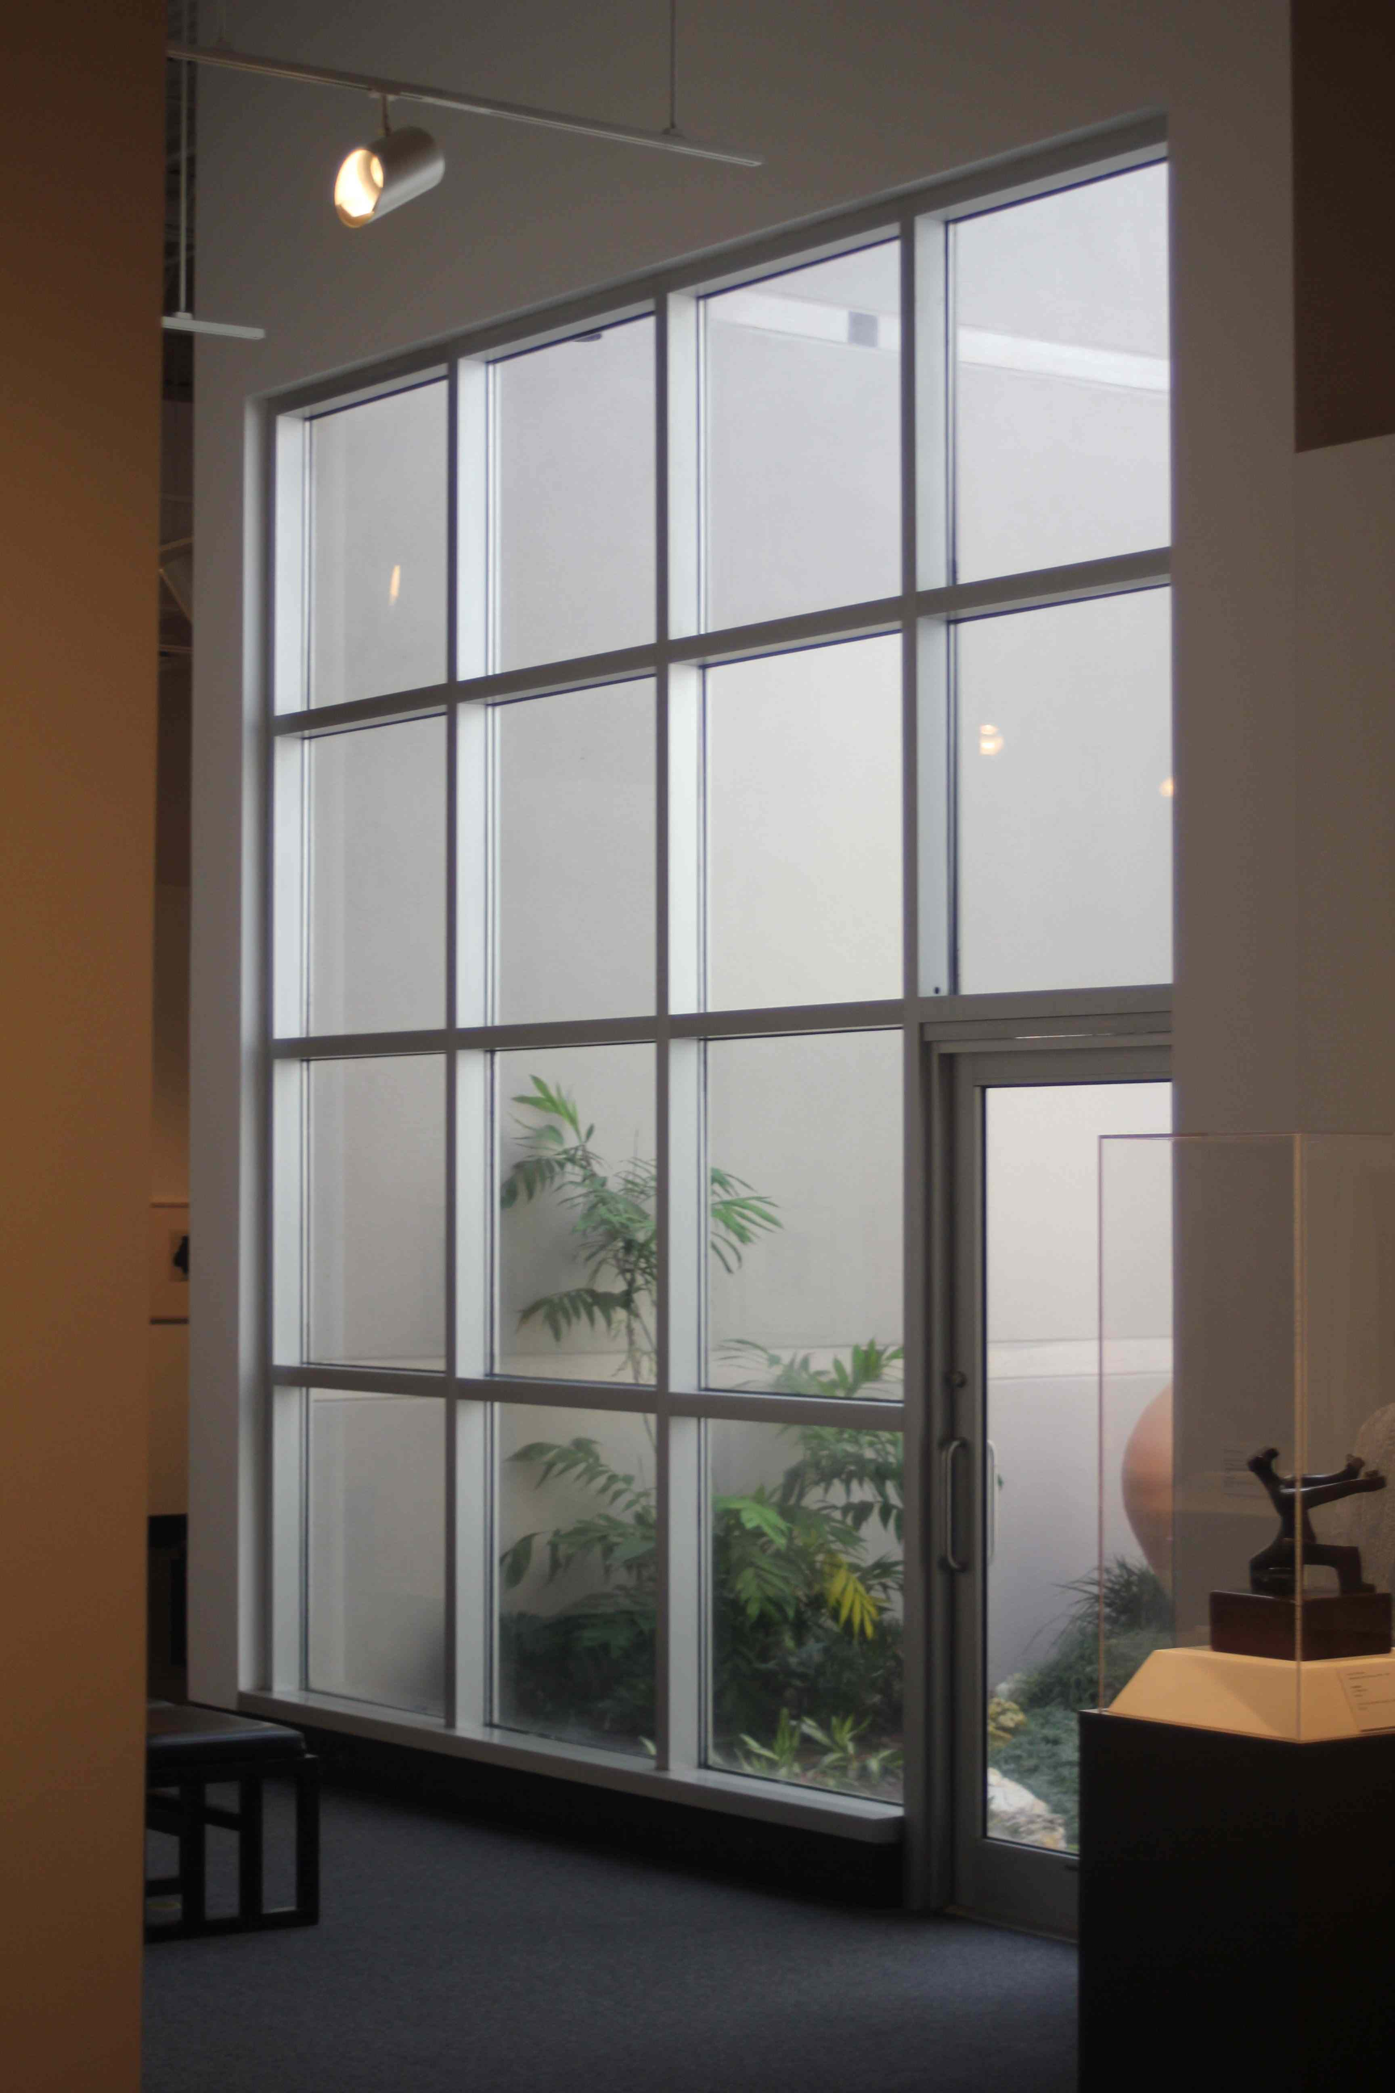
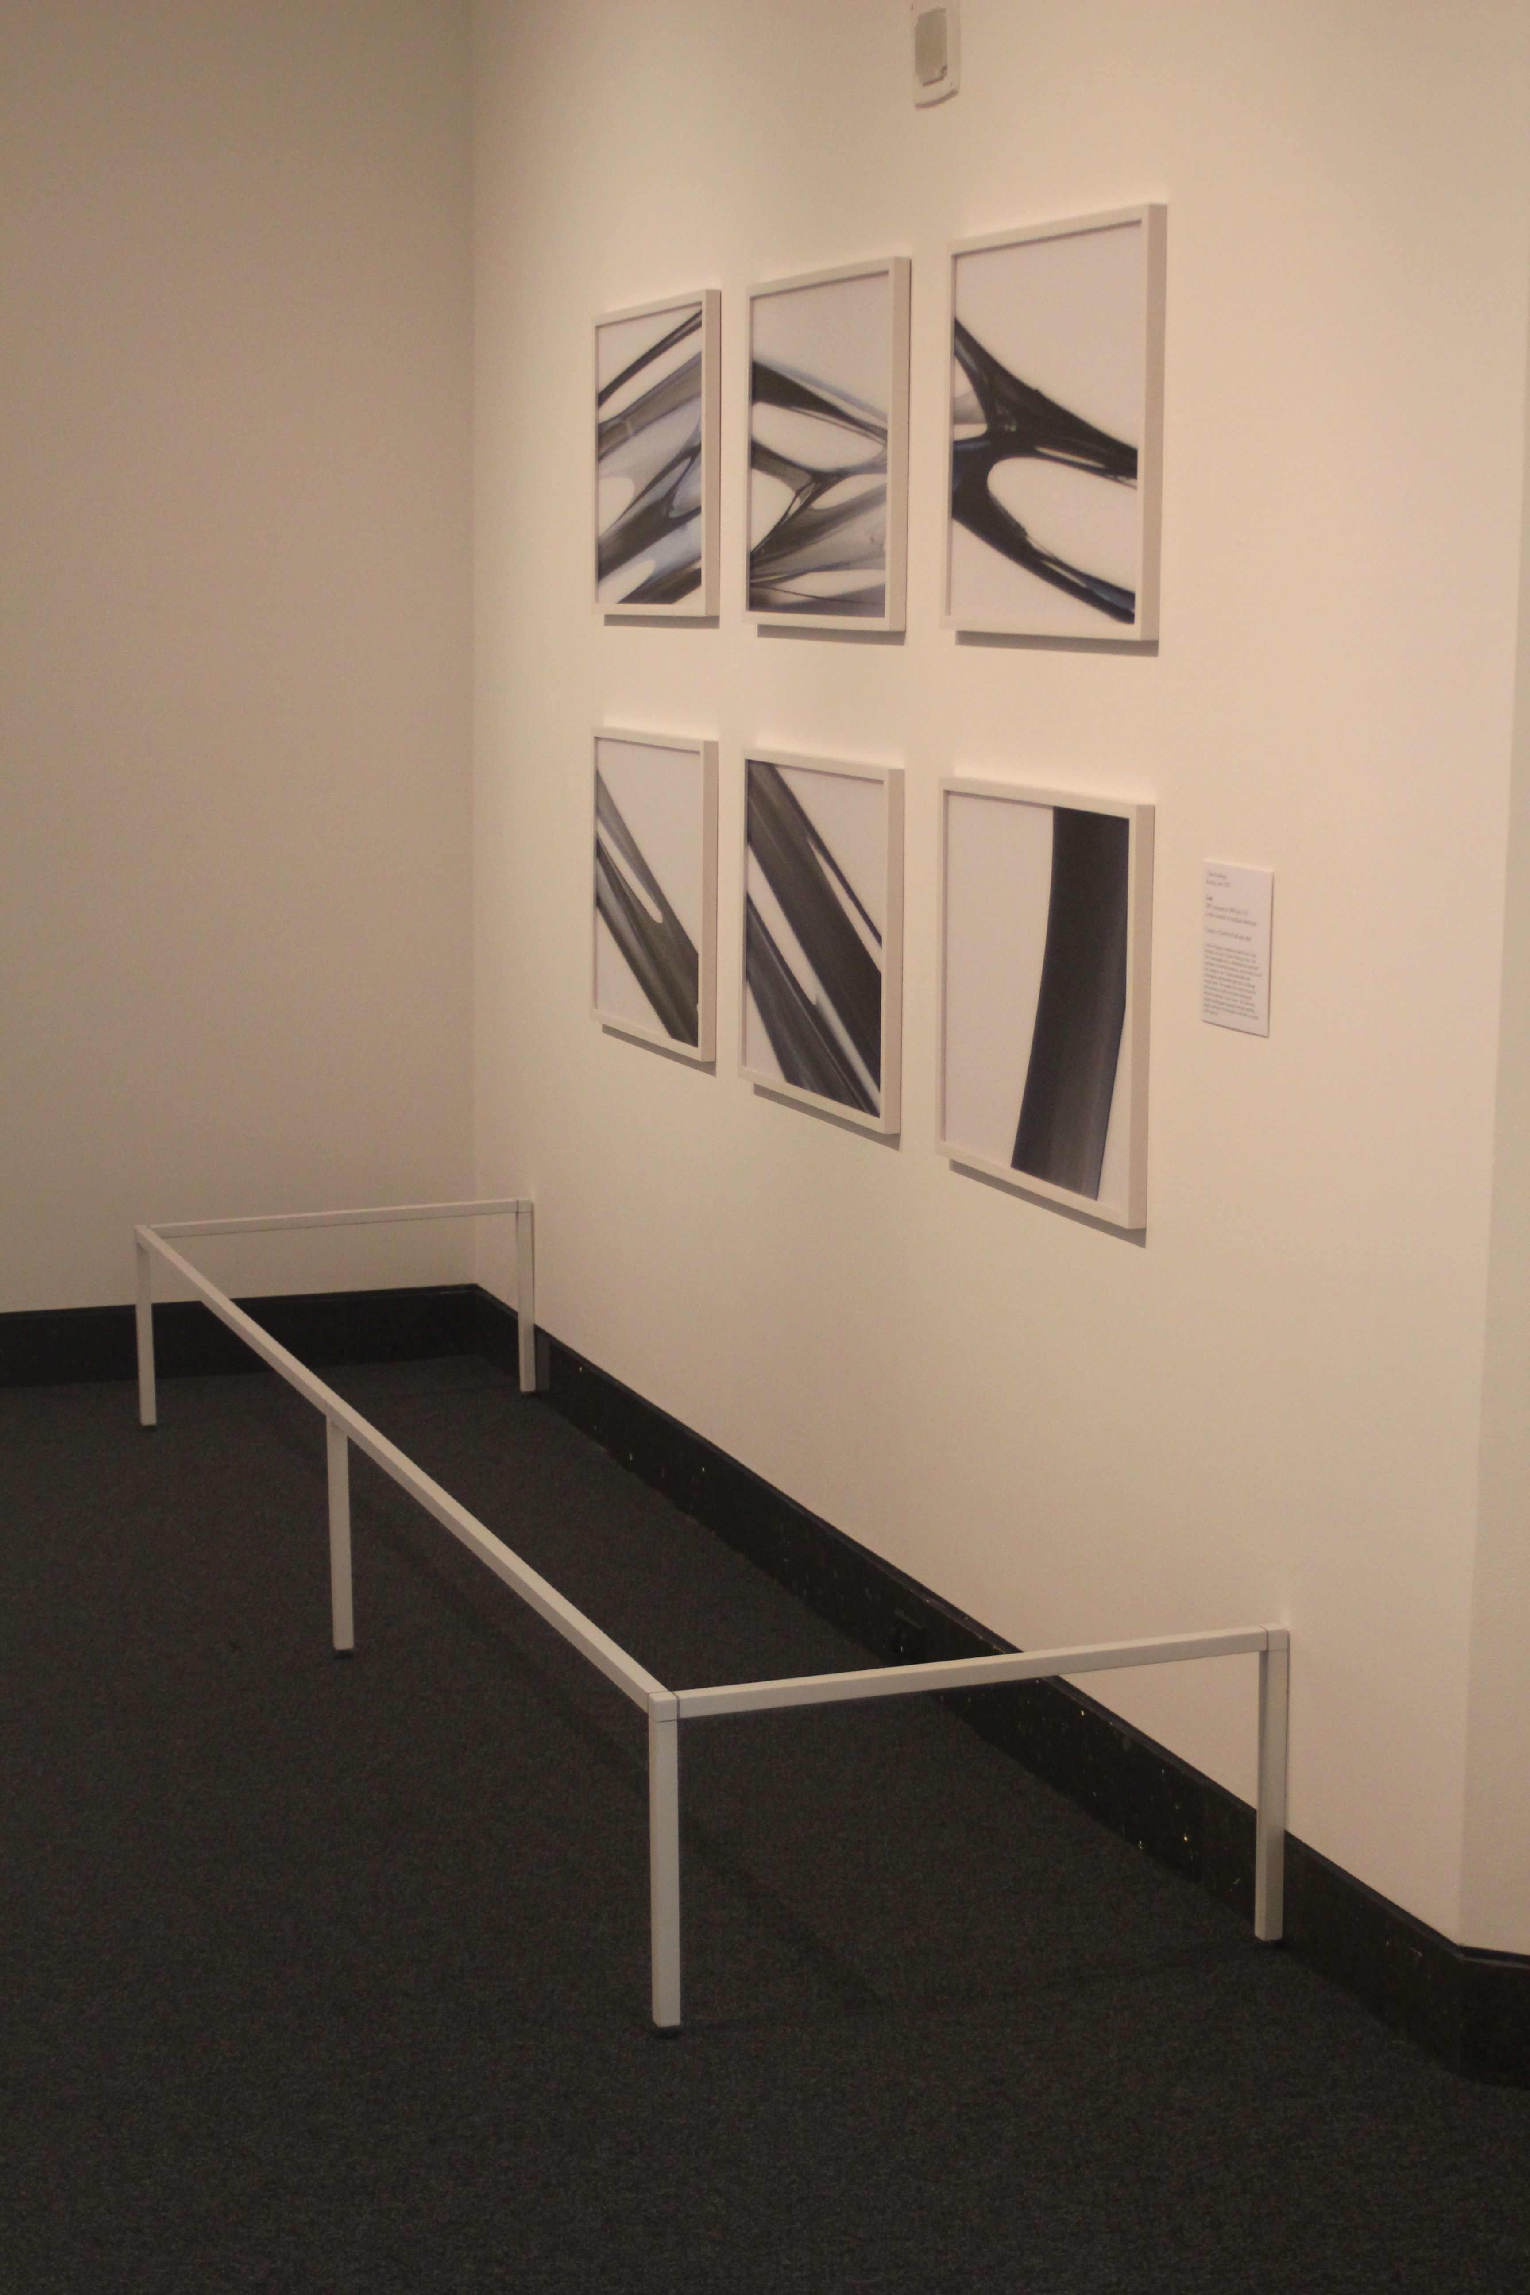
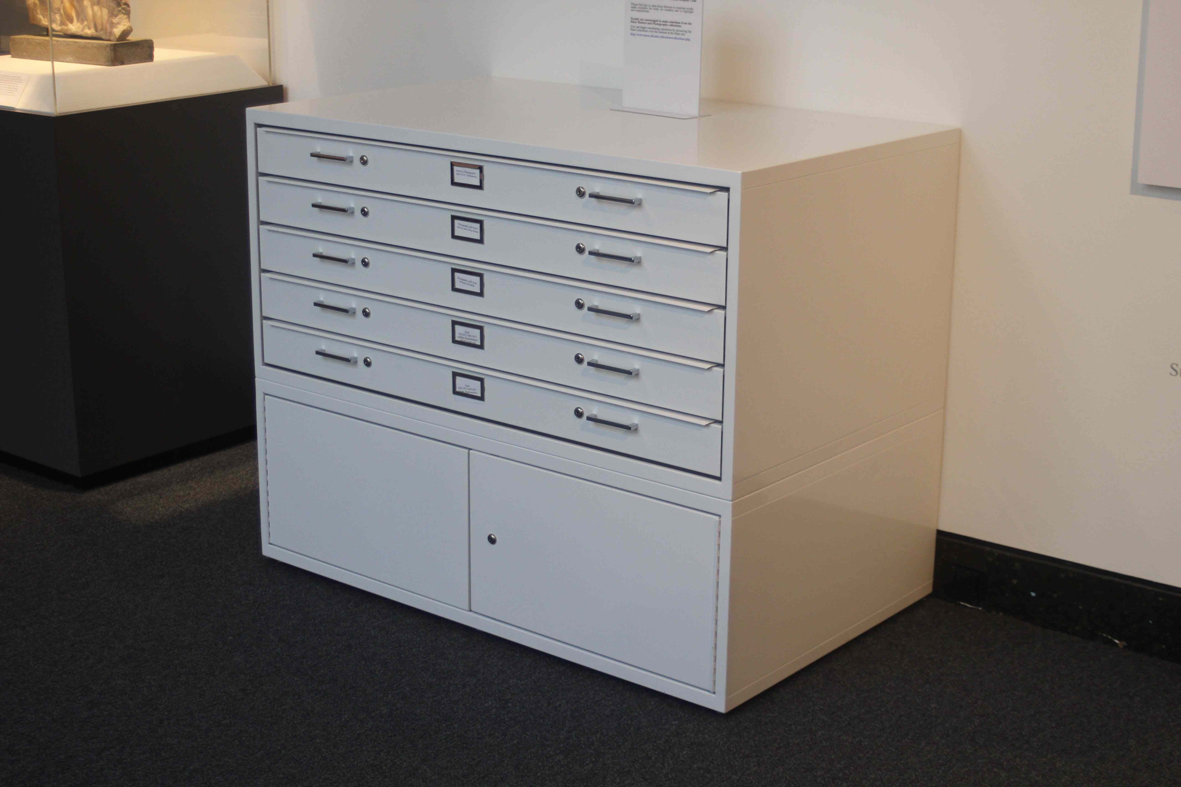

Slide 34
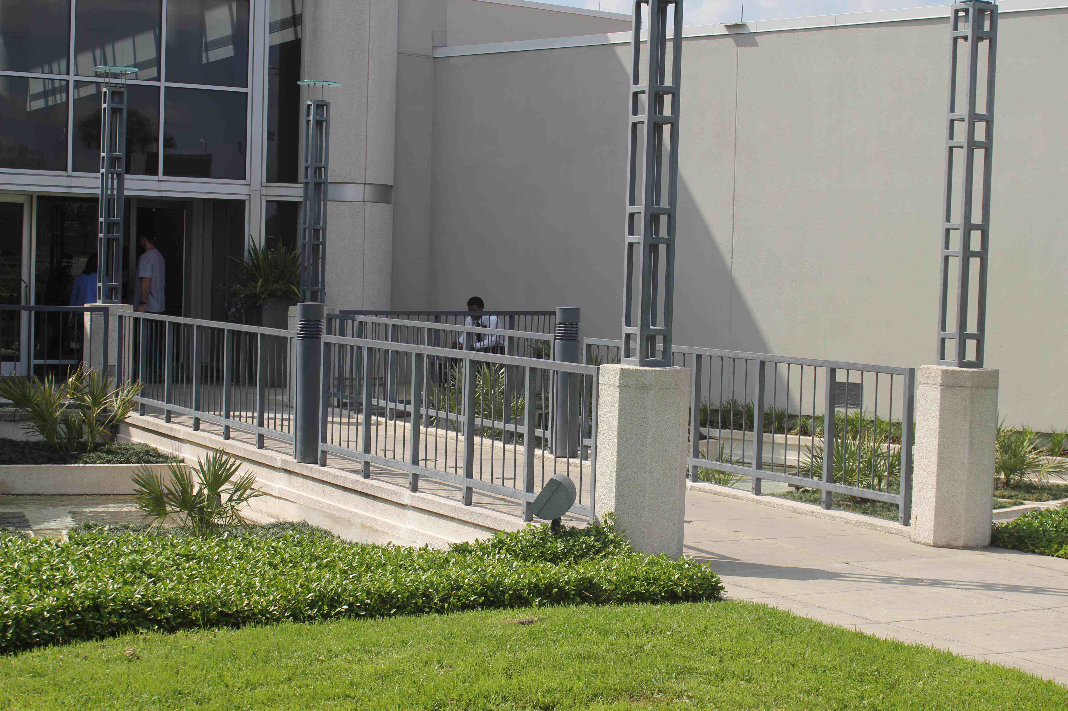

Slide 35
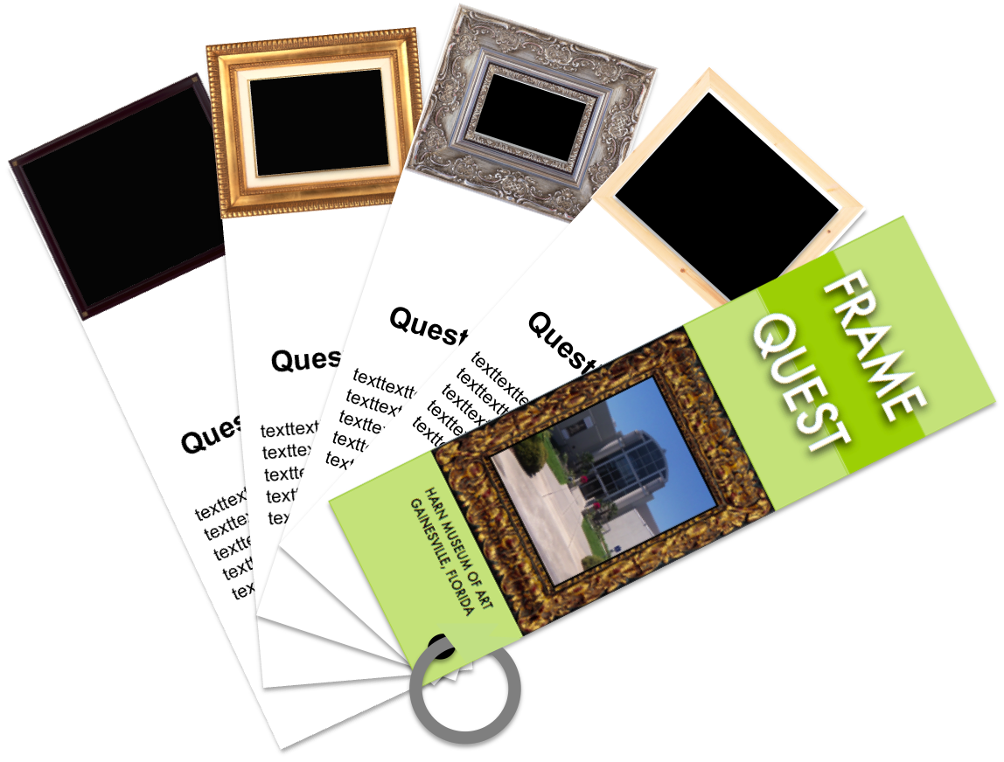
Frame Quest

Slide 36
Frame Quest

Slide 37
Frame the Art Museum

Slide 38
Educational Guide
Introduction
Glossary
A Background for Frames
Exhibition Writing Activities
Outside Activity and Reading Suggestions

Slide 39
