Slide 1
Open access isn’t just for the sciences: Digital scholarship in the humanities and social sciences
Dr. Sophia Krzys Acord, Associate Director, Center for the Humanities and the Public Sphere Dr. Laurie Taylor, Digital Humanities Librarian, UF Smathers Libraries
Notes:
[Sophia]
I am a sociologist, and Laurie is a scholar of English and cultural studies. So we are always puzzled by the fact that, for some reason, open access is generally a term associated with the biological, physical, chemical, and medical sciences. Sure, journal subscriptions in these fields are orders of magnitude more expensive than subscriptions in the arts, humanities, and social sciences. And, sure, they publish more frequently and tend to ‘expire’ more quickly than in our fields. All of these facts certainly predispose the sciences to explore digital and low-cost publication mechanisms. But, we’d like to use this opportunity to discuss the many ‘flavors’ of open access publication that exist in the humanities and social sciences, many of which are scholar-driven and pre-date open-access movements in the sciences. In fact, many of these publication and dissemination models are not usually branded as ‘open access’, and refer to themselves using a different terminology such as ‘online’ ‘digital scholarship’ ‘working papers’, etc. But, it is our goal here to say that these movements, despite appearing under different names, are very much in keeping with the open access spirit of increasing the dissemination and quality of scholarly publications in the digital age.
Our talk has three parts today:
Some background to the unique publishing issues in the humanities and social sciences
Examples of various OA initiatives across the humanities and social sciences (and arts, briefly)
Discussion of OA policies at scholarly societies in the humanities and social sciences
Our normal caveats apply:
Not everyone in every field engages in OA practices of the sort we will describe (individual proclivities rein)
There are tremendous cultural differences between fields
The age of a scholar matters enormously when thinking about how to disseminate one’s scholarship

Slide 2
Unique publishing concerns in the Humanities and Social Sciences
Long lag time to publication
Larger scholarly outputs
Vanishing publication opportunities in some subfields
Fewer publication outlets, period
Many small and low-paradigm fields
Publishing ‘data’ often requires expensive permissions, type-setting, and layout charges
Notes:
[Sophia]
Unique publishing concerns that lend themselves to exploring alternative economic and material publishing models:
Long lag time to publication
2 years to publication in economics. 18 months is standard in many social sciences. Big problem for junior faculty who publish articles.
In the mid-80s to -90s, Centers for Slavic and Eastern European Studies self-published conference proceedings and books on the collapse of communism b/c they couldn’t wait for the publication timetable to get urgent work disseminated.
Larger scholarly outputs
4 articles in a journal issue
Vanishing publication opportunities in some subfields
Serials crisis in the sciences -> declining monograph budgets.
Very difficult to publish anything pre-1900 and non-American in history.
Fewer publication outlets, period
In some flagship journals, only 16 articles a year can be published.
Many small and low-paradigm fields
If there is only one faculty member at a university in a particular field, the institution may not be able to purchase materials for them. (LEGs.)
No universal flagship journals like Science or Nature (but also fewer papers going through review at the top outlets, so it’s not as expensive as wading through the drek)
Publishing ‘data’ often requires expensive permissions, type-setting, and layout charges
Typesetting – Ancient Greek is often messed up by presses.
Reproduction fees for illustrations
Color costs money
So, with this background laid out: how are the humanities and social sciences thinking about using open-access publication mechanisms to address these concerns and enhance the visilibility of their work in the digital age?

Slide 3
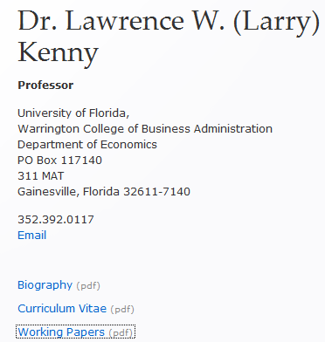
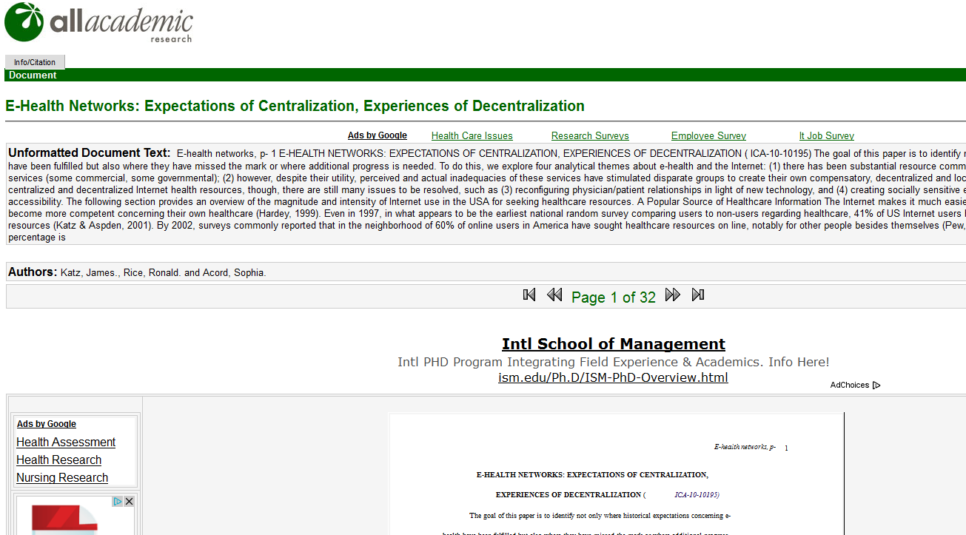
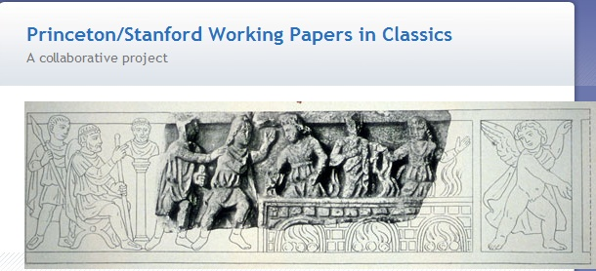
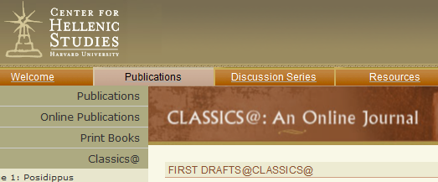
Working papers and preprints
Notes:
[Sophia]
There are certainly completely open-access journals in the humanities and social sciences, which Laurie will speak to in a moment. But in many of the social sciences, there is also a strong tradition of posting well-developed working papers to personal websites, and sometimes even preprints. (I’ve heard there is a ‘don’t ask, don’t tell’ culture with many social science journals.) Increasingly, this tradition is extending to sharing one’s work in occasional paper series, and working paper repositories. In economics, for example, it’s downright encouraged to get your work out there in occasional or working paper form for feedback and attribution, b/c the lag to publication is too long. You get, as some call it, ‘reputation’ credit for posting your papers. I’ll mention a few of these repositories here.
The most well known open-access repository in the social sciences and humanities is the SSRN, or Social Science Research Network. (SSRN has again been named the Number 1 Open Access Repository in the World (for July, 2012) by the Ranking Web of World Repositories. The SSRN was founded in 1994, and today has over 1.3 million users in 23 research areas spanning the humanities, and more recently, some of the social sciences (Classics, Rhetoric, Music, Philosophy, American Literature). They also have a Partners in Publishing program to post forthcoming papers to SSRN, but anything an author uploads is downloadable for free The SSRN is a great way to aggregate and distill literature as a reader, but an as an author receive usage statistics, early feedback, etc. It’s important to note that most users post “penultimate drafts” to SSRN, simultaneous to journal acceptance. SSRN allows bibliographic information to be updated when a paper is published. A related but semi-open-access repository is the National Bureau of Economic Research, which makes work accessible to journalists, government employees, and residents of developing countries.
Some humanities, particular classics, are also seeing a growing working paper culture. The Princeton/Stanford Working Papers in Classics works to make the results of current research undertaken by members of Princeton and Stanford Universities in the field of classics available in advance of final publication. Harvard’s Center for Hellenic Studies also has a “First Draft” section to disseminate work pre-publication. Again, these are ways to earn reputation credit, begin the citation process, and solicit some peer review in parallel to the formal publication process.
The final form of working papers that exists is found in conference paper repositories, as maintained by many scholarly societies in the social sciences in particular. These can be hosted by SSRN or “All Academic” company. All Academic works to maintain the scholarly merit of each publication in our collection. In most cases, authors retain copyright. Users are asked to comply with the wishes of the scholar. Many of the papers are conference papers and other unpublished manuscripts. Scholars may request contact before citing these works. Not for commercial uses.
Again, it depends on the culture of a subfield. In econometrics, there is a bigger fear of being scooped. Other fields are more sharing. Generally speaking, younger scholars need to establish their street cred through traditional, peer-reviewed output before OA papers are read.

Slide 4
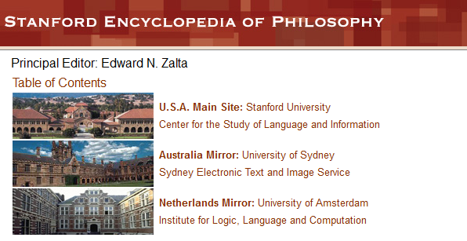
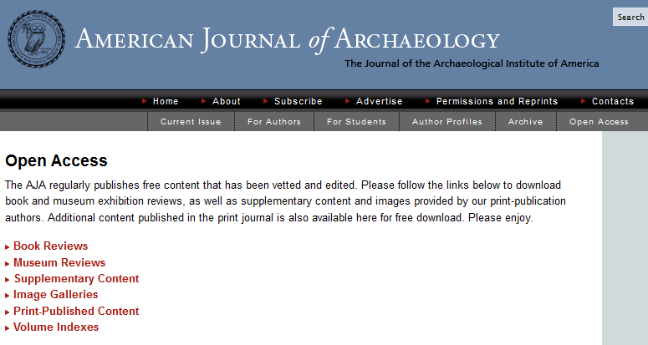
Reviews and commentaries
Notes:
[Sophia]
The Humanities and Social Sciences have been innovative in thinking about what kinds of content can be made open access. Book and exhibition reviews, for example, don’t usually keep journals financially afloat, but they can be important units of scholarly work in some fields. CF: Bryn Mawr Classical Review that is distributed by listserv, and the American Journal of Archaeology publishes book and exhibition reviews in OA.
Listservs and blogs such as H-Net and Savage Minds in anthropology are also useful ways to share resources and commentaries in a field, as well as one’s own scholarship in some cases, to unrestricted publics (within reason).
Finally, we all complain about our students reading Wikipedia, but Stanford actually did something about it in hosting the Stanford Encyclopedia of Philosophy.

Slide 5
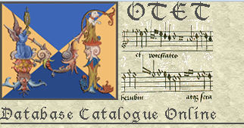
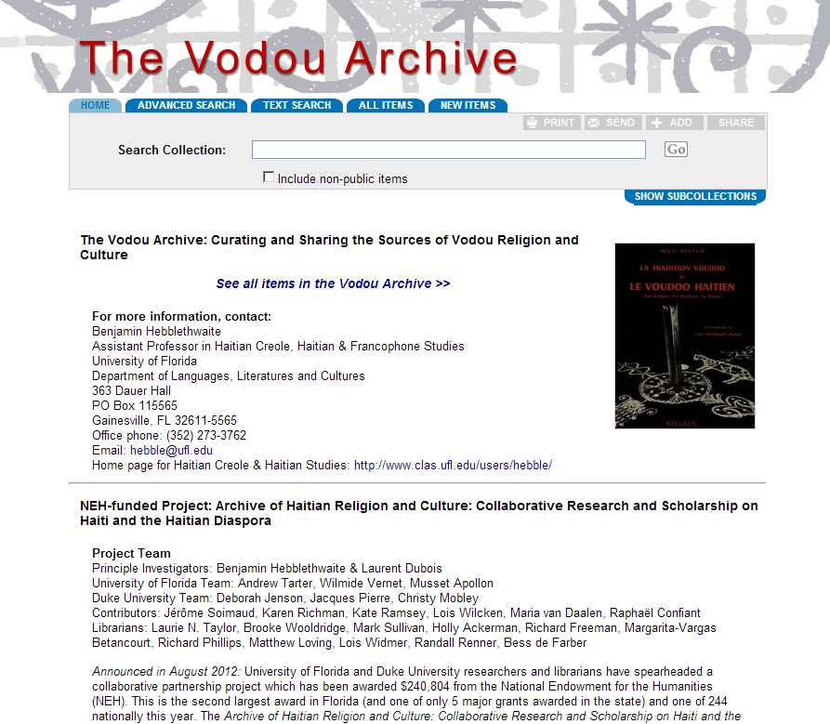
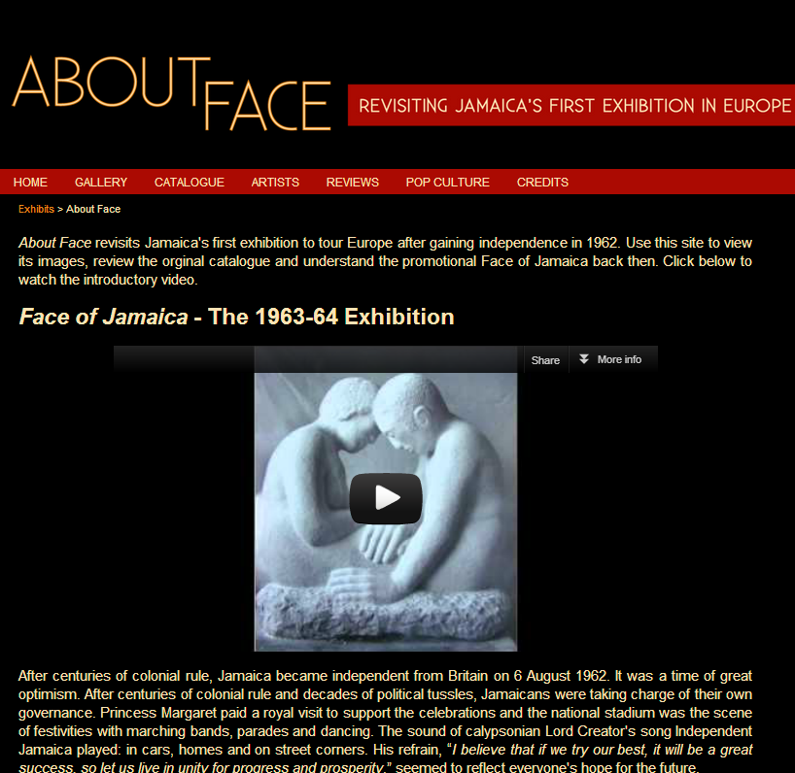
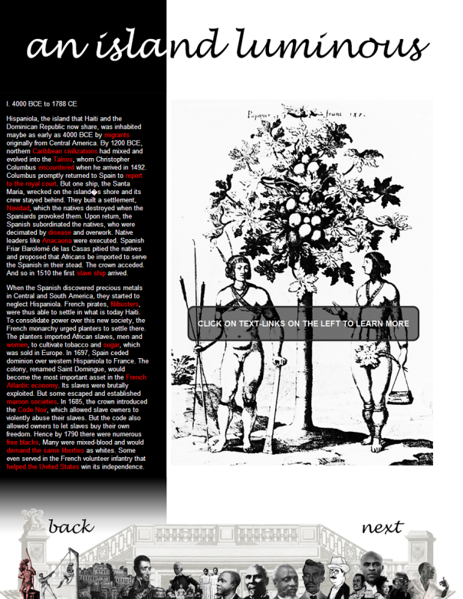
Archives and databases
Notes:
[Sophia]
Laurie and I are also fond of describing the many excellent data curation projects in the humanities at UF, which feature open access to primary sources, and frequently interwoven with scholarly commentary. The future of the scholarly edition is open access.

Slide 6
The Yin and Yang of Open Access
Data, archives,
grey literature, etc.
Courtesy of:
Steven C. Wheatley, vice president, American Council of Learned Societies
Peer-reviewed
formal archival publication
Notes:
[Sophia]
I showed this slide last year at OA week, but I’m bringing it back to emphasize that open access publication opportunities are often related to needs concerning the digital availability of data. You may be wondering, for example, why am I talking so much about classical disciplines? Well, the relatively small amount of data in fields like Greek Literature and Epigraphy is moving entirely online to a place where Greek texts can be published, searched, improved, translated, and secondary scholarship can be published with deep links to databases and images. Why pay for a high-quality reproduction of an image when you can perpetually link to it online?

Slide 7
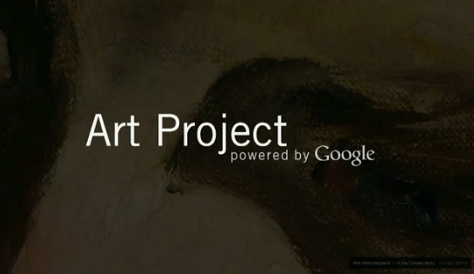
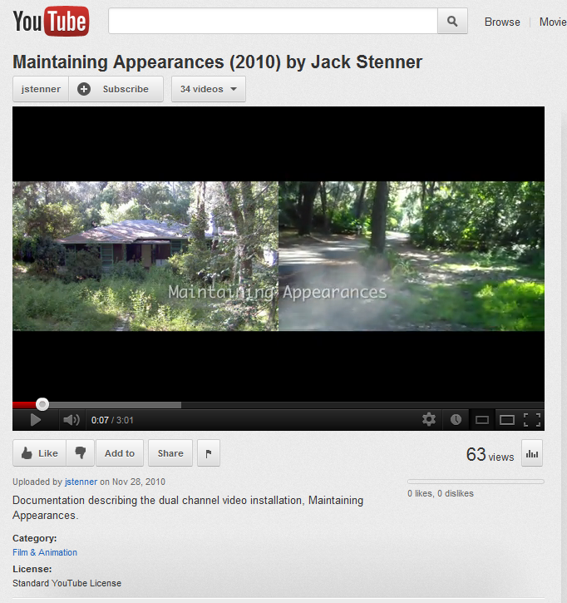
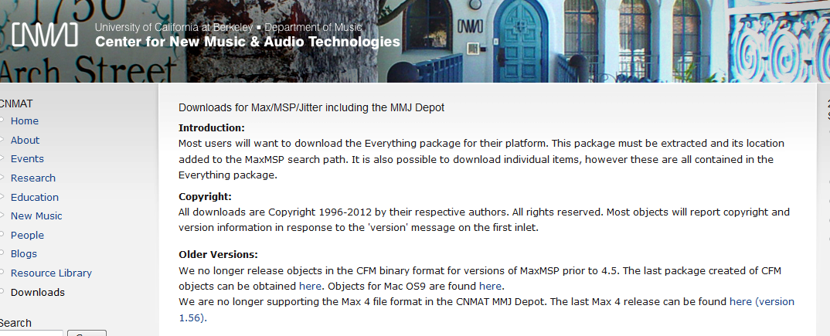
OA Art
Notes:
[Sophia]
Images from the Yale Center for British Art are now accessible through the Google Art Project, which provides high-resolution digital images of art from museums worldwide.
Jack Stenner here in our School of Art + Art History has a YouTube channel where he makes documentation of his performance and digital installation pieces available.
Scholars who work in producing new media technologies, such as at Berkeley’s Center for New Music and Audio Technologies, release software downloads for scholars and amateurs, some in open-source.
So, with this ‘yang’ of OA behind us, I turn now to Laurie to speak more about the ‘yin’ of OA publication through books, journals, and other outlets.

Slide 8
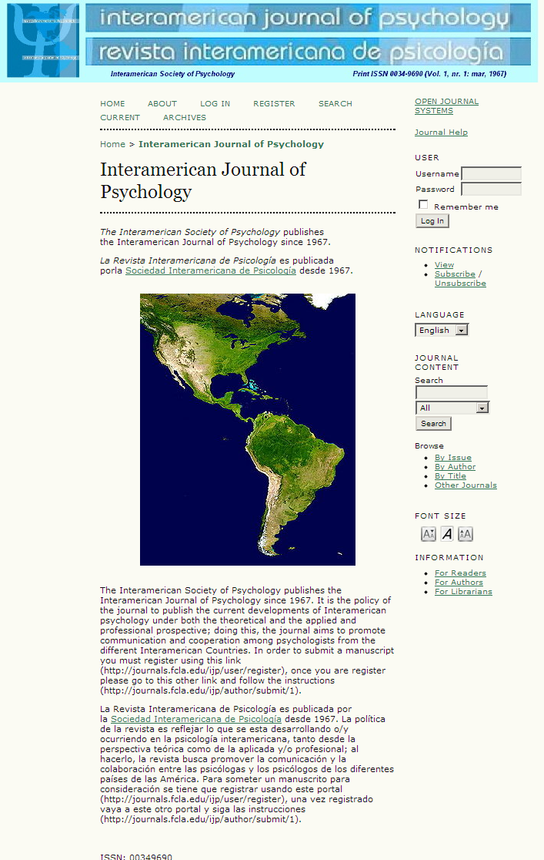
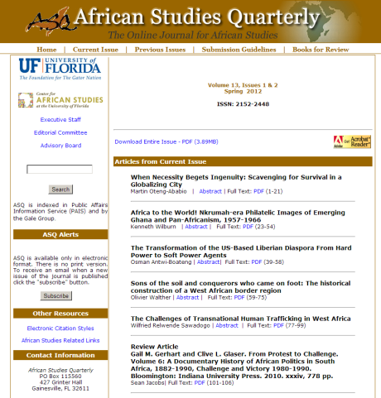
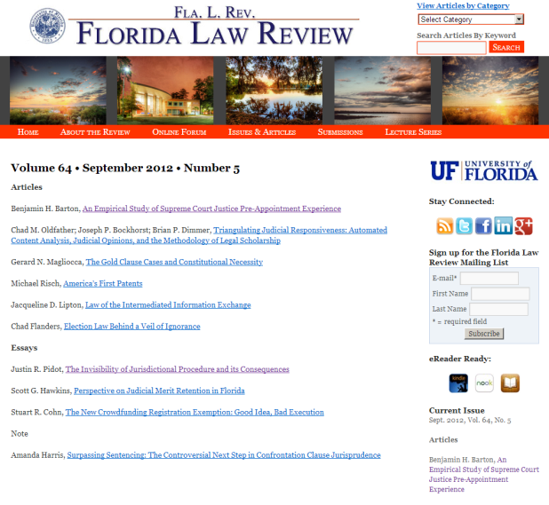
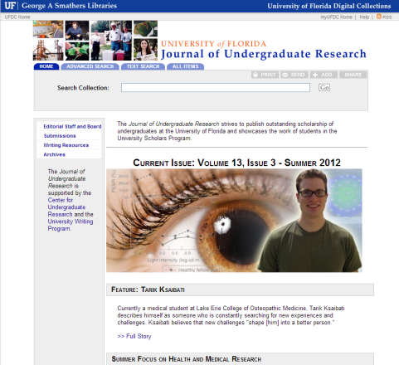
Open Access, Refereed Journals
Notes:
[Laurie]
Scholarly fields, societies, and publishers are all working through publishing successfully in service of their core values and goals in the digital age in different ways.
The examples on this slide show several journals published at UF that are primarily or heavily humanities and social sciences and that are being published as Open Access, Refereed journals.
These and other journals elect to be openly available online while supporting traditional peer review for different reasons. In many cases, OA publishing simply makes the most sense for the core goals and allows the journals to overcome prior obstacles and offers additional benefits. In fact, the clear value and mission alignment of Open Access publishing can mean the journals don’t first identify as Open Access, they identify as scholarly journals that, of course, are Open Access because it simply makes sense.
So, the journals here are:
Interamerican Journal of Psychology [Area studies, needs to be OA to actually reach the scholarly community]
ImageTexT: Interdisciplinary Comic Studies The ImageTexT Journal, supported by the Department of English, is another great example of something that couldn’t be done as a fully traditional journal because of the heavy use of images (it also has conference proceedings, exhibits, and other components, but is still generally traditional aside from the visual aspects).
African Studies Quarterly [Area studies, needs to be OA to actually reach the scholarly community; was OA before OA was a term]
Florida Law Review Legal studies, so needs to be online to be usable and useful.
Journal of Undergraduate Research Published originally fully online and continues to do so, and now publishes directly to the IR. Created to support and showcase quality undergraduate research and, of necessity, needed to be online to share the research.

Slide 9
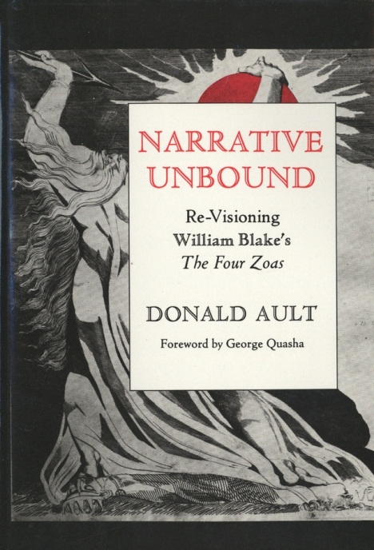
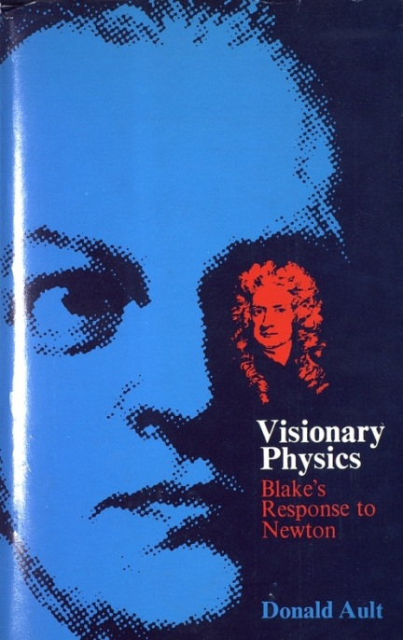
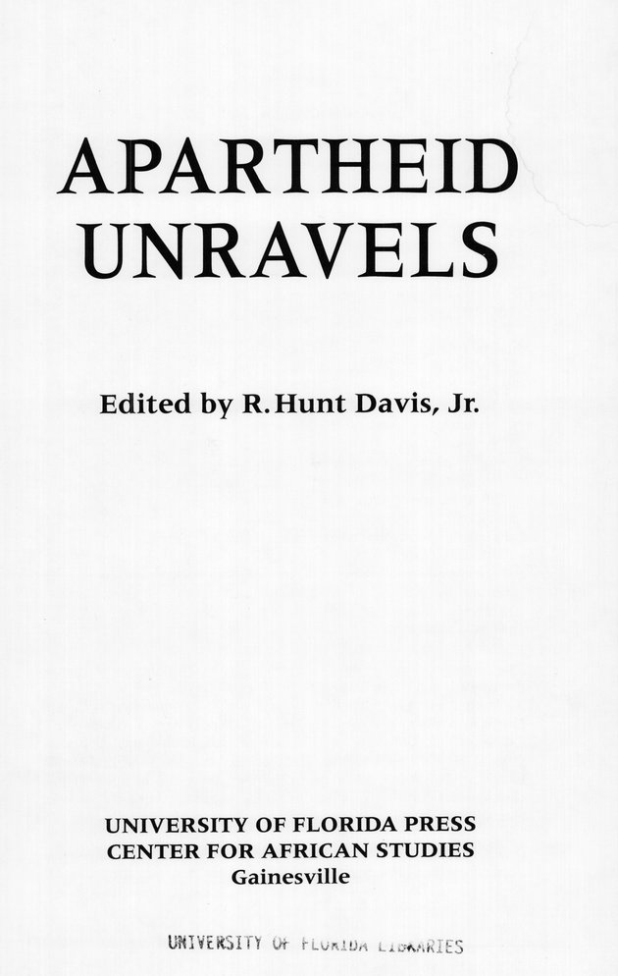
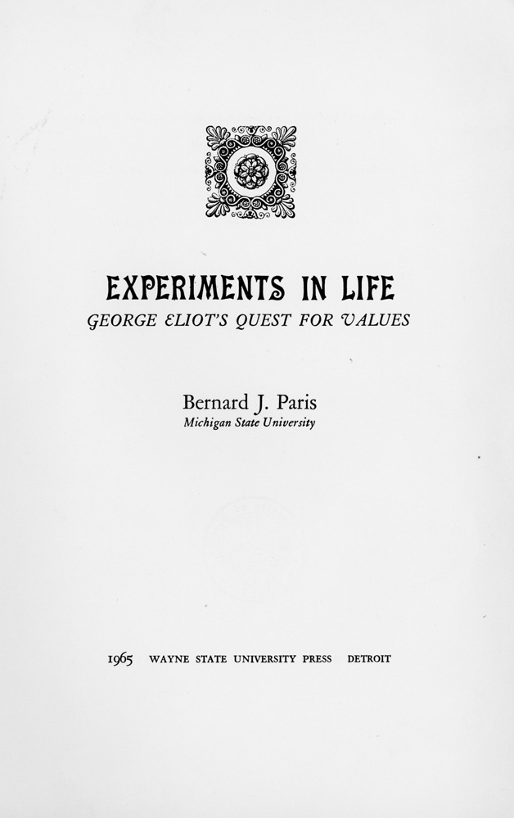
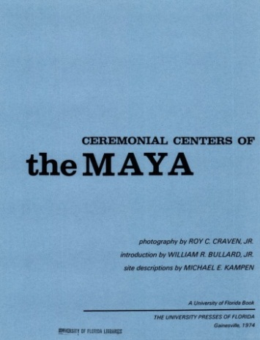
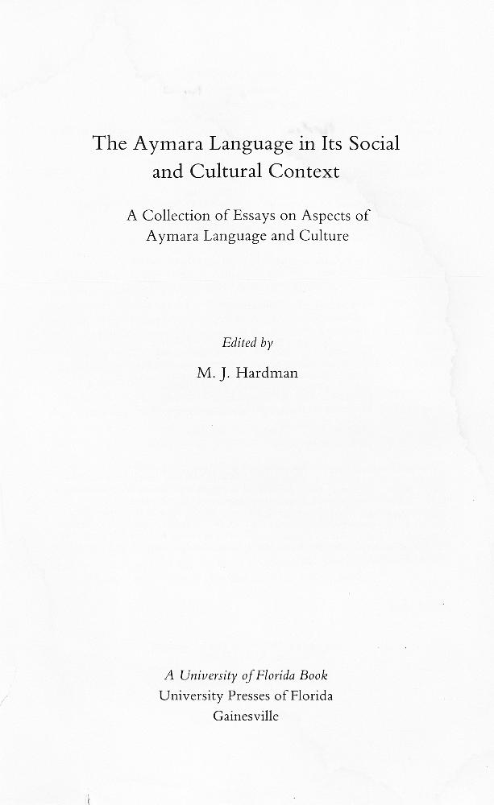
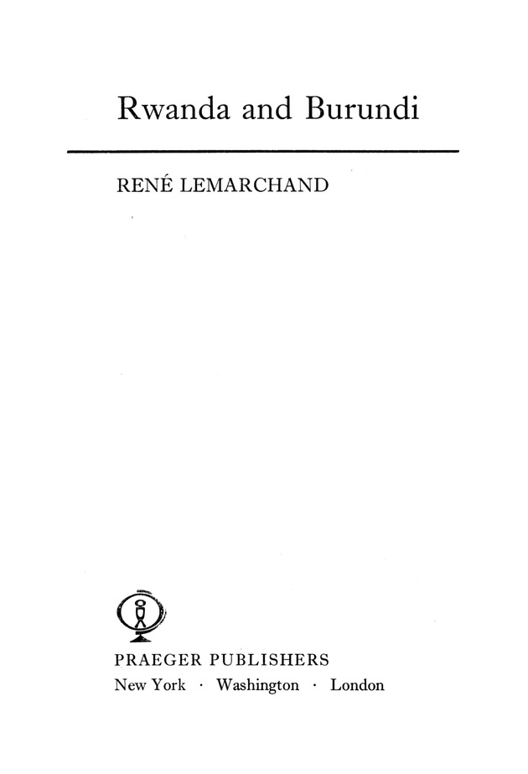
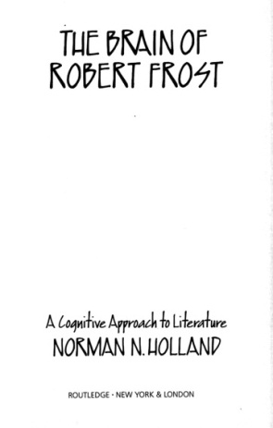
Open Access Monographs, “Born Digital/OA” and “Re-born Digital/OA”
Notes:
[Laurie]
Just how much money are those royalty checks worth to you? For some scholars, not as much as the widespread dissemination of their work.
Recent news stories abound of University and Academic presses digitizing their backlists, as well as new initiatives to develop all-digital, open access books from the very start as with California Classical Studies and the ACLS Humanities E-books, and there are new tools to help in this process like Open Monograph Press from the Public Knowledge Project.
Included with some of these initiatives are additional efforts to rethink how to successfully do peer review, maintaining the same rigor and quality but trying to grapple with the issues of lengthy time delays. Still other initiatives seek to grapple with core problems.
For instance, an article appeared in The Chronicle just last week on a new e-book initiative for Art, Art History, and Architecture from Yale Press. This is critical because art history needs high quality images to be included with their textual arguments. This continues to be extremely difficult and costly in print and digitally because of permissions. The new initiative is supported by a grant from the Mellon Foundation to Yale press specifically to support “how to make digital art-history publishing work better” (http://chronicle.com/article/Hot-Type-Art-Publishers-Look/135068/).
This sort of work is part of an overall trend where publishers, scholars, and our other core collaborators are working together to rethink how we do scholarship and scholarly communications in the digital age, and a great deal of how we do it ties to why we do it, which again means that more and more of our work is Open Access, even if we don’t necessarily use that term.

Slide 10
Open Access Policies by Scholarly Societies & Communities
Many disciplinary associations have been dubious of the open access movement, saying that it would hurt their revenues from journals (either directly through subscriptions or indirectly as an incentive to become a member of the association). [Rosemary] Feal [Executive Director] said she did not share those concerns.
"We believe the value of PMLA is not just the individual article, but the curation of the issue," she said. PMLA regularly includes thematic issues or issues where articles relate to one another. While there will be value in reading individual articles, she said, that does not replace the journal. Further, she said, the individual articles posted elsewhere could attract interest to the journal. The MLA's journal policies tend to be watched by many humanities related associations, and Feal said she hoped the MLA change would have an influence in encouraging open access. "While recognizing that each association and journal has its own business model, we hope that they will find ways, like the MLA, to disseminate their scholarship broadly.”
InsideHigherEd
Notes:
[Laurie]
In June of this year, “The journals of the Modern Language Association, including PMLA, Profession, and the ADE and ADFL bulletins, adopted new open-access-friendly author agreements, which will go into use with their next full issues. The revised agreements leave copyright with the authors and explicitly permit authors to deposit in open-access repositories and post on personal or departmental Web sites the versions of their manuscripts accepted for publication.” (http://www.mla.org/news_from_mla/news_topic&topic=596)
The text on the slide is from an article in InsideHigherEd on the MLA announcement. The quote from Rosemary Feal, the Executive Director for MLA is worth repeating: "We believe the value of PMLA [the primary MLA journal] is not just the individual article, but the curation of the issue.” She is explicitly stating that publishers add value and that Open Access to individual articles has value and does not detract from the value of the scholarly publication or from the scholarly society.
This is not a unilateral change, and Feal rightly states: "While recognizing that each association and journal has its own business model, we hope that they will find ways, like the MLA, to disseminate their scholarship broadly.”
http://www.insidehighered.com/news/2012
/06/06/mla-embraces-open-access-writer-agreements-journals#ixzz29fmrEvcJ

Slide 11
Open Access Policies by Scholarly Societies & Communities
“The current system of access to journal content certainly contains elements of unfairness […]. But solutions that ignore the wide differences between the respective landscapes of science and humanities journals generate new, and more difficult, dilemmas. Requiring authors to pay the costs of their own publications is not the answer. The AHA suggests that historians begin thoughtful conversations at their own institutions and participate in the discussions that we will initiate at our annual meeting, our web site and other appropriate venues.”
Notes:
[Laurie]
The quote on this slide is from the American Historical Association or AHA, issued last month. The AHA statement here reinforces what MLA has stated, which is that “each association and each journal has its own business model.”
MLA stressed that their goal was to “find ways […] to disseminate their scholarship broadly.” This is a goal we all have all scholars, as members of our scholarly societies, and as contributors to our scholarly journals and publications.
In looking to support this goal, the American Historical Association also rightly notes that there is no one model for doing so and that, for them, requiring authors to pay the costs of their own publications is not the answer.
Like MLA, AHA encourages that historians engage in conversations and participate in discussions on developing successful models or methods,

Slide 12
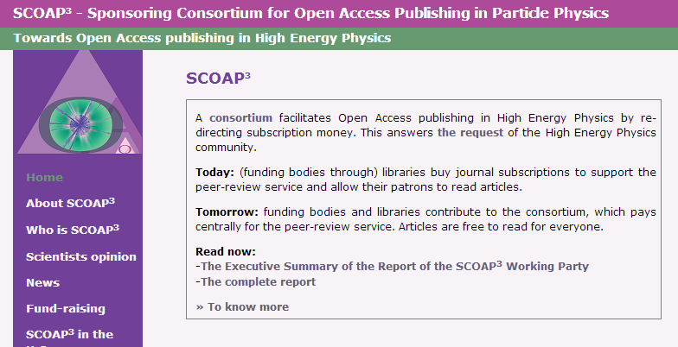
Open Access Policies by Scholarly Societies & Communities
SCOAP³ - Sponsoring Consortium for Open Access Publishing in Particle Physics
Notes:
[Laurie]
In looking for additional models, some of the discussions on Open Access are still hindered by thinking individually as a lone scholarly society or journal, instead of collectively as we can do with Open Access.
The High Energy Physics community has an amazing model for how to successfully think through Open Access as a community. This slide shows the logo for SCOAP³ – the Sponsoring Consortium for Open Access Publishing in Particle Physics.
“SCOAP³ is a consortium facilitates Open Access publishing in High Energy Physics by re-directing subscription money. This answers the request of the High Energy Physics community.
Today: (funding bodies through) libraries buy journal subscriptions to support the peer-review service and allow their patrons to read articles.
Tomorrow: funding bodies and libraries contribute to the consortium, which pays centrally for the peer-review service. Articles are free to read for everyone.”
(http://scoap3.org/)
In the SCOAP³ model, the community did not approach the problem alone. Instead, the scholars, scholarly journals, publishers, and libraries all worked together to develop an equitable solution that met everyone’s needs.
Again, this may not be a model that works for everyone, but it is another model that is being successfully implemented for all involved. And, by successful, I mean that it better serves the core values and goals of scholars, scholarly societies, academic institutions, and the full academic and public communities that we’re part of.

Slide 13
Considerations Moving Forward
Incentivize senior faculty to establish high-quality refereed OA outlets.
Treat dissertations and creative works differently to avoid impeding the publishing process.
Think about primary and secondary sources as two sides of the same OA coin.
Think creatively about ways that Universities can distribute subscription fees to support the costs of publishing for scholarly societies.
Notes:
[Laurie]
This is what we do as academics and scholars: support our fields and communities. Open Access is another term for what we all believe in.
Particularly in the humanities and social sciences, where funding is minimal, we need to think creatively about how to support scholarly needs for dissemination and peer review. Let’s drive technology, not let it drive us.

Slide 14
Thank you
Dr. Sophia Krzys Acord, Associate Director, Center for the Humanities and the Public Sphere Dr. Laurie Taylor, Digital Humanities Librarian, UF Smathers Libraries
Notes:
[Sophia]
I am a sociologist, and Laurie is a scholar of English and cultural studies. So we are always puzzled by the fact that, for some reason, open access is generally a term associated with the biological, physical, chemical, and medical sciences. Sure, journal subscriptions in these fields are orders of magnitude more expensive than subscriptions in the arts, humanities, and social sciences. And, sure, they publish more frequently and tend to ‘expire’ more quickly than in our fields. All of these facts certainly predispose the sciences to explore digital and low-cost publication mechanisms. But, we’d like to use this opportunity to discuss the many ‘flavors’ of open access publication that exist in the humanities and social sciences, many of which are scholar-driven and pre-date open-access movements in the sciences. In fact, many of these publication and dissemination models are not usually branded as ‘open access’, and refer to themselves using a different terminology such as ‘online’ ‘digital scholarship’ ‘working papers’, etc. But, it is our goal here to say that these movements, despite appearing under different names, are very much in keeping with the open access spirit of increasing the dissemination and quality of scholarly publications in the digital age.
Our talk has three parts today:
Some background to the unique publishing issues in the humanities and social sciences
Examples of various OA initiatives across the humanities and social sciences (and arts, briefly)
Discussion of OA policies at scholarly societies in the humanities and social sciences
Our normal caveats apply:
Not everyone in every field engages in OA practices of the sort we will describe (individual proclivities rein)
There are tremendous cultural differences between fields
The age of a scholar matters enormously when thinking about how to disseminate one’s scholarship

