Slide 1
The Florida Digital Newspaper Library
http://ufdc.ufl.edu/newspapers
Notes:
Thanks to the Tampa Bay Library Consortium for arranging and hosting this presentation.
Today, we’re speaking about the Florida Digital Newspaper Library.
====================================================
Full Outline
Thanks
Introductions
Overview - Current status and collection goals
Size and scope
Needs: 30K microfilm reels at UF alone
Contents
Range of time, frame historic and current and explain scope
example with BCT and others with scattered years
example with changes: worst of renames and papers that moved cities; Ok. Daily News now just O. News
Functionality
Mention regular usability studies
Enhancements
Search by date range
Resources for assisting patrons –
Examples of common questions
Approach and walk through several questions
Where you go from there – new FAQ
Continuing the conversation We’d like to get your feedback and we’ll share how to contact us
Q&A

Slide 2
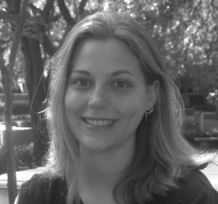
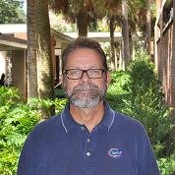
Laurie N. Taylor
Digital Humanities Librarian
Patrick Reakes
Chair, Library West
Notes:
First, to get started, we wanted to do introductions.
I’m Laurie Taylor, the Digital Humanities and Outreach Librarian for all of the digital collections supported by UF, including the Florida Digital Newspaper Library.
Pat introduction.
We work with a team of people at UF who all support and develop the Florida Digital Newspaper Library.

Slide 3
Agenda
Current status and collection goals
Contents
Functionality
Resources for assisting patrons
Continuing the conversation
Q&A
Notes:
This is the agenda for what the webinar today will cover:
We’ll start by going over what the Florida Digital Newspaper Library is, covering:
Current status and collection goals
Contents
And Functionality
Then, we’ll cover resources for assisting patrons and how to continuing the conversation from the webinar on, before closing with a question and answer session.
===========================
Overview - Current status and collection goals
Size and scope
Needs: 30K microfilm reels at UF alone
Contents
Range of time, frame historic and current and explain scope
example with BCT and others with scattered years
example with changes: worst of renames and papers that moved cities; Ok. Daily News now just O. News
Functionality
Mention regular usability studies
Enhancements
Search by date range – coming soon
Resources for assisting patrons –
Examples of common questions
Approach and walk through several questions
Where you go from there – new FAQ
Continuing the conversation We’d like to get your feedback and we’ll share how to contact us
Q&A

Slide 4
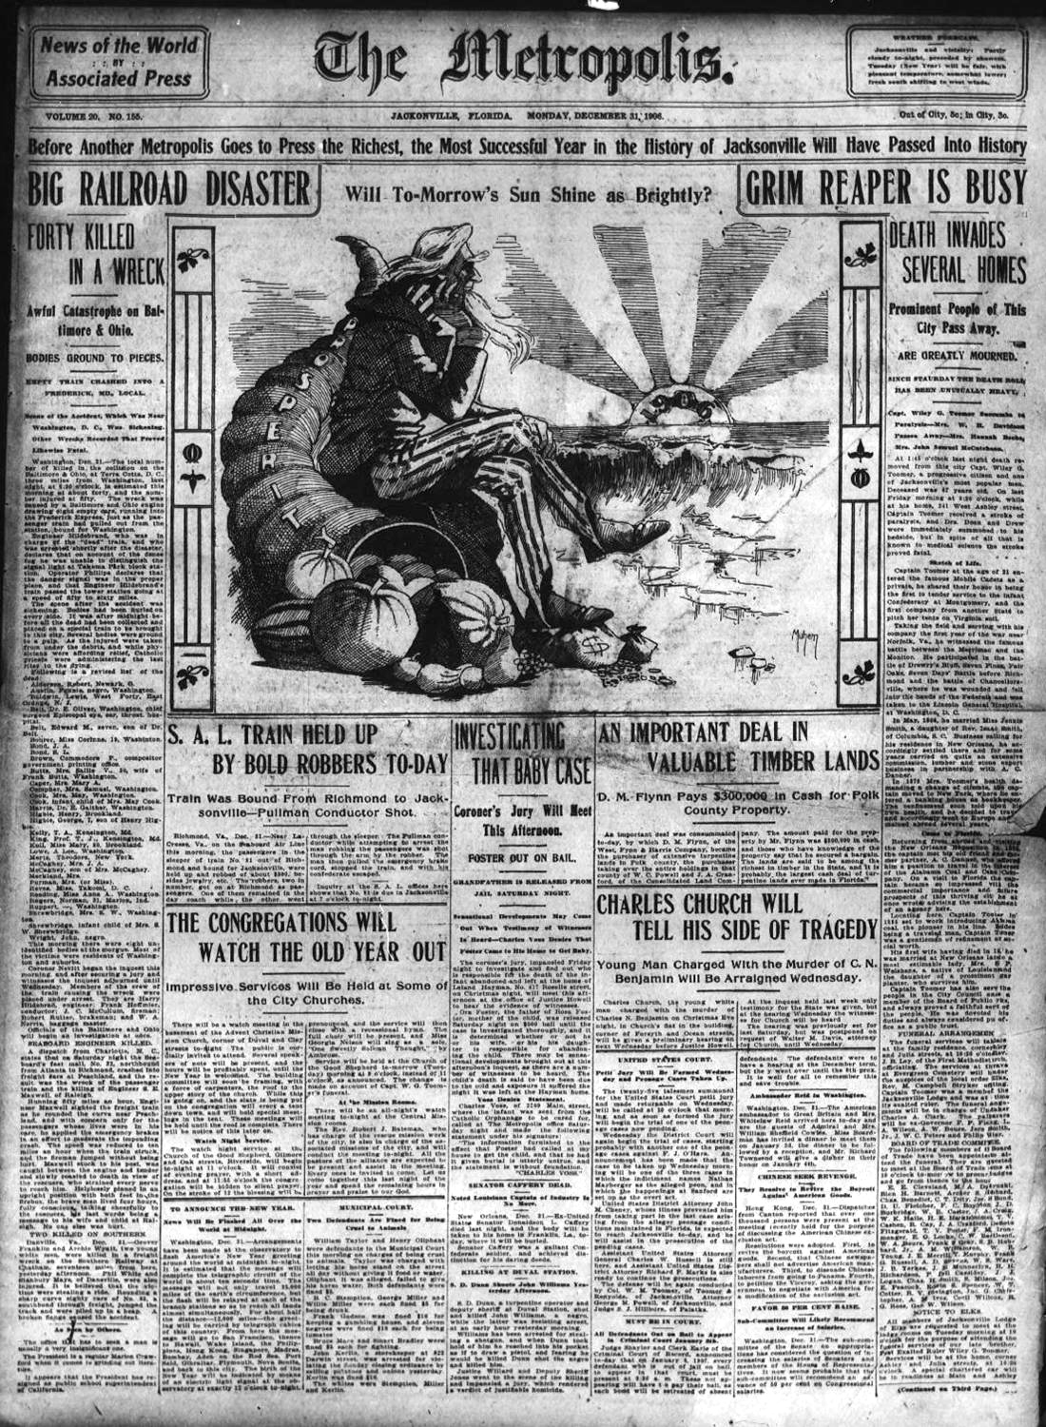
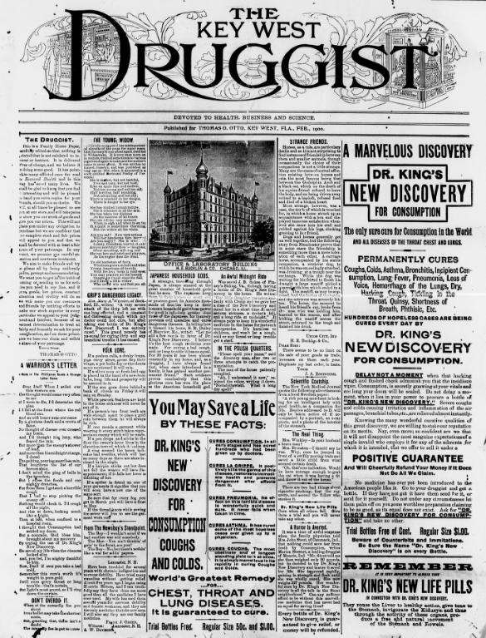
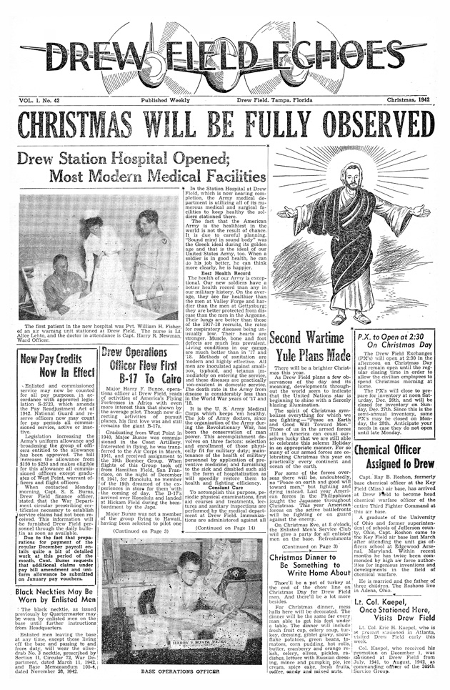
http://ufdc.ufl.edu/newspapers
Notes:
Current Status and Collection Goals
The FDNL currently has over 1.3 million pages of historic through current newspapers. The Florida Digital Newspaper Library is accessed over 1 million times each month.
Currently, new issues of local, rural Florida newspapers are added on an ongoing basis. These newspapers replace what UF formerly preserved in microfilm with microfilming ending in 2005 and the process now all-digital.
The newspapers in the Florida Digital Newspaper Library come from libraries and other organizations throughout the State of Florida. The majority are from the P.K. Yonge Library of Florida History at the George A. Smathers Libraries, University of Florida, which holds the largest collection of newspapers in the State. A collection and preservation effort begun in 1944 called for acquisition of at least one newspaper from each of Florida's 67 counties on an ongoing basis. The library began to produce in-house microfilm copies of its Florida newspapers in 1947, microfilming and now digitizing 67 current Florida newspapers on a regular basis today. Retrospective digitization is undertaken in-house when possible. This is going to remain an ongoing challenge because UF alone has over 30,000 reels of Florida newspapers on microfilm, so there’s a great deal of work to be done.
The Florida Digital Newspaper Library has been funded in part by grants from Florida’s Library Services and Technology Act (LSTA) Grants Program, from the National Endowment for the Humanities' National Digital Newspaper Program, and from the Institute for Museum and Library Services, and receives ongoing support from the University of Florida George A. Smathers Libraries.

Slide 5
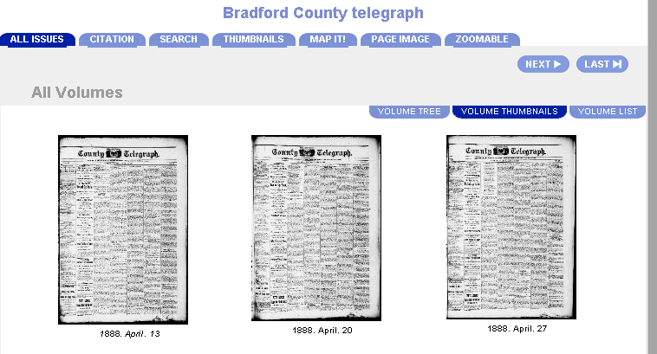
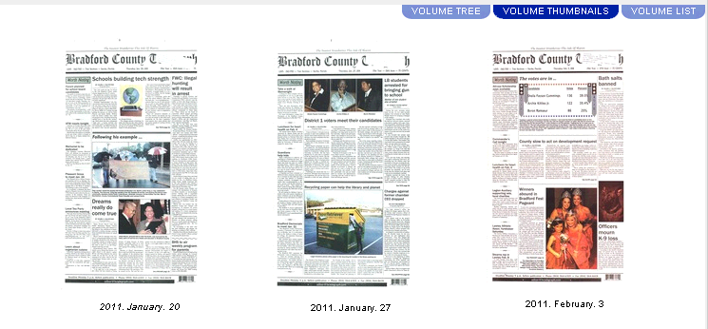
Notes:
Contents
The contents of the FDNL cover historic through current content. Because FDNL grew out of the earlier microfilming program where UF formerly microfilmed many local papers, that process changed to digitization in 2005. Since 2005, UF has no longer microfilmed and instead has digitized Florida newspapers from 2005-present.
Thus, much of the content is from 2005-present.
While it’s critical to preserve the current news which will eventually become historic, there’s also great interest in the already historic news.
Whenever possible, UF has sought grant funding to enable the retrospective digitization of historic Florida newspapers. A great deal of historic newspapers have also been digitized, but this has been as funding allowed so it was opportunistic and tactical rather than a comprehensive or systematic approach.
Thus, there are also many historical newspaper issues.
In some cases, there are complete or nearly complete runs of a particular newspaper title.
For instance, the Bradford County Telegraph from 1888-present is in the FDNL. The majority of years for the Jax Air News are as well.
The images on this slide show some of the historic and more recent issues.
For many papers, it may only be issues from 2005-present.

Slide 6
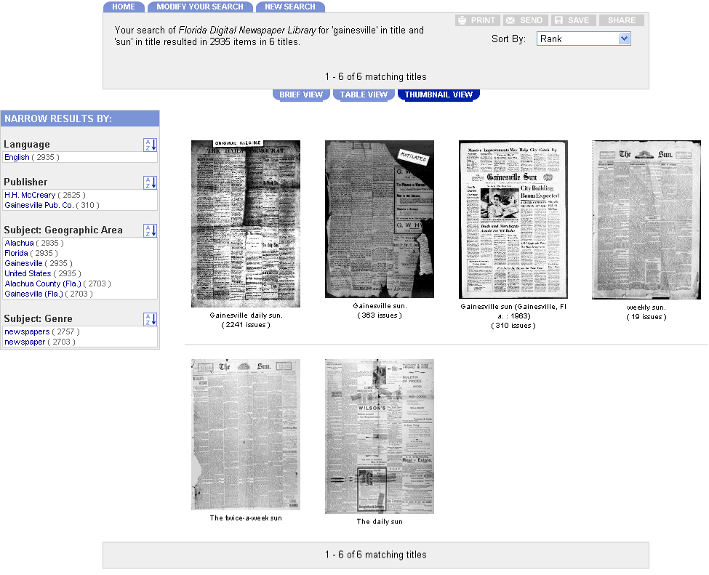
Notes:
Contents
In addition to the range and variety with historical and current newspapers, many of the newspapers themselves change a great deal over time.
For instance, some papers change a word in the name, like the Okeechobee Daily News dropping Daily to become the Okeechobee News.
Others, like The Gainesville Sun, change names and publishers over the years. The image here shows some of those title changes.
Still others change the location with some papers in Florida moving from Jacksonville to Tampa, and only sometimes is this related to a title and publisher change.
The different titles, publishers, and locations are important to support use and research. However, this information can also be confusing when patrons simply want their hometown paper which at least seems to have been the same paper for many years.

Slide 7
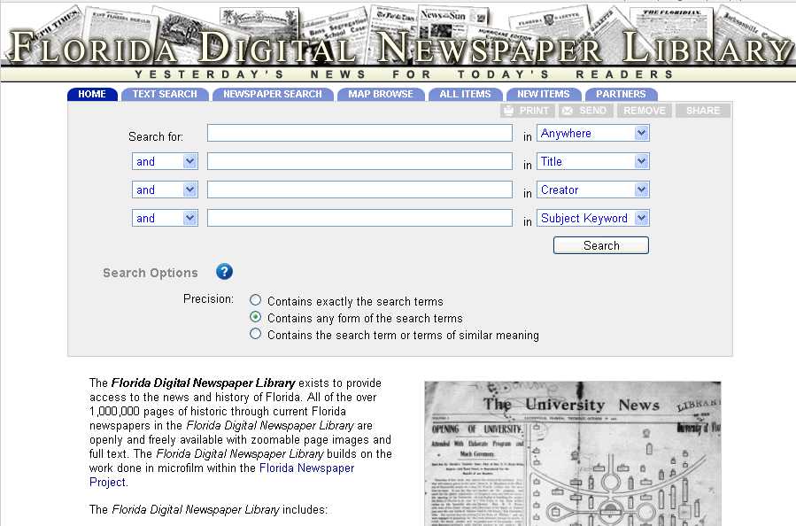
Notes:
Functionality
The complexity of dealing with newspapers brings us to Functionality of the FDNL.
With the complexity of the name changes, location changes for publishers, and simply so much rich content, the Florida Digital Newspaper Library also offers a number of features to ensure the materials are usable.
What you see on this slide is the homepage for FDNL.
Here, patrons can easily search by full citation.
Patrons can click on the “Text Search” tab to search the full text.
Patrons can also browse by “All Items” and “New Items”. This is essential for patrons who are interested in something, but not always sure what they want to find so browsing allows them to serendipitously stumble across items of interest and just to browse as an end in itself.

Slide 8
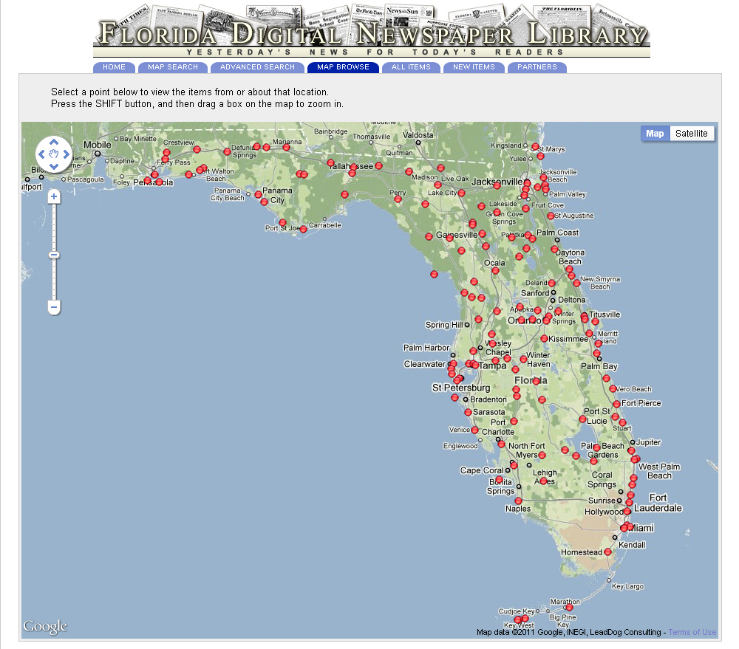
Notes:
Most recently, we also added a Map Browse.
This is part of UF’s ongoing work to enhance the system. We conduct regular usability studies and implement enhancements when possible.
The Map Browse on this slide shows the standard view. The dots are the central points for each of the towns where the newspapers are published.
This is very important when people are looking for news from their area, but aren’t sure what the newspaper title might be and are looking for papers from a general area and not necessarily only Port St. Lucie or another city.
This is also very important for historical research. Florida used to have a thriving turpentining and Spanish moss gathering industry, with these often located in the same town. Turpentine and Spanish moss are both very flammable. That, plus the frequency of lightning in Florida and the heat resulted in many fires that destroyed towns where the towns were not later rebuilt. With the towns no longer existing, no one would know to search for them. The map gives patrons a way to see papers from their area, even for places that are no longer there.

Slide 9
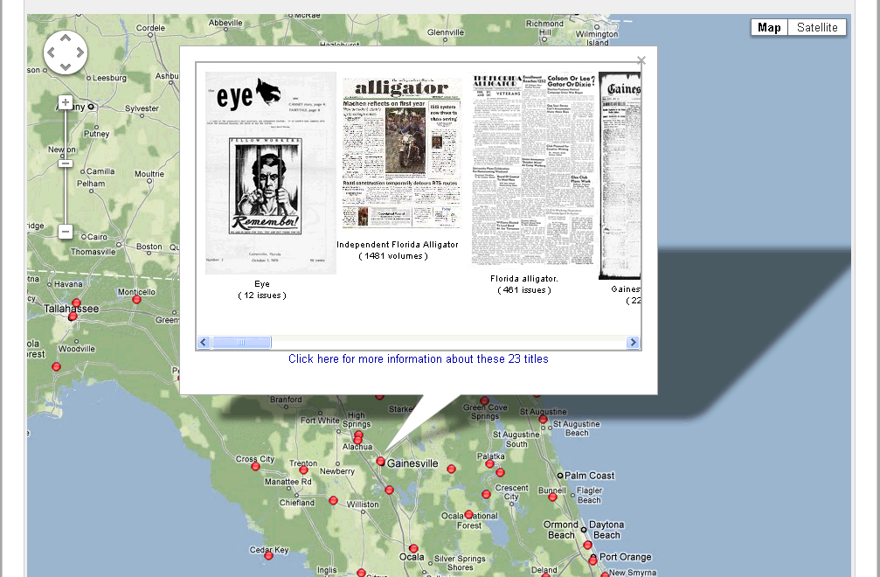
Notes:
Clicking on one of the points brings up this view, which shows cover pages and number of issues for the papers from that location.

Slide 10
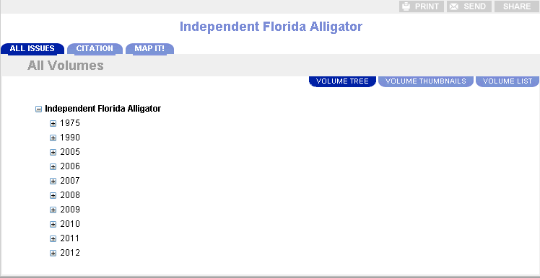
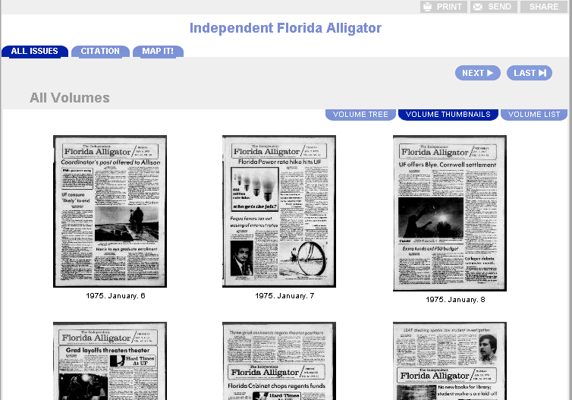
Notes:
Functionality
In addition to the functionality at the top-most level, the FDNL supports many features for each title and each newspaper issue.
The images on this slide show the title level display by date. Additionally, patrons can select “Volume Thumbnails” to see the cover issues for all of the papers. This is a fabulous feature for students looking for a strong headline story for a class paper.

Slide 11
Notes:
Functionality
At the issue level, there are many different views to support patrons. The slide here shows the simple page image view. Patrons can use the “Go To” page numbers to go to a particular page and the “Next” and other buttons to page through the issue.

Slide 12
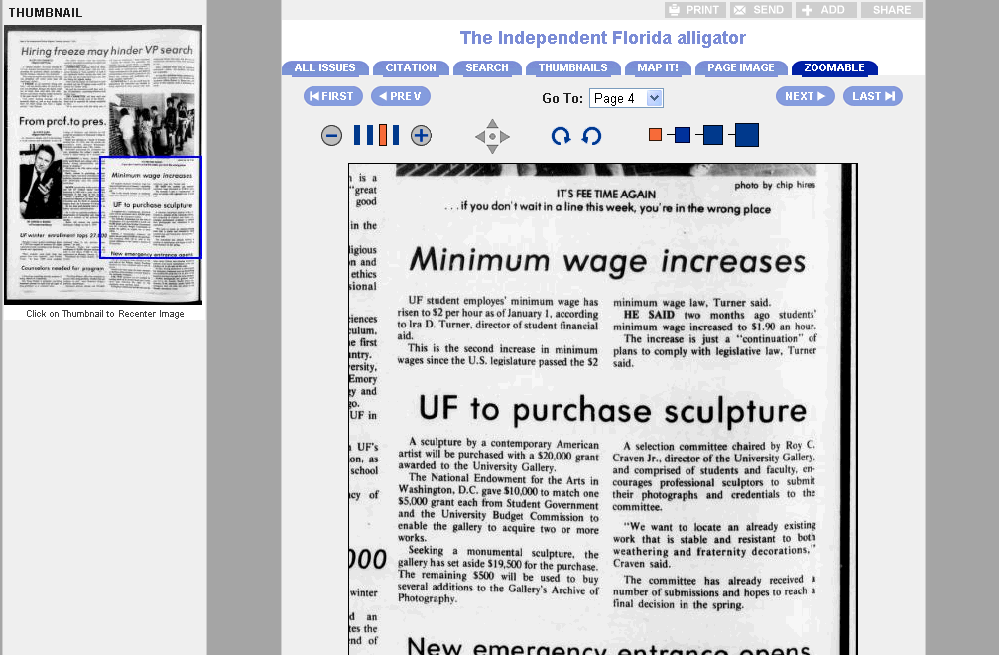
Notes:
The “zoomable” tab allows patrons to zoom in to the page image, which is often needed to read the small print.

Slide 13
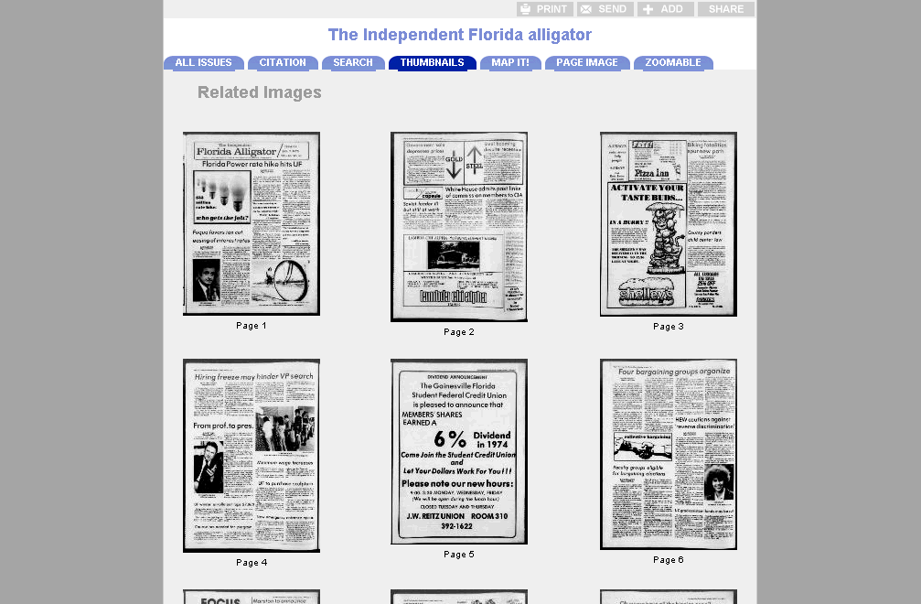
Notes:
Patrons can also use the “Thumbnails” tab to see the thumbnails for all pages of an issue, which is again great for students looking for a local interest column or other news from a specific date in history.
There are a number of other tabs. One is “citation” which gives all of the citation information for use in referencing the item, including the permanent link.
The “Search” tab allows patrons to search the full text of that specific issue.
The “Map It!” tab shows the location of the publisher for the specific paper.
The “All Issues” tab shows the list of all of the issues listed by date, which was shown on an earlier slide.

Slide 14
Notes:
Additionally, many of the newer issues are now received as the digital files that the newspapers send to their printers to create the printed newspaper. These “born digital” files are often PDFs. The PDF display is used for these issues and it’s shown on this slide.
In addition to such a wide range of content and so many features, the FDNL is always changing and growing with new issues added daily and new features implemented as resources allow.

Slide 15
Notes:
Citation slide, consistency and constancy of the permanent URL.
Can also mention small, gray buttons: print, send, add, and share.
After this slide, we move to showing online: http://ufdc.ufl.edu/newspapers

Slide 16
Example Searches and Browses
Browsing All Items
Map Browse
Text Search (Full Text Search)
Newspaper Search (Main Search, Metadata/Record)
Notes:
Browsing all items
Selecting facet for Air Bases
brings up Drew Field Echoes, Southernmost Flyer, Gulf Defender, and Jax Air News
Text search for basketball, http://ufdc.ufl.edu/l/fdnl1/results/?text=basketball
Tyndall Target example is 7th result
Clicking on it brings up search page: http://ufdc.ufl.edu/l/UF00076230/00008/search?search=basketball with text in context
Text-on-page-highlighting not yet in place, but is in the work queue, but the search page with highlighted text gives context
Same features already covered with citation, thumbnails, map it, page image, and zoomable
Let’s say we wanted a great image
From the single issue, we can click on thumbnails to see the overview: http://ufdc.ufl.edu/l/UF00076230/00008/thumbs?search=basketball
Let’s say these didn’t work for us, so we can click on all issues: http://ufdc.ufl.edu/l/UF00076230/00008/allvolumes?search=basketball
Then, on volume thumbnails to see the covers for all of the issues: http://ufdc.ufl.edu/l/UF00076230/00008/allvolumes2?search=basketball
Newspaper search for Air http://ufdc.ufl.edu/l/fdnl1/results/?t=air+force,,,&f=ZZ,+TI,+AU,+TO
Use facets to narrow for Jax: http://ufdc.ufl.edu/l/fdnl1/results/?t=air+force,,,,%22Jacksonville%22&f=ZZ,%20TI,%20AU,%20TO,SP
The remaining result is the Jax Air News
Clicking on through to the issue: http://ufdc.ufl.edu/l/UF00028307/01495?search=air
And to the search page: http://ufdc.ufl.edu/l/UF00028307/01495/search?search=air
Shows the terms we searched for in the search, and we can search for something else like admiral: http://ufdc.ufl.edu/l/UF00028307/01495/search?search=admiral

Slide 17
FAQ
Where can I find additional years of a newspaper?
How do I save an image?
Can I Print an Image for Personal Use?
Notes:
Resources for assisting patrons
Even with all of this change, we often receive the same types of questions from patrons and these questions have remained fairly consistent over the past few years.
We’ve now covered the contents and functionality of FDNL, and so we’d like to share resources for assisting patrons.
This slide shows several common questions. All of these are listed on the “Help” page, which is accessible from the “Help” link in the top right corner.
Additionally, patrons can always email us by clicking on the “Contact Us” link at the bottom of every page.
So, let’s go through these questions and answers.
Where can I find additional years of a newspaper?
For newspaper issues that are not online, they are often only available on microfilm. To be certain of this, it’s best to check the title and city for the paper the patron is requesting. As we saw with the Gainesville Sun, Daily Sun, Twice Weekly Sun, the paper may be there but it may be under another name. The confusion over paper names leads to patrons to misremembering the paper name fairly frequently. Also, patrons sometimes ask for a specific paper, thinking it’s the only one in the area and so the only one with what they’re looking for. In some cases, patrons can find what they need in another paper.
For the other cases, where the paper is not online, it is most often available in microfilm. We normally recommend that patrons contact their local library to borrow the film using interlibrary loan and then the film can be sent to them, so that they can access the film in their local library.
How do I save an image?
Walkthrough process: http://ufdc.ufl.edu/l/ufdchelp#save
Can I Print an Image for Personal Use?
Click on permissions link: http://ufdc.ufl.edu/l/permissions
Go to Fair Use, remind that libraries need to exert and support Fair Use, and a personal copy certainly applies.

Slide 18
The Florida Digital Newspaper Library
http://ufdc.ufl.edu/newspapers
Notes:
Those are our most frequent questions. We’d like to know what other questions people are receiving and to know how we can provide further support. It may be that we can add a few questions to our FAQ or that a LibGuide is needed or something else.
To know what’s needed, we’ll start the conversation here with Q&A. Please, also continue the conversation by contacting us. We can be reached by clicking the “contact us” form at the bottom of every page in the FDNL.
Thank you for your time today and to the Tampa Bay Library Consortium for hosting this presentation, as well as for the wonderful work to support AskA Librarian.
Now let’s open the Q&A.

