Slide 1
- ARL Position Description Bank -
May 2012

Slide 2
Agenda
Welcome & Introductions
Review
Concept
Metadata
Functionality
Mock-Up

Slide 3
Overall Goal
another interactive discussion covering:
user needs
system specifications and functionality

Slide 4
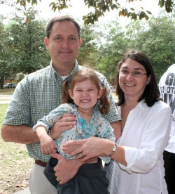
Brian W. Keith
Associate Dean, Administrative Services and Faculty Affairs
Project Team
Bonnie J. Smith
Assistant Program Director, Human Resources
Laurie N. Taylor
Digital Humanities Librarian
Mark V. Sullivan
Head, Digital Development and Web Services

Slide 5
Introductions
Participant Introductions

Slide 6
Review Design Elements
Web application
A simple, intuitive, easy to use interface
Metadata submitted and maintained by institution
combination of externally viewable and for institution’s eyes only
Keyword searchable
Ability to customize and brand at the institutional level

Slide 7
Review Design Elements
Secure digital preservation
Documents uploaded and updated by institutions
Files could be text, PDF, or Word documents
PDs and/or vacancy announcements and/or activity/assignment reports

Slide 8
Review Design Elements
Metadata and documents should not include:
Home address or telephone number
Social security number
Date of birth
Driver's license or identification number, alien registration number, passport number, etc.
Bank account, or credit or debit card information

Slide 9
(Minimal) Required Metadata
Externally Viewable – Used for Searching
1 Working title (what if no working title?)
2 % FTE (?)
FLSA status
3 Position type (select one)
Professional librarian
Other professional
Support or paraprofessional (exempt only)
Hourly and overtime eligible (non-exempt)
4 Appointment type
Regular
Tenure Accruing or Permanent Status Eligible (?)
Temporary
Internship
Residency/Fellowship

Slide 10
(Minimal) Required Metadata
Externally Viewable – Used for Searching
5 Library type
Law Library
Medical Library
All Other
Dates (system generated not inputted)
6 Functional Area

Slide 11
Metadata – Externally Viewable
Functional Areas – Select all that apply
Public Services | Acquisitions | Facilities
Reference/Research | Preservation | Development/Fundraising
Subject Specialist | Access Services | Finance/Budget/Accounting
Instruction Services | Cataloging | Grants Management
Scholarly Communication/ Copyright | Shared Collections | Human Resources
Collection Development | Digital Services | Systems (IT)
Archiving/Curatorial/Special Collections and Rare Books | Data Curation | Administration
Liaison | Off-Site Storage | Branch Management
Assessment |  | Departmental Management
 |  | Exhibits

Slide 12
Metadata – Externally Viewable
Functional Areas – DELETED from Previous List
Media Specialist | Document Delivery | Communications/PI
 | ILS
 | Technical Services

Slide 13
Metadata – Externally Viewable
Functional Areas – Select all that apply
Public Services
Technical Services
Administration
Other

Slide 14
Optional Metadata
Institution’s Eyes Only
Pre-Programmed
Employee name
Supervisor name
Reports to (alpha numeric field)
Rank/classification
Hire date
Termination date
Position number
Department/branch/unit
Review cycle (next date for review)
Notes
10 customizable alpha/numeric fields

Slide 15
Functionality
Features
Ability to upload other, institution-level files
Archives and access to previous versions of documents for a position
System will track submission and modification dates, and user information
Forwarding option
Support for the establishment of review schedules
Ability to flag vacant positions

Slide 16
Functionality
Features
Run reports for all, external only and internal only positions
Institutional contact information will be incorporated
Ability to search by institutional characteristics:
region (ARL) and
public v. private

Slide 17
Discussion
What else – what are we missing or should we think about?

Slide 18
Mock-Up

Slide 19
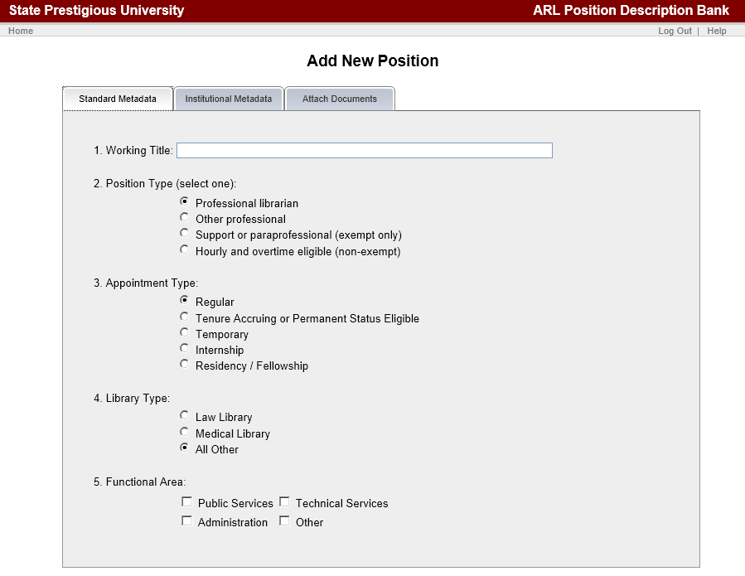
Add New Position - 1

Slide 20
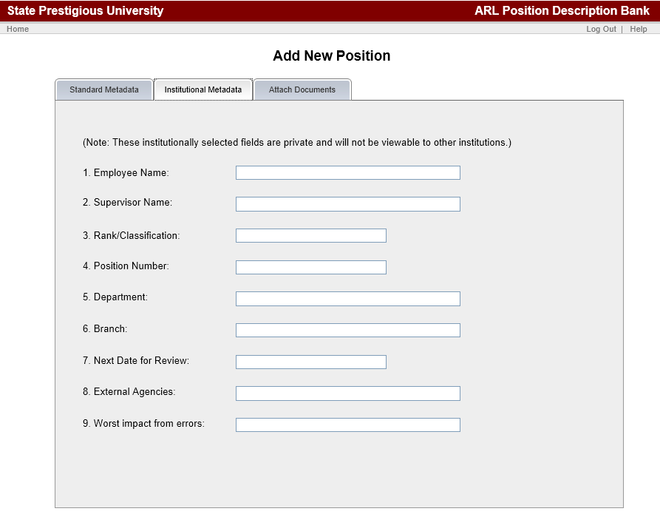
Add New Position - 2

Slide 21
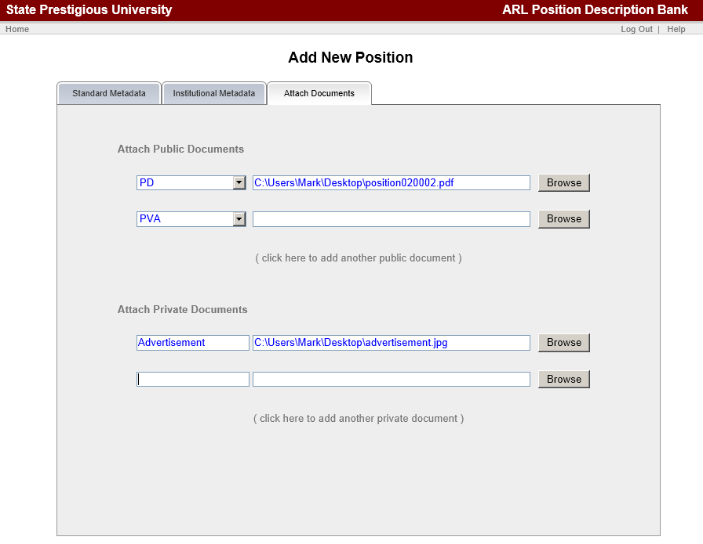
Add New Position - 3

Slide 22
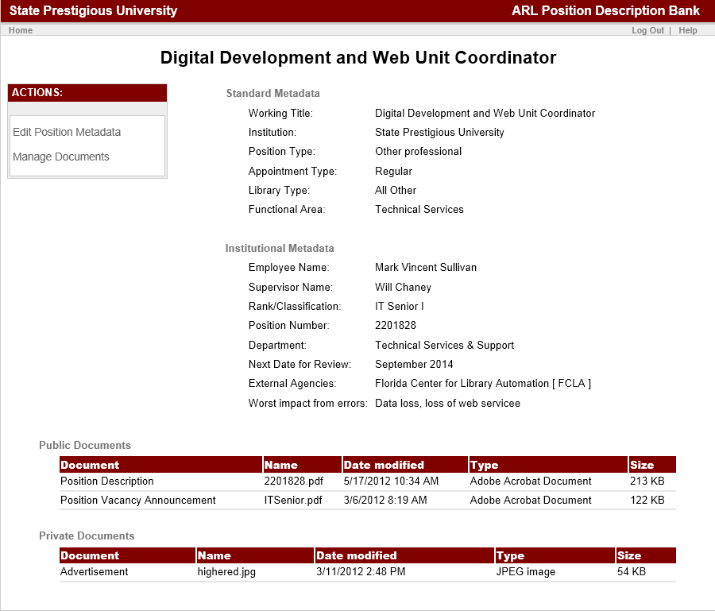
Single Record View

Slide 23
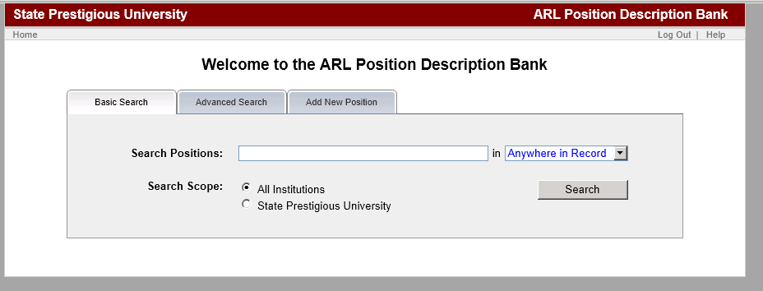
Basic Search

Slide 24
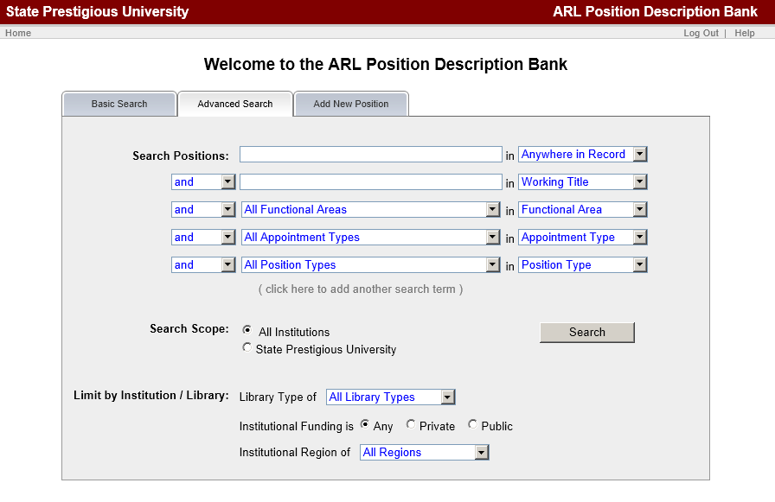
Advanced Search - Global

Slide 25
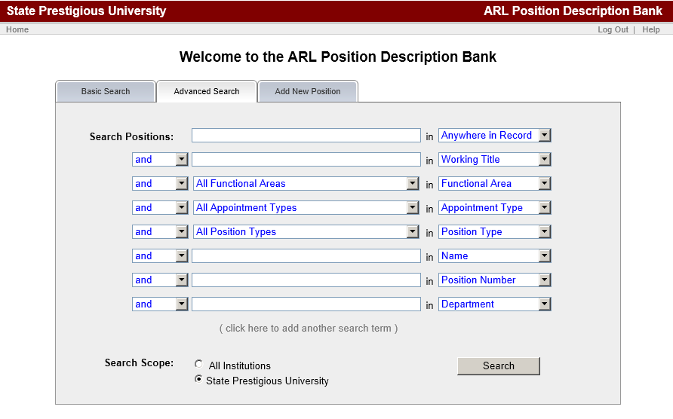
Advanced Search - Institution

Slide 26
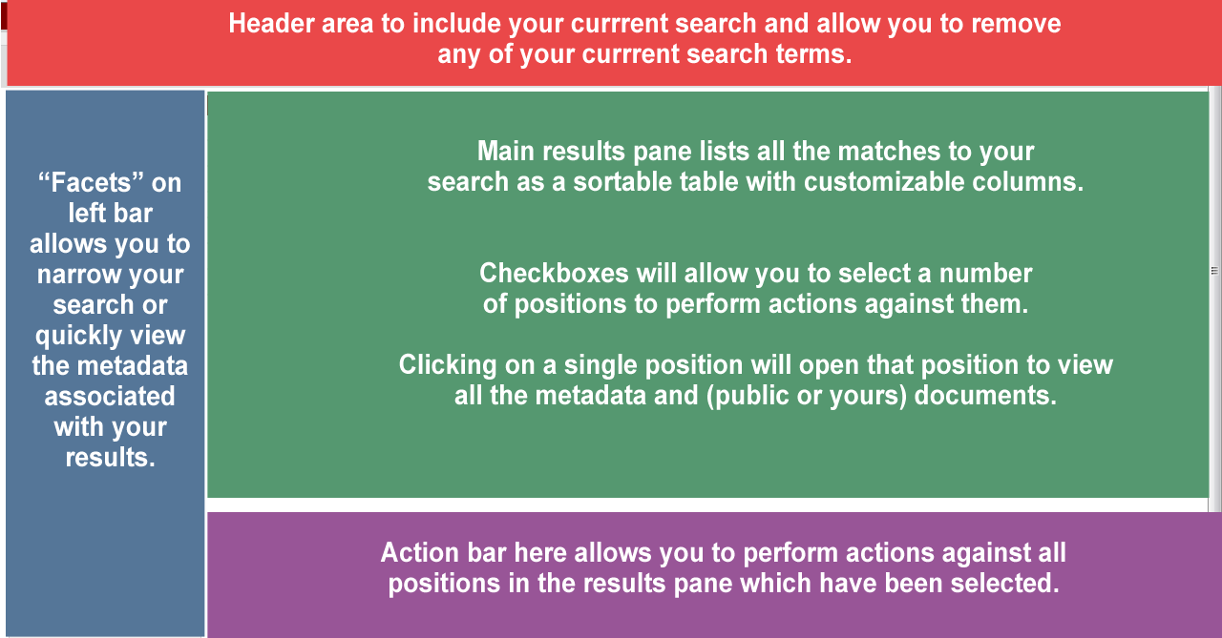
Search Results - Layout

Slide 27
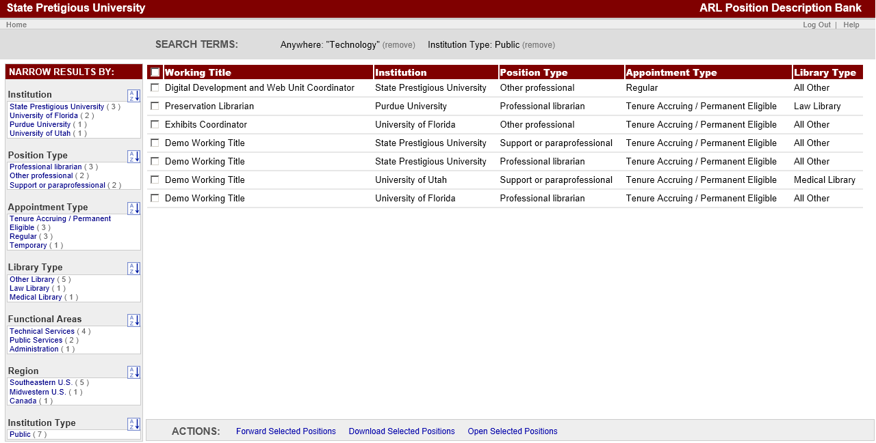
Search Results

Slide 28
- ARL Position Description Bank -
Questions?
Anything Else?

Slide 29
- ARL Position Description Bank -
Thank you
- Contact Information -
Bonnie Smith
Email: ARLPDBank@uflib.ufl.edu
Phone: 352-273-2603

