Slide 1
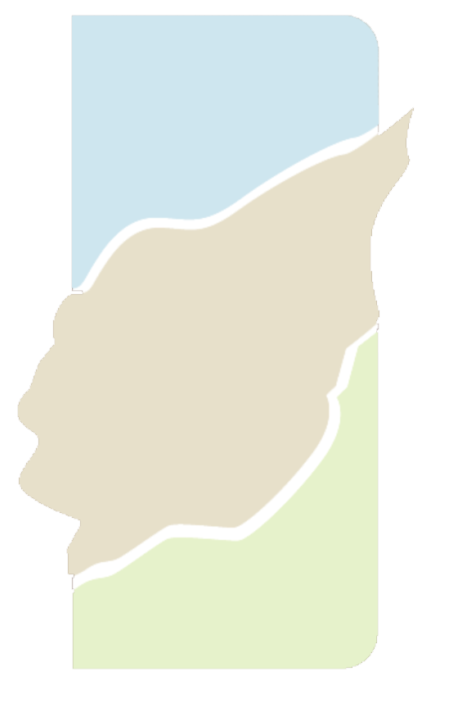
Mark V. Sullivan, Application Engineer/Digital Curation Director
Laurie N. Taylor, Technical Director
Digital Library of the Caribbean
marsull@uflib.ufl.edu and laurien@ufl.edu
The Digital Library of the Caribbean
www.dloc.com

Slide 2
dLOC Model
The Digital Library of the Caribbean (dLOC) is a cooperative digital library for resources from and about the Caribbean and circum-Caribbean. dLOC provides access to digitized versions of Caribbean cultural, historical and research materials currently held in archives, libraries, and private collections.
Notes:
Points to highlight that will be covered:
dLOC is a permanent preservation and access repository with enhanced features for contributing partners and users.
Organizational structure with strong governance
Scope of collections includes archives, artifacts, books, government or official documents, journals, newspapers, numeric data, and recorded sound and video. Collections contributed will pertain but not be limited to the arts, culture, ecosystems, government and civic society, history, literature, sciences, and travel.
Collection management: all partners select what to digitize and digitize and contribute their selected materials. Partners review for copyright, create metadata, and digitize to shared standards.
All materials remain property of the partners. Partners only grant permissions for materials to be accessible and preserved through dLOC.

Slide 3
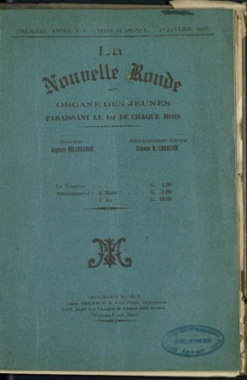
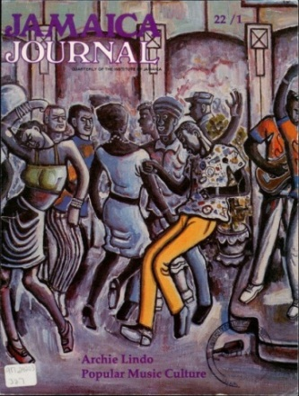
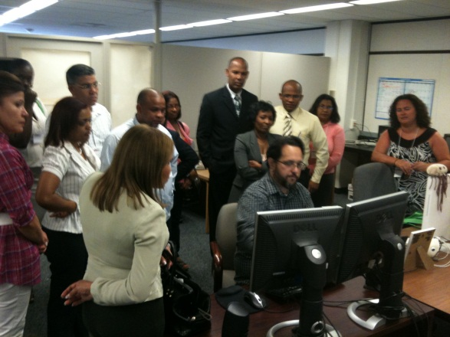
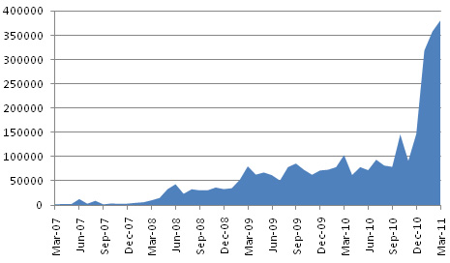
dLOC Collaboration
32 Partners – Caribbean, Europe and US
Access to Caribbean Resources
Over 12 million hits since 2006
Over 1.7 million pages of content
Digitization Training Program for Partners
Caribbean Studies and Educational Outreach
Preservation, Access, and Enhanced Features
dLOC Oral Histories Workshop
ACURIL 2011 Tampa, FL
Monthly Hits
March 2007 – March 2011
Notes:
27 on-site trainings reaching 450 people
Online supports with over 1,000 documented hits

Slide 4
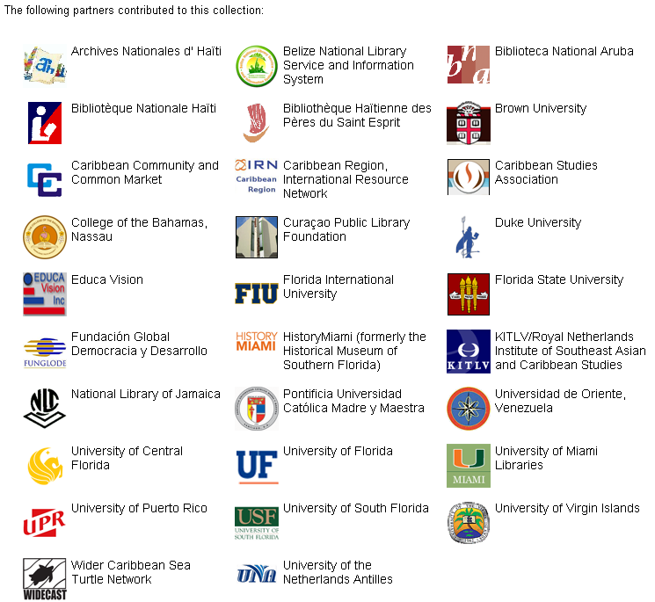
dLOC Collaboration
Partner Training
Technical Infrastructure
Institutional Support
dLOC Partners with Collections Online
Notes:
27 on-site trainings reaching 450 people
Online supports with over 1,000 documented hits

Slide 5
dLOC Governance
Partners (Affiliated, Scholar Contributors)
Members
Executive Board
Scholarly Advisory Board
Program Team Members
Notes:
Member model is new and being released for sustainability of ongoing program growth which includes support for onsite training and equipment for partners.

Slide 6
Basic Search
The basic search allows you to access bibliographic citation information of the items in dLOC. Just enter the search term from any computer with Internet access.
Notes:
All materials also searchable through various library catalogs and through Google. All materials are structured for search engine optimization and for maximum interoperability to ensure materials are found.

Slide 7
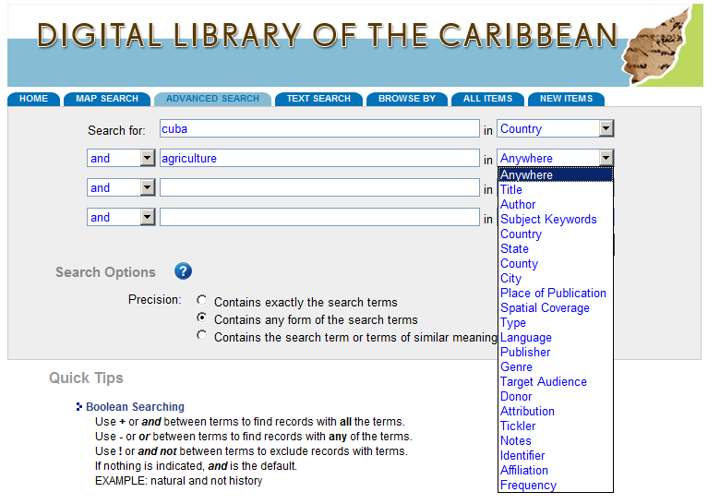
Advanced Search
The advanced search feature will allow you to restrict your search terms by categories such as title, author, subject keyword, country and more.

Slide 8
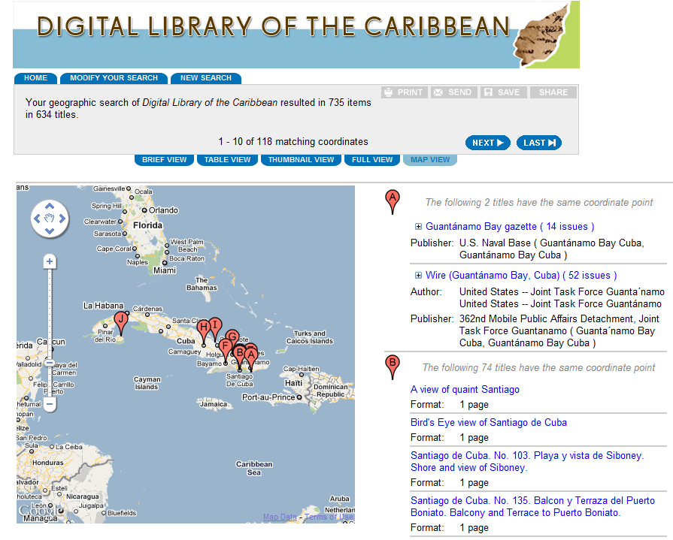
Map Search
If you are looking for items with discrete geographic locations, use the Map Search feature. You can also view the results in Map View.

Slide 9
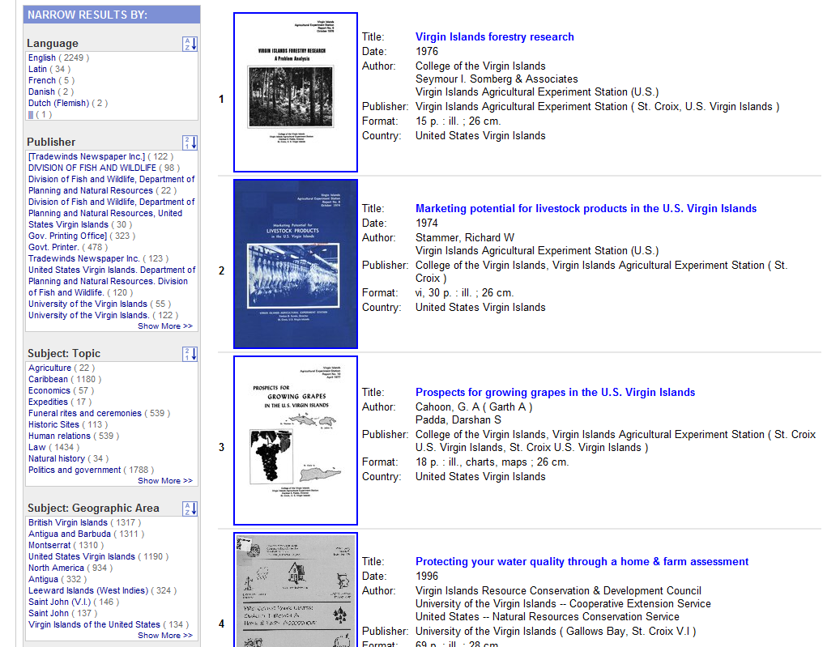
Faceted Searching
Expand or narrow the results by selecting the related search terms in the box to the left.
Options for faceted searching include: publisher, geographic area, subject keywords and more.

Slide 10
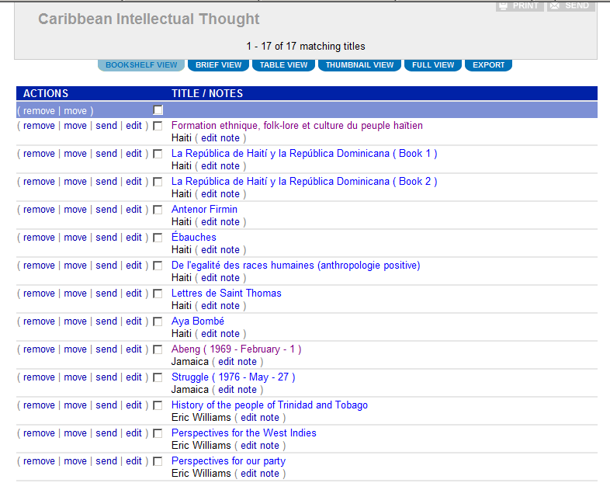
mydLOC Registered Users
Registration is optional, but adds many features such as the ability to comment on items, create public and private bookshelves and save searches.

Slide 11
Partner & Topical Collections
Notes:
Partner collections and topical/thematic collections
Same functionality at the collection level but branded for the Partner and with all materials in one collection for ease of use and for reporting statistics, etc.
Similar support for full thematic collections but can also have simple thematic landing pages that orient towards the materials without being a full collection. Similar support for online exhibits and other ways to curate and present materials as a whole, in addition to individaully.

Slide 12
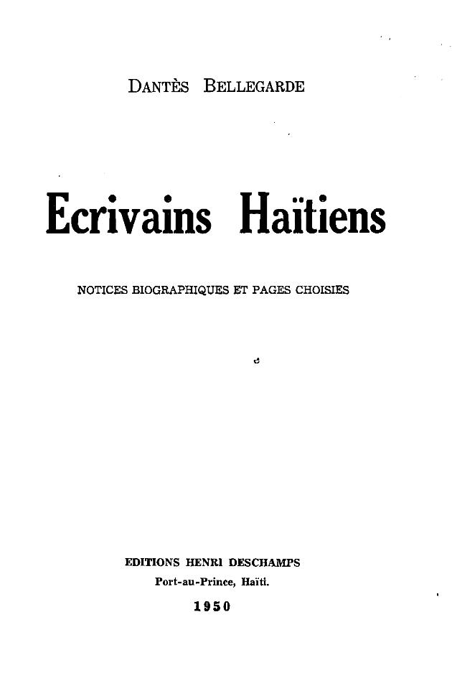
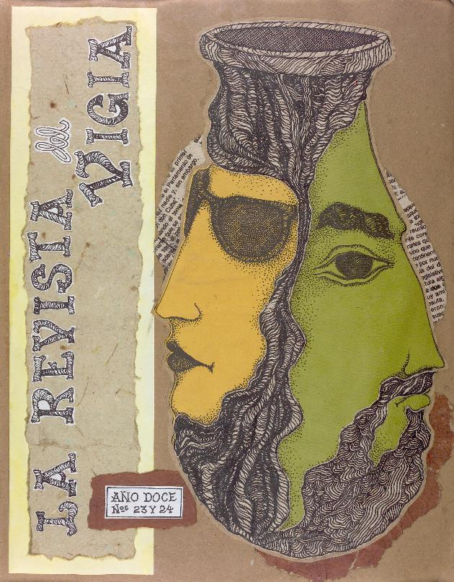
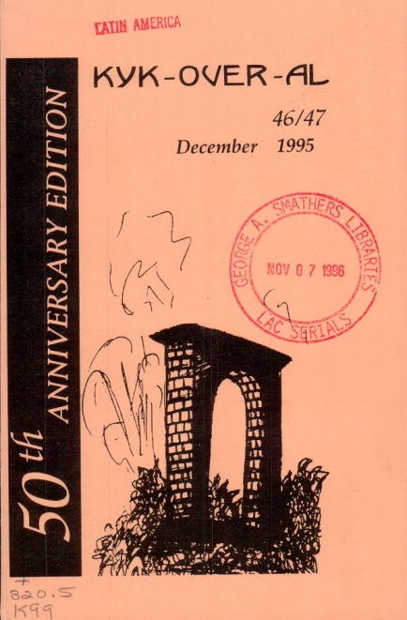
Literature
Caribbean literature plays an important role in understanding the region. Current and historical items in dLOC serve a variety of research needs in the region. A literature sub-collection is in discussion with several users of the site.
Title: Ecrivains Haitiens
Author: Dantes Bellegarde
Year: 1950
Contributor: Bibliotheque Haitienne des Peres du Saint Esprit
Title: La revista del Vigía
Author: Ediciones Vigia
Year: 1990
Contributor: University of Florida
Title: Kyk-Over-Al
Author: British Guiana’s Writer’s Assn
Year: online from 1948 - 1995
Contributor: University of Florida

Slide 13
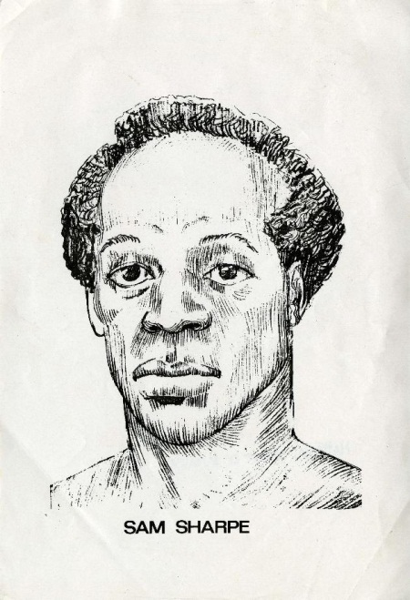
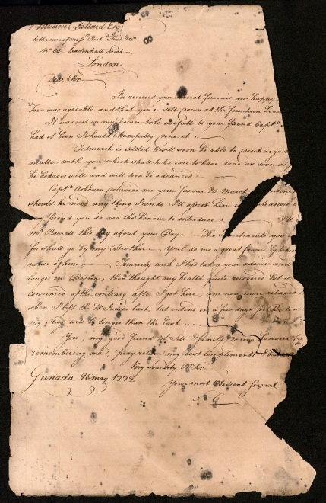
History of Slavery
Many dLOC partners also contribute collections on the early history of slavery and emancipation. Items include books, manuscripts, maps, prints and much more.
Title: The Honorable Sam Sharpe
Collection: Jamaica Unshackled
Contributor: National Library of Jamaica
Title: Letterbook for the Simon Plantation, St. Kitts
Creator: Samuel Cary
Date: 1772
Contributor: University of Florida

Slide 14
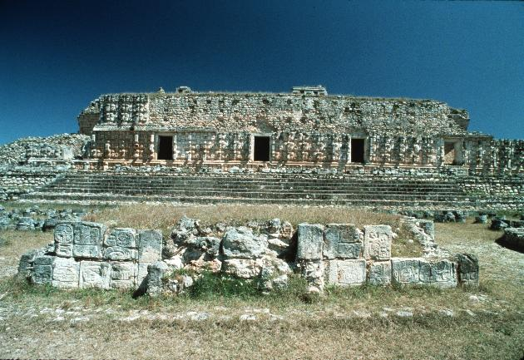
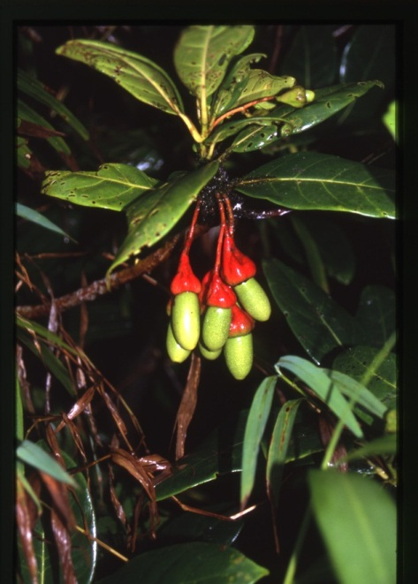
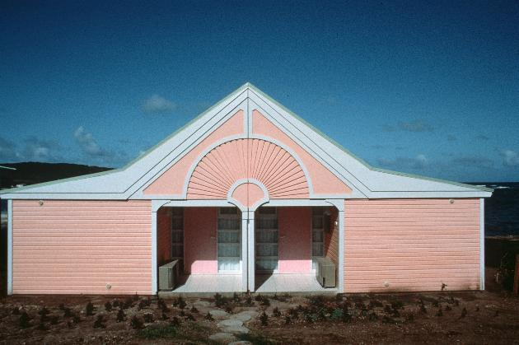
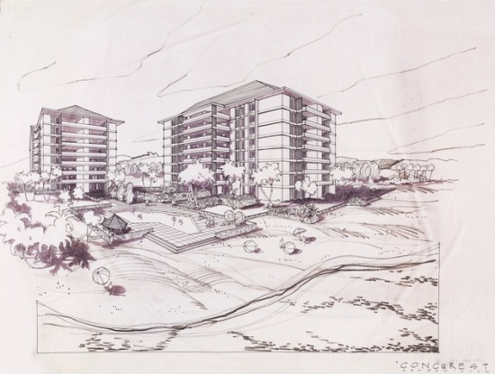
Flora, Landscape
and Architecture
Kenneth Treister, Architect Collection of 3,000 Photographs, Architectural Drawings, Project Files, Etc
Caribbean plants vouchered and expertly identified by Dr. Scott Zona during his 25 years of botanical research in the Caribbean.
Laraceae
Dominica, Freshwater Lake

Slide 15
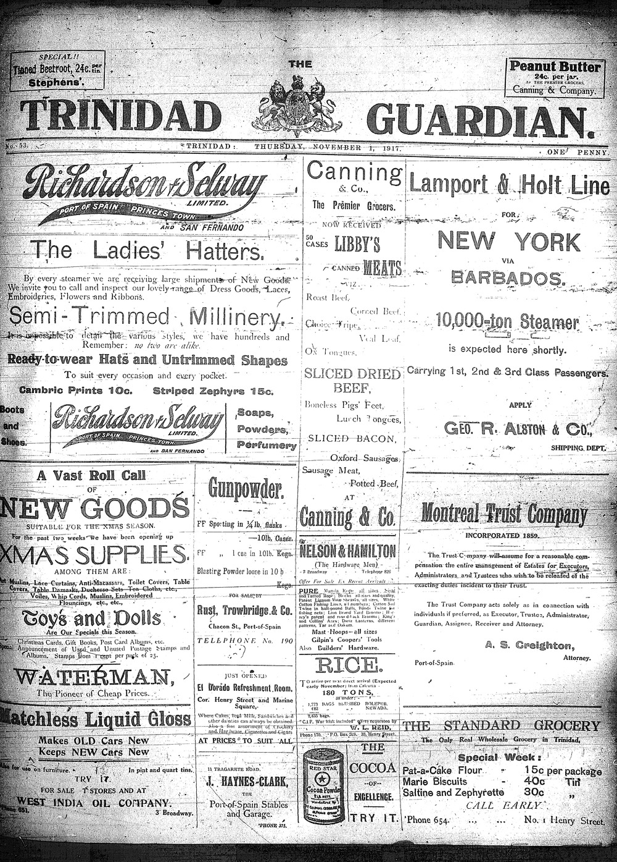
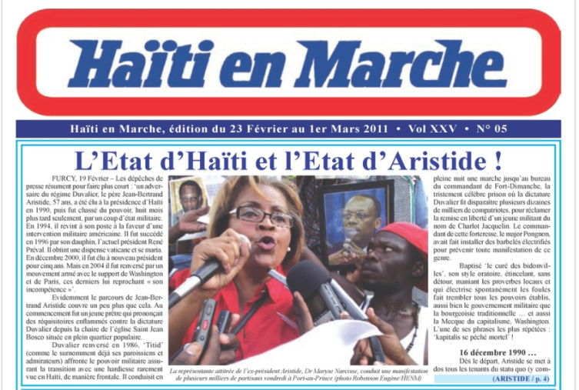
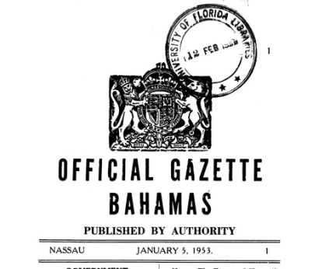
Historical and Current
Serial Publications
Select Academic Journals
Caribbean Review of Books
Caribbean Ornithology
Eme Eme
Kyk-Over-Al
Jamaica Journal
MaComere
Sargasso
Caribbean Newspaper Digital Library
Current Stats: 171 titles, approx. 398,000 pages 2.97 million hits
Government Gazettes
100,000 pages
19 titles
Title: Haiti En Marche
Date: 1999-2001 online
Contributor: Publisher
Title: Trinidad Guardian
Date: 1917-1931 online
Contributor: University of Florida

Slide 16
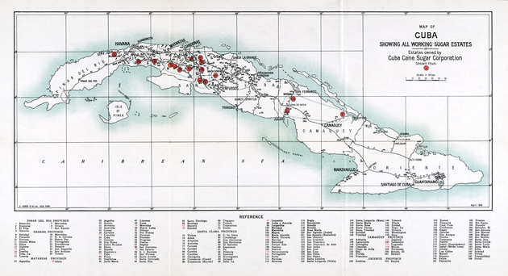
Cuban Sugar Collections
dLOC hosts many materials about the trade, manufacture, and Cuban sugar cultivation records from the 1850s until the Cuban sugar industry by the government of Fidel Castro. The collection provides descriptions of the social, political, and economic environment in which Cuban sugar was manufactured.
1917 Map of Cuba showing all working sugar estates. Cuba Cane Sugar Corporation

Slide 17
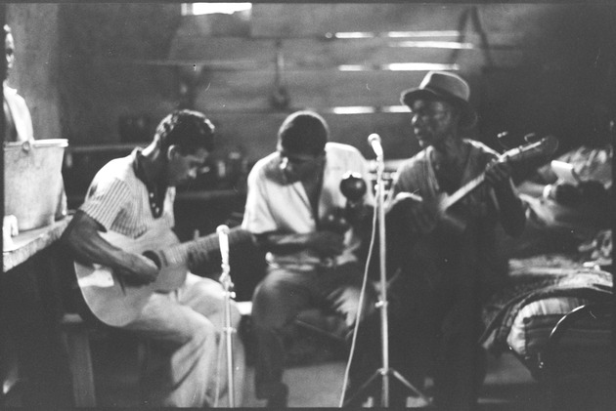
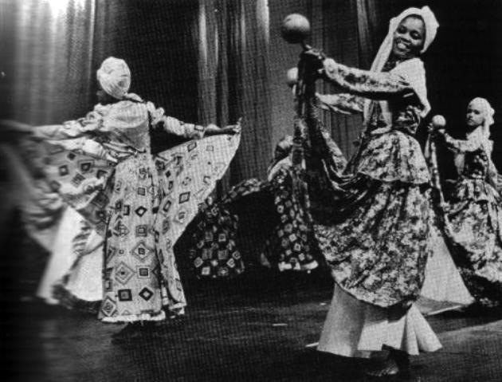
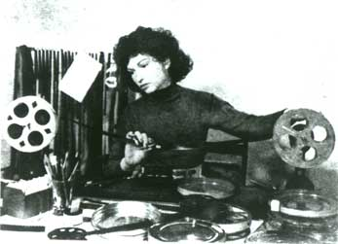
Culture and Arts
Alan Lomax Photographs and Recordings from the Caribbean are being added!
CARICOM is building a comprehensive collection of CARIFESTA materials.
Title: Digital images of Alan Lomax photographs
Location: Lopinot, Trinidad
Contributor: Association of Cultural Equity
13 Maya Deren Recordings
Title: Haitian Voodoo Recordings –
Ceremony bapteme tambour
Location: Haiti
Contributor: University of Florida

Slide 18
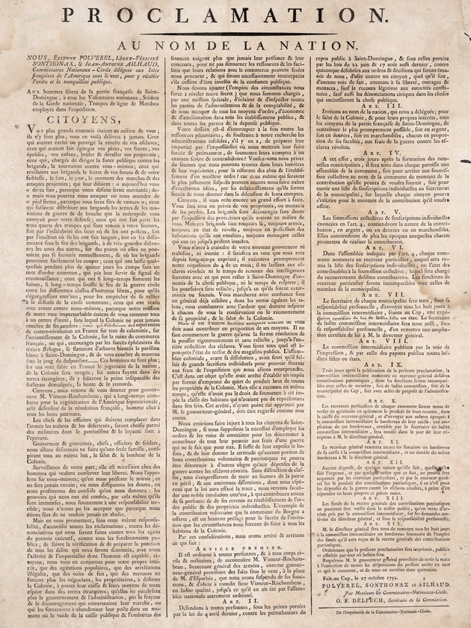
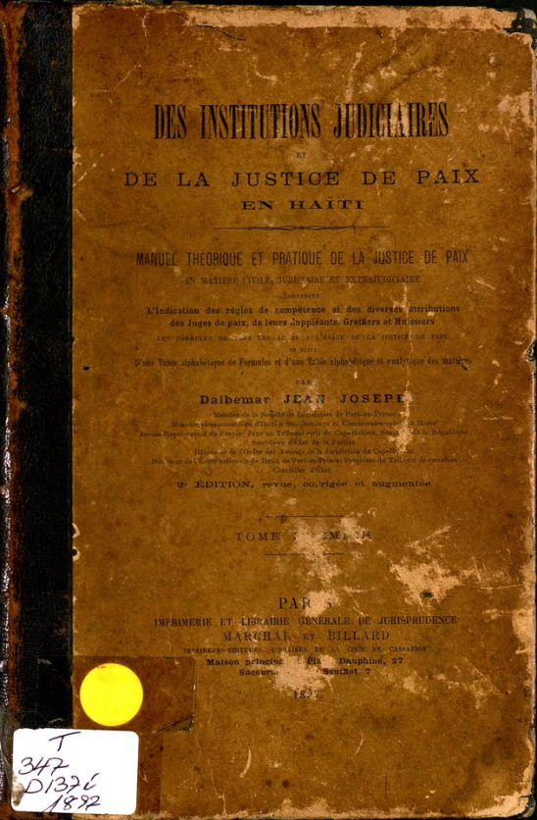
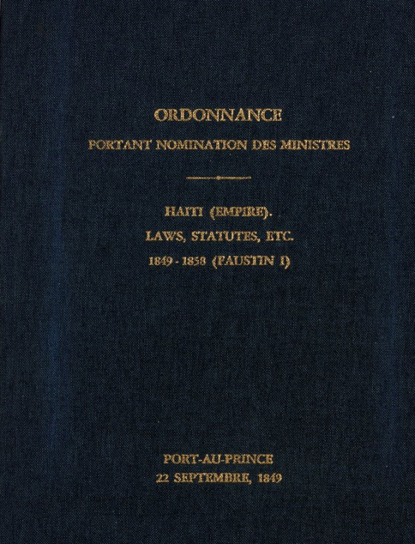
Law and Government Documents
_{x}
Notes:
The Law Library Microform Consortium (LLMC), a non-profit cooperative of libraries, is dedicated to - and passionate about - its twin goals: 1) Preserving legal titles and government documents, and 2) Making this valuable content accessible and searchable.
LLMC began its work using microform and has since added digital technologies. In 2010, LLMC and a group of member libraries launched the LLMC Haiti Legal Patrimony Project. The LLMC Haiti Legal Patrimony Project combines the strengths of collections and resources in many law libraries around the world, locating, digitizing, and providing central access to these resources. All materials for the LLMC Haiti Legal Patrimony Project are available through LLMC Digital (for subscribers who pay for access) and freely available through the Digital Library of the Caribbean (dLOC).
This is the first digital project of this sort undertaken by LLMC. In this project, one of LLMC’s goals was to build the worldwide network. As stated on the LLMC website: “The real potential behind the Haiti Legal Patrimony Project is the opportunity to combine the scattered resources of law libraries around the world. To get that process going, over 13 libraries have agreed to sponsor the project by canvassing their collections to see if they have unique titles to contribute.” (http://www.llmc.com/HaitiOverview.asp)
In working on the LLMC project, partners learned more about their own collections and about the materials themselves. The initial “master title list” which included all materials that were wanted for the project grows each month as new materials critical to the project goals are added to the list. Many of the items being added to the list have already been digitized. The project itself is thus digitizing materials to preserve and provide access and also increasing access and enhancing the findability and usability of already digitized materials by collocating them within a central collection and providing the context to understand and use the materials. This sort of curatorial work is core to providing the level of access required for disaster mitigation and it requires a great deal of work. In fact, this curatorial work is recognized as academic scholarship in itself by the digital humanities. The level of complexity and quantity of work for this requires a community response. Finding materials, creating context, and collocating the materials within the proper context is a necessary response and one that can only be met through a larger community and digital library communities can provide the required support.

Slide 19
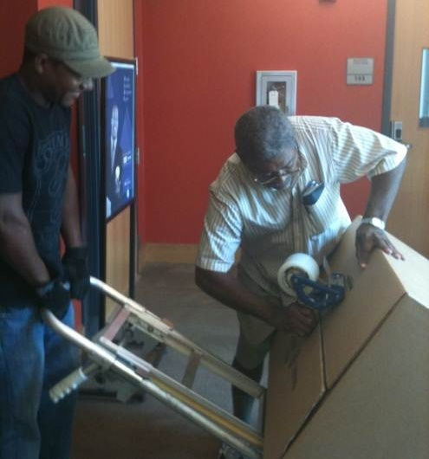
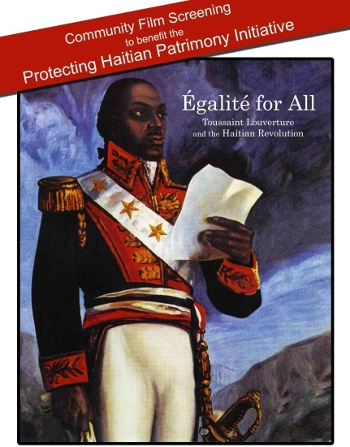
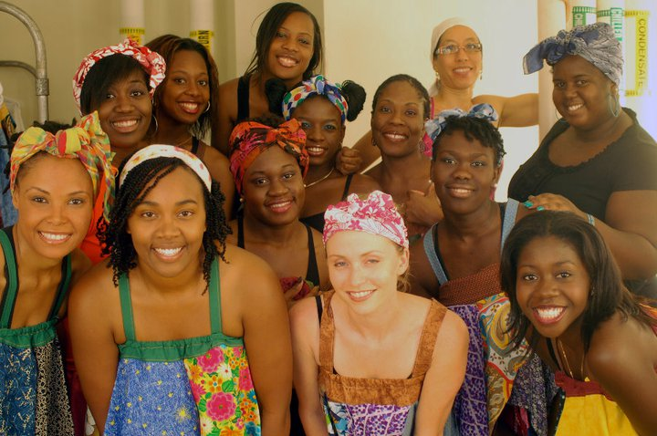
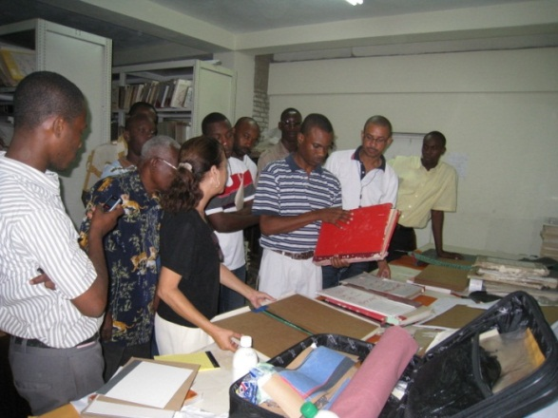
Protecting Haitian Patrimony
Encourage communication across institutions working to assist Haiti’s libraries.
Coordinate technical and in-kind assistance for Haiti’s libraries.
Raise money to support specific collection/archival recovery and preservation projects in Haiti
Sobe Export employees preparing the shipment for Haiti. August 2010
Elizabeth Chin, a Katherine Dunham specialist from Occidental College, and University of Florida students at PHPI Benefit
Preservation Training. June 2010
Joint FIU/UM Fundraiser
Little Haiti Cultural Center
February 2011

Slide 20
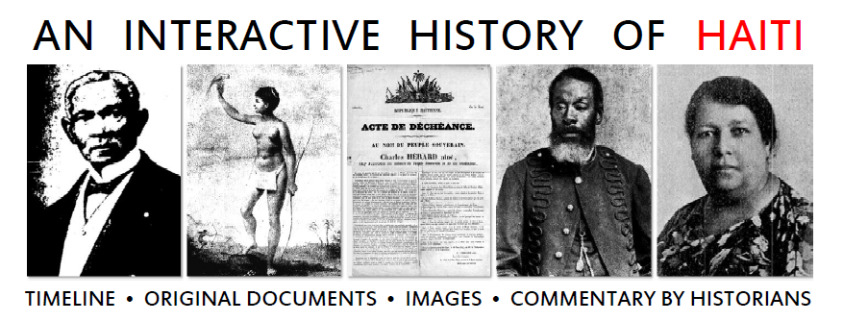
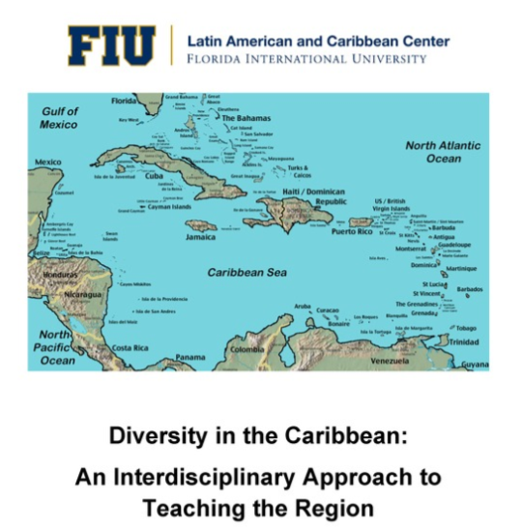
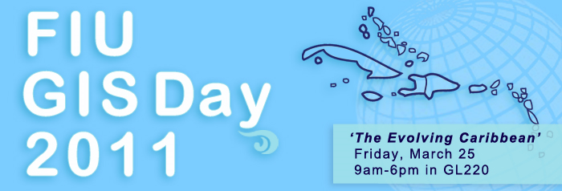
dLOC Educational Outreach
Caribbean Diversity and Technology Workshops
FIU Technology Fee Grant
Faces of Jamaica Online Exhibit
Teacher Training Miami, FL
Facilitator: Matthew J. Smith,
Lecturer, UWI Mona
Sponsor: Latin American
and Caribbean Center at FIU

Slide 21
Mark V. Sullivan, Application Engineer/Digital Curation Director
Laurie N. Taylor, Technical Director
Digital Library of the Caribbean
marsull@uflib.ufl.edu and laurien@ufl.edu
The Digital Library of the Caribbean
www.dloc.com

