Slide 1
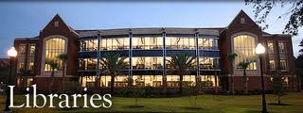
Libraries for Sustainability
Exploring Sustainability Practices in Libraries
Webinar Series 2012
Webinar 2 of 4
Exploring Sustainability Practices in Libraries- April 24, 2012
Notes:
Bonnie
Welcome and thank you for joining us to explore sustainability practices in libraries.
This session will be recorded and the recording and slides will be available after the session.

Slide 2
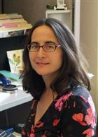
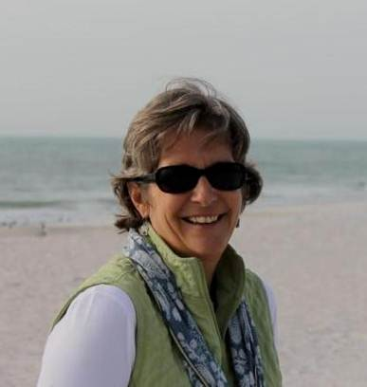
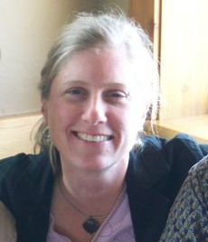
Facilitators
Madeleine Charney
Umass Amherst Library
Bonnie J. Smith
University of Florida Libraries
Beth Filar Williams
UNC Greensboro Libraries
Notes:
There will be three facilitators today –
my name is Bonnie Smith and I work at the University of Florida Libraries. I have a real desire to see libraries of all kinds play a central role in sustainability topics and in finding meaningful ways to collaborate and pool our resources to affect change.
Beth …..
Madeleine …….

Slide 3
Background on Webinar Series
Objectives for series:
Collaborate
Share ideas & information
Build networks
Educate
Take action
Libraries for Sustainability Webinar Series 2012
Exploring Sustainability Practices in Libraries - April 24, 2012
Notes:
Bonnie -
There are over 100 enrolled participants from all over the country and representing different types of organizations, such as public school and academic libraries, corporations, non-profits; there are library volunteers, librarians, graduate students, consultants, individuals working in the green building industry, and even international participants.
This is the second webinar in a series of 4 webinars on Libraries for Sustainability
The first webinar focused on finding ways to continue our work through the American Library Association (ALA) whether it be through the Task Force on the Environment or other venue. Leadership for this effort and collaborations are beginning to congeal.
The objectives for the webinar series are to
strengthen our collaboration
share ideas and best practices, no need to reinvent the wheel – let’s share what we are doing
help strengthen and build networks
Educate ourselves regarding the multi faceted efforts around sustainability and the role of libraries
take action in our own libraries and collaboratively – we are hoping that from this series a group or several groups will form that will take action and plan for concrete ways to collaborate and perhaps present at ALA or AASHE or other suitable venues. If you are interested in playing a leadership role, please contact one of us.

Slide 4
Sustainability Defined
The concept of sustainability emerges from "sustainable development" defined in the 1987 Brundtland Report as “development that meets the needs of the present without compromising the ability of future generations to meet their own needs,” addressing the balance between social equity, economic vitality, and environmental integrity.
society
environment
economy
Environment
Society
Economy
Triple bottom line
Notes:
Bonnie
For the purposes of this webinar series, we are using a definition of sustainability that emerges from the field of sustainable development -
simultaneously creating healthier ecosystems, healthier social systems and healthier economies.

Slide 5
Objectives for Today’s Webinar
Exploring Sustainability Practices in Libraries
Inspire
Inform
Create momentum for collaboration
Libraries for Sustainability Webinar Series 2012
Exploring Sustainability Practices in Libraries - April 24, 2012
Notes:
Bonnie

Slide 6
Agenda for Today’s Webinar
Exploring Sustainability Practices in Libraries
Greening Libraries – Kathryn Miller
Academic Libraries – Marianne Buehler
School Libraries – Laura Barnes
Working with Community – Mandy Henk
Libraries for Sustainability Webinar Series 2012
Exploring Sustainability Practices in Libraries - April 24, 2012
Notes:
Madeleine – go over agenda and format –
Each presenter given 5 minutes to present on their topic and each followed by 5 minutes Q&A
Presenters were selected based on their extensive experience for the topic….

Slide 7
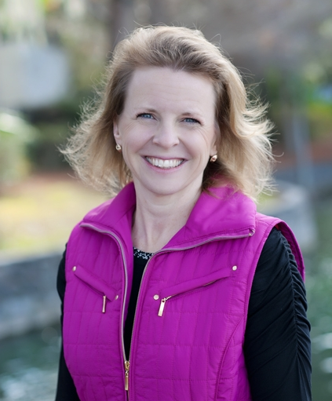
Sustainability through Library Operations
Kathryn Miller, MLS, MAT, EdD
AVP, Academic Resources
Argosy University
kjmiller@argosy.edu
312-718-5391
Libraries for Sustainability Webinar Series 2012
Exploring Sustainability Practices in Libraries - April 24, 2012

Slide 8
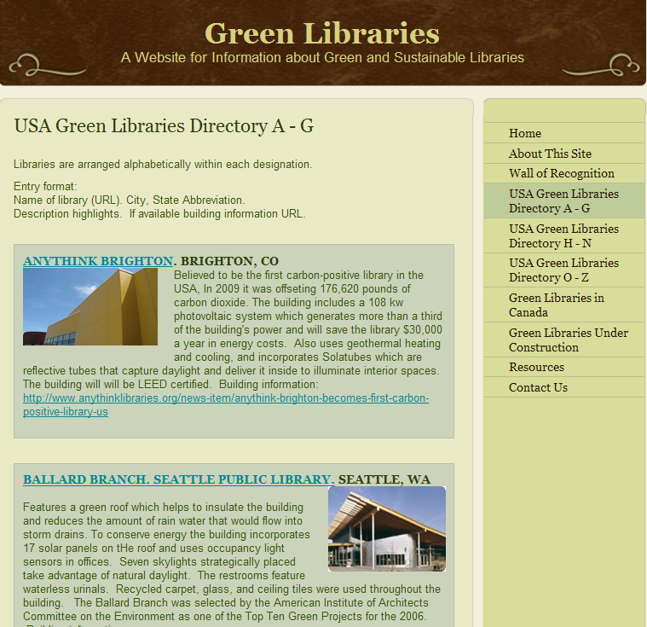
Buildings
LEED ( Leadership in
Energy & Environmental Design)
LEED provides building
owners and operators
with a framework for
planning green building
design, construction,
operations and
maintenance solutions.
Libraries for Sustainability Webinar Series 2012
Exploring Sustainability Practices in Libraries - April 24, 2012

Slide 9
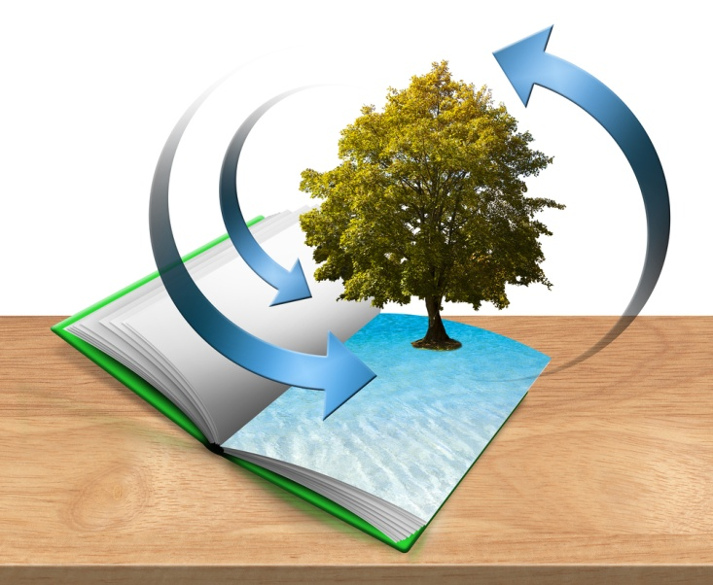
Indoor Updates
Natural Stone (not synthetics)
Glass (not plastic)
Lighting
Motion-activated sensors
Use Compact Fluorescent Light (CFL) bulbs
Vampire power
Paint
Use nontoxic, low VOC (volatile organic compound).
Light color paint reflects the sun’s heat
Libraries for Sustainability Webinar Series 2012
Exploring Sustainability Practices in Libraries - April 24, 2012

Slide 10
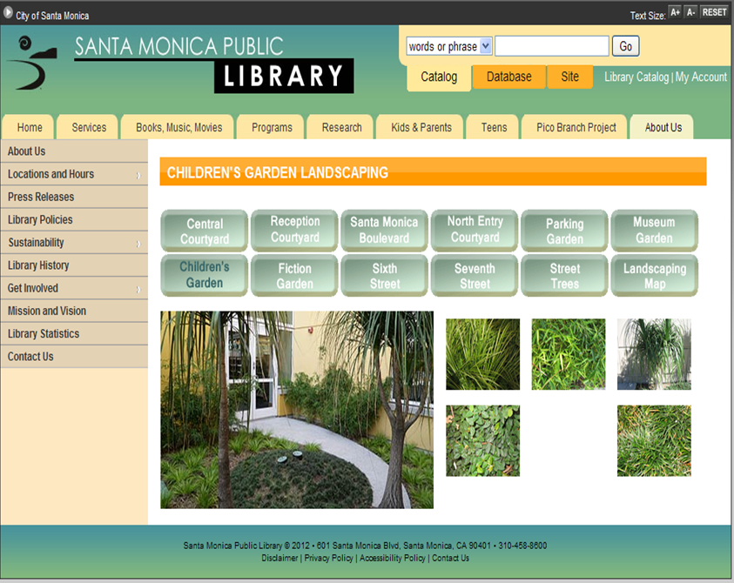
Outdoor updates
Landscape with native plants.
Climate-appropriate
species will reduce
water needs.
Do you need a lawn?
Consider rocks, bark
and other ground
cover.
Libraries for Sustainability Webinar Series 2012
Exploring Sustainability Practices in Libraries - April 24, 2012

Slide 11
Transportation
How do people get to your library?
Walk
Sidewalks
Bus or Train
Schedules (Personalized?)
Shelter
Bike
Route maps
Bike Rack
Carpool
Employees
Patrons
Libraries for Sustainability Webinar Series 2012
Exploring Sustainability Practices in Libraries - April 24, 2012

Slide 13
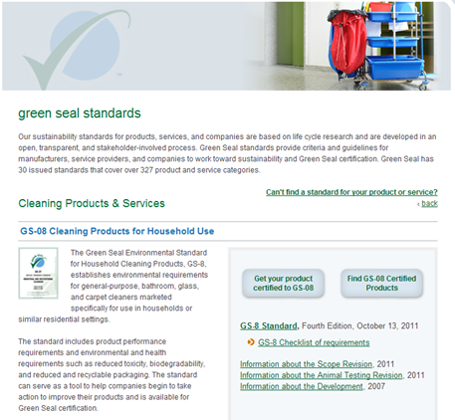
Purchasing
Consider --How is the item packaged?
--What is its useful life?
--How will the item eventually be disposed of?
Purchasing Power --Look for Green Seal productsGS-8 standard
--Look for Energy Star
ratings for office equipment
Libraries for Sustainability Webinar Series 2012
Exploring Sustainability Practices in Libraries - April 24, 2012

Slide 14
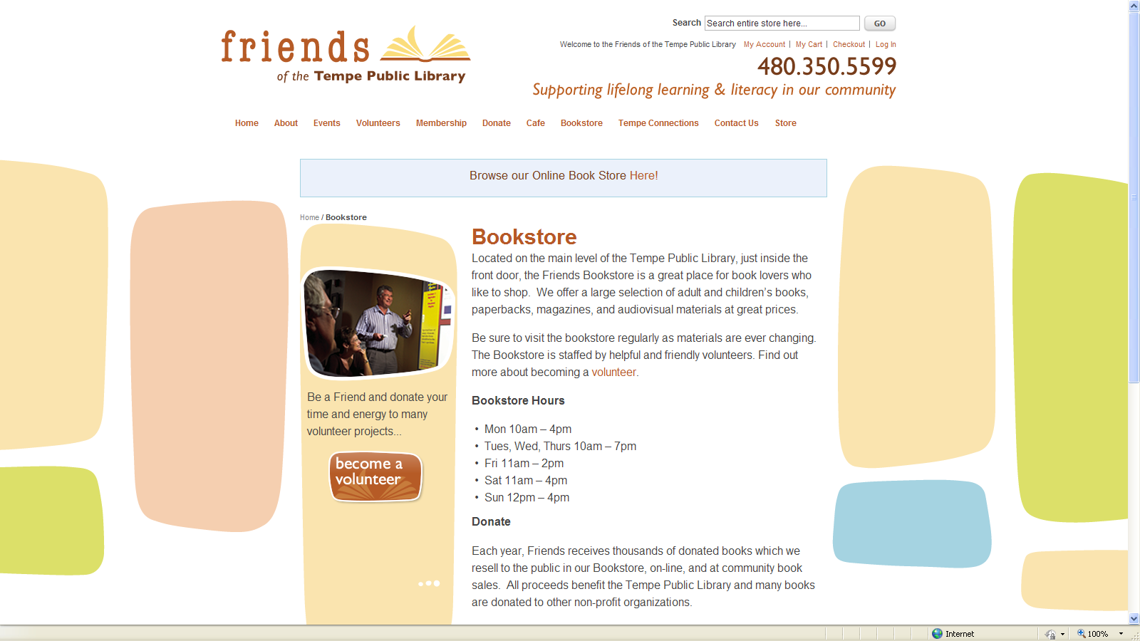
Process
Weeding | Interlibrary loan (ILLiad) | Document delivery services
Patron-driven collection development
Libraries for Sustainability Webinar Series 2012
Exploring Sustainability Practices in Libraries - April 24, 2012

Slide 15
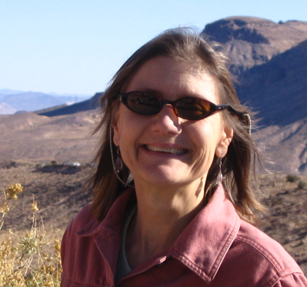
Academic Libraries:
Sustainability in Action
Marianne A. Buehler
Urban Sustainability Librarian / IR Manager-Administrator
University of Nevada, Las Vegas
Libraries for Sustainability Webinar Series 2012
Exploring Sustainability Practices in Libraries - April 24, 2012
Notes:
All types of libraries have a lot to offer in the realm of embracing sustainability concepts and actions. My topic is focused on academic libraries and sustainable opportunities.
Librarians who are passionate about the various aspects of sustainability are leading initiatives (perfect examples are Beth, Madeleine, and Bonnie who are manifesting opportunities for all of us by offering online webinars to garner momentum)

Slide 16
Faculty and Librarian Collaborations
Sustainability Across the Curriculum
Librarians with instructional design and curriculum redesign skills partnering with faculty to infuse sustainability into the curriculum, Northern AZ University http://library.nau.edu/information/library_strategic_and_operating_plans_2010-2011.pdf
Ponderosa & Piedmont Projects–librarians and faculty address global and local sustainability challenges, some reflected in curriculum development efforts. http://sustainability.emory.edu/page/1021/Piedmont-Project/
Libraries for Sustainability Webinar Series 2012
Exploring Sustainability Practices in Libraries - April 24, 2012

Slide 17
Faculty and Librarian Collaborations
Sustainability Research
Global traction: Showcase research, sustainable topic publications, AASHE STARS reporting, conferences, presentations, and more –> deposit in institutional repositories. http://digitalcommons.library.unlv.edu/reports/
Joint presentations and articles
Support faculty editors: Open access journals http://digitalcommons.library.unlv.edu/jhdrp/
Libraries for Sustainability Webinar Series 2012
Exploring Sustainability Practices in Libraries - April 24, 2012

Slide 18
Librarian and Student Collaborations
Sustainable Activity
Graduate Student Sustainability Seminar–assist with resources, educate about highlighting research output in an IR (presentations, posters, articles) → intellectual content is open access and globally available. http://digitalcommons.library.unlv.edu/cs_ug_research
Graduate Student Scholarly Communication Seminar–enhance knowledge re: open access to research, retaining copyrights to articles. http://guides.library.unlv.edu/scholarlycommunication
Undergraduate Student Research–Posters, peer-reviewed research awards http://digitalcommons.library.unlv.edu/cs_ug_research/
http://digitalcommons.library.unlv.edu/award/
Libraries for Sustainability Webinar Series 2012
Exploring Sustainability Practices in Libraries - April 24, 2012

Slide 19
Academic Campus Sustainability Opportunities
Serve on a sustainability committee / initiative
Exhibits (online or physical) http://www.lib.uchicago.edu/e/webexhibits/sustainability/
http://library.ucr.edu/view/libraries/rivera/exhibits/food_sus_rivera/food_sus_rivera.html
Partner with food services (free vegan dinner at Earth Hour), free campus movies (Forks Over Knives), Campus sustainability coordinator organized this.
Faculty/staff/student open and advertised presentations related to sustainability.
Libraries for Sustainability Webinar Series 2012
Exploring Sustainability Practices in Libraries - April 24, 2012

Slide 20
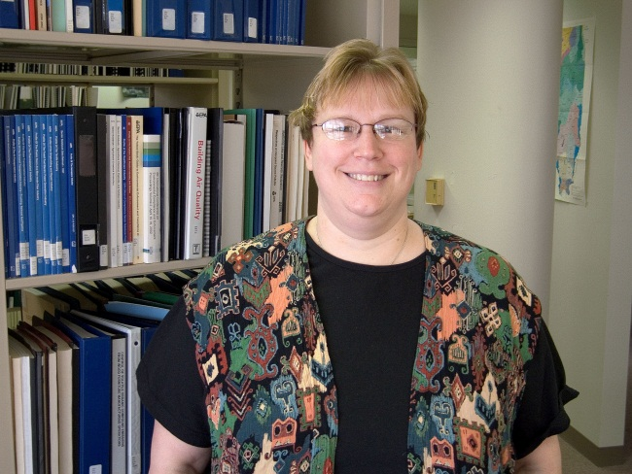
Sustainability in School Libraries
Laura L. Barnes, Librarian
University of Illinois at Urbana-Champaign Prairie Research Institute
l-barnes@illinois.edu
Libraries for Sustainability Webinar Series 2012
Exploring Sustainability Practices in Libraries - April 24, 2012

Slide 21
Sustainability in School Libraries
School Librarians are Special
School librarians operate inside a larger organization
Changes to facilities are often out of their control
Purchasing may be centralized at the building or district level
Difficult to implement green purchasing program at library level
School librarians are also certified teachers
Can partner with classroom teachers or teach environmental education units independently
Often participate in faculty meetings and may sit on school and district-wide committees
Are trusted information providers within the school building
Libraries for Sustainability Webinar Series 2012
Exploring Sustainability Practices in Libraries - April 24, 2012

Slide 22
Sustainability in School Libraries
Lead by Example
Start a faculty/staff environmental committee in your school or join existing one.
Be the go-to person for environmental information.
Partner with other teachers to incorporate environmental ed. into the classroom
Establish a book trading program among faculty & staff. Or start a school-wide used book exchange program for students.
Consider environmental factors when planning a new library space.
Do stand-alone environmental ed. programs during scheduled library time.
Libraries for Sustainability Webinar Series 2012
Exploring Sustainability Practices in Libraries - April 24, 2012

Slide 23
Sustainability in School Libraries
Case Study: Millburn Central School
K-8 school in Wadsworth, IL received BP A+ for Energy grant entitled Let the Sun Shine: Hands-on Solar Energy Activities @ Your Library
Integrated energy activities into the school library media program
School librarian combined story time and projects to teach students:
The power of the sun (kindergarten),
How to measure solar energy (first grade),
Harnessing the power of the sun to generate electricity for the home (second grade) and to power cars (third grade).
Students demonstrated their projects at “Days in the Sun” family activity programs in the school library courtyard.
Libraries for Sustainability Webinar Series 2012
Exploring Sustainability Practices in Libraries - April 24, 2012
Notes:
K – Listened to The Snowy Day by Ezra Jack Keats, then compared melting rates of snow in sunshine (solar energy) with snow in shade and observed melting rates of snow on plates with different connectivity.
1st – Listened to My Light by Molly Bang, then measured solar energy with radiometers, created bead people with ultraviolet detecting lights, and experimented with ways to increase and increase and decrease exposure of their bead people to ultraviolet rays.
2nd -- Listened to The Little House by Virginia Lee Burton. Second graders study how communities change. During their energy story time, they built models of houses powered by solar energy to show how houses have changed since The Little House was written in 1943.
3rd – Listened to If I Built a Car by Chris Van Dusen. In their energy story time, third graders built cars powered by solar energy.

Slide 24
Sustainability in School Libraries
For More Information
Green Libraries LibGuide http://uiuc.libguides.com/green-libraries Includes information specific to school libraries.
Environmental Education LibGuide
http://uiuc.libguides.com/environmental-education
Environmental Novels: An Annotated Bibliography http://hdl.handle.net/2142/696 Lists novels for teens and adults with environmental themes
Environmental News Bits
http://envnewsbits.wordpress.com
Includes Education, Libraries, and Publications categories.
Libraries for Sustainability Webinar Series 2012
Exploring Sustainability Practices in Libraries - April 24, 2012
Notes:
K – Listened to The Snowy Day by Ezra Jack Keats, then compared melting rates of snow in sunshine (solar energy) with snow in shade and observed melting rates of snow on plates with different connectivity.
1st – Listened to My Light by Molly Bang, then measured solar energy with radiometers, created bead people with ultraviolet detecting lights, and experimented with ways to increase and increase and decrease exposure of their bead people to ultraviolet rays.
2nd -- Listened to The Little House by Virginia Lee Burton. Second graders study how communities change. During their energy story time, they built models of houses powered by solar energy to show how houses have changed since The Little House was written in 1943.
3rd – Listened to If I Built a Car by Chris Van Dusen. In their energy story time, third graders built cars powered by solar energy.

Slide 25
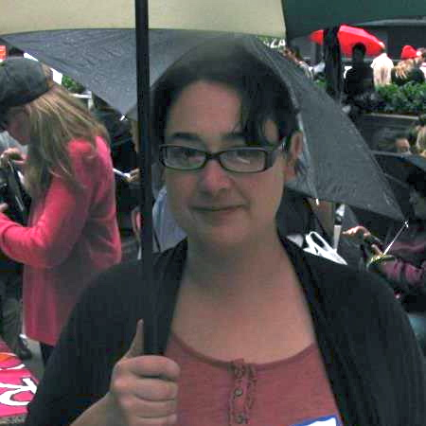
Working with Community
Mandy Henk
Access Services Librarian
DePauw University
&
Guerrilla Librarian
People's Library
Occupy Wall Street
amandahenk@depauw.edu
Libraries for Sustainability Webinar Series 2012
Exploring Sustainability Practices in Libraries - April 24, 2012

Slide 26
Sustainability
This movement is relentless and unafraid. It cannot be mollified, pacified, or suppressed. There can be no Berlin Wall moment, no treaty-signing, no morning to awaken when the superpowers agree to stand down. The movement will continue to take myriad forms. It will not rest. There will be no Marx, Alexander, or Kennedy. No book can explain it, no person can represent it, no words can encompass it, because the movement is the breathing, sentient testament of the living world.
And I believe it will prevail. I don’t mean defeat, conquer, or cause harm to someone else. And I don’t tender the claim in an oracular sense. I mean the thinking that informs the movement’s goal—to create a just society conducive to life on Earth—will reign. It will soon suffuse and permeate most institutions. But before then, it will change a sufficient number of people so as to begin the reversal of centuries of frenzied self-destruction.
Inspiration is not garnered from litanies of what is flawed; it resides in humanity’s willingness to restore, redress, reform, recover, reimagine, and reconsider. Healing the wounds of the Earth and its people does not require saintliness or a political party. It is not a liberal or conservative activity. It is a sacred act.
--Paul Hawken
Libraries for Sustainability Webinar Series 2012
Exploring Sustainability Practices in Libraries - April 24, 2012

Slide 27
Two Paths
Libraries for Sustainability Webinar Series 2012
Exploring Sustainability Practices in Libraries - April 24, 2012
Notes:
Sustainability requires both practical and concrete changes in our daily work. It requires us to examine our existing systems, find the leverage points available to us and use those to create new ways of doing things and to incorporate a new mindset into our libraries. A mindset that puts the well-bring of the planet and its people at the forefront of our decisions. It requires scrupulous attention to detail, complex analysis, and making decisions based in empirical reality with a full understanding of the impacts of those decisions. It requires the outright rejection of willful ignorance and groupthink. The practical side of sustainability is hard work and often thankless work as well.
The transition to sustainability also requires the work of activism, not just advocacy, but direct action intended to provide support for those doing the practical work of building new sustainable systems. Many, if not most of us currently employed in a library, will be doing both kinds of work.
Both kinds of work are absolutely necessary and go hand in hand. Neither can succeed without other and neither is more valuable than the other.
I’m going to very briefly address both kinds of work as they relate to our communities and our role within those communities.

Slide 28
The Practical Work of Sustainability
Transitioning to sustainability requires a reexamination of the systems that surround us.
All systems have elements, interrelationships, and a purpose.
By examining the system as a whole, we can find leverage points to use that will help us to identify the changes that are both within our power and likely to have the most impact.
Systems thinking also gives us a structure to use to look at where the system is failing and offers suggestions for how to bring the system into a more sustainable state.
Libraries for Sustainability Webinar Series 2012
Exploring Sustainability Practices in Libraries - April 24, 2012
Notes:
To start with the practical side of sustainability, there is a vast and most excellent literature out there on everything from cradle to cradle production to carbon footprinting to being an ethical employer. The library specific literature is rather scant, but I, and others, are working on fixing that now. The first thing to understand about the practical side of sustainability is that it requires a new way of thinking about how we do our work—a systems level analysis of the library and the external systems that we rely on. I’ve been asked to speak about the community side of things and so we’ll move that in a moment. For now, let’s look at the library as a system. What are the elements, the interconnections, and, of course the purpose of this system, we call the library?

Slide 29
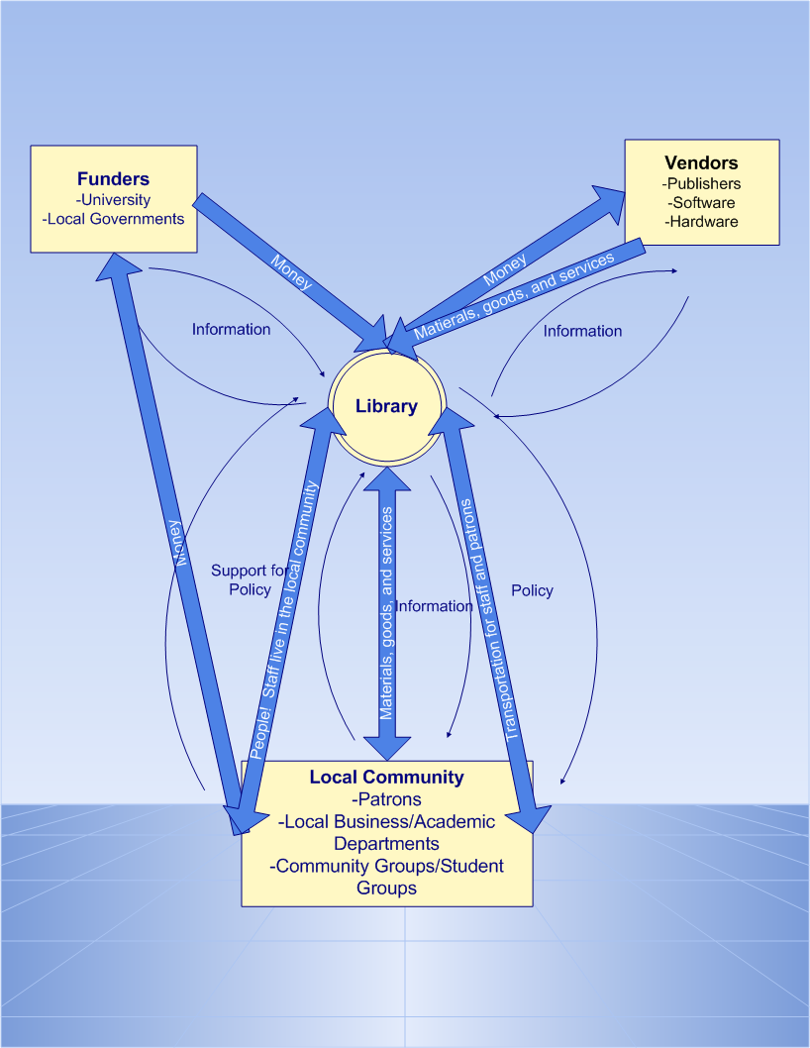
Libraries for Sustainability Webinar Series 2012
Exploring Sustainability Practices in Libraries - April 24, 2012
Notes:
This is a complex graph, but you can see here is very simplified picture of the library and its external systems. We have funders, usually a university or city, we have our vendors, who provide us with materials and we have our local community. You can see how we are connected to our community—through our materials and services, through our people, since our staff are themselves members of the local community, and though .
So, those interconnections, those relationships, help us to find what we can begin changing to make an impact sustainability. Our time is much too short to get into the details of using leverage points, but leverage points are incredibly powerful tools to use to create change in a system. Let’s look, for just a quick moment at one of those interconnections—materials and services, and see what leverage points we can use to strengthen the sustainability of our local community.

Slide 30
Materials and Services: Leverage Points for Sustainability
Numbers: Move more of your budget into building a strong sustainability collection.
Balancing Feedback Loops: Look closely at how you get information about your community’s information needs and how quickly that information comes to you. Create community boards for underrepresented members of your community to improve that flow and create internal structures to act on it.
Information Flows: Create avenues for sustainability information about your local community. Do this through regular meetings, reading groups (for staff and patrons), newsletters, whatever you have available to you.
Rules: Change your circulation policies if they are having a disproportionate influence on poor people in your community.
Self-Organization: Get a seat at the local sustainability table for your library. Join the local transition town group, get a booth at the farmer’s market, make sure the library sis represented on the local sustainability commission or office of sustainability. Offer programming for these groups.
Goals: For those with detailed collection development polices, what does that policy say about sustainability collections? What about programming polices? Make changes where needed and possible.
Paradigms: What if we stop thinking of our selves as serving our community and started thinking about ourselves as part of the community?
Libraries for Sustainability Webinar Series 2012
Exploring Sustainability Practices in Libraries - April 24, 2012
Notes:
The leverage points here come from Donella Meadow’s book Thinking in Systems: A Primer. Not all of the points are available to everyone, but most people working in a library will have access to some of them. They offer the beginnings of what can become a sustainable library built securely on the foundations of strong community support and attention to the weakest members of our community. But how do we get to point where these kinds of ideas can be widely accepted within our profession and by our directors?

Slide 31
Confronting Power
The whole history of the progress of human liberty shows that all concessions yet made to her august claims have been born of earnest struggle. The conflict has been exciting, agitating, all-absorbing, and for the time being, putting all other tumults to silence. It must do this or it does nothing. If there is no struggle there is no progress. Those who profess to favor freedom and yet deprecate agitation are men who want crops without plowing up the ground; they want rain without thunder and lightning. They want the ocean without the awful roar of its many waters. This struggle may be a moral one, or it may be a physical one, and it may be both moral and physical, but it must be a struggle. Power concedes nothing without a demand. It never did and it never will. Find out just what any people will quietly submit to and you have found out the exact measure of injustice and wrong which will be imposed upon them, and these will continue till they are resisted with either words or blows, or with both. The limits of tyrants are prescribed by the endurance of those whom they oppress.
--Fredrick Douglas
Libraries for Sustainability Webinar Series 2012
Exploring Sustainability Practices in Libraries - April 24, 2012
Notes:
The history of progressive social change is one of struggle. It is hard. It takes bravery, a willingness to forgo comfortable lives and directly confront power. We don’t, can’t, do it as part of our daily work lives. We have to do it as citizens and as spiritual beings. We also have to do it together. Through unity and peaceful, but confrontational protest, we can make our voices heard and change what is possible.

Slide 32
To put it more simply . . .
The earth is not dying, it is being killed. And those that are killing it have names and addresses.
--Utah Philips
Libraries for Sustainability Webinar Series 2012
Exploring Sustainability Practices in Libraries - April 24, 2012
Notes:
We can change the dialog. We can change the paradigms. If we don’t step up to the plate ourselves and stand for our values, who will?

Slide 33
Protest is moral act, founded in love
But there is another way. And that is to organize mass non-violent resistance based on the principle of love. It seems to me that this is the only way as our eyes look to the future. As we look out across the years and across the generations, let us develop and move right here. We must discover the power of love, the power, the redemptive power of love. And when we discover that we will be able to make of this old world a new world. We will be able to make men better. Love is the only way.
--Dr. Martin Luther King
Libraries for Sustainability Webinar Series 2012
Exploring Sustainability Practices in Libraries - April 24, 2012
Notes:
I’ll conceed that not everyone can do the work of direct action. Some have physical issues, some are just tired from a lifetime of fighting the good fight and ready to rest. That’s OK. There are plenty of us left. The movement needs us. We need each other. Without those of us willing to take to the streets, those of us working in the stacks and back offices, and reference desks can’t do what they need to do. The road to sustainability, the road to a better world, is long and hard. But we will get there because we have no other choice. There is no path out of overshoot and destruction that is worth pursuing other than sustainability. There is work ahead, but work that we can undertake joyfully and will a clear conscience. We are the lucky ones with the power and drive to build the bridge to a better world.

Slide 34
Libraries for Sustainability
Additional Questions for Presenters?
Libraries for Sustainability Webinar Series 2012
Exploring Sustainability Practices in Libraries - April 24, 2012

Slide 35
Libraries for Sustainability
Upcoming Events:
June 12, 2012, 2:00-3:00 (EST) Webinar - Preparing for ALA Annual and options for future collaboration
June 22-26, 2012 - ALA Annual - Informal Meet-up
August 28, 2012 2:00-3:00 (EST) Webinar - Action Plan Follow Up & Discussion
Libraries for Sustainability Webinar Series 2012
Exploring Sustainability Practices in Libraries - April 24, 2012
Notes:
Beth
Next webinar -
facilitated group discussion on presentation interests - ideas for collaboration... a webinar for those who would like to be directly involved in and commit to taking leadership for a groups/collaborations (ALA – TFOE as one example) to work on specific aspects of sustainability (academic libraries, school libraries, public libraries, community outreach, collection development….) instead of just focusing on preparing for ALA annual…. Thoughts? Is it possible through Collaborate to have breakout rooms? If so, depending on the response we get we could facilitate multiple discussions and then come back together and share objectives of how they will organize themselves, recruit people, collaborate…?
We could put a call out for people to email us with their desire for collaboration/topic/area. Get names then set the agenda for the webinar (an individual for each break out session would be responsible for their discussion) and let people know what topics/collaborations will be initiated during the webinar…

Slide 36
Libraries for Sustainability
New Librarians for Sustainability listserv -coming soon!
Join the LinkedIn group: “Sustainability Librarians”
Contact facilitators & presenters:
Madeleine Charney mcharney@library.umass.edu
Bonnie Smith bonniesmith@ufl.edu
Beth Filar Williams greeningyourlibrary@gmail.com
Kathryn Miller kjmiller@argosy.edu
Marianne Buehler Marianne.Buehler@unlv.edu
Laura Barnes l-barnes@illinois.edu
Mandy Henk amandahenk@depauw.edu
Libraries for Sustainability Webinar Series 2012
Exploring Sustainability Practices in Libraries - April 24, 2012
Notes:
Beth

Slide 37
Libraries for Sustainability
Exploring Sustainability Practices in Libraries
Thank you!
Libraries for Sustainability Webinar Series 2012
Exploring Sustainability Practices in Libraries - April 24, 2012
Notes:
Beth

