Slide 1
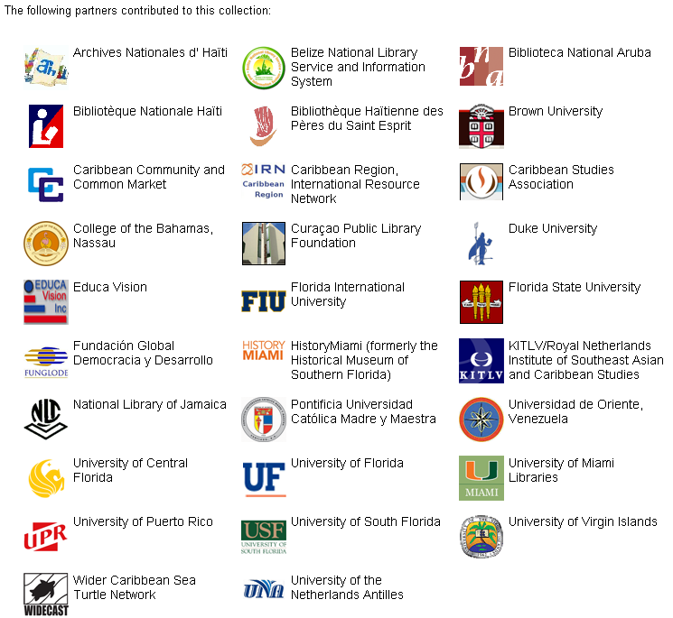
dLOC Partners
Technologies & Training
Institutional Support
Scholarly Curation
dLOC Partners with Collections Online

Slide 2
dLOC Members
Executive dLOC Members:
The College of the Bahamas Library
Duke University Libraries
Florida International University Libraries
Florida State University Libraries
University of Central Florida Libraries
University of Florida Libraries
The University of Virgin Islands Library
Sustaining dLOC Member:
University of Miami Libraries
Supporting dLOC Members:
Belize National Library
Florida International University Latin American and Caribbean Center
New York University Division of Libraries
Contributing dLOC Members:
Brown University John Hay Library
Caribbean Community Secretariat
Caribbean Information Resource Network
Princeton University Library
This list was prepared based on membership invoices submitted by June 15.

Slide 3
Basic Search
The basic search allows you to access bibliographic citation information of the items in dLOC. Just enter the search term from any computer with Internet access.
Notes:
The Digital Library of the Caribbean (dLOC) is a cooperative digital library for resources from and about the Caribbean and circum-Caribbean. dLOC provides access to digitized versions of Caribbean cultural, historical and research materials currently held in archives, libraries, and private collections.
Here you see the homepage for dLOC. All materials are searchable and browseable from the dLOC homepage. All materials are also searchable through various library catalogs and through Google. All materials are structured for search engine optimization and for maximum interoperability to ensure materials are found.
The initial functionality focused on ease of use with a simple search box, full text searching, and advanced features implemented in a technical, system-wide manner.

Slide 4
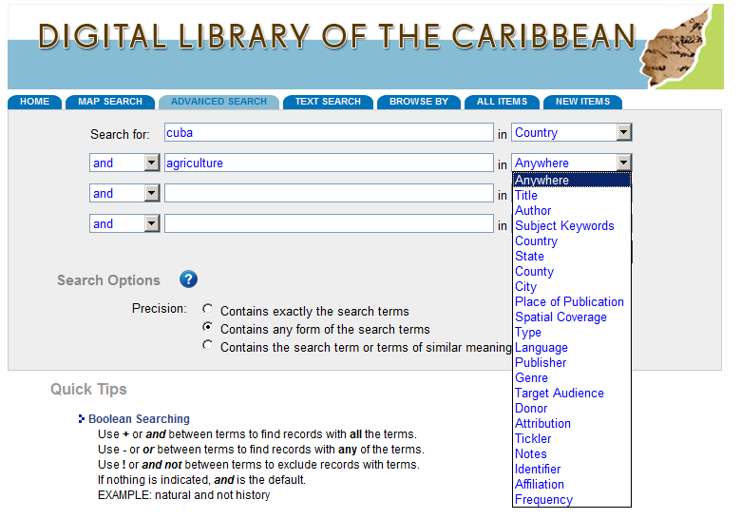
Advanced Search
The advanced search feature will allow you to restrict your search terms by categories such as title, author, subject keyword, country and more.

Slide 5
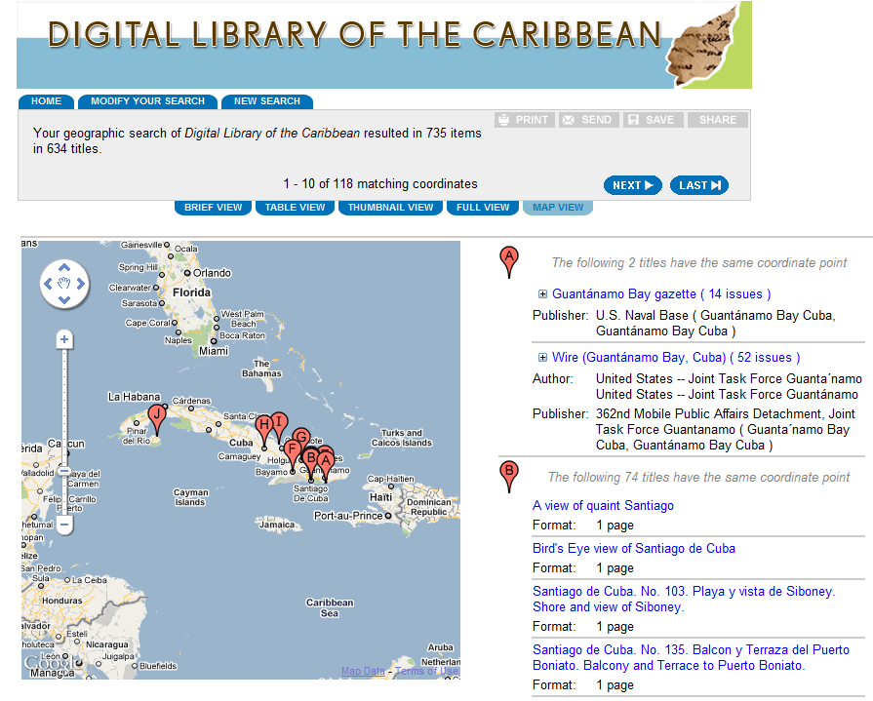
Map Search
If you are looking for items with discrete geographic locations, use the Map Search feature. You can also view the results in Map View.

Slide 6
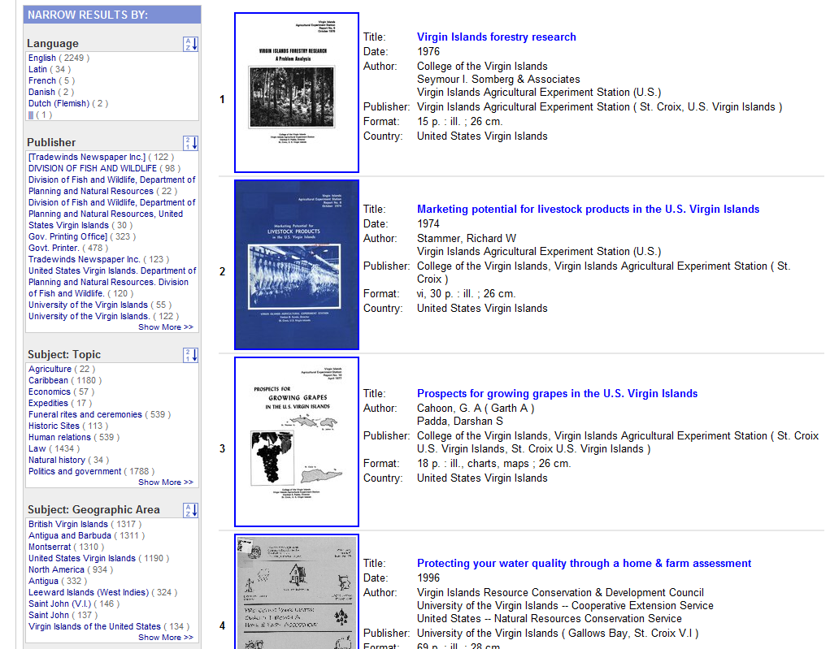
Faceted Searching
Expand or narrow the results by selecting the related search terms in the box to the left.
Options for faceted searching include: publisher, geographic area, subject keywords and more.

Slide 7
Laurie N. Taylor, PhD
Digital Humanities Librarian
University of Florida
Laurien@ufl.edu
Popular Culture in Periodicals: Abeng, Struggle, Arts Jamaica, and Jamaica Journal
www.dloc.com

Slide 8
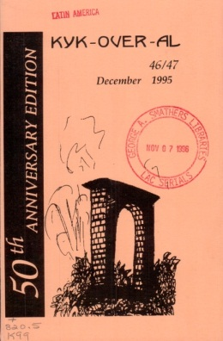
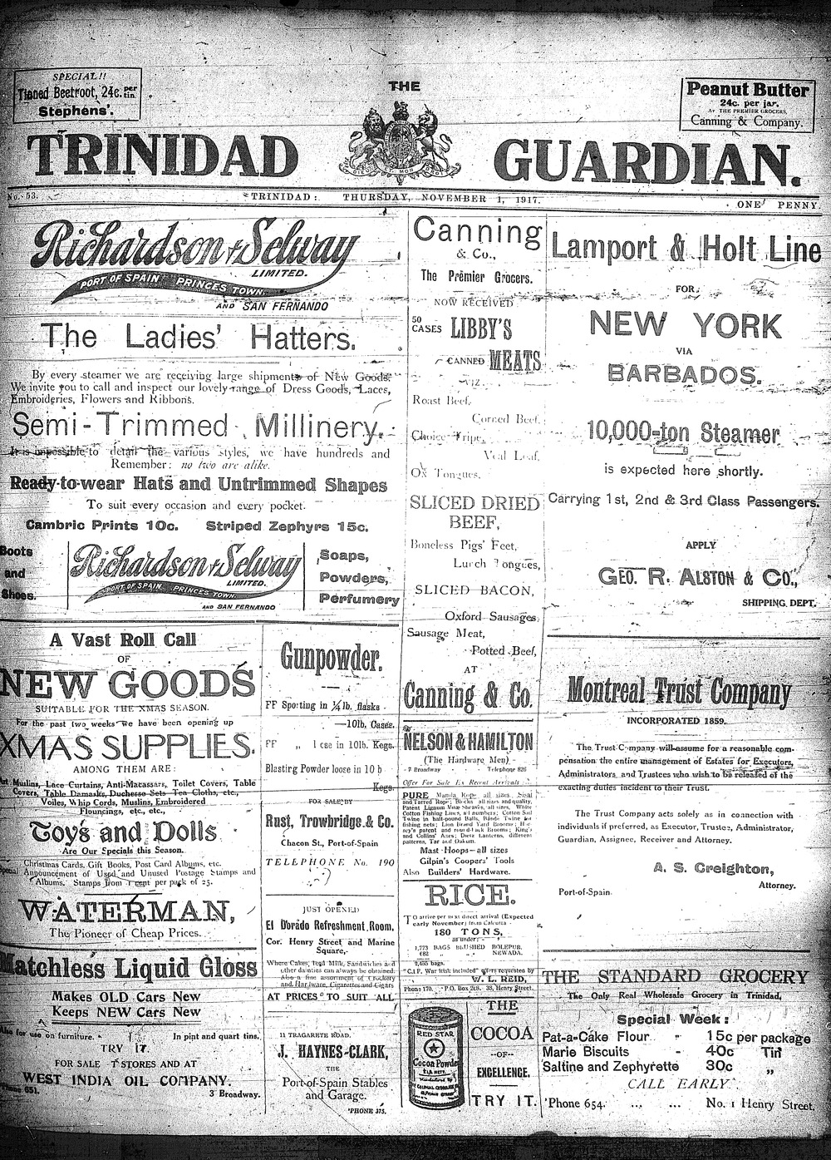
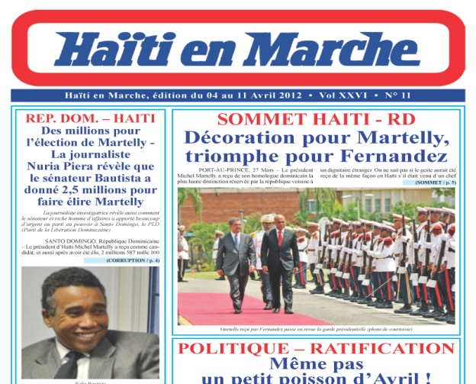
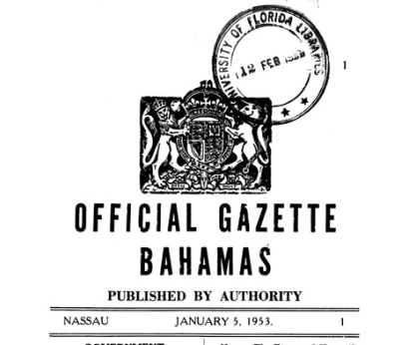
Historical and Current
Serial Publications
Select Academic Journals
Caribbean Review of Books
Caribbean Ornithology
Eme Eme
Kyk-Over-Al
Jamaica Journal
MaComere
Sargasso
Caribbean Newspaper Digital Library
Current Stats: 171 titles, approx. 399,000 pages 3.15 million hits
Government Gazettes
100,000 pages
19 titles
Title: Haiti En Marche
Date: 1999-2012 online
Contributor: Publisher
Title: Trinidad Guardian
Date: 1917-1931 online
Contributor: University of Florida
Notes:
One of the topical collections is the Caribbean Newspaper Digital Library, which houses Abeng, Stuggle, Arts Jamaica, and the Jamaica Journal.
Periodicals capture and represent the news of the day as well as popular culture.
dLOC provides access, preservation, and organizational context and collateral supports to present and represent popular culture through periodicals and other materials.
Periodicals are particularly important because they are timely—capturing and participating with the news of the day and popular culture and so being able to participate in and sustain a conversation that meaningfully informs and impacts culture and social change.

Slide 9
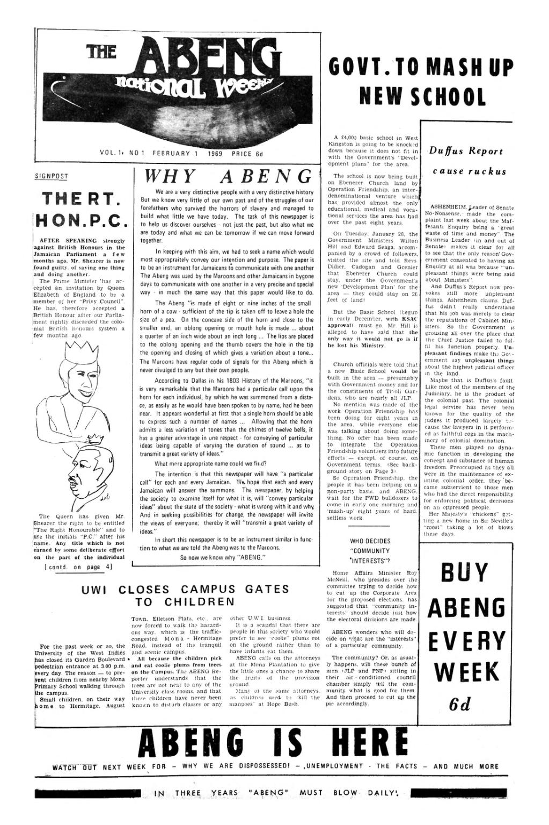
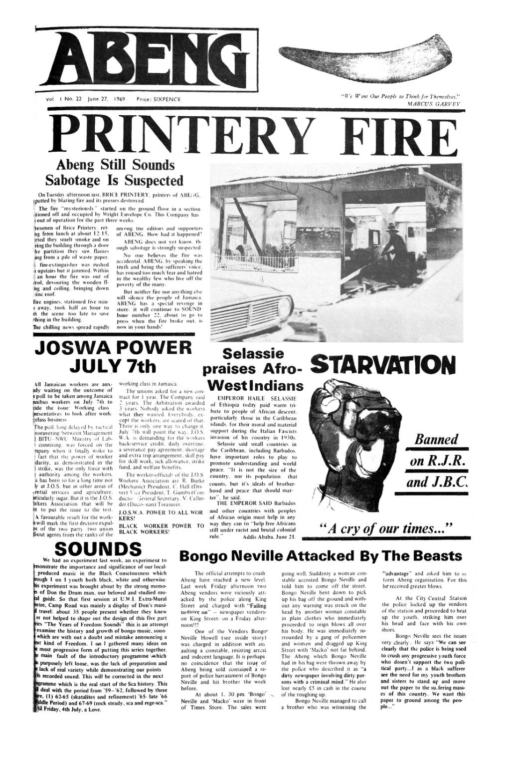
Abeng
http://dloc.com/UF00100338
Notes:
To introduce a few examples of this from dLOC, I begin with Abeng.
The weekly Abeng newspaper (February 1 - September 27, 1969) was published in response to the Black Power and protest movement that emerged after the ban on Dr. Walter Rodney, the Guyanese and University of the West Indies historian, who was prohibited from landing in Kingston on October 15th, 1968 after attending a Black Writers conference in Montreal, Canada. Rodney was known in Jamaica for his lectures and talks on African history and the liberation movements in Africa. These talks were given not only on the campus but in communities of the urban and rural poor. The ban triggered protests by UWI students and the urban poor in Kingston and led to public debate about the state of Jamaican social, economic and political life. The Abeng newspaper‘s Managing Editor was Robert Hill (UWI graduate student) and other editors included George Beckford (UWI lecturer), Rupert Lewis (UWI graduate student) and Trevor Munroe (Rhodes Scholar at Oxford University).
The Abeng group was a political centre for the Black Power movement, socialists, the independent trade union movement, Rastafarians, supporters of the opposition People’s National Party and people disaffected with the two main political parties. Abeng therefore became a focal point of critique and activism against the ruling Jamaica Labour Party and a harbinger of the radicalism in Jamaica in the 1970s.
Abeng’s relevance to popular culture and social change can be seen from its own presence and from its legacy. For instance, when Small Axe was announced (http://publicculture.dukejournals.org/content/9/2/local/back-matter.pdf)
the announcement placed Small Axe in context with Abeng, stating that “Small Axe is a new journal of social, cultural, and political criticism from the Caribbean” and “Following in the tradition of journals such as New World Quarterly, Abeng, Socialism and Savucou,” and that the intent was “hope is through a critical engagement with the issues of our time to be part of the refashioning of social and political hopes for an alternative to our present.”

Slide 10
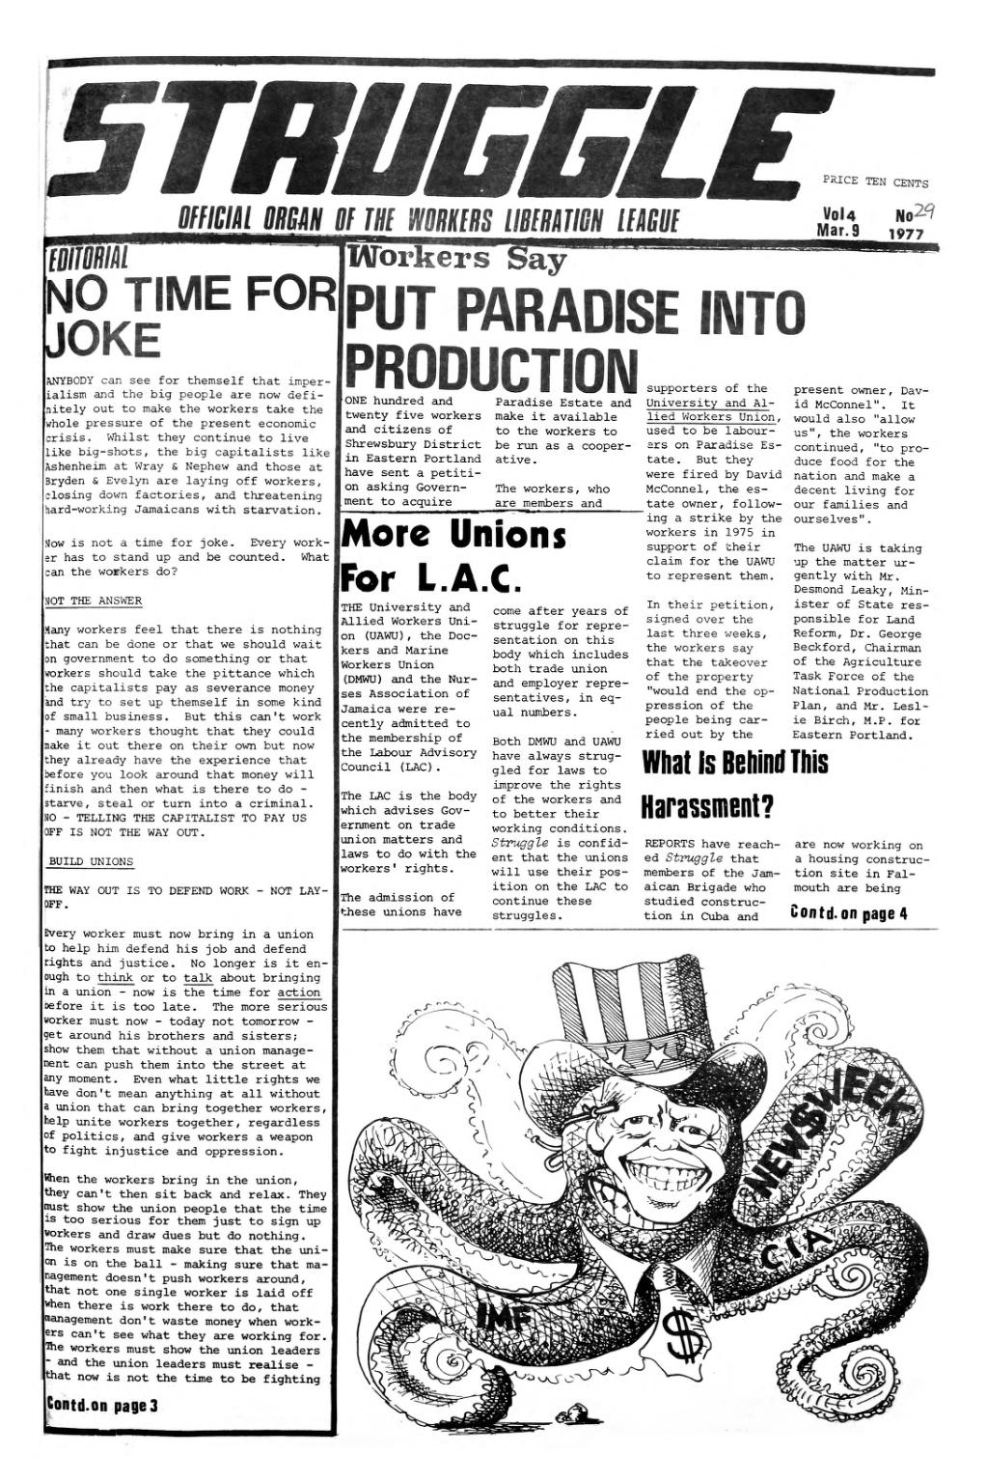
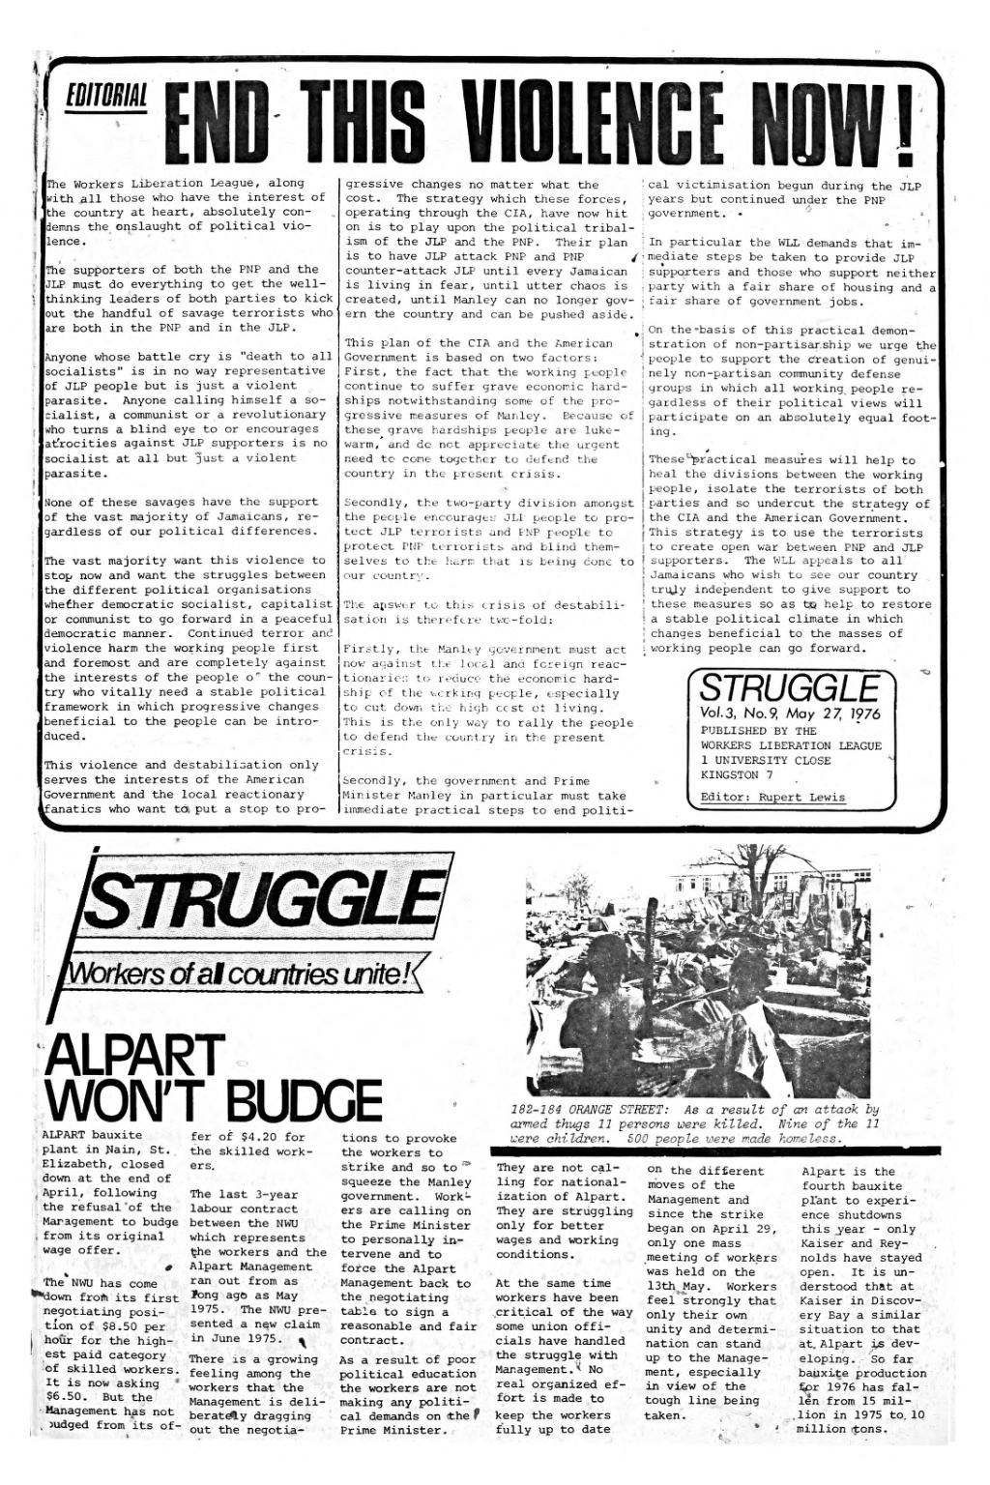
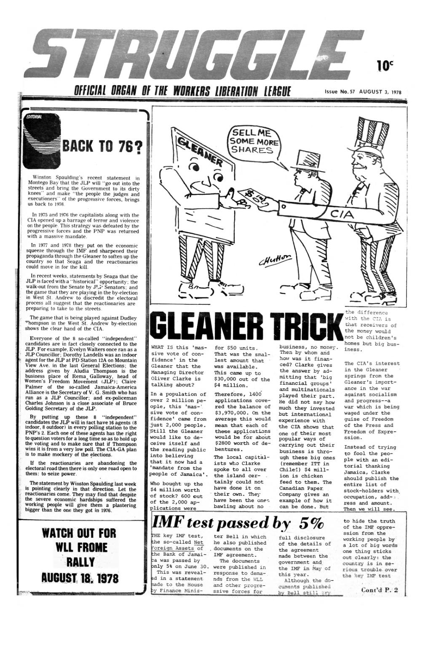
Struggle
http://dloc.com/UF00100337
Notes:
In 1974, Struggle began as the mimeographed newsletter of the Workers Liberation League which gave critical support to Michael Manley’s democratic socialist program in the 1970s.
Struggle was published first as a mimeographed newsletter in 1974 when the Workers Liberation League was formed. It was edited by Rupert Lewis and he continued as editor when Struggle became the organ of the Workers Party of Jamaica in 1978. In the 1980s editors included Elean Thomas, Elaine Wallace and Ben Brodie. The Workers Liberation League grew out of the political initiative of academics - Trevor Munroe, Rupert Lewis as well as Don Robotham, Derek Gordon who studied in the University of Chicago in the early 1970s and were connected to activists in the Black Panther Movement and African-American radicals in the Communist Party of the United States. The latter group formed the Paul Bogle League which brought together academics, working class and community activists who read and discussed Karl Marx’s Capital and Lenin’s political writings and sought to build on Jamaica’s radical traditions in the trade union movement and in the People’s National Party from the 1930s to the 1960s. The Paul Bogle League was also involved with the formation of the University and Allied Workers Union in the early 1970s and worked with the Independent Trade Union Action Council. Politically the Workers Liberation League gave critical support to Michael Manley’s democratic socialist program in the 1970s.

Slide 11
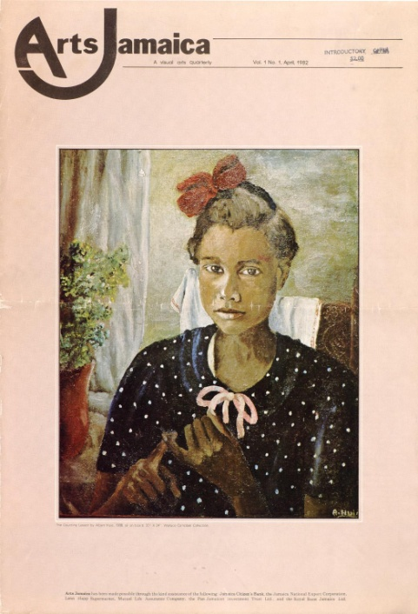
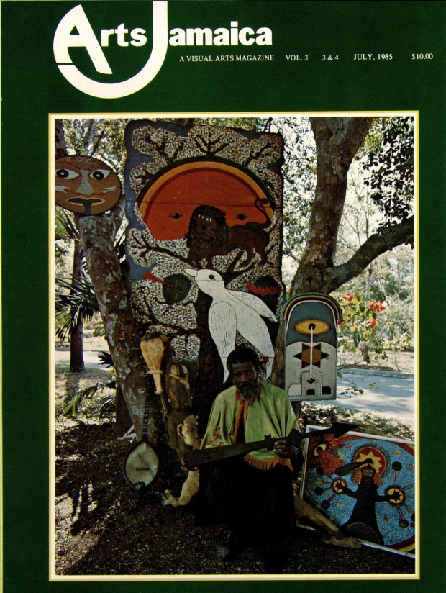
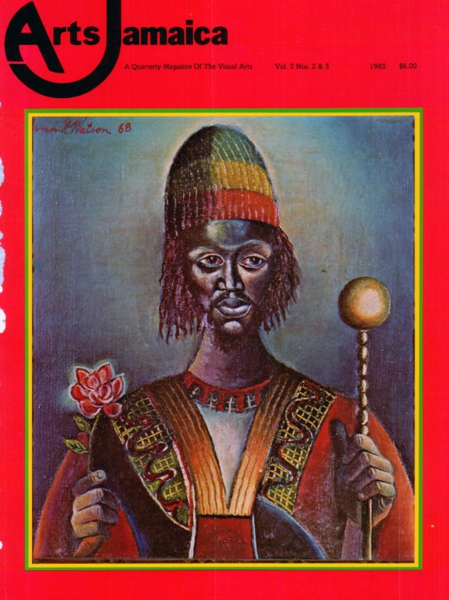
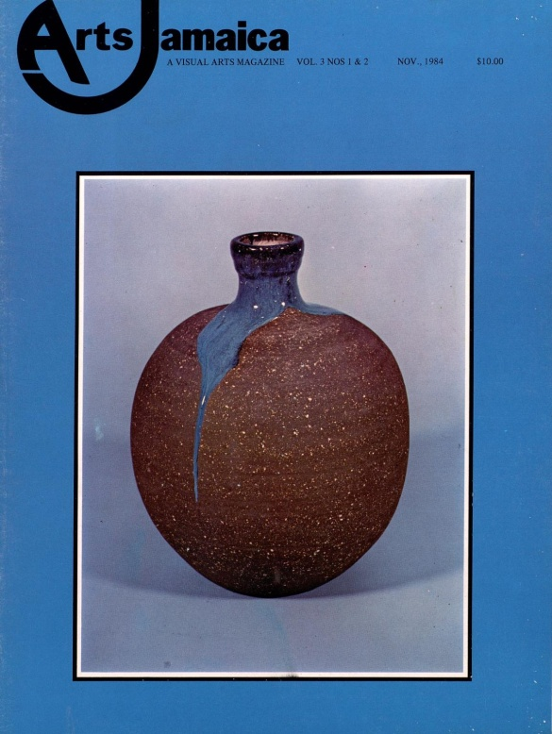
Arts Jamaica
http://dloc.com/UF00101459
Notes:
(1982-1985). Arts Jamaica.
Visual arts magazine published for a short period of time.
Recently, the Frost Museum in Miami, Florida used Arts Jamaica to do the research for an exhibit (http://intuitives.frostartmuseum.org/). Thus, this visual arts magazine had impact within its own publishing history and continues to inform and have impact now for its presentation and representation of the arts and culture.

Slide 12
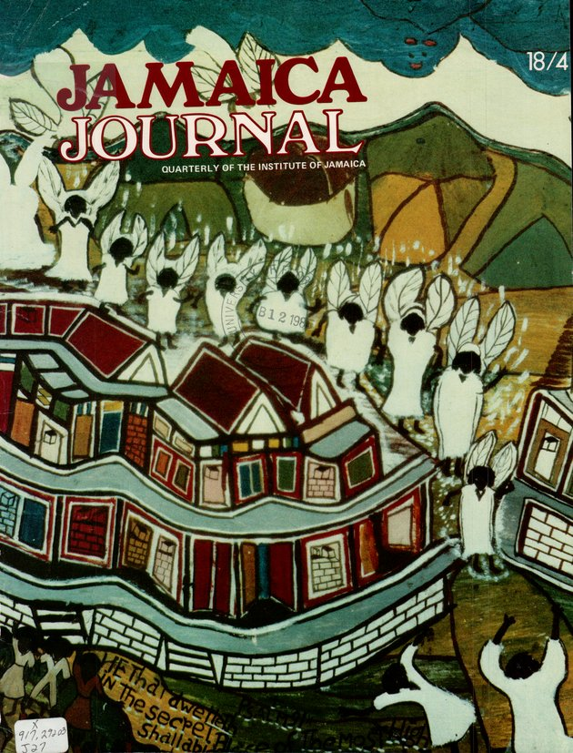
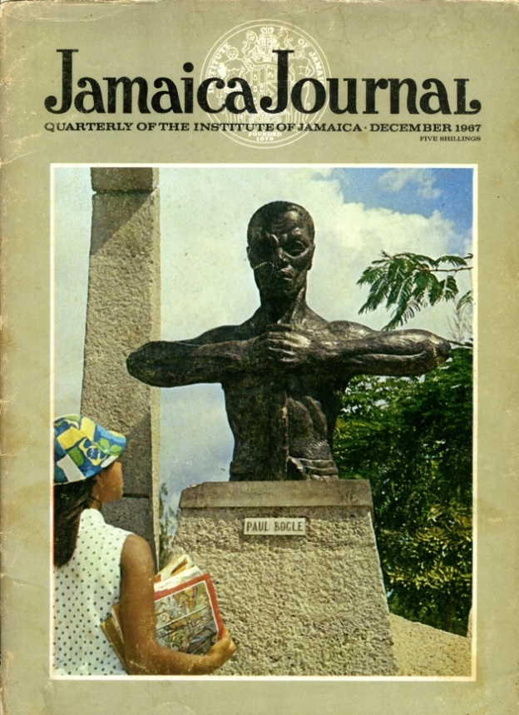
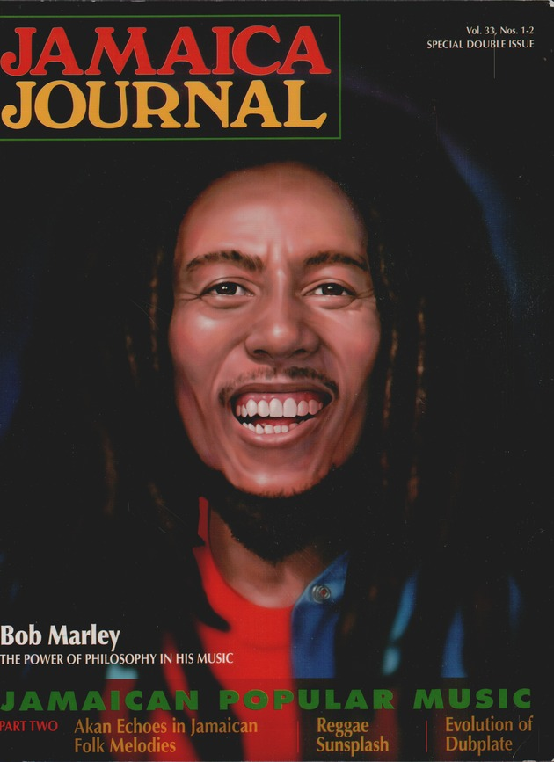
Jamaica Journal
http://dloc.com/UF00090030
Notes:
The Jamaica Journal is the flagship publication of the Institute of Jamaica and the Caribbean’s leading cultural publication on Jamaica’s heritage. Published in 1967, Jamaica Journal’s coverage of a wide range of topics including history, literature, science and the arts is an important source for Jamaican research.
Summary contributed by Clover Johnston Director, Development & Public Relations, Institute of Jamaica

Slide 13
Brooke Wooldridge
Director, Digital Library of the Caribbean
bwooldri@fiu.edu
Popular Culture & Social Change with the Caribbean IRN Collection
www.dloc.com/icirn

Slide 14
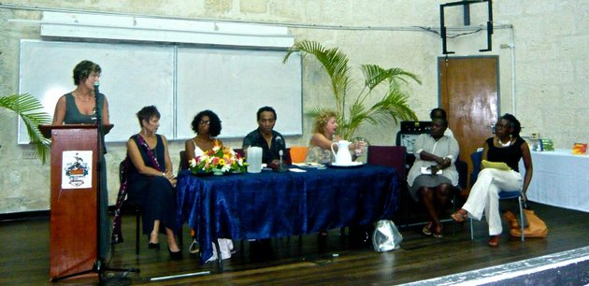
Breaking Sexual Silences : Readings and Discussions
May 31, 2010 UWI Cave Hill Barbados
Caribbean Regional Board
Natalie Bennett, Rosamond S. King, Angelique V. Nixon, and Colin Robison
Co-ordination consultant - Vidyaratha Kissoon
Notes:
The Caribbean IRN is a network that connects activists, scholars, artists and other individuals and organizations who do research and work on issues related to diverse genders and sexualities in the Caribbean
This collection will store various documents, reports, archival clippings, and other materials related to this work. Our general collection includes materials we have been collecting and archiving since the Caribbean IRN's inception in 2009. Thus far, our collection includes a variety of materials (newspaper articles, scholarly papers, activist reports, open letters, creative expressions, interviews, and more) which offers a glimpse into the complexity of LGBT lives and experiences in the Caribbean. This collection presents multiple perspectives from the personal to community and political organizing, from health agencies to academic research. It is a small but growing collection - a work in progress that brings materials on Caribbean Sexualities together in this way (digital open access) for the first time.

Slide 15
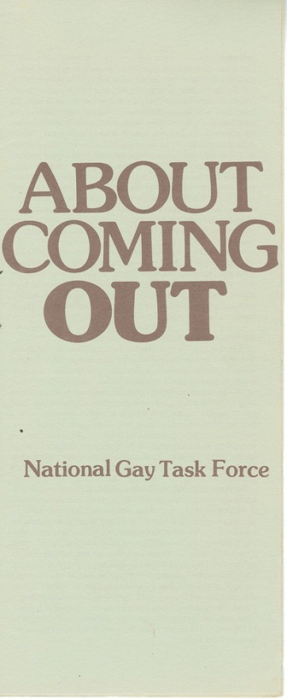
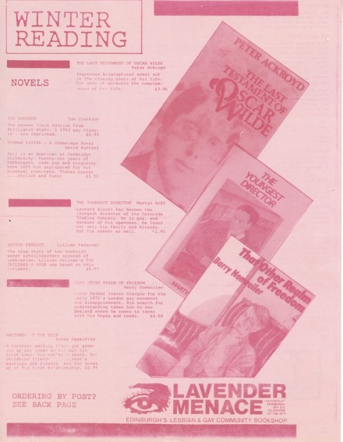
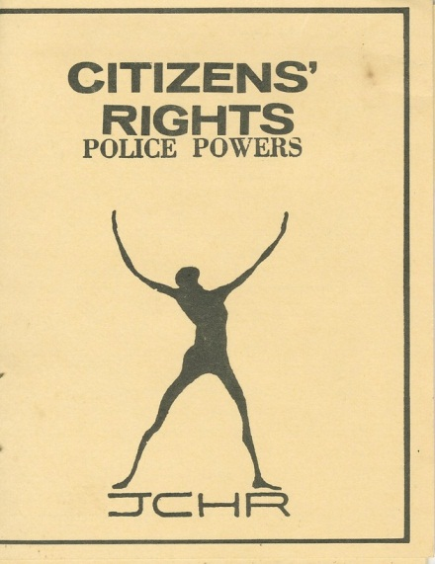
Gay Freedom Movement
Notes:
One major part of our collection will be the archives of the Gay Freedom Movement (GFM) in Jamaica. The Gay Freedom Movement was active in Jamaica between 1974 and 1983 and the archives of the GFM are now digitised for further study and historical purposes. These archives are being made available with the permission of Larry Chang, one of the founders of GFM. The GFM preceeded the Jamaica Forum for Lesbians, All-sexuals and Gays (JFLAG). The GFM collection will allow for researchers, activists and educators to gain insights into the history of organizing around gender and sexuality in the Caribbean.

Slide 16
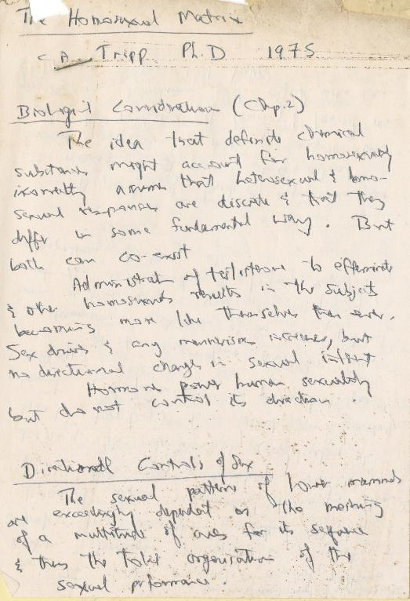
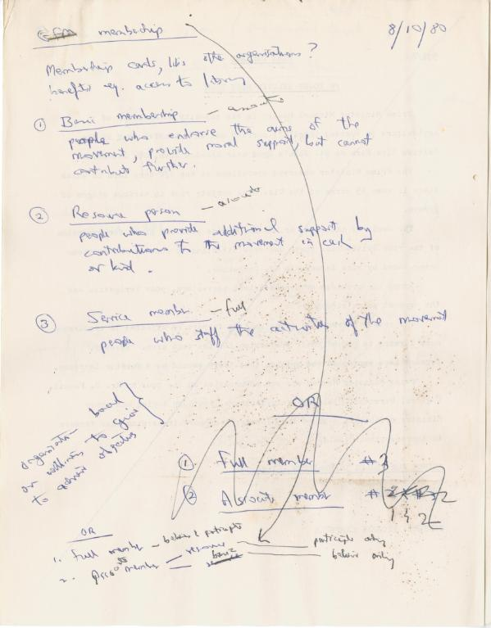
Larry Chang’s Notes

Slide 17
Rainbow Alliance of
The Bahamas
Next project of the Caribbean IRN –
Document the work of the Rainbow Alliance from 1999-2008
Notes:
History
The group was established in May 1999 during a social event hosted by members of other LGBT groups. The members of those groups, BGLAD (Bahamian Gays and Lesbians Against Discrimination) and Hope TEA (Hope Through Education and Awareness), decided it would be better to pool their resources together and create one national gay rights organization. They named it “The Rainbow Alliance of The Bahamas.”
The activist arm of the group placed it in the public spotlight between 2004 and 2008. The group eventually disbanded in 2008 due to a lack of resources.

Slide 18
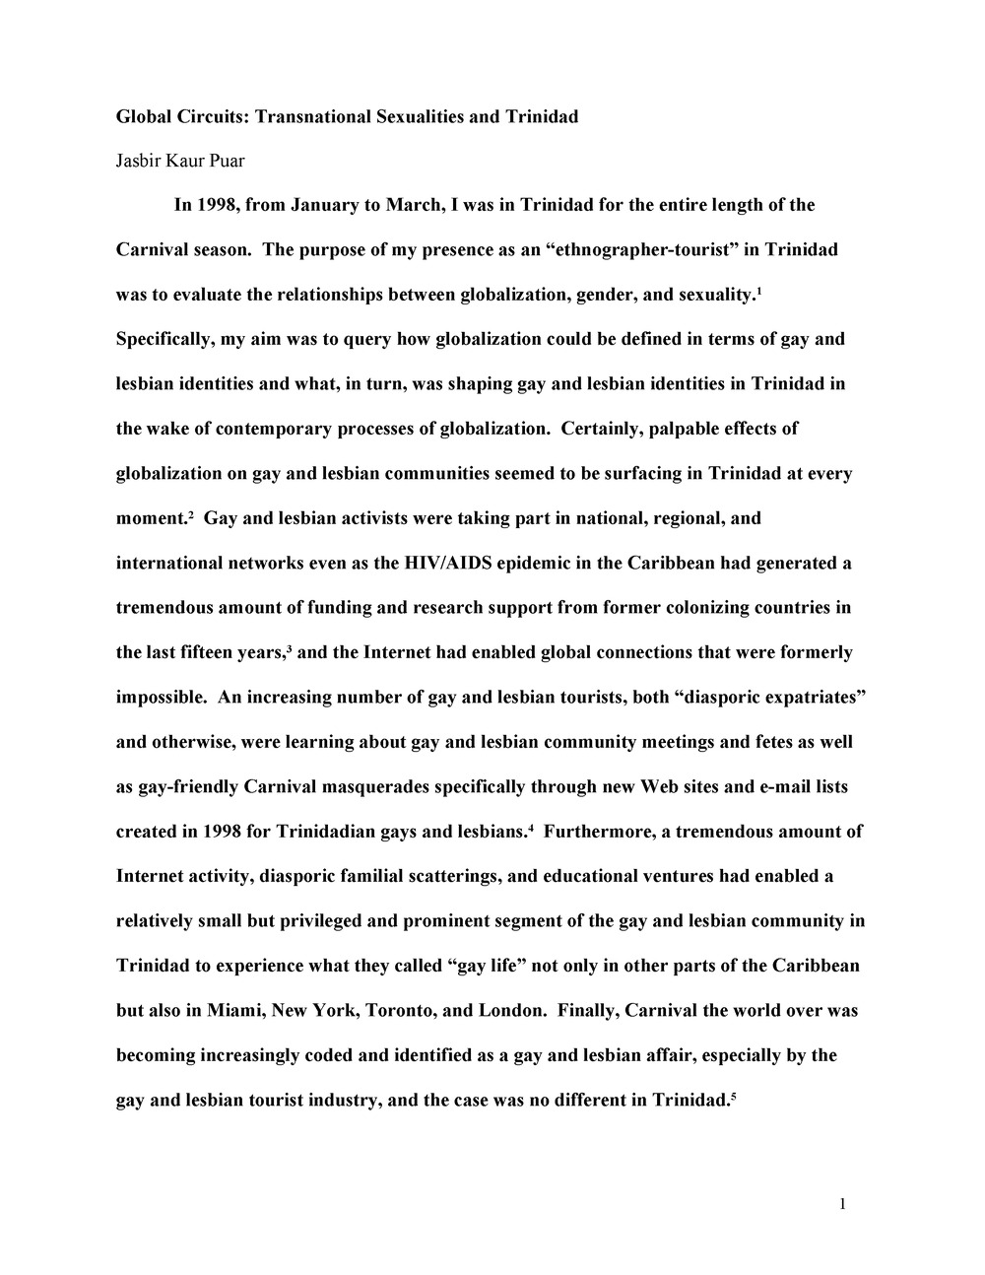
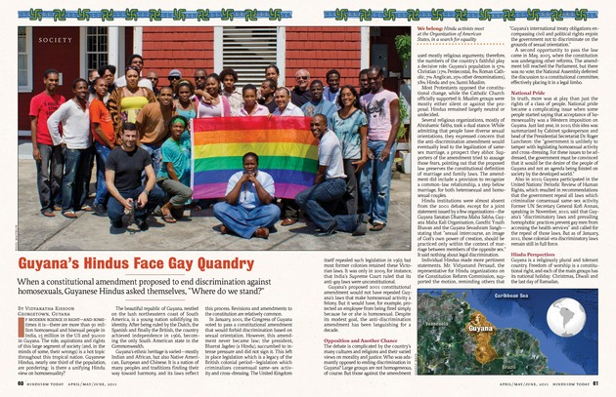
Other Materials

Slide 19
Gayle Williams
Latin American and Caribbean Information Resources Librarian
Gayle.williams@fiu.edu
Social Change through Performance: the Carifesta Collection of dLOC
www.dloc.com/dloc1/carifesta

Slide 21
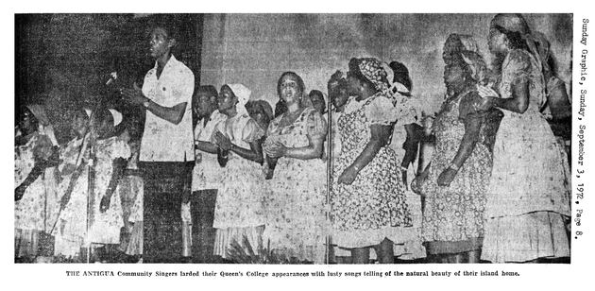
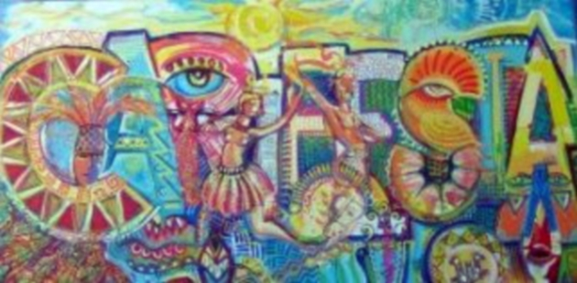
Carifesta 1972: www.dloc.com/CA00199919
Carifesta 2003: www.dloc.com/CA00099756

Slide 22
Thank you!
Questions, Comments, Suggestions
Contact: dloc@fiu.edu

