Slide 1
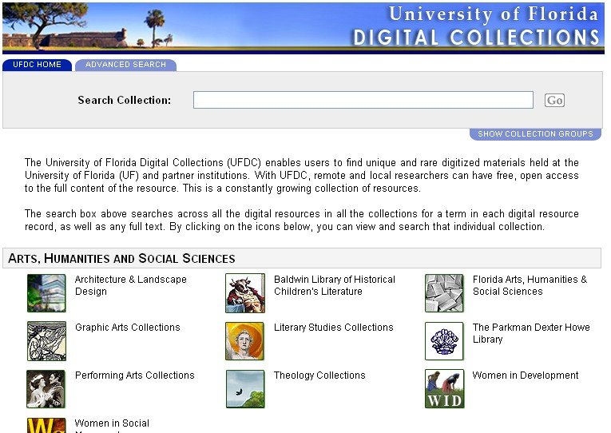
UFDC
Using the Collections
Endless possibilities:
∙ Unique sources
∙ Primary sources
∙ Add visual interest to
presentations
∙ Images for marketing efforts
∙ Demonstrate research depth
and breadth
∙ Cultural context and dimension
∙ Available here and now, free!
http://ufdc.ufl.edu/

