Slide 1
The Preservation Conversation: Exploring Historic Preservation Processes in Florida
Austin Bell
Renee Kiefer
Kim Tinnell
April 18, 2011

Slide 2
Historic preservation differs among sites.

Slide 3
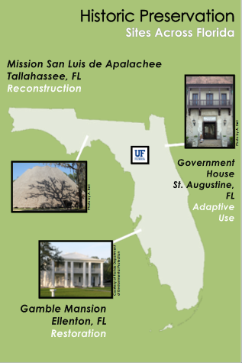

Slide 4
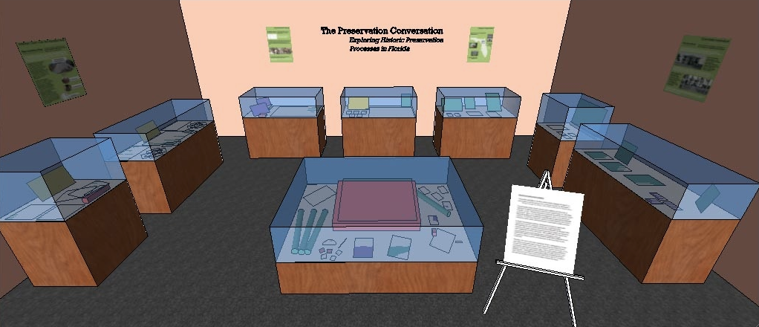
Gallery Layout

Slide 5
The Preservation Conversation
“It has been said that, at its best, preservation engages the past in a conversation with the present over a mutual concern for the future.”
-William Murtagh, first Keeper of the National Register for Historic Places
What does historic preservation do? How does the “conversation” change from site to site?
Importance of the Herschel Shepard Collection
Introduction to the exhibition

Slide 6
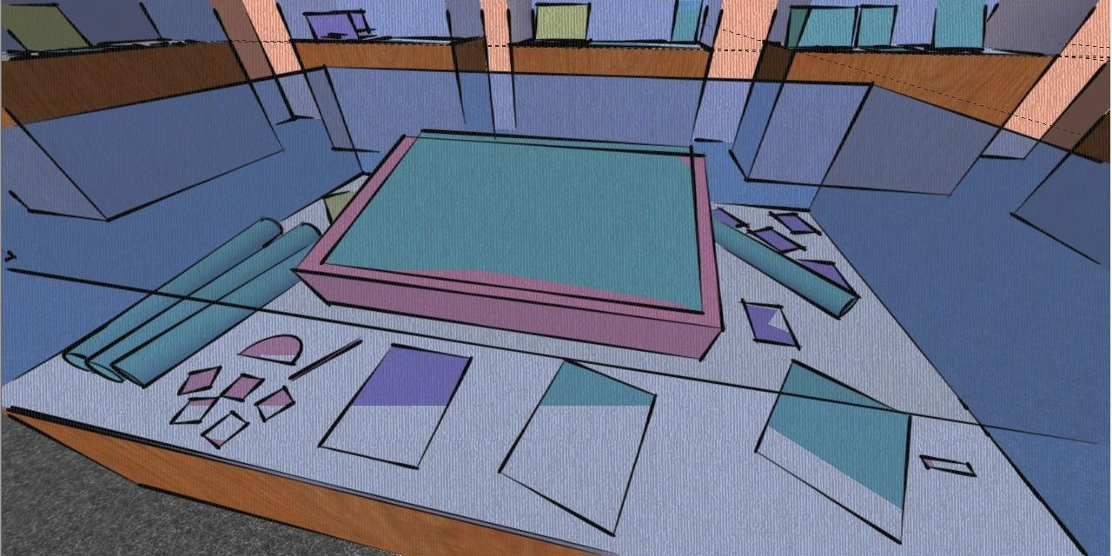
Historic Preservation Workspace
Architectural drafting table Pencil, protractor, line level
Rolled blueprints Book
Photographs Herschel Shepard photo and bio

Slide 7
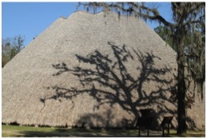
Mission San Luis de Apalachee
The Apalachee Council House

Slide 8
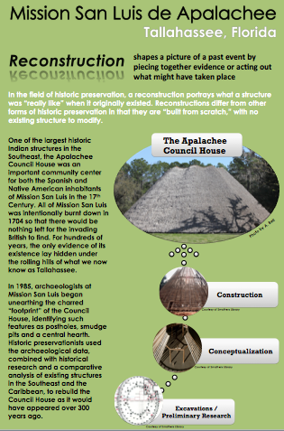

Slide 9
Mission San Luis de Apalachee Reconstruction

Slide 10
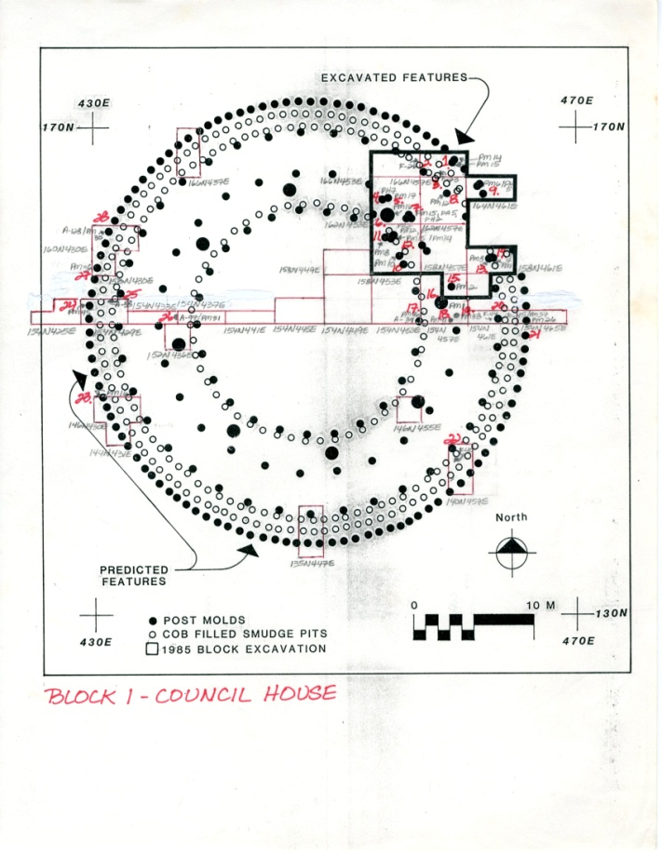
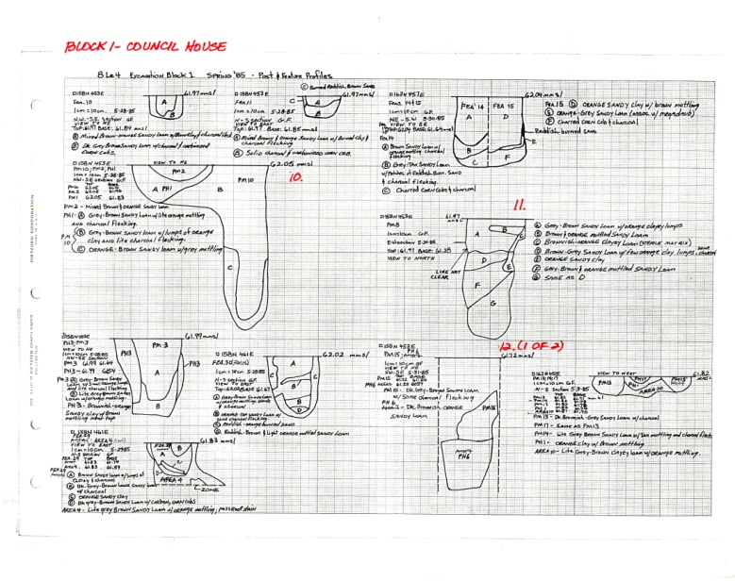
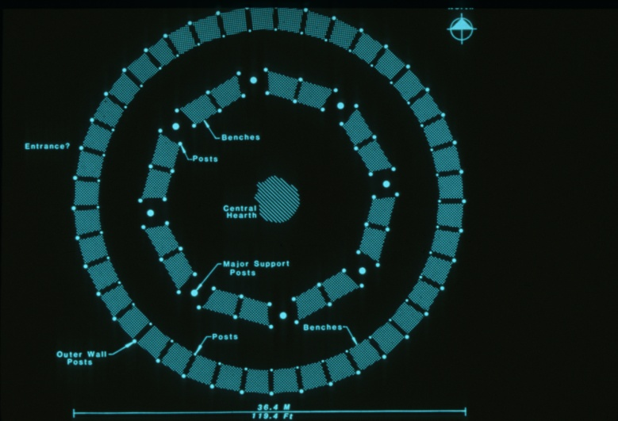
“Block 1 – Council House: 8Le4 Excavation Block 1, Spring ’85 Post & Feature Profiles”
Archaeological profile of Council House post-molds
Author unknown
Facsimile of handwritten drawing
Circa 1985
8 ½ x 11 inches
“Block 1 – Council House”
Archaeological site plan for Council House
Author unknown
Facsimile of computer printout with handwritten notes
Circa 1985
11 x 8 ½ inches
Case 1 Grouping
Computer rendering of proposed Council House layout
Author unknown
Photographic print, reproduction from slide (2x2”)
Date unknown
5 x 7 inches

Slide 11
Mission San Luis de Apalachee Reconstruction

Slide 12
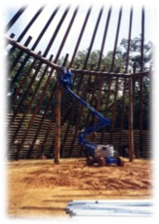
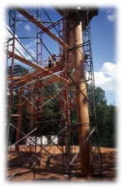
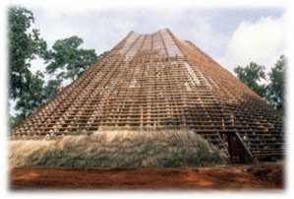
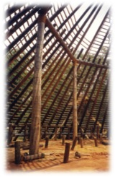
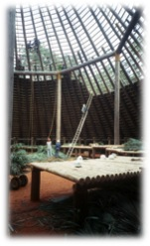
Council House under construction, view from interior of two men in cherry-picker
Photographer unknown
Photographic print
Date unknown
6 x 4 inches
Exterior view (from ground) of construction of Council House with scaffolding
Photographer unknown
Photographic print, reproduction from slide (2x2”)
Date unknown
6 x 4 inches
Case 2
Photo Cluster 1
Exterior view of Council House during application of roof thatching
Photographer unknown
Photographic print, reproduction from slide (2x2”)
Date unknown
5 x 7 inches
Council House under construction, view from interior before installation of benches
Photographer unknown
Photographic print
Date unknown
6 x 4 inches
Interior view of application of palm frond thatched roof to Council House
Photographer unknown
Photographic print, reproduction from slide (2x2”)
Date unknown
6 x 4 inches

Slide 13
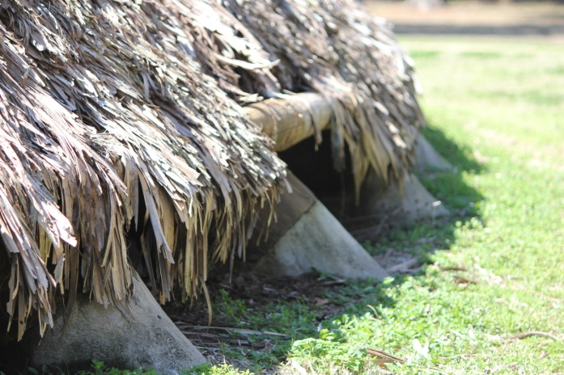
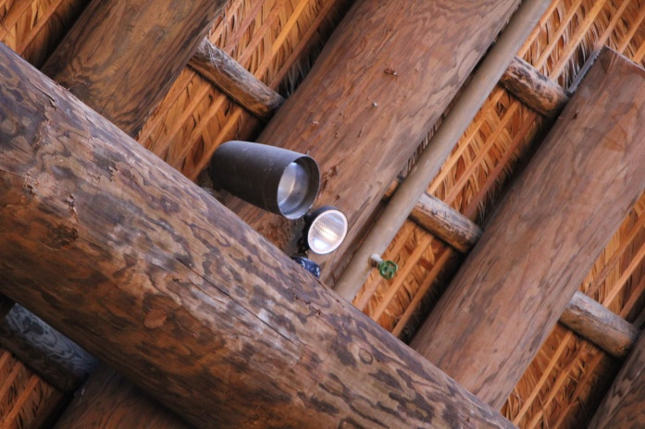
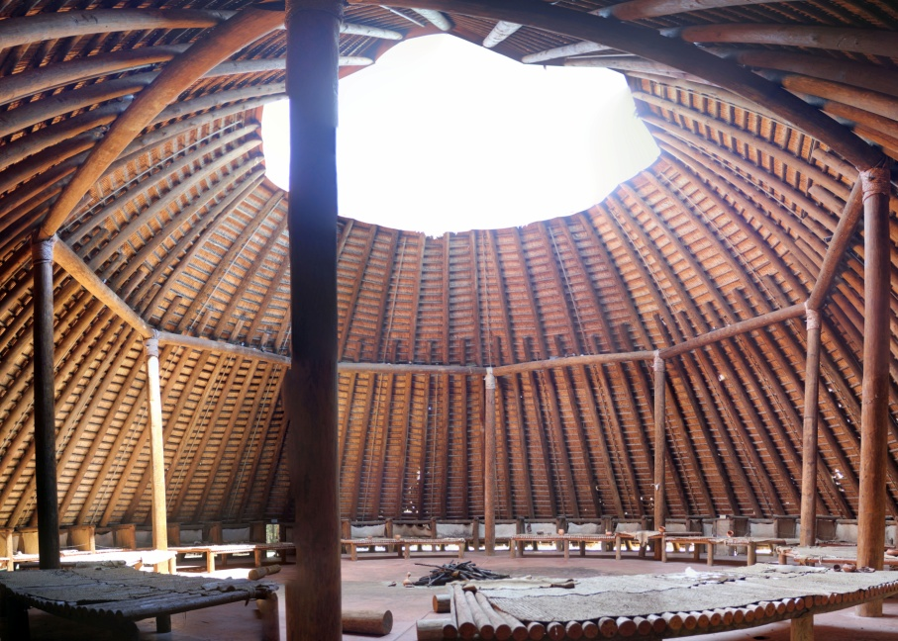
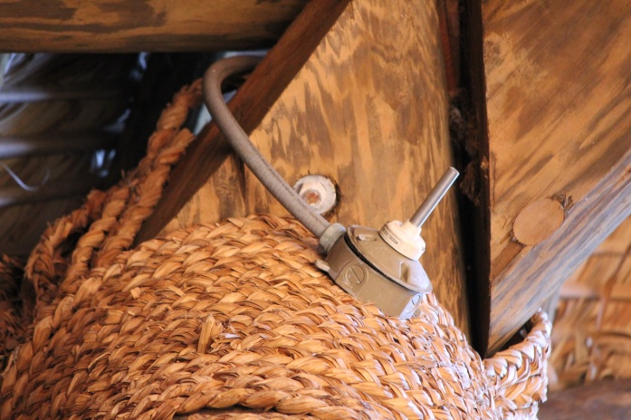
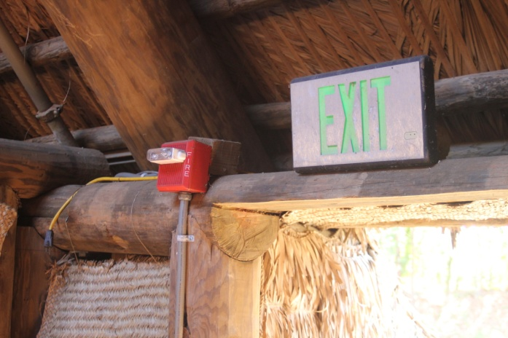
Case 2
Photo Cluster 2
Concrete support anchors at the base of the peripheral post holes of Council House
Austin Bell
Photographic print
February 2011
4 x 6 inches
Lighting and sprinkler systems along interior roof of Council House
Austin Bell
Photographic print
February 2011
4 x 6 inches
Crossbeam support along interior roof of Council House
Austin Bell
Photographic print
February 2011
4 x 6 inches
Fire alarm and exit sign on interior of entrance to Council House
Austin Bell
Photographic print
February 2011
4 x 6 inches
Panoramic view of Council House interior
Austin Bell
Photographic print
February 2011
5 x 7 inches
Notes:
While visiting this site, we were able to photograph themes reflected in exhibit but not easily visible

Slide 14
Government House

Slide 15
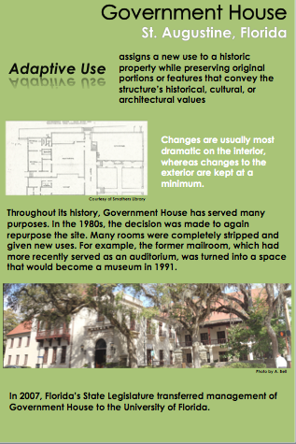

Slide 16
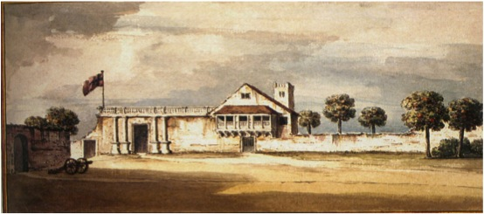
View of the Governor’s House at St. Augustine, in E. Florida, November 1764
Artist unknown
Photographic reproduction
Reproduced in 2002 with permission from Elsbeth Gordon
9 x 13 inches

Slide 17
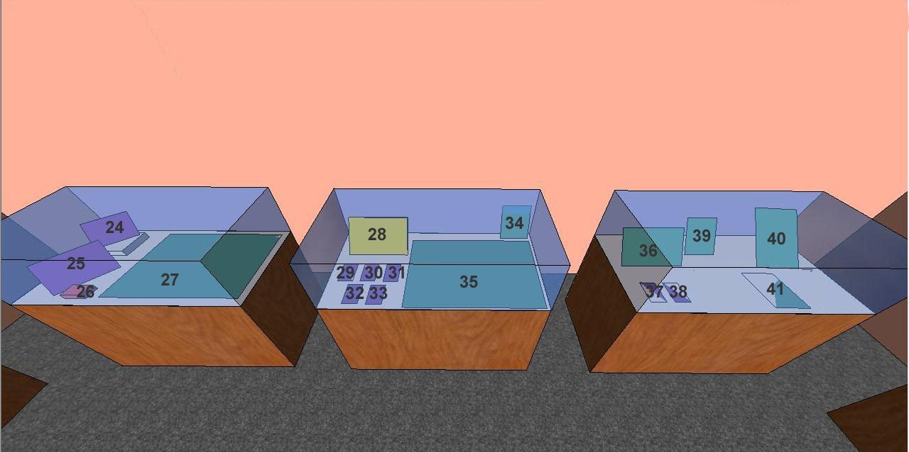
Government House Adaptive Use

Slide 18
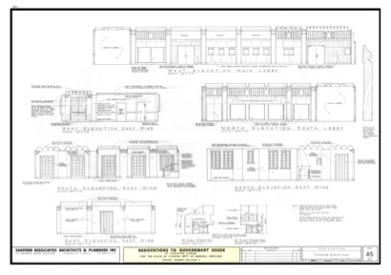
Renovations to Government House, Interior Elevations
Shepard and Associates, Inc.
Architectural drawing
June 27, 1988
Sheet A5
24 x 36 inches

Slide 19
Government House Adaptive Use

Slide 20
St. Augustine Historic District State Properties and Structures
University of Florida
Poster
2008
16 x 11.8 inches

Slide 21
Government House Adaptive Use

Slide 22
The Gamble Mansion Restoration

Slide 23
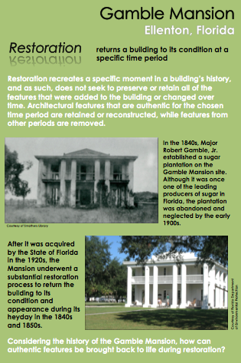

Slide 24
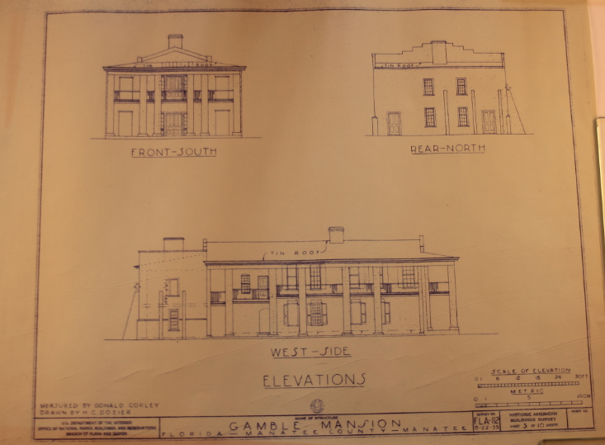
Gamble Mansion west-side elevation
Historic American Buildings Survey
Blueprint
June 22, 1935
Sheet 3 of 10
18 x 24 inches

Slide 25
The Gamble Mansion Restoration

Slide 26
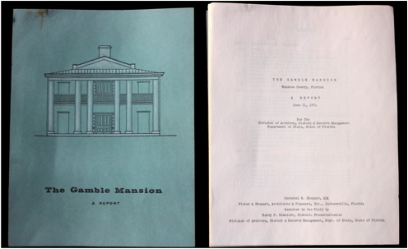
“The Gamble Mansion: A Report”, prepared for the Florida Department of State, Division of Archives, History and Records Management
Herschel Shepard, Fisher & Shepard, Architects & Planners, Inc.
Thirty-three page typeset report
June 21, 1974
11 x 18 ½ inches

Slide 27
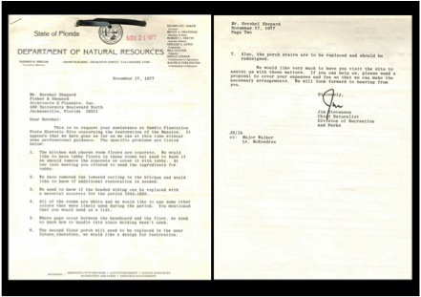
Letter to Herschel Shepard, from Florida Department of Natural Resources
Two-page typeset letter
November 17, 1977
11 x 18 ½ inches

Slide 28
The Gamble Mansion Restoration

Slide 30
Exhibition Materials Provided
Introductory panel
Object checklist
Object labels
Key images
Layout
Press release
Brochure
CD

Slide 31
